Slide 1

Ph.D. Committee
Minimizing I/O Bottlenecks to Achieve Scalable and High-Throughput Systems
Soujanya Ponnapalli
September 27th, 2023
Vijay Chidambaram
Emmett Witchel
James Bornholt
Jonathan Goldstein
Natacha Crooks
Notes:
Thanks a lot for attending my dissertation defense!
In today’s talk, I will discuss how I/O bottlenecks limit the performance of modern systems
and present our approach of minimizing these I/O bottlenecks to
achieve scalable, high-throughput systems!
First, let's discuss
the need for scalable high-throughput systems!

Slide 2







Modern Applications and Data Trends
Applications
Cloudification of
Network & Edge
Proliferation of
Cloud Computing
Acceleration of data analytics
AI/ML and HPC analytics
Decentralized Applications
Notes:
Within the last decade,
it has become significantly easier
To collect data at a large scale
To store large volumes of data with high availability
And to process this data at much faster rates
So, most of the applications today store AND process large volumes of data!
Following these data trends,

Slide 3
Modern Applications and Data Trends
Applications
Cloudification of
Network & Edge
Proliferation of
Cloud Computing
Acceleration of data analytics
I/O-intensive applications call for scalable, high-throughput systems
Decentralized Applications
AI/ML and HPC analytics
Notes:
modern applications have become I/O-intensive and are increasing the demand for scalable, high-throughput systems

Slide 4
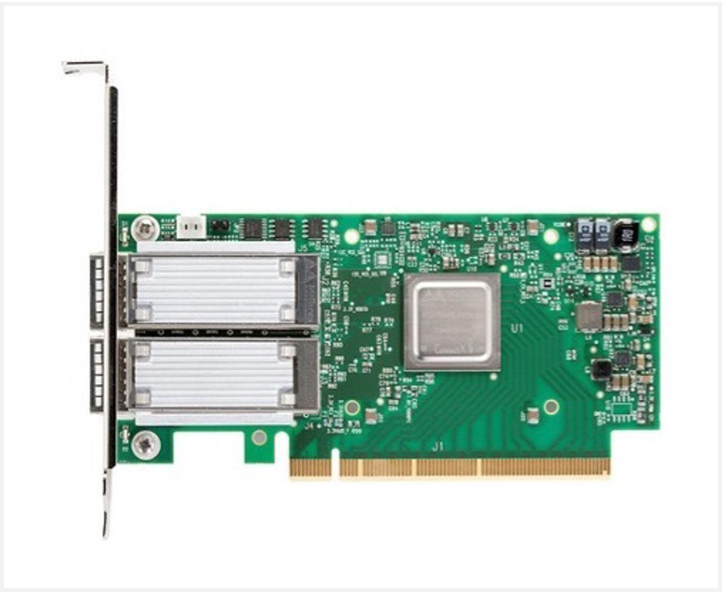
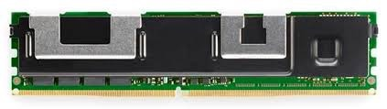

Modern Hardware and Innovations
Applications
Network adapters
Persistent Memory (PM)
and CXL
Hardware
Gigabit Ethernet
adapter cards
Low-latency storage
with scalable capacity
Notes:
Similarly, within the last decade, hardware landscape has changed significantly.
Today, we have gigabit Ethernet cards that enable low-latency network communications
And on the storage front, we have
(a) Persistent Memory: a new byte-addressable storage media, and
(b) CXL, a cache coherent interconnect for memory devices,
that together provide low-latency storage with scalable capacity.
These innovations are driving fundamental changes in systems design

Slide 5
Modern Hardware and Innovations
Applications
1. In datacenters, network round-trips are faster than writing to disk
Hardware
 | eRPC [1] | Azure SSDs [2]
Measure | Round-Trip Time | Disk Write
Latency
 | eRPC [1] | Azure SSDs [2]
Measure | Round-Trip Time | Disk Write
Latency | < 10us | 40–50x↑
 | eRPC [1] | Azure SSDs [2]
Measure | Round-Trip Time | Disk Write
Latency | < 10us
[1] Kalia, Anuj, Michael Kaminsky, and David Andersen. "Datacenter {RPCs} can be general and fast." 16th USENIX Symposium on Networked Systems Design and Implementation (NSDI 19). 2019.
[2] https://www.2azure.nl/2019/08/21/azure-ultra-disk-performance-storage-now-available/
Notes:
First, with low-latency networks,
network round-trips are now much faster than writing to disks in datacenters
For a round-trip communication across two servers within the same datacenter,
it takes less than 10us
However, write to a high-end disk in Azure takes almost 50 times longer

Slide 6
Modern Hardware and Innovations
Applications
2. Persistent Memory (PM) fills the gap between DRAM and SSDs
Hardware
Media | DRAM | SSD | PM
Durability | No | Yes
Latency | 80—140ns ( 1x ) | 500x↑
Media | DRAM | SSD | PM
Durability | No | Yes | Yes
Latency | 80—140ns ( 1x ) | 500x↑ | 3x↑
Media | DRAM | SSD | PM
Durability | No
Latency | 80—140ns ( 1x )
Call for scalable systems that can effectively utilize modern hardware
Notes:
Next, the new Persistent Memory media, is a new data point that fills the gap between DRAM and SSDs.
While DRAM : supports low latency loads and stores, it does not store data across power cycles
On the other hand, we have SSD’s that support data durability but have about two orders of magnitude higher latency!
Now, with the Optane DC Persistent Memory we can load and store data durably at DRAM-comparable low latencies
Overall. modern hardware calls for scalable systems that can effectively utilize available resources.

Slide 7
Modern Hardware and Innovations
Applications
2. Persistent Memory (PM) fills the gap between DRAM and SSDs
Hardware
New hardware increases demand for scalable, high-throughput systems
Media | DRAM | SSD | PM
Durability | No | Yes
Latency | 80—140ns ( 1x ) | 500x↑
Media | DRAM | SSD | PM
Durability | No | Yes | Yes
Latency | 80—140ns ( 1x ) | 500x↑ | 3x↑
Media | DRAM | SSD | PM
Durability | No
Latency | 80—140ns ( 1x )
Notes:
and are also increasing demand for scalable, high-throughput systems

Slide 8
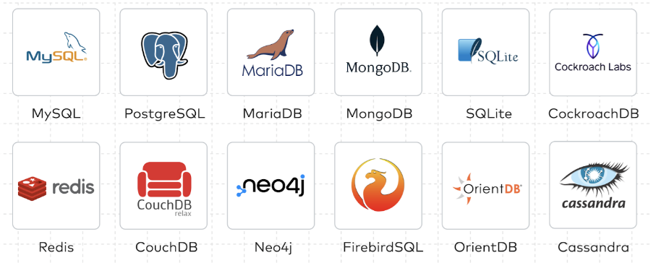
Data Stores: Heart of Systems Infrastructure
Applications
Systems
Systems
Hardware
Data stores fail to utilize available resources or meet the demands of applications
Notes:
Today, systems like key-value stores and databases, are at the heart of modern systems infrastructures
However, these data stores are unable to utilize available hardware resources and fail to meet the demands of I/O-intensive applications.

Slide 9
Systems We Discuss
Applications
Systems
Hardware
Notes:
Today, we will discuss three unique data stores :

Slide 10

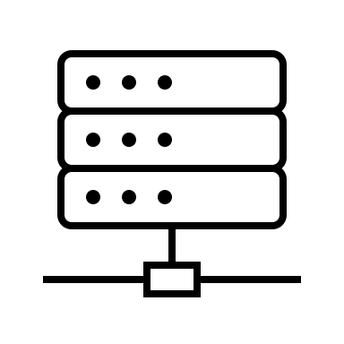
Systems We Discuss
Applications
Monolithic System | Distributed System
 | Centralized Trust | Decentralized Trust
Key-Value Stores
Systems
Hardware
Put, Get
key, value
Notes:
First, we discuss monolithic key-value stores where applications interact with a single server.
Here, applications use put and get requests to store and access data in the form of key, values pairs.

Slide 11
Systems We Discuss
Applications
Monolithic System | Distributed System
 | Centralized Trust | Decentralized Trust
Key-Value Stores | Databases | Public blockchains
Systems
Hardware
…
Transaction
key, value
Notes:
Next, we discuss distributed databases, where applications can execute transactions on their data.
while their data may physically reside across multiple servers.

Slide 12

Systems We Discuss
Applications
Monolithic System | Distributed System
 | Centralized Trust | Decentralized Trust
Key-Value Stores | Databases | Public Blockchains
Systems
Hardware
…
Transaction
key, value
Notes:
Finally, we discuss public blockchains, where like with databases, applications, can execute transactions on their data.
However, in public blockchains, applications and servers cannot trust other servers that store data and execute transactions.

Slide 13
Systems: Target Hardware
Monolithic System | Distributed System
 | Centralized Trust | Decentralized Trust
Key-Value Stores | Databases | Public Blockchains
Persistent Memory
Monolithic System | Distributed System
 | Centralized Trust | Decentralized Trust
Key-Value Stores | Databases | Public Blockchains
Notes:
Overall, we consider three unique systems with distinct architectures while also
targeting different hardware resources
For instance, we discuss key-value stores designed for Persistent Memory

Slide 14
Systems: Target Hardware
Monolithic System | Distributed System
 | Centralized Trust | Decentralized Trust
Key-Value Stores | Databases | Public Blockchains
Persistent Memory | Datacenter networks and SSDs
Notes:
Then, we discuss ddistributed atabases designed for datacenter networks and SSDs!

Slide 15
Systems: Target Hardware
Monolithic System | Distributed System
 | Centralized Trust | Decentralized Trust
Key-Value Stores | Databases | Public Blockchains
Persistent Memory | Datacenter networks and SSDs | Commodity servers
Notes:
Finally, we discuss decentralized public blockchains that can only assume commodity servers

Slide 16
Limitations: Low Throughput and Poor Scalability
Monolithic System | Distributed System
 | Centralized Trust | Decentralized Trust
Key-Value Stores | Databases | Public Blockchains
Persistent Memory | Datacenter networks and SSDs | Commodity servers
These systems incur I/O bottlenecks that are inherent to their design
Notes:
In this dissertation, we
First, highlight that these three systems suffer from low throughput and have poor scalability.
Next, show that these systems incur fundamental I/O bottlenecks
that are inherent to their design choices!
Finally, we introduce three novel

Slide 17



Scalable and High-Throughput Systems
Skye
Cascades
RainBlock
Notes:
Systems that achieve high throughput and scalability :
Skye, PM key-value store
Cascades, a distributed database for datacenter networks and SSDs
RainBlock, a public blockchain that assumes commodity hardware
With these three systems, we

Slide 18
Systematic approach of re-architecting data stores to minimize I/O bottlenecks
Skye
Cascades
RainBlock
Notes:
present a general and
systematic approach for minimizing I/O bottlenecks for achieving
high throughput and scalability
Since the committee is the most familiar with RainBlock,
I will first discuss RainBlock, then Skye and then Cascades

Slide 19
Minimizing I/O Bottlenecks in
Public Blockchains
RainBlock
Notes:
So in the first part,
lets look at the I/O bottlenecks in public blockchains and how we overcome them with RainBlock

Slide 20



Public blockchains: Performance Limitations
Public blockchains execute user transactions in a decentralized manner
Public blockchains have low throughput and have poor scalability
Throughput: 10 tps
Throughput: 25 tps
Throughput: > 20K tps
(1000x higher)
Public blockchains incur I/O bottlenecks due to their decentralized nature
Notes:
Public blockchains execute user transactions ina decentralized manner.
Two of the most popular public blockchains, suffer from low throughput and have poor scalability
For instance, bitcoin processes 10 tps and Ethereum processes < 25 tps while their centralized counterparts like VISA have about 3 orders of magnitude high throughput
Today, I will show that
public blockchains incur I/O bottlenecks which limit their overall performance

Slide 21
Public Blockchains: Outline
Overview on Public Blockchains
I/O Bottlenecks in Ethereum
RainBlock’s Design and Architecture
Performance Evaluation
Limitations and Tradeoffs
Notes:
So first, I will
present a brief overview on public blockchains
and discuss I/O bottlenecks that directly limit their performance
Then I will introduce the design and architecture of RainBlock
Describe its performance, limitations, and trade-offs

Slide 22
Blockchains: Distributed Decentralized Databases
The history of processed transactions are stored as an immutable chain of blocks
Miner1
B1
B2
B3
Miner2
Miner3
B1
B2
B3
B1
B2
B3
Notes:
Blockchains are De-centralized databases
In blockchains, servers executing transactions are called miners
Each miner maintains the history of processed transactions as an immutable chain of blocks

Slide 23
Blockchains: Distributed Decentralized Databases
Header
The history of processed transactions are stored as an immutable chain of blocks
Miner1
...
Tx
Tx
Tx
B1
B2
B3
Miner2
Miner3
B1
B2
B3
B1
B2
B3
Notes:
Each block stores an ordered list of transactions
And any block is processed only
after its previous block

Slide 24
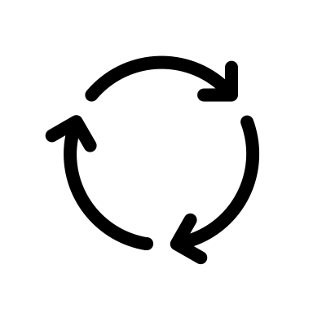
Public Blockchains: SMR and Consensus
State Machine Replication (SMR)
Miner1
B1
B2
B3
Miner2
Miner5
Miner5
Consensus
B1
B2
B3
B1
B2
B3
Miner3
Miner4
Consensus adds fixed latency, storage determines the block size
B1
B2
B3
B1
B2
B3
Notes:
Public blockchains have open networks
As in, they allow any server to execute transactions
This means that, miners can also be malicious
Therefore, public blockchains, employ consensus protocols to tolerate a minority of malicious miners
With consensus, all miners start from a specific system state and execute the same user transactions to arrive at a deterministic final state!
Miners behave as state machine replicas to process transactions.
We notice that while such consensus protocols add fixed latency for processing blocks of transactions, it
however, it is the storage at miners that determine the number of transactions in each block!

Slide 25

Impact of Storage on Throughput
Cluster-1
Cluster-2
Miner1
Miner1
30K Txs
PoW
PoW
State-0
～3 users
Miner2
Miner3
Miner2
Miner3
State-0
～10M users
6x slower
2.5x smaller blocks
Storage has a direct impact on block size and overall throughput
Notes:
To understand this behavior, we run a simple microbenchmark using
two private Ethereum clusters, with 3 miners each
Each cluster processes 30K transactions in total.
While the first cluster has no system state, the second cluster is initialized with 10M user accounts.
Despite using the same proof-of-work consensus protocol,
the second cluster is 6 times slower, and creates blocks that are 2.5 times smaller than the first cluster.
Therefore, we show that I/O bottlenecks lower the block size and thereby limit the end-to-end throughput of public blockchains.

Slide 26

Transaction Processing in Ethereum
Accessing and modifying state in the critical path of processing transactions
Transaction (Tx-0)
DRAM
1
DRAM
SSD
2
3
4
4
Miner
Block
Block
DRAM
DRAM
5
5
6
6
Miner
Miner
Notes:
To understand the nature of these I/O bottlenecks, let’s taka closer look at how transactions are processed in Ethereum
Ethereum miners store the system state locally on SSDs
To execute a transaction, a miner first reads the necessary data from the SSD into DRAM.
It then executes the transaction and modifies the data accordingly
And then writes the changes back to its local storage.
Once the miner, mines the transaction into a block, it sends the block to other miners.
Other miners also read the data from their local storage,
execute the transactions in the block, and
modify their state accordingly. This way, miners re-execute transactions to ensure correctness.

Slide 27
Transaction Processing in Ethereum
Accessing and modifying state in the critical path of processing transactions
Transaction (Tx-0)
DRAM
Merkle tree (logical)
1
DRAM
SSD
Authenticate data and provide proofs
2
3
0
A
f
B
C
D
4
4
Miner
0
f
Block
Block
v1
v2
v3
v4
DRAM
DRAM
5
5
C
A
v3
6
6
Miner
Miner
Notes:
zooming Further into how system state is stored at each miner,
state is stored using authenticated data structures like Merkle trees!
Merkle trees provide data along with proofs that help verify the correctness of the data
The system state in Ethereum is stored in a logical Merkle tree, which is flattened and stored as key-value pairs on disk.

Slide 28
Transaction Processing in Ethereum
Accessing and modifying state in the critical path of processing transactions
Transaction (Tx-0)
DRAM
Merkle tree (logical)
1
DRAM
SSD
Authenticate data and provide proofs
2
A
A’
3
0
A
f
C
D
C’
B
C
4
4
Miner
0
f
Block
Block
v1
v3
v3
v2
vX
v4
DRAM
DRAM
5
5
A
v3
C
A
v3
C
6
6
Miner
Miner
Notes:
Traversing such a tree requires multiple RANDOM disk reads.
And updating a value results in multiple disk writes

Slide 29
I/O Bottlenecks in Ethereum
Using LSM-based key-value stores to store system state
These stores introduce additional layer of I/O overheads
Unable to cache frequently-accessed system state
Index Merkle nodes with their hashes
Merkle node updates are viewed as new key-value pairs
Limiting I/O parallelism
Miners are responsible for ordering transactions and updating system state
Update system state in the critical path of processing transactions
Notes:
In summary, I/O bottlenecks in public blockchains arises for three main reasons:
First miners use LSM-based key-value stores to store the system state on disk
which add I/O overheads of their own.
Next, due to this design, miners are unable to differentiate between writes and updates
and are unable cache the most frequently modified nodes in the Merkle tree.
Finally, since miners are responsible for ordering transactions and maintaining latest system state,
there is limited possible I/O parallelism.
These together limit the transaction processing rate of public blockchains.

Slide 30
Transaction Processing in Ethereum
Accessing and modifying state in the critical path of processing transactions
DRAM
SSD
  To read or update a single 100B user account, Ethereum reads above 40MB, resulting in 40-60x I/O amplification!
Transaction (Tx-0)
Miner1
Merkle tree
A
A’
0
A
f
C
D
C’
B
C
0
f
Block
Block
v1
v3
v3
v4
v2
vX
Miner1
Miner1
C
A
v3
On-disk layout
Notes:
We measure that, to read a single user account, Ethereum reads 40-60 times more data!

Slide 31
Transaction Processing in Ethereum
Accessing and modifying state in the critical path of processing transactions
DRAM
SSD
  To read or update a single 100B user account, Ethereum reads above 40MB, resulting in 40-60x I/O amplification!
Transaction (Tx-0)
Miner1
Merkle tree
A
A’
0
A
f
C
D
C’
B
C
0
f
Block
Block
  To process a single block of 100 simple transactions, Ethereum performs more than 10,000 (100x) random I/O operations!
v1
v3
v3
v4
v2
vX
Miner1
Miner1
C
A
v3
On-disk layout
Notes:
and, to process a single block of 100 simple transactions, Ethereum performs 100 times more random I/O operations.
(pause)

Slide 32
Faster Transaction Processing
RainBlock
Goal: Miners can process more transactions in the same amount of time
Approach: I/O-efficient data authentication to minimize I/O bottlenecks
Miners release larger blocks and achieve higher throughput
Notes:
With our work RainBlock. we enable faster transaction processing
The main insight is to enable miners to process more transactions in the same time without modifying the consensus protocol!
Our approach is to minimize I/O bottlenecks from system at miners,
This allows theminerm to process more transactions per consensus round, and release larger blocks to achieve higher throughput.

Slide 33
RainBlock: Faster Transaction Processing
RainBlock, a new architecture for public blockchains that increases overall throughput by enabling faster transaction processing at miners
RainBlock eliminates I/O bottlenecks in transaction processing and allows miners to execute and verify more transactions per unit time
RainBlock employs the novel Distributed Sharded Merkle Tree (DSM-Tree) for I/O-efficient transaction processing
In a geo-distributed setting, with 4 miners in 4 regions spread across 3 continents, RainBlock miners can process about 20K transactions per second
Notes:
RainBlock makes the following key contributions!
RainBlock introduces a new architecture for public blockchains, that increases the overall throughput by enabling faster transcation processing at miners
RainBlock eliminates the I/O bottlenecks at miners and allows them to execute and verify more transactions per unit time
For eliminate I/O bottlenecks, RainBlock employs the novel Distributed, Sharded, Merkle tree or the DSM-Tree data structure
In a geo-distributed setting, RainBlock miners can process more than 20 thousand transactions per second.

Slide 34


RainBlock: Architecture for Public Blockchains
Miners do not perform I/O in the critical path
Transaction (Tx-0)
Helper1
2. Submit
Miner1
Helper2
HelperX
Miner2
MinerN
1. Prefetch
3. Update
Storage Nodes
Storage Nodes
...
Distributed Sharded Merkle Tree (DSM-Tree)
Notes:
To minimize I/O bottlenecks, the system state is decoupled from miners, it is shard-ed, and stored across the memory of multiple storage nodes.
These nodes store the Merkle tree in a memory-optimized format using the DSM-Tree data structure
I/O helpers are introduced to perform I/O on behalf of miners
Typically, I/O helpers prefetch the data required for executing any tx from the storage nodes
I/O-helpers submit the transactions and the prefetched data to the miners
Miners execute the txs, create a new block; and update the storage nodes. Storage nodes perform these updates asynchronously.
Thus, RainBlock miners process transactions faster: typically, without performing any I/O in the critical path!

Slide 35
RainBlock: Challenges
Challenge-I: Concurrent updates to storage
I/O-Helpers can prefetch from storage nodes while miners are updating them
Storage nodes need to provide consistency in the presence of concurrency!
Notes:
RainBlock also addresses two main challenges to achieve high throughput
In RainBlock, I/O helpers can prefetch data from storage nodes while miners are updating them in parallel.
Therefore, storage nodes need to provide consistency in the presence of concurrency

Slide 36
RainBlock: Challenges
Challenge-I: Concurrent updates to storage
I/O-Helpers can prefetch from storage nodes while miners are updating them
Storage nodes need to provide consistency in the presence of concurrency!
Challenge-II: Increased network traffic
RainBlock trades off local disk-I/O for network-I/O
Data is now transmitted over the network, and is very large
Stateless Clients proposal did not gain traction due to high network overheads
Notes:
Next, RainBlock architecture trades off local disk I/O for network I/O
Therefore, RainBlock needs to reduce amount of data transmitted over the network
Note that, stateless clients proposal from Ethereum introduced separate storage nodes like in RainBlock,
but did not gained traction due to high network overheads!

Slide 37
Handling Concurrent Operations
Concurrency and consistency
Helper1
Miner1
B1
B2
B3
Prefetch data from the requested snapshot or the latest snapshot (default)
MinerN
B3
B1
B2
B3’
Prefetch
Update
Storage Nodes
...
Distributed Sharded Merkle Tree (DSM-Tree)
On updates, shards create new copies of data
Notes:
Recall that, In RainBlock, I/O-helpers can prefetch from storage nodes
while miners are updating them in parallel
Further, as miners share the storage nodes,
multiple miners can update them simultaneously.
To handle this, the DSM-Tree in storage nodes employs copy-on-write.
On updates, (1) storage nodes create new copies of the modified data
(2) And, I/O-helpers prefetch data from a specific snapshot or the latest snapshot by default.
Once blocks in the main chain are confirmed, then snapshots from unconfirmed blocks are garbage collected at the storage nodes.

Slide 38
Two-layered DSM-Tree
Concurrency and consistency
Helper1
2. Submit
Miner1
Top layer of DSM-Tree:
Miner’s private cache
Witnesses
1. Prefetch
Storage Nodes
...
The DSM-Tree layers collaborate with each other to reduce network traffic
Notes:
Naively, I/O-helpers may prefetch full paths in the Merkle tree called witnesses,
and submit them to miners.
However, RainBlock miners store the top layer of the DSM-Tree
in a private in-memory cache.
The two layers of the DSM-Tree
the private top layer at miners, and the
common, shard-ed bottom layer in the storage nodes,
collaborate with each other to reduce network traffic.

Slide 39
Two-layered DSM-Tree
Reduce network traffic
Helper1
2. Submit
Miner1
Compact witnesses
1. Prefetch
Storage Nodes
...
Cross-layer optimizations reduce network traffic by up to 95%
Notes:
For example, miners can store the top layer of the DSM-Tree (till a configurable depth)
I/O-helpers instead of fetching full witnesses, can pre-fetch only data that is not present at the miners
called compact witnesses,
and submit them to the miners.
Such cross-layer optimizations in DSM-Trees reduce the network traffic in RainBlock by up to 95%

Slide 40

Life of a Transaction in RainBlock
Miners do not perform I/O in the critical path
Top layer DSM-Tree
Transactions
Helper
2. Submit
Miner
Compact witnesses
B_{n}
1. Prefetch
3. Update
...
Bottom layer DSM-Tree
Notes:
In summary, RainBlock,
miners store the top layer of the DSM-Tree
Bottom layerof the DSM-Tree is shard-ed across the memory of multiple storage nodes
The I/O-helper pre-executes transactions to prefetch compact witnesses from the storage nodes
I/O-helpers then submit the transactions, and the compact witnesses to the miner
Miner uses the compact witnesses and its private cache to process transactions
Miner then creates a valid block and updates the storage nodes
Storage nodes asynchronously create new snapshot of data corresponding to the updates from the new block
Old unconfirmed snapshots are periodically garbage collected at the storage nodes.

Slide 41
RainBlock: Trust, Safety, and Security
I/O-Helpers, Miners, and Storage nodes work without trust
Communicate with authenticated data and decentralize trust
Relies on underlying unmodified consensus for safety and correctness
Safety and security remains the same as Ethereum
Notes:
Note that,
All RainBlock components operate without trusting others: they communicate using witnesses and authenticated data
Since RainBlock does not modify the underlying consensus protocol to achieve high throughput!
It retains the safety and security properties of Ethereum’s proof-of-work consensus protocol.

Slide 42

Implementation
15k lines of code at https://github.com/RainBlock
Notes:
We implement RainBlock in 15k lines of code and it is publicly available!

Slide 43
Implementation and Evaluation
15k lines of code at https://github.com/RainBlock
Experimental setup
Amazon EC2 m4.2xlarge instances
  32GB RAM
  48 threads per machine
I/O-helper, miner, or storage node, per instance
Workloads represent transactions in the public Ethereum
Notes:
To evaluate the throughput and scalability of RainBlock,
we use amazon ec2 large instances, each with 32 GB DRAM and 48 threads
I/O-helpers, miners, and storage nodes, are deployed on their own instances
We use a workload generator to synthesize workloads that are similar to the transactions in the public Ethereum main network

Slide 44
RainBlock: Evaluation
Performance of a single miner of RainBlock against Ethereum
Throughput and scalability of RainBlock in a geo-distributed setting
Performance impact of the tunable parameters of DSM-Tree
Network overheads in RainBlock
Notes:
We
compare the performance of a single miner in RainBlock with Ethereum
We evaluate the throughput and scalability of RainBlock in a geo-distributed setting
We also discuss the confirgurable parameters of DSM-tree and the performance benefits from its optimizations
Finally, we quantify the network overheads in RainBlock.
Today, lets look at the the throughput and scalability of RainBlock I ngeo-distributed settings

Slide 45
RainBlock in Geo-Distributed Settings
Geo-distributed settings
Four miners across in 4 different regions spread across 3 continents
Four I/O-helpers per miner
16 storage nodes across wide-area-network
RainBlock miners process ～20K transactions per second
Transaction confirmation latency is the same as Ethereum
Notes:
We deploy RainBlock
In a geo-distributed setting with 4 miners across 4 regions spread across 3 different continents
We use 4 I/O-helpers per miner to create high transaction load
Finally, we use 16 storage nodes which are accessible over the slow, wide-area network
In these setting, RainBlock can process about 20 thousand transactions per second, using a total of 32 servers and have the same transaction confirmation latency as in Ethereum!
We also notice that RainBlock’s throughput was stable even with a higher number of miners!

Slide 46
RainBlock: Limitations and Tradeoffs
Deconstruct miners and employs separate storage nodes
Additional resources to achieve high throughput and scalability
How to incentivize storage nodes to serve the latest system state?
I/O-helpers or users pay storage nodes for accessing their data
Market economics regulate replication and availability of data
Notes:
Overall, RainBlock improves the throughput of public blockchains by orders of magnitude by employing a small percentage of additional hardware
One of the main questions that remain in RainBlock is
who should pay the storage nodes for serving the latest system state?
We propose a preliminary solution where I/O-helpers pay storage nodes while prefetching data
And where market economics can incentivize them to store data with high availability
While we outline a few ways to incentivize RAINBLOCK components we do not address a complete solution!

Slide 47
RainBlock
ATC’21
Minimizes I/O bottlenecks from authenticated data structures
Enables faster transaction processing at miners
Avoids I/O in the critical path using I/O-Helpers and storage nodes
DSM-Trees reduce network traffic
Miners can process 20K Txs/s in a geo-distributed setting
Notes:
In summary,
RainBlock is amongst the first works to highlight the impact of I/O bottlenecks on end-to-end performance and scalability,
And takes the novel approach of minimizing these I/O bottlenecks to enable faster Tx processing in public blockchains
RainBlock architecture avoids I/O in the critical path of Tx processing using I/O-Helpers and storage nodes
RainBlock uses DSM-Trees for I/O-efficient authenticated storage and to reduce network traffic
Miners processes 20K tps in a geo-distributed setting!
pause for questions!

Slide 48
Minimizing I/O Bottlenecks in
PM Key-Value Stores
Skye
Notes:
Now, lets discuss how we minimize I/O bottlenecks in PM key-value stores
with Skye

Slide 49
PM Stores: Throughput and Scalability Limitations
Workload: YCSB Load-A with 8B keys and 256B values
 | FlatStore | An Efficient Log-Structured Key-Value Storage Engine for Persistent Memory (ASPLOS’20)
 | Viper | An Efficient Hybrid PMem-DRAM Key-Value Store (VLDB’21)
 | ChameleonDB | A key-value store for optane persistent memory (Eurosys’21)
Notes:
State-of-the-art PM key-value stores suffer from low-throughput and have poor scalability.
To show this, we use 3 PM stores:
FlatStore, Viper, and ChameleonDB, and use
the standard YCSB LoadA worklaod with 8B keys and 256B values

Slide 50
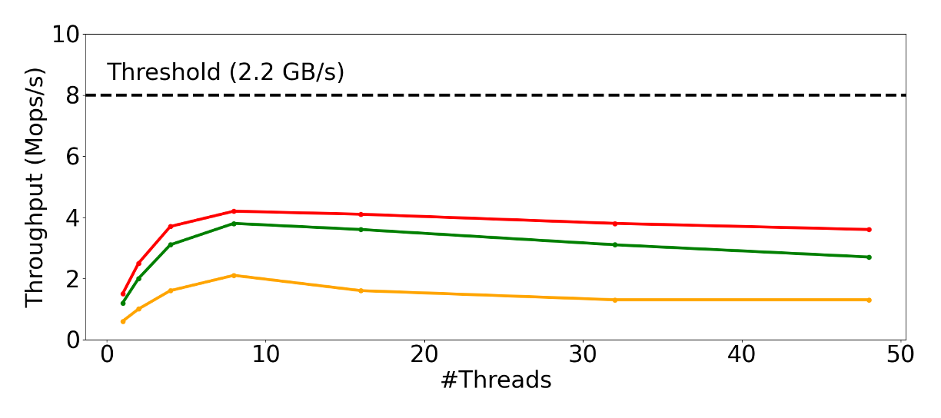
PM Stores: Throughput and Scalability Limitations
Workload: YCSB Load-A with 8B keys and 256B values
 | FlatStore | An Efficient Log-Structured Key-Value Storage Engine for Persistent Memory (ASPLOS’20)
 | Viper | An Efficient Hybrid PMem-DRAM Key-Value Store (VLDB’21)
 | ChameleonDB | A key-value store for optane persistent memory (Eurosys’21)
Notes:
We run these PM stores on a single PM DIMM that has a write bandwidth of 2.2 GB/s
We plot their end-to-end throughput on the Y-axis while scaling the number of application threads on the X-axis.
We show that all PM stores have low throughput!

Slide 51
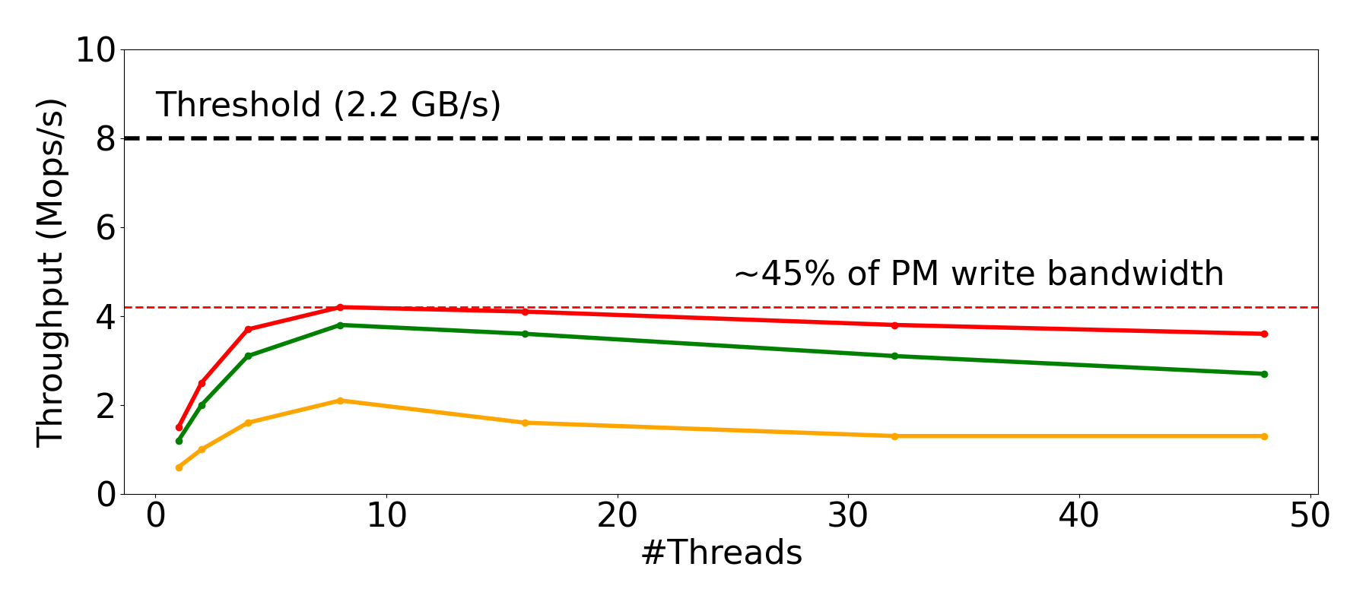
PM Stores: Throughput and Scalability Limitations
Workload: YCSB Load-A with 8B keys and 256B values
 | FlatStore | An Efficient Log-Structured Key-Value Storage Engine for Persistent Memory (ASPLOS’20)
 | Viper | An Efficient Hybrid PMem-DRAM Key-Value Store (VLDB’21)
 | ChameleonDB | A key-value store for optane persistent memory (Eurosys’21)
Performance limitations are due to I/O bottlenecks from the PM media
Throughput does not scale with the available PM capacity
Notes:
We observe that PM stores utilize < 45% of available PM bandwidth
And their throughput decreases with the increasing number of application threads
Further, their throughput does scale with the available PM capacity!
With our work, we shows that these performance limitations are due to I/O bottlenecks from underlying media

Slide 52
PM Stores: Outline
Overview on PM and PM key-value stores
I/O Bottlenecks from PM media
Skye: Design and Architecture
Performance Evaluation
Limitations and Tradeoffs
Notes:
in this part of todays talk,
First, I will present an overview on Persistent Memory and discuss the
I/O bottlenecks in PM key-value stores
Then I will introduce Skye and
Discuss its performance, limitations, and tradeoffs

Slide 53
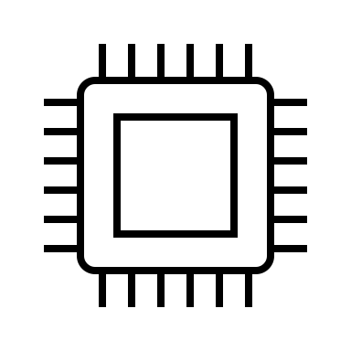
PM: Non-Uniform Memory Access Servers
 | CPU
 | DRAM
 | PM
CPU-0
Notes:
Persistent Memory is available on multi-socket servers that have non-uniform memory access.
For instance, cores within a CPU socket access local DRAM over the memory bus!

Slide 54

PM: Non-Uniform Memory Access Servers
 | CPU
 | DRAM
 | PM
1x
～3x
CPU-0
CPU-1
Notes:
And since, these servers have multiple CPUs
cores from other CPU socket can access remote memory over the NUMA interconnect
Remote accesses incur higher latency and are up to 3 times slower than local accesses!

Slide 55
PM: Alongside DRAM on Memory Bus
 | CPU
 | DRAM
 | PM
CPU-0
CPU-1
Notes:
In NUMA servers,
PM is available alongside DRAM.

Slide 56
PM: Alongside DRAM on Memory Bus
NVDIMM-5
NVDIMM-11
...
...
NVDIMM-1
NVDIMM-7
 | CPU
 | DRAM
 | PM
NVDIMM-0
NVDIMM-6
CPU-0
CPU-1
A single four-socket server can host up to 6 TB of PM as 256 GB NVDIMMs
Notes:
It comes as non-volatile DIMMs of different sizes:
Note that a single server can host up to 6 TB of PM.

Slide 57
PM: Alongside SSDs on PCIe Bus
NVDIMM-5
NVDIMM-11
...
...
NVDIMM-1
NVDIMM-7
 | CPU
 | DRAM
 | PM
 | Disk
NVDIMM-0
NVDIMM-6
SSD
NVDIMM-12
NVDIMM-n
...
CPU-0
CPU-1
PCIe Bus: CXL-based PM expansion
With CXL, modern servers can support scalable PM capacity and bandwidth
Notes:
Further, with CXL, PM is also available alongside SSDs over the PCIe-bus
Therefore, modern servers can scale the available PM capacity and bandwidth within a single server!

Slide 58
PM: Promising for Building Key-Value Stores
Qualitative Characteristics
Scalable capacity and high density
Durable like SSDs
Byte-addressable and provides low latency like DRAM
Notes:
With these key characteristics, PM is a promising technology for building large-scale key-value stores
First,
PM supports scalable capacity and bandwidth within a server and has high density relative to DRAM
Next,
PM is durable and stores data across power cycles like SSDs
Finally, PM is also byte-addressable and fast: It has DRAM comparable low latencies.

Slide 59
PM: Promising for Building Key-Value Stores
Qualitative Characteristics
Scalable capacity and high density
Durable like SSDs
Byte-addressable and provides low latency like DRAM
Performance Characteristics
Nuanced performance profile [1—3]
[1] Yang, Jian, et al. "An empirical guide to the behavior and use of scalable persistent memory." 18th USENIX Conference on File and Storage Technologies (FAST 20). 2020.
[2] Daase, Björn, et al. "Maximizing persistent memory bandwidth utilization for OLAP workloads." Proceedings of the 2021 International Conference on Management of Data. 2021.
Existing PM stores do not account for its complex performance characteristics
Notes:
However, prior work shows that PM has nuanced performance which makes it challenging for PM stores to obtain high bandwidth utilization.
We notice that existing PM stores do not account for these complex performance characteristics of PM and suffer from low throughput and have poor scalability.

Slide 60
Existing PM Stores: Common Practices
CPU-0
CPU-1
 | CPU
 | DRAM
 | PM
 | Disk
NVDIMM-0
NVDIMM-1
NVDIMM-2
NVDIMM-3
Notes:
To understand the performance limitations of PM stores, lets take a look at a few of their common practices.
PM stores are built for NUMA servers with multiple NVDIMMs per NUMA node

Slide 61
Existing PM Stores: Hardware-Managed NVDIMMs
CPU-0
CPU-1
 | CPU
 | DRAM
 | PM
 | Disk
NVDIMM-0
NVDIMM-1
NVDIMM-2
NVDIMM-3
Notes:
1. All existing PM stores configure PM in the interleaving mode.
With interleaving,
They rely on hardware to combine multiple NVDIMMs and run on a single PM device per NUMA node.
For instance, a large file round-robins across available NVDIMMs in a NUMA node at fixed, 4kB granularities!

Slide 62
Existing PM Stores: Hardware-Managed NVDIMMs
CPU-0
CPU-1
 | CPU
 | DRAM
 | PM
 | Disk
Hardware controls data placement across multiple NVDIMMs in a NUMA node
NVDIMM-0
NVDIMM-1
NVDIMM-2
NVDIMM-3
Notes:
Therefore, PM stores rely on hardware and no longer control how data is placed to across multiple NVDIMMs in a NUMA node

Slide 63
Existing PM Stores: Direct-Access to PM
CPU-0
CPU-1
 | CPU
 | DRAM
 | PM
 | Disk
NVDIMM-0
NVDIMM-1
NVDIMM-2
NVDIMM-3
Notes:
2. PM stores provide Direct-access to applications
With such architectures they leverage the low-latency of PM.
For example, PM stores memory-map regions of PM into user-space and allow application threads to directly read and write data to PM.
With direct-access, applications can scale the number threads that concurrently access PM!

Slide 64
Existing PM Stores: Direct-Access to PM
CPU-0
CPU-1
 | CPU
 | DRAM
 | PM
 | Disk
Applications controls the number of concurrent I/O operations on PM
NVDIMM-0
NVDIMM-1
NVDIMM-2
NVDIMM-3
Notes:
Therefore, PM stores adopt direct-access architectures to provide low-latency and rely on applications to control the number of concurrent I/O operations on PM.

Slide 65
Existing PM Stores: Can Overload PM Controllers
 | CPU
 | DRAM
 | PM
 | Disk
CPU-0
CPU-1
NVDIMM-0
NVDIMM-1
NVDIMM-2
NVDIMM-3
NVDIMM-0
Notes:
With these design choices,
if hardware places all the hot data on a single NVDIMM
Then all application threads concurrently access this NVDIMM
And overwhelm its memory controller!

Slide 66
Common Practices in PM Stores
Direct-access for applications
Applications scale the number of I/O threads
Applications control number of concurrent operations to PM
PM stores no longer control the number of concurrent I/O operations to PM
Notes:
Therefore, to summarize a few key practices in PM stores,
First, they provide applications with direct-access to PM:
With this design choice applications determine the number of I/O threads that can access PM directly, and obtain low latencies.
However, PM stores no longer control the number of concurrent I/O operations to PM

Slide 67
Common Practices in PM Stores
Direct-access for applications
Applications scale the number of I/O threads
Applications control number of concurrent operations to PM
Hardware-managed NVDIMMs
Memory-controllers determine data placement
They make placement decisions at coarse 4kB granularities
PM stores no longer control data placement or #concurrent I/O ops on NVDIMMs
Notes:
Next, PM stores leverage interleaved NVDIMMs
And rely on hardware-managed NVDIMMs to decisions at coarse 4kB granularities

Slide 68
Common Practices and their Limitations
Direct-access for applications
Applications determine the number of I/O threads
Applications control number of concurrent operations on NVDIMMs
Hardware-managed NVDIMMs
Memory-controllers determine data placement
They make placement decisions at coarse 4kB granularities
PM stores give up fine-grained control on how I/O is performed on NVDIMMs
PM stores no longer control data placement or #concurrent I/O ops on NVDIMMs
Notes:
PM stores oflload fine-grained control over PM access to hardware and applications and incur I/O bottlenecks from PM media

Slide 69
PM Performance Characteristics
Qualitative Characteristics | Performance Characteristics
High density and scalable capacity | Nuanced Performance Characteristics *
Durable like SSDs
Byte-addressable and provides low latency like DRAM
Qualitative Characteristics | Performance Characteristics
High density and scalable capacity | Nuanced Performance Characteristics *
Durable like SSDs | Asymmetric read/write latency
Byte-addressable and provides low latency like DRAM
Qualitative Characteristics | Performance Characteristics
High density and scalable capacity | Nuanced Performance Characteristics *
Durable like SSDs | Asymmetric read/write latency
Byte-addressable and provides low latency like DRAM | Low I/O bandwidth relative to DRAM
It is challenging to obtain high PM bandwidth utilization
Notes:
Note that,
PM has asymmetric read/write latency and has much lower I/O bandwidth than DRAM.
Therefore, it is crucial for PM stores to obtain high bandwidth utilization to achieve scalable high-throughput
However complex performance characteristics of PM media make it challenging to obtain high PM bandwidth utilization

Slide 70
Analyzing PM Characteristics
Interleaving
Masks the complexity of managing multiple NVDIMMs
Write bandwidth utilization is not stable across access sizes
Thread scaling
Increases CPU and PM bandwidth utilization
Too many threads beyond a threshold hurt PM bandwidth utilization
Concurrent I/O [1]
Obtain peak PM bandwidth with fewer threads
[1] Daase, Björn, et al. "Maximizing persistent memory bandwidth utilization for OLAP workloads." Proceedings of the 2021 International Conference on Management of Data. 2021.
Notes:
We study the performance characteristics of PM and summarize our analysis:
We observe that
although interleaving masks the complexity of managing multiple NVDIMMs per NUMA node,
it results in throughput that is not consistent across different access sizes
Similarly, although increasing the number of threads helps achieve higher bandwidth utilization,
using too many threads beyond a certain threshold overloads NVDIMMs and results in poor bandwidth utilization
Finally, contrast to prior findings, we notice that performing concurrent reads and writes
helps achieve peak PM bandwidth with fewer threads!

Slide 71
Four Recommendations for PM Stores
(R1) NVDIMM-awareness
Manage PM as multiple NVDIMMs
(R2) Bounded thread scaling
Limit the maximum number of concurrent threads per NVDIMM
(R3) Mixing reads and writes
Obtain peak throughput fewer threads
(R4) NUMA-awareness
Minimize cross-socket traffic
Notes:
Following our analysis, we highlight
four design principles ti achieve high PM write bandwidth utilization
First, PM stores must manage NVDIMMs without interleaving
Second, PM systems must limit the maximum number of concurrent threads per NVDIMM;
Third, they must not avoid mixing reads with writes to the same NVDIMM;
Finally, PM stores must minimize remote-NUMA accesses to achieve high, scalable performance

Slide 72
Four Recommendations for PM Stores
(R1) NVDIMM-awareness
Manage PM as multiple NVDIMMs
(R2) Bounded thread scaling
Limit the maximum number of concurrent threads per NVDIMM
(R3) Mixing reads and writes
Obtain peak throughput fewer threads
(R4) NUMA-awareness
Minimize cross-socket traffic
PM stores must retain fine-grained control over all PM accesses
Avoid I/O bottlenecks from the underlying PM media
Notes:
In contrast to the common practices of existing PM stores,
Our analysis highlights that PM stores must retain fine-grained control over all PM accesses to
Avoid I/O bottlenecks from underlying PM media and to obtain stable and high PM bandwidth utilization

Slide 73
Fine-Grained Control on all PM Accesses
Skye
Goal: Achieve stable and high PM bandwidth utilization
Approach: PM media-aware architectures to minimize I/O bottlenecks

Slide 74
Skye: Fine-Grained Control on all PM Accesses
Skye diverges from common practices in PM stores and retains fine-grained control over all PM accesses to obtain scalable and high PM bandwidth utilization
Skye manages PM as multiple, individual software-managed NVDIMMs in non-interleaved mode using a novel nvLOG interface
Skye provide indirect-access to applications using dedicated worker threads
Skye leverages multiple media to avoid overloading PM and obtains 2—5x higher throughput relative to state-of-the-art PM stores on standard YCSB workloads
Notes:
Skye diverges from common practices in PM stores, and claims control back from hardware and applications, to obtain high and scalable PM bandwidth utilization
Skye manages PM as multiple, individual software-managed NVDIMMs in non-interleaved mode using its novel nvLOG interface
Skye employs dedicated worker threads to provide indirect-access to applications
Skye leverages multiple media to avoid overloading PM and obtains 2—5x higher throughput relative to state-of-the-art PM stores on standard YCSB workloads

Slide 75
Skye: Fine-Grained Control on all PM Accesses
Design practices | Reason | Skye
Interleave NVDIMMs | Simplifies data placement
Direct access | Low latency
Overload NVDIMMs | PM-agnostic design
Design practices | Reason | Skye
Interleave NVDIMMs | Simplifies data placement
Direct access | Low latency
Overload NVDIMMs | PM-agnostic design
Notes:
Recall that, existing PM stores employ interleaving and provide direct-access to applications and can overload NVDIMMs
However, Skye takes a different approach!

Slide 76
Skye: Fine-Grained Control on all PM Accesses
Design practices | Reason | Skye
Interleave NVDIMMs | Simplifies data placement | Non-interleaved PM
Direct access | Low latency
Overload NVDIMMs | PM-agnostic design
CPU-0
CPU-1
nvLOG
interface
NVDIMM-0
NVDIMM-1
NVDIMM-2
NVDIMM-3
Notes:
First, skye configures PM in the non-interleaved mode
and manages multiple NVDIMMs each as its own PM device!
It uses nvLOG, a novel logging interface to access PM.
with this design choice, Skye distributed data across NVDIMMs at flexbile application-specific data granularities like individual key-value pairs.
------
Write at the granularity of data flexible data sizes
manage the I/O load balance across NVDIMMs

Slide 77
Skye: Fine-Grained Control on all PM Accesses
Design practices | Reason | Skye
Interleave NVDIMMs | Simplifies data placement | Non-interleaved PM
Direct access | Low latency
Overload NVDIMMs | PM-agnostic design
Design practices | Reason | Skye
Interleave NVDIMMs | Simplifies data placement | Non-interleaved PM
Direct access | Low latency | In-direct access
Overload NVDIMMs | PM-agnostic design
CPU-0
CPU-1
NVDIMM-0
NVDIMM-1
NVDIMM-2
NVDIMM-3
Notes:
Next, Skye provides indirect-access for applications

Slide 78
Skye: Fine-Grained Control on all PM Accesses
Design practices | Reason | Skye
Interleave NVDIMMs | Simplifies data placement | Non-interleaved PM
Direct access | Low latency | In-direct access
Overload NVDIMMs | PM-agnostic design
CPU-0
CPU-1
In-direct
access
NVDIMM-0
NVDIMM-1
NVDIMM-2
NVDIMM-3
Notes:
Like existing PM stores,
Skye also memory-maps PM regions into user-space.
However, instead of allowing applications to directly access PM,
Skye uses dedicated worker threads to perform I/O on NVDIMMs
With indirect-access, skye controls the number of concurrent threads per NVDIMMs
-----
Write at the granularity of data flexible data sizes
manage the I/O load balance across NVDIMMs

Slide 79
Skye: Fine-Grained Control on all PM Accesses
Design practices | Reason | Skye
Interleave NVDIMMs | Simplifies data placement | Non-interleaved PM
Direct access | Low latency | In-direct access
Overload NVDIMMs | PM-agnostic design
Design practices | Reason | Skye
Interleave NVDIMMs | Simplifies data placement | Non-interleaved PM
Direct access | Low latency | In-direct access
Overload NVDIMMs | PM-agnostic design | DRAM and SSDs
CPU-0
CPU-1
NVDIMM-0
NVDIMM-1
NVDIMM-2
NVDIMM-3
Notes:
Finally, skye leverages multiple media like DRAM and SSD to avoid overloading PM.

Slide 80
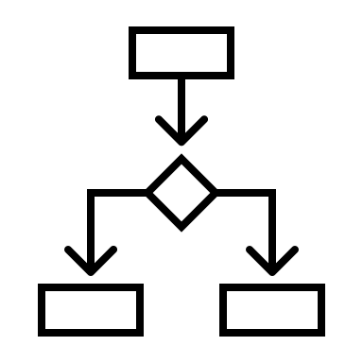
Skye: Fine-Grained Control on all PM Accesses
Design practices | Reason | Skye
Interleave NVDIMMs | Simplifies data placement | Non-interleaved PM
Direct access | Low latency | In-direct access
Overload NVDIMMs | PM characteristics | DRAM and SSDs
CPU-0
CPU-1
NVDIMM-0
NVDIMM-1
NVDIMM-2
NVDIMM-3
Notes:
Instead of using PM indexes that result in inefficient I/O,
Skye uses in-memory indexes and periodically checkpoints them to disks!

Slide 81
Skye: Design and Architecture
CPU-0
CPU-1
CPU-1
NUMA-aware Request Router
2-4
Meta Index
Request
Queue
Merge log
Dedicated
Worker N-0
NVDIMM-1
NVDIMM-2
NVDIMM-3
NVDIMM-0
NVDIMM-2
NVDIMM-3
Data
Metadata
Disk Checkpoint
Notes:
To tie these design choices together,
Skye adopts a NUMA-aware architecture only shares a request router across multiple NUMA nodes.
Using the nvLOG interface, Skye maintains data and metadata logs on NVDIMMs
Next, skye uses dedicated worker threads and maintains request pending quests in DRAM to provide indirect-access to applications
And finally, skye uses in-memory indexes to store metadata and
employs merge logs to update them asynchronously
and leverages disks for checkpoints

Slide 82
Life of a Put Request in Skye
CPU-0
CPU-1
NUMA-aware Request Router
1
2-4
5,6
1
5
4
Meta Index
Request
Queue
Background
thread
4
Application
thread
Merge log
Dedicated
Worker N-0
1
5
NVDIMM-0
NVDIMM-1
NVDIMM-2
NVDIMM-3
2
3
2
Data
3
Metadata
6
Disk Checkpoint
6
Notes:
Now lets look at the life of a put request in Skye
Skye routes a put request uniformly across available NVDIMMs
An application thread enqueues to the request in the specific request pending queue.
The worker threads in skye, dequeue requests and append to the data and metadata logs on PM
The metadata is also inserted into an in-memory merge log before the worker processes the next request
Asycnhronously, a background thread in Skye processes the index merge requests in the merge log
and update the in-memory data structure
Periodically, skye checkpoints to disks to limit recovery time.

Slide 83
Life of a Get Request in Skye
CPU-0
CPU-1
CPU-1
NUMA-aware Request Router
3
1-3
Meta Index
Request
Queue
Application
thread
Merge log
NVDIMM-1
NVDIMM-2
NVDIMM-3
NVDIMM-0
NVDIMM-2
NVDIMM-3
Data
Metadata
Notes:
Now lets look at the life of a get request in skye

Slide 84

Life of a Get Request in Skye
CPU-0
CPU-1
CPU-1
NUMA-aware Request Router
3
1-3
4
2
Meta Index
Request
Queue
1
Dedicated
Worker N-0
Merge log
Application
thread
3
NVDIMM-1
NVDIMM-2
NVDIMM-3
NVDIMM-0
NVDIMM-2
NVDIMM-3
4
4
Data
Metadata
Notes:
To route a get request, application threads query the merge logs and the in-memory indexes across NUMA nodes.
The request is routed to the node containing the latest update
A dedicated worker thread dequeues the get request, performs the read from the data logs, and returns the value to the application

Slide 85
Implementation
10K lines of C++ code
nvLOG: Software-managed NVDIMMs
Batching and Media-specific optimizations
nt-stores to write to NVDIMMs
AVX-enabled memcpy to read from NVDIMMs
Indexes: FASTER in-memory key-value store
Notes:
We implement Skye in 10K lines of C++ code.
With nvLOG: we obtain software-managed NVDIMMs and leverage media-specific optimizations
Like batching,
Using non-temporal stores for write -
And efficient memcopies to read from NVDIMMs
As its in-memory index that is periodically checkpointed to disk,
skye uses FASTER, an in-memory key-value store

Slide 86
Evaluation
Experimental setup:
Chameleon cloud compute_nvdimm server
Four socket NUMA server
56 cores per CPU
3 TB of PM as 24 x 128 GB NVDIMMs
Standard YCSB workloads with 8B keys and 256B values
Notes:
To evaluate Skye, we use a compute-nvdimm server in chameleon cloud
Which is a four-socket NUMA server
With 56 cores per CPU and has 3 TB of PM in total
We use standard YCSB workloads with 8B keys and 256B values for all our experiments

Slide 87
Evaluation
Throughput and scalability of Skye for write-dominant workloads
Performance of Skye relative to state-of-the-art PM stores
Configurable parameters of Skye and latency of requests
Memory and CPU overheads of Skye
Notes:
In detail, we evaluate the throughput and scalability of Skye for write-dominant workloads
We also compare the throughput and scalability of Skye with the sate-of-the-art PM key-value stores
Next, we discuss the configurable paramters in Skye and their impact on its end-to-end latency and throughput
We also quantify the memory and CPU overheads of Skye
Today, lets discuss the performance of Skye for write-dominant workloads

Slide 88
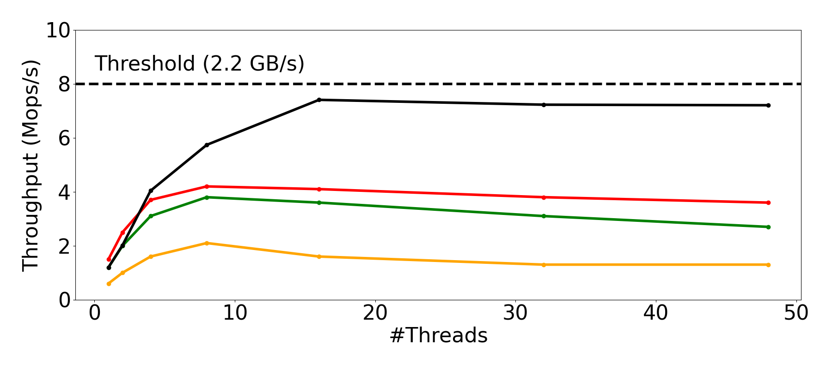
Skye: Throughput
Workload: YCSB Load-A with 8B keys and 256B values
 | FlatStore | An Efficient Log-Structured Key-Value Storage Engine for Persistent Memory (ASPLOS’20)
 | Viper | An Efficient Hybrid PMem-DRAM Key-Value Store (VLDB’21)
 | ChameleonDB | A key-value store for optane persistent memory (Eurosys’21)
 | Skye | A PM key-value store with fine-grained control over all PM accesses
2x
Notes:
We show that Skye outperforms existing PM stores!
With 48 application threads, Skye has 2x higher throughput than the next best FlatStore on the standard YCSB Load A workload.

Slide 89
Skye: Throughput and Scalability
Workload
YCSB Load-A workload
8B keys, 256B values
Single NVDIMM
7.2 Mops/s (1x throughput)
89% of write bandwidth
4 NVDIMMs across 4 NUMA nodes
～28 Mops/s (3.9x throughput)
86% of PM write bandwidth
#NVDIMMs | Mops/s | PM %bw | Scaling
1 | 7 | 89% | 1x
4 | 28 | 86% | 3.9x
Skye outperforms existing PM stores by up to 2 – 5x across YCSB workloads
Notes:
Further, we show that Skye hass throughput that scales with increasing number of NVDIMMs across NUMA nodes
On a single NVDIMM,
Skye processes 7.2 Mops/s and obtains 89% of PM write bandwith
And with 4 NVDIMMs across four NUMA nodes,
Skye’s throughput scales by 3.9x, obtaining about 86% of total available PM write bandwidth

Slide 90
Discussion: CXL Emulation
nvLOG can be extended to support slower media like CXL-SSDs
Skye obtains 88% of available emulated-CXL attached PM bandwidth [1]
CXL performance is more nuanced than remote NUMA [2]
Next steps: Evaluate Skye with realistic CXL emulation or with real CXL
[1] Ahn, Minseon, et al. "Enabling CXL Memory Expansion for In-Memory Database Management Systems." Data Management on New Hardware. 2022. 1-5.
[2] Myoungsoo Jung. Hello bytes, bye blocks: PCIe storage meets compute express link for memory expansion (CXL-SSD). In Proceedings of the 14th ACM Workshop on Hot Topics in Storage and File Systems. 45–51
Notes:
Skye can support newer PM media like CXL-attached storage by extending the nvLOG interface
to the optimize logging on that specific media.
- Currently we support PM and SSDs with nvLOG
We observe that Skye obtains 88% of the CXL-attached PM write bandwidth
For these experiments, we emulate CXL-attached PM using a remote NUMA node in a dual-socket server
However, recent work highlights that like PM, CXL also has nuanced performance characteristics which cannot be emulated using a NVDIMM over the NUMA interconnect.
Therefore, we plan to evaluate skye with a more realistic emulation of CXL in the future

Slide 91
Skye: Limitations and Tradeoffs
Skye trades low latency for obtain scalable and high throughput
Supports flexible batching to operate at low latency and throughput
In-direct access provides high throughput and incurs high CPU utilization
Skye allows concurrent reads and writes to PM to lower CPU utilization
Notes:
Fundamentally, skye trades-off low latency for applications and obtains high PM bandwidth utilization.
Skye can be configured to operate in the low-latency mode where it achieves comparable latencies as existing PM stores
Also,
Skye, with dedicated worker threads, incurs high CPU utilization to obtain stable and high PM write bandwidth utilization

Slide 92
Skye
Minimizes I/O bottlenecks to obtain high PM bandwidth utilization
Provides in-direct access to PM for applications and employs software-managed NVDIMMs to retain control over all PM accesses
Leverages DRAM indexes and SSDs to avoid overloading PM controllers
With four NVDIMMs across four NUMA nodes, Skye obtains 86% of available PM write bandwidth
Notes:
In summary,
Minimizes I/O bottlenecks to obtain high PM bandwidth utilization
Provides in-direct access to PM for applications and employs software-managed NVDIMMs to retain control over all PM accesses
Leverages DRAM indexes and SSDs to avoid overloading PM controllers
With four NVDIMMs across four NUMA nodes, Skye obtains 86% of available PM write bandwidth
(pause for questions)

Slide 93
Minimizing I/O Bottlenecks in Distributed Databases
Cascades
Notes:
Finally, in the third part
lets look at I/O bottlenecks in Distributed databases and how we minimize them with Cascades

Slide 94


Distributed Databases: Performance Limitations
Databases distributed across multiple servers but operate like they are on one server
For consistent recovery, logs are updated in the critical path of transactions
Transactions
…
Recovery logs
Updates to recovery logs in the critical path limit overall throughput and scalability
Notes:
At a high-level,
distributed Databases store data across multiple servers but operate as if the data resides on a single, highly-available server!
So these databases tolerate failures using replicas and recovery logs.
These logs are updated in the critical path of processing transactions
and introduce I/O bottlenecks that fundamentally limit the throughput and scalability of distributed databases!

Slide 95
Distributed Databases: Outline
Overview on Distributed Databases
I/O Bottlenecks from Recovery Logs
Cascades: Design and Architecture
Performance Evaluation
Notes:
As an outline for this part of the talk,
I will present a brief overview on distributed databases
and discuss the I/O bottlenecks from recovery logs
Then I will introduce the design and architecture of Cascades and
Finally, discuss its performance

Slide 96
Distributed Databased: Overview
Achieve high scalability
Tolerate failures and provide high availability
Support atomic, consistent, and durable transactions
Handle conflicting transactions
Notes:
First, lets look at how distributed databases
Achieve high scalability,
Provide high availability despite failures,
And support ACID transactions while handling conflicts

Slide 97


Distributed Databases: Partitioning
Partitioned or shared-nothing architectures for scalability
…
Notes:
Distributed databases often adopt shared-nothing architectures to achieve high scalability!
Here, data is partitioned across available servers

Slide 98
Distributed Databases: Replication
Replication for high availability and fault tolerance
Notes:
And, to provide high availability and tolerate failures,
databases maintain replicas for each data partition

Slide 99
Distributed Transactions
Tx
Transactions
Atomicity: All servers unanimously agree to either commit or abort the transaction
Two-Phase Commit (2PC) protocol supports atomic distributed transactions
Notes:
With partitioning, databases must process user transactions that may span across multiple servers
To support atomicity: which guarantees that this transaction is either committed or aborted across all participating servers unanimously ,
databases employ distributed protocols like two phase commit

Slide 100

Two-Phase Commit and Atomicity
Atomic distributed transactions
P1
P2
Tx1
Notes:
With two phase commit, a distributed transaction is committed in two phases.
First, one of the participants acts as the transaction coordinator.

Slide 101

Two-Phase Commit and Atomicity
Phase-I: Participants prepare to commit or abort the transaction
P1
P2
PREPARE TX1
PREPARE TX1
Tx1
YES
YES
Notes:
In the first phase, the coordinator sends a prepare message to all the participants.
In response, participants attempt to acquire locks for the values modified by the transaction,
If they're successful, they vote yes.
Once the coordinator receives votes from all participants,
it decides to commit the transaction, and ..

Slide 102
Two-Phase Commit and Atomicity
Phase-II: Participants commit the transaction
P1
P2
COMMIT TX1
COMMIT TX1
Tx1
YES
YES
Updates are now visible and the transaction’s commit status is notified to clients
Notes:
initiaties the second phase
It sends a commit message to all participants,
In response, participants modify the values, and release locks
Now, these updates are visible to future transactions.
and the transactions' commit status is notified to clients.

Slide 103
Two-Phase Commit and Strong Consistency
Strong consistency: concurrent transactions with conflicting write sets
P1
P2
Tx1
Tx2
Notes:
Note that protocols like 2pc provide strong consistency and serialize conflicting transactions
For example,
If we have a second concurrent transaction, where both transactions modify the same value,
Then with 2pc the second transaction is aborted.
In more detail, the transaction, the coordinator,
initializes the first phase, and sends a prepare message

Slide 104

Two-Phase Commit and Strong Consistency
Strong consistency: concurrent transactions with conflicting write sets
P1
P2
PREPARE TX2
PREPARE TX2
Tx1
NO
YES
Tx2
Notes:
However, since one of the partitions is unable to acquire the necessary locks, it votes no!
Once the coordinator receives all votes,

Slide 105
Two-Phase Commit and Strong Consistency
Strong consistency: concurrent transactions with conflicting write sets
P1
P2
ABORT TX2
ABORT TX2
Tx1
Tx2
YES
YES
Clients is notified of the aborted transaction
Two-phase commit provides atomicity and strong consistency for distributed transactions
Notes:
It sends an abort message in the second phase.
IN response, participants release any acquired locks
Finally the client is notified that the transaction is aborted
This way, two-phase commit supports atomic and strongly consistent distributed transactions

Slide 106
Two-Phase Commit and Durability
Logs: Consistent recovery in the event of failures
P1
P2
Tx1
Tx2
Servers log their status before communicating their progress to other servers
Notes:
For durability, two-phase commit relies on recovery logs
All participants servers write to logs before communicating over the network --
to tolerate failures and recover to a consistent state.

Slide 107
Two-Phase Commit and Durability
P1
P2
PREPARE TX2
PREPARE TX2
Tx1
Tx2
P1 [ TX2 ] YES
P1 [ TX2 ] NO
P1 [ TX2 ] YES
Notes:
For example,
First coordinator logs its status before sending the prepare message

Slide 108
Two-Phase Commit and Durability
P1
P2
Tx1
NO
YES
Tx2
P1 [ TX2 ] YES
P1 [ TX2 ] NO
P1 [ TX2 ] YES
Notes:
and the participants also log their votes before sending them to the coordinator.

Slide 109


Two-Phase Commit and Durability
P1
P2
Tx1
NO
NO
YES
Tx2
P1 [ TX2 ] YES
P1 [ TX2 ] NO
P1 [ TX2 ] YES
Notes:
If one of the servers crash during the first phase,

Slide 110

Two-Phase Commit and Durability
P1
P2
YES
Tx1
Tx2
P1 [ TX2 ] YES
P1 [ TX2 ] NO
P1 [ TX2 ] YES
Notes:
Then the servers use these logs and recover to a consistent state

Slide 111
Two-Phase Commit and Durability
P1
P2
PREPARE TX2
YES
Tx1
NO
Tx2
P1 [ TX2 ] YES
P1 [ TX2 ] NO
P1 [ TX2 ] YES
Notes:
When the coordinator retries, the server responds with its vote

Slide 112
Two-Phase Commit and Durability
P1
P2
Tx1
Tx2
ABORT TX2
P1 [ TX2 ] NO
P1 [ TX2 ] YES
P1 [ TX2 ] YES
Notes:
Coordinator then logs the abort decision before initializing second phase

Slide 113
Two-Phase Commit and Recovery Logs
P1
P2
Tx1
Tx2
ABORT TX2
ABORT TX2
ABORT TX2
P1 [ TX2 ] YES
P1 [ TX2 ] YES
P1 [ TX2 ] NO
Notes:
And eventually all recovery logs reflect that tx2 is aborted
before its locks are released --

Slide 114
Two-Phase Commit and Recovery Logs
Tx1
Tx2
ABORT TX2
ABORT TX2
ABORT TX2
P1 [ TX2 ] YES
COMMIT TX1
P1 [ TX2 ] YES
COMMIT TX1
P1 [ TX2 ] NO
COMMIT TX1
Notes:
and log the commit of tx1 before releasing locks and making the results visible
This way, all participants arrive at a decision decision unanimously for both the transactions.

Slide 115
Two-Phase Commit and Recovery Logs
Tx1
Locks in memory are released and client notifications are sent only after the recovery logs on disk are updated
Tx2
ABORT TX2
ABORT TX2
ABORT TX2
P1 [ TX2 ] YES
COMMIT TX1
P1 [ TX2 ] YES
COMMIT TX1
P1 [ TX2 ] NO
COMMIT TX1
Notes:
Notice that recovery logs are updated before releasing locks in the critical path of committing or aborting a transaction
and induce I/O bottlenecks

Slide 116
Two-Phase Commit and Recovery Logs
P1
P2
Tx1
Tx2
P1 [ TX2 ] YES
ABORT TX2
P1 [ TX2 ] YES
ABORT TX2
P1 [ TX2 ] NO
P1 [ TX2 ] YES
P1 [ TX2 ] NO
P1 [ TX2 ] YES
Notes:
However, without recovery logs,

Slide 117
Two-Phase Commit and Recovery Logs
P1
P2
Tx1
Tx2
ABORT TX2
P1 [ TX2 ] NO
P1 [ TX2 ] YES
P1 [ TX2 ] YES
Notes:
if a server crashes

Slide 118
Two-Phase Commit and Recovery Logs
P1
P2
Tx1
Tx2
?
ABORT TX2
P1 [ TX2 ] NO
P1 [ TX2 ] YES
P1 [ TX2 ] YES
Logs are crucial to ensure that all partitions recover to a consistent state after failures
Notes:
it cannot recover to a consistent state
Therefore, logs are crucial for ensuring consistent recovery in the event of a failure

Slide 119
Distributed Databased: Summary
Partitioning: Achieve high scalability
Replication: Provide high availability
Atomic commit protocols: Support distributed transactions
Logging: Tolerate failures and recover to a consistent state
Notes:
So far, we’ve discussed how databases rely on
Partitioning for Achieving high scalability
Replication for Providing high availability
Employ atomic commit protocols like two-phase commit to support ACID distributed transactions
More importantly,
databases employ on recovery logs which are crucial for recovering to a consistent state in the event of a failure,

Slide 120
Distributed Databased: Summary
Partitioning: Achieve high scalability
Replication: Provide high availability
Atomic commit protocols: Support distributed transactions
Logging: Tolerate failures and recover to a consistent state
Databases trade-off high throughput and scalability in exchange for simple recovery
Notes:
Further, databases trade-off high performance in exchange for simple recovery!

Slide 121
Recovery Logs: Performance Limitations
Disks are slower than network communications within a datacenter
Network communication
Mellanox CX5 NICs, 100Gbps link
eRPC: Low-latency general-purpose RPC framework
Azure SSDs
Ultra disks
Premium disks
Notes:
To quantify the overheads from logging
we run a simple microbenchmark!
Since, disks are much slower than network communications within a datacenter
For this experiment we use eRPC over Mellanox CX5 NIC with Azure SSDs
We compare the round-trip time of a message over the network with the write latency of replicated disks

Slide 122
Recovery Logs: Performance Limitations
Disks are slower than network communications within a datacenter
Network communication
Mellanox CX5 NICs, 100Gbps link
eRPC: Low-latency general-purpose RPC framework
Azure SSDs
Ultra disks
Premium disks
eRPC | UltraSSD | PremiumSSD
Round-trip time | write latency | write latency
10 us | 450 us | 2 ms
1x | 45x | 200x
Notes:
while ultra disks are more expensive, and are also up to 5 times faster than, than premium disks
depending on the performance characteristics of the underlying disks,

Slide 123
Recovery Logs: Performance Limitations
Network communication
Mellanox CX5 NICs
eRPC: Low-latency general-purpose RPC framework
Logging
UltraSSD
PremiumSSD
Logging for recovery adds ～50-200x higher latency in the critical path and fundamentally limits the throughput and scalability of distributed databases
eRPC | UltraSSD | PremiumSSD
Round-trip time | write latency | write latency
10 us | 450 us | 2 ms
1x | 45x | 200x
Notes:
logging for recovery adds up to two orders of magnitude higher latency and
fundamentally limits the throughput and scalability of distributed databases

Slide 124
I/O Bottlenecks from Recovery Logs
Tightly couple the in-memory and on-disk system states
Alternate between updating in-memory state and recovery logs
Disk I/O in the commit path and tradeoff high throughput
Recall: Locks are held while appending to logs on disk
Locks serialize conflicting transactions and cause them to stall on I/O
Limits concurrency and hurts scalability of distributed transactions
Notes:
These I/O bottlenecks in databases arise from to two main reasons:
First, databases tightly couple the in-memory and on-disk system states
Where servers Alternate between updating in-memory state and the on-disk recovery logs
in the commit path and tradeoff high throughput
Further, Servers hold locks while appending to recovery logs and so
Conflicting transactions stall on disk I/O.
While locks re crucial for supporting strong consistency,
this design reduces concurrency and fundamentally limits overall throughput and scalability

Slide 125
Alternate Updates to In-Memory and On-Disk State
P1
P2
Tx
P1 [ TX2 ] YES
P1 [ TX2 ] NO
P1 [ TX2 ] YES
Notes:
For instance, in the two-phase commit protocol,
servers lock values in-memory, append their votes to logs,

Slide 126
Alternate Updates to In-Memory and On-Disk State
P1
P2
Tx
COMMIT TX1
COMMIT TX1
COMMIT TX1
P1 [ TX2 ] YES
P1 [ TX2 ] YES
P1 [ TX2 ] NO
Notes:
then they utpdates the values in memory and log the transaction commit

Slide 127
Coupling Updates to Honor Dependencies
COMMIT TX1
P1 [ TX2 ] YES
P1
P2
Participants update their recovery log BEFORE communicating over the network
& Phase-I is completed BEFORE Phase-II is initiated
Notes:
Such tight coupling of updates helps honor dependencies and simplifies recovery.
Since All participants update their recovery logs before communicating over the network
And phase-I completes before phase-II is initiated
If a server crashes in the second phase, individual logs would never have records that reflect a transaction that is
Committed at the coordinator but isn’t prepared at one of its participants

Slide 128
Tradeoff Performance for Simple Recovery
Strawman solutions like updating recovery logs asynchronously
Introduce too many possible crash states
Would require tracking complex dependencies for consistent recovery
A log record should be recovered if it and all the log records it depends on across different servers are recovered
Fundamental trade-off between achieving high throughput and simplify recovery
Notes:
Therefore, strawman solutions like updating recovery logs asynchronously,
introduces too many possible crash states
Would require tracking complex dependencies for consistent recovery
Therefore, databases choose simple recovery and tradeoff performance

Slide 129
High Throughput and Simple Recovery
Cascades
Goal: Scale distributed transactions even for highly-contented workloads
Approach: To avoid updates to recovery logs in the critical path
Notes:
With cascades,
We obtain high throughput without complicating recovery
Our goal is to scale distributed transactions feven or highly contended workloads
And cascades achieves this reducing the latency of log updates in the critical path

Slide 130
Cascades:
Cascades simultaneously achieves high throughput, scalability, and ACID distributed transactions, without trading off simple recovery
Cascades allows transactions to speculate on the durability of log records and make forward progress without waiting on I/O
Cascades employs Lattice, a logging infrastructure that manages dependencies across log records with a novel recoverable logs API
Cascades achieves 24—100x higher throughput for highly-contended workloads
Notes:
Cascades simultaneously achieves high throughput, scalability, and supports ACID distributed transactions,
without trading off simple recovery
It allows transactions to speculate on the durability of log records and makes forward progress without waiting on disk I/O
Cascades employs Lattice, a logging infrastructure that manages dependencies across log records and recovers to a consistent state in the event of a failure
Cascades achieves 24x—100x higher transaction throughput for highly-contended workloads

Slide 131
Recoverability of Log Records
A log record is recoverable if the log record and all other records that it depends on are persisted
A recoverable log record should never be rolled back
Notes:
Cascades defines a log record recoverable if the log record and all other records that it depends on are persisted
A recoverable log record never be rolled back

Slide 132
Design Choices in Cascades
I. Decoupling in-memory and on-disk updates
Does not waiting for log records to be recoverable
Initiates a write to logs, speculates on log record becoming recoverable
II. Asynchronous recoverability and early lock release
The log records are made recoverable asynchronously
In-memory locks are released before these records are recoverable
Notes:
Cascades decouples updates to in-memory and on-disk state
Instead of waiting for log records to be recoverable, cascades
Initiates a write to logs, speculates on log record becoming recoverable, and makes forward progress.
Further, cascades relies on asynchronous recoverability of lock records and
Releases In-memory locks once the request for recoverability is made

Slide 133
Cascades Challenges
Track dependencies to identify recoverable points in logs
Rollback servers to a consistent state in the event of failures
Without trading off simplicity or performance
Early-Lock Release proposal has not been adopted
As it requires complex rollback of in-memory state
Notes:
One of the main challenges with this design choice is to efficiently track the dependencies across log records.
And to rollback to a consistent state in the event of failures
Note that previous proposals for early lock release are not adopted because of their complex in-memory rollback protocols

Slide 134
Lattice: Fault-tolerant Logging Infrastructure
Lattice manages replicas, tolerates failures, and simplifies recovering to a consistent state without trading off performance
Lattice tracks distributed dependencies between log records using vector timestamps and introduces a novel recoverable logs API
Lattice guarantees that a recoverable record or committed log record will never be rolled back
Notes:
For tracking dependencies and consistent recovery,
Cascades employs a novel logging infrastructure, lattice
Lattice manages replicas, tolerates failures, and simplifies recovering to a consistent state without trading off performance
Lattice tracks distributed dependencies between log records using vector timestamps and introduces a novel recoverable logs API
Lattice guarantees that a recoverable record or committed log record will never be rolled back

Slide 135
Lattice and its API for Recoverable Logs
Append ( ByteArray log_record ) -> LSN
Append (ByteArray log_record,
ByteArray timestamp,
ByteArray out_timestamp)-> LSN
Lattice tracks and manages the dependencies across log records using timestamps
Notes:
Note that instead of supporting a simple append API,
Lattice allows cascades to send the log_records dependencies in the form a vector timestamp
And provides an timestamp for the current log_record so that
Future requests can take dependencies on this log record.
Internally LATTICE tracks and manages these dependencies across log records.

Slide 136



Cascades with Lattice
P1
P2
Tx1
Tx2
LATTICE
RecoverableLogs
LATTICE
RecoverableLogs
LATTICE
RecoverableLogs
Notes:
With recoverable logs from lattice,
only the primary replicas in each partition in Cascades have the results of speculative execution

Slide 137
Cascades with Lattice
P1
P2
Tx1
Tx2
LATTICE
RecoverableLogs
LATTICE
RecoverableLogs
LATTICE
RecoverableLogs
Replicas are held back and updated only with log records that are recoverable
Notes:
The secondary replicas are intentionally held back to contain only recoverable log records.

Slide 138
Cascades with Lattice
P1
P2
Tx1
Tx2
LATTICE
RecoverableLogs
LATTICE
RecoverableLogs
LATTICE
RecoverableLogs
Notes:
Now if a primary server crashes,
we need to rollback all the other primaries to a consistent state

Slide 139
Cascades with Lattice
P1
P2
Tx1
Tx2
LATTICE
RecoverableLogs
LATTICE
RecoverableLogs
LATTICE
RecoverableLogs
All primaries with records that depend on not-yet-recoverable records are crashed
Notes:
To achieve this
Lattice relies on hot standbys that only have recoverable records
It forces the failures to spread to other primaries that have log records which depend on the failed records.

Slide 140
Cascades with Lattice
P1
P2
Tx1
Tx2
LATTICE
RecoverableLogs
LATTICE
RecoverableLogs
LATTICE
RecoverableLogs
Inflight transactions are rolled back to return to a consistent state after a crash
Notes:
This way, inflight transactions will be rolled back on a Crash
And cascades returns to a consistent state

Slide 141
Implementation
Cascades in 10K lines of C++ code
Application Logs from LATTICE
Cascades servers implement the novel Recoverable processes API
Uses eRPC for all network communications
Azure disks for replicated logging
Notes:
Cascades in 10K lines of C++ code
Application Logs from LATTICE
Cascades servers implement the novel Recoverable processes API
Uses eRPC for all network communications
Azure disks for replicated logging

Slide 142
Evaluation
Cascades is run on a VM with Windows 2019 Server
3 servers and 1 client per server
  EPYC 7402P 24-Core Processor with 48 threads
  128 GB of DRAM, 1.6 TiB of NVMe SSD
  Dual-port Mellanox ConnectX-5 (CX5) NICs
    25Gbps and 100Gbps links
VMs have direct access to the CX5 NICs via host PCIe passthrough.
Notes:
Cascades is run on a VM with Windows 2019 Server
3 servers and 1 client per server
EPYC 7402P 24-Core Processor with 48 threads
128 GB of DRAM, 1.6 TiB of NVMe SSD
Dual-port Mellanox ConnectX-5 (CX5) NICs
25Gbps and 100Gbps links
VMs have direct access to the CX5 NICs via host PCIe passthrough.

Slide 143
Evaluation
Throughput of Cascades for highly-contented workloads
Performance with faster and more-expensive SSDs
Throughput and scalability of Lattice logs
Overheads from tracking dependencies in Lattice
Notes:
Throughput and latency of Cascades for highly-contented workloads
Performance with faster and more-expensive SSDs
Throughput and scalability of Lattice logs
Overheads from tracking dependencies in Lattice
IN todays talk we will look at the latency and throughput of cascades

Slide 144
Cascades with High Contention
We compare against a variant of Cascades that updates recovery logs in the critical path
For highly-contended workloads, and on Premium SSDs (2ms latency)
Cascades processes 0.1 Mops/s
~100x higher throughput relative to its synchronous variant
Notes:
We compare against a variant of Cascades that updates recovery logs in the critical path
For highly-contended workloads,
and on Premium SSDs (with 2ms write latency)
Cascades processes 0.1 Mops/s
It achieves ~100x higher throughput relative to its synchronous variant

Slide 145
Cascades with Faster Disks
For highly-contended workloads, and on Ultra SSDs (450us latency)
Cascades processes 0.1 Mops/s
~ 24x higher performance relative to its to synchronous variant
Cascades throughput is disk bandwidth bound
Notes:
With the same highly-contended workloads,
and on Ultra SSDs (with 450us latency)
Cascades processes 0.1 Mops/s
~ 24x higher performance relative to its to synchronous variant
Cascades throughput is disk bandwidth bound

Slide 146
Overheads from Lattice
Cascades with Lattice has 45% higher latency relative to performing synchronous updates to log
Batching and group commit
30% of this latency overheads is from Lattice tracking distributed dependencies across log records
Notes:
Cascades with Lattice has 45% higher latency relative to performing synchronous updates to log
Batching and group commit
30% of this latency overheads is from Lattice tracking distributed dependencies across log records

Slide 147
Cascades
Cascades speculates on the recoverability of log records and makes forward progress without waiting on disk I/O
Cascades employs Lattice, a novel logging infrastructure to perform asynchronous updates to recovery logs and track the distributed dependencies across log records
With Lattice, Cascades achieves high performance and simple recovery
Cascades achieves 24—100x higher throughput for highly-contended workloads with 45% higher request latencies relative to synchronous logging
Notes:
In summary,
Cascades speculates on the recoverability of log records and makes forward progress without waiting on disk I/O
Cascades employs Lattice, a novel logging infrastructure to perform asynchronous updates to recovery logs and track the distributed dependencies across log records
With Lattice, Cascades achieves high performance and simple recovery
Cascades achieves 24—100x higher throughput for highly-contended workloads with 45% higher request latencies relative to synchronous logging

Slide 148
Summary

Slide 149
I/O Bottlenecks
Monolithic System | Distributed System
 | Centralized Trust | Decentralized Trust
Key-Value Stores | Databases | Public Blockchains
Persistent Memory | Datacenter networks and SSDs | Commodity servers
Notes:
In today’s talk we have looked at three unique data stores:
PM key-value stores,
Distributed databases
And public blockchains

Slide 150
I/O Bottlenecks: Public Blockchains
Monolithic System | Distributed System
 | Centralized Trust | Decentralized Trust
Key-Value Stores | Databases | Public Blockchains
Persistent Memory | Datacenter networks and SSDs | Commodity servers
Provide low latency | Logs to recover from failure | Authenticate data to decentralize trust
PM media | I/O in the critical path for simple recovery | Authenticated storage
Systems incur I/O bottlenecks that are inherent to their design and architecture
Notes:
I’ve highlighted how each of these systems suffers from low throughput due to I/O bottlenecks that are inherent to the systems.

Slide 151
I/O Bottlenecks: PM Key-Value Stores
Monolithic System | Distributed System
 | Centralized Trust | Decentralized Trust
Key-Value Stores | Databases | Public Blockchains
Persistent Memory | Datacenter networks and SSDs | Commodity servers
Provide low latency
PM media
Notes:
We’ve discussed how PM stores aim to provide low-latency to applications and incur I/O bottlenecks from not catering to the nuanced performance characteristics of PM media

Slide 152
I/O Bottlenecks: Distributed Databases
Monolithic System | Distributed System
 | Centralized Trust | Decentralized Trust
Key-Value Stores | Databases | Public Blockchains
Persistent Memory | Datacenter networks and SSDs | Commodity servers
Provide low latency | Logs to recover from failure
PM media | I/O in the critical path for simple recovery
Notes:
Then we have discussed how distributed databases need to update recovery logs in the critical path to tolerate failures
and how they tradeoff performance in exchange for simple recovery.

Slide 153
I/O Bottlenecks: Public Blockchains
Monolithic System | Distributed System
 | Centralized Trust | Decentralized Trust
Key-Value Stores | Databases | Public Blockchains
Persistent Memory | Datacenter networks and SSDs | Commodity servers
Provide low latency | Logs to recover from failure | Authenticate data to decentralize trust
PM media | I/O in the critical path for simple recovery | Authenticated storage
Notes:
Finally, we have also discussed how miners in public blockchains rely on authenticated data structures like Merkle trees to operate without trusting other miners
And have seen how inefficient implementations of authenticated storage limited their throughput and scalability

Slide 154
Redesign Systems: Carefully Craft Components
Customize storage subsystem
To available hardware and applications’ data layout
Co-design data processing with data storage
Deconstruct the responsibilities of each system component
Reconstruct how and when I/O is performed
To achieve I/O-efficient systems that improve resource utilization
Notes:
To minimize these i/o bottlenecks,
We fundamentally redesign systems to carefully-craft the the Roles and Responsibilities of Each System compoenet
To this end, we follow a few key ideas:
first we customize the storage subsystem to align with the performance characteristics of underlying media and its applications’ data layout.
Next, we co-design data processing along with its storage and deconstruct entities to have specific responsibilities
Finally, we reconstruct how and when I/O is performed by leverage techniques like asynchrony and batching to achieve I/O-efficient systems that improve utilization of underlying resources

Slide 155
PM Key-Value Stores
Customizes storage layer with nvLOG interface
  Persistent Memory characteristics
Codesigns data processing
  Indirect-access to applications with dedicated threads
  Leveraging multiple media
Restructures I/O
  Software-managed NVDIMMs
  Avoid overwhelming PM controllers
Notes:
For instance,
In skye,
We have nvLOGs to customize storage,
Codesign data processing to all cater to PM characteristics
And finally use software-managed NVDIMMs to restructure how I/O is performed

Slide 156
Distributed Databases
Customizing storage layer with LATTICE
  Recovery logs on replicated disks
  Recoverability with transitive dependencies
Codesigning data processing with storage
  Cascades as Recoverable Application with LATTICE
  Early-lock release
Restructuring I/O
  Asynchronous durability
Notes:
In Cascades,
We use Lattice to customize to disks and the application requirements of tracking dependencies
Then we coodesign the transaction proessing engine in cascades with a novel API
And rely on asynchrony to restructure I/O

Slide 157
Public Blockchains
Customize the storage layer with DSM-Tree
  For managing authenticated data in memory
Codesigning data processing with storage
  Deconstructing miners into miners, I/O-helpers, and storage nodes
Restructuring I/O
  Compact witnesses over the network
  Asynchronous durability at storage nodes
Notes:
Finally, in RainBlock
we customize the storage layer using DSM-Tree
to manage authenticated data and store them in-memory instead of on disk
Deconstruct miners into miners, I/O-helpers, and storage nodes
Restructuring I/O
Compact witnesses over the network
Asynchronous durability at storage nodes

Slide 158
Conclusion
Notes:
Before wrapping up this presentation

Slide 159





Dissertation Committee
Vijay Chidambaram
Emmett Witchel
Natacha Crooks
James Bornholt
Jonathan Goldstein
Notes:
Id like to thank my supervisor Vijay for teaching me almost everything that I know about research!
and my amazing committee for being super generous and supportive!

Slide 160









Family & Friends like Family
Notes:
My family for being there every single time I needed them and believe in me no-matter-what

Slide 161



Collaborators, Mentors, and Research Buddies
VRG
MSR Cambridge
MSR Redmond
Notes:
And my collaborators, mentors, and research buddies, over the last 6years
For making me realize that research is a lot fun too!

Slide 162
Conclusion
I/O Bottlenecks: Unique root causes
PM-agnostic design choices
Updates to recovery logs in the critical path
Updates to authenticated storage in the critical path
Systematically minimize I/O bottlenecks
Custom-building storage system
Codesigning data processing and storage
Restructuring how and when I/O is performed
Notes:
With that, Id like to now conclude my defense.
In today’s defense,
we’ve discussed three data stores and their inherent I/O bottlenecks with unique root causes.
Then, we’ve looked at how we can systematically minimize these I/O bottlenecks

Slide 163
Conclusion – Questions?
I/O Bottlenecks: Unique root causes
PM-agnostic design choices
Updates to recovery logs in the critical path
Updates to authenticated storage in the critical path
Systematically minimize I/O bottlenecks
Scalable and high-throughput systems
Skye outperforms PM stores by up to 2.5 – 5x
Cascades achieves ～16x higher throughput with Lattice
RainBlock miners obtain ～20x higher throughput relative to Ethereum
Notes:
And Finally discussed the core contributions of my research:
The three novel scalable, high-throughput systems.

Slide 164
Fundamental Redesign – Why?
PM-aware file systems like OdinFS for existing PM key-value stores
High sys-call API overheads: 6—16x lower Mops/s
Distributed databases – Cascades requires no client modifications
New recoverable APIs that track dependencies and simplify recovery
Public blockchains – RainBlock benefits when users send witnesses
DSM-Tree: Vertical and horizontal caching, in-memory layout

Slide 165
Ethereum Consensus Discussion
Increased block size many times over the years
Switched to Proof-of-Stake on December 1st, 2020

Slide 166
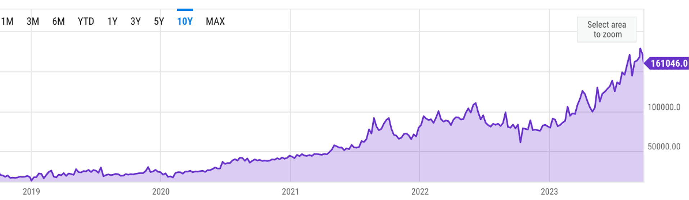
Ethereum Average Block Size

Slide 167
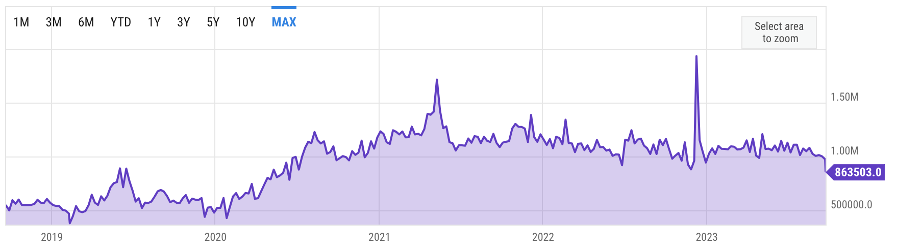
Ethereum Transactions Per Day

Slide 168
CXL Discussion
TODO: check Emmett’s presentation!

Slide 169
CXL Performance

Slide 170
PM is not commercially available anymore

Slide 171
Lattice Dependency Tracking

Slide 172
Cascades Notification Mechanism

Slide 173
Consistency Levels: Cheat Sheet

Slide 174
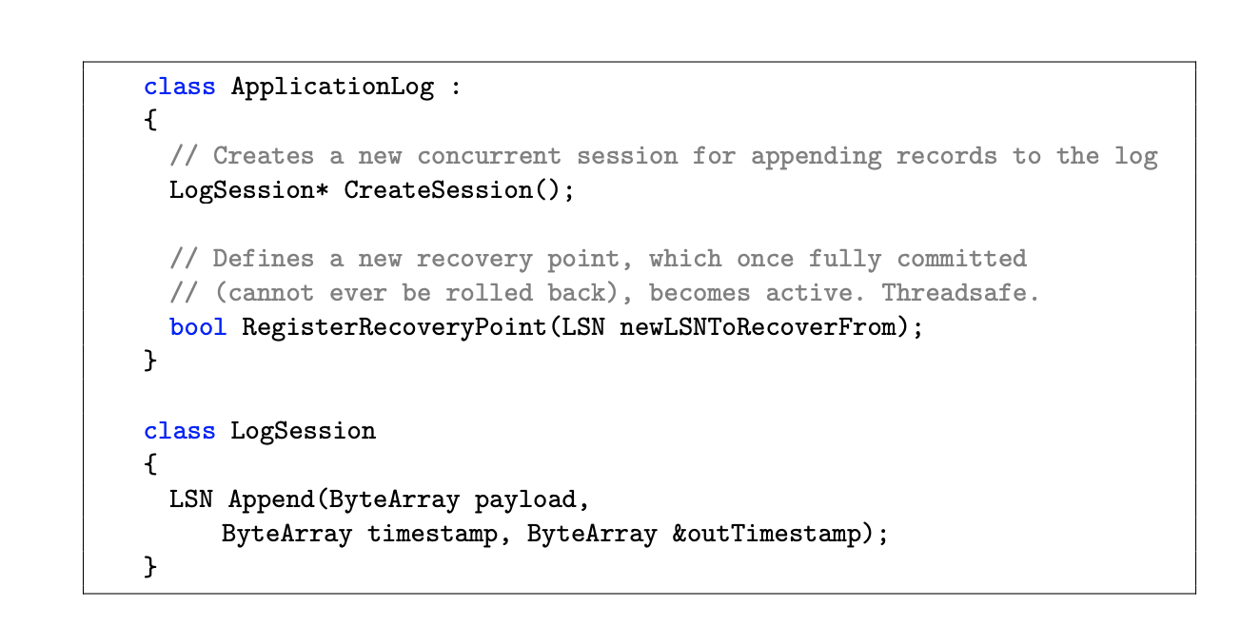
Lattice and RecoverableLogs API

Slide 175
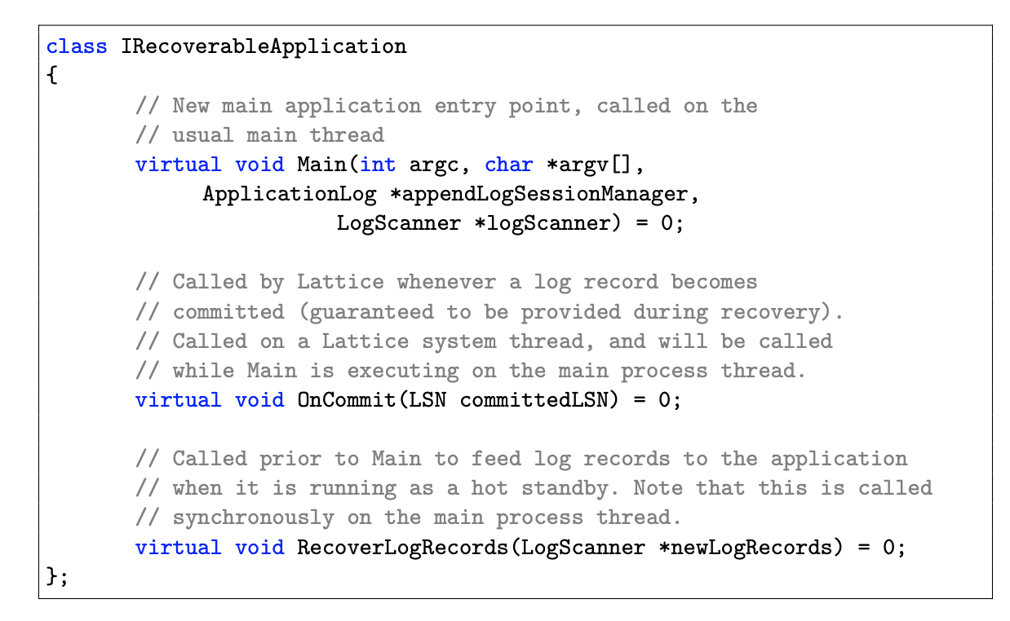
Cascades with Lattice

Slide 176
Early Lock Release and Asynchronous Durability
Tx1
Tx2
ABORT TX2
ABORT TX2
ABORT TX2
P1 [ TX2 ] YES
COMMIT TX1
P1 [ TX2 ] YES
COMMIT TX1
P1 [ TX2 ] NO
COMMIT TX1

Slide 177
Modern Hardware and Innovations
Applications
Media | DRAM (1x) | SSD | PM | Network
Latency | 80 ns |  | 2x ↑ | 25x ↑
Bandwidth | > 100 GB/s |  | 3x ↓ | 8x ↓
Media | DRAM (1x) | SSD | PM | Network
Latency | 80 ns | 500x ↑ | 2x ↑ | 25x ↑
Bandwidth | > 100 GB/s | 20x ↓ | 3x ↓ | 8x ↓
Media | DRAM (1x) | SSD | PM | Network
Latency |  |  | 2x ↑ | 25x ↑
Bandwidth |  |  | 3x ↓ | 8x ↓
Hardware
Notes:
These two innovations significantly improve the landscape of available resources:
While, on one end, we have the volatile DRAM that supports low latency and high bandwidth,
On the other, we have the durable SSD’s that have much higher latency and lower bandwidth!
-------
we compare the performance of these emerging hardware against the latency and bandwidth of DRAM and SSD

Slide 178
Modern Hardware and Innovations
Applications
Media | DRAM (1x) | SSD | PM | Network
Latency | 80 ns | 500x ↑ | 2x ↑ | 25x ↑
Bandwidth | > 100 GB/s | 20x ↓ | 3x ↓ | 8x ↓
Media | DRAM (1x) | SSD | PM | Network
Latency | 80 ns | 500x ↑ | 2x ↑ | 25x ↑
Bandwidth | > 100 GB/s | 20x ↓ | 3x ↓ | 8x ↓
Hardware
1. Persistent Memory (PM) fills the gap between DRAM and SSDs
Notes:
First, Persistent Memory that fills this gap between DRAM and SSDs.
Intel's Optane DC Persistent Memory offers durability
- at DRAM-comparable low latencies and at much higher bandwidth than SSDs

Slide 179
Modern Hardware and Innovations
Applications
Media | DRAM (1x) | SSD | PM | Network
Latency | 80 ns | 500x ↑ | 2x ↑ | 25x ↑
Bandwidth | > 100 GB/s | 20x ↓ | 3x ↓ | 8x ↓
Media | DRAM (1x) | SSD | PM | Network
Latency | 80 ns | 500x ↑ | 2x ↑ | 25x ↑
Bandwidth | > 100 GB/s | 20x ↓ | 3x ↓ | 8x ↓
Hardware
1. Persistent Memory (PM) fills the gap between DRAM and SSDs
2. Networks are faster than NVMe SSDs
Notes:
Next, with low-latency networks,
network communication within a datacenter is much faster and than reading and writing to NVMe SSDs

Slide 180
Modern Hardware and Innovations
Applications
Media | DRAM (1x) | SSD | PM | Network
Latency | 80 ns | 500x ↑ | 2x ↑ | 25x ↑
Bandwidth | > 100 GB/s | 20x ↓ | 3x ↓ | 8x ↓
Hardware
1. Persistent Memory (PM) fills the gap between DRAM and SSDs
2. Networks are faster than NVMe SSDs
Modern hardware calls for systems that can effectively utilize available resources
Notes:
Such modern hardware requires systems that can effectively utilize available available resources.

Slide 181
Lattice
Log records mark the progress of the commit path
Deconstruct logging into:
Durable: May be rolled back during recovery
Recoverable: Will never be rolled back

Slide 182
Coupling Updates to track Dependencies
P1 [ TX2 ] NO
COMMIT TX1
P1 [ TX2 ] YES
P1 [ TX2 ] YES
P1 [ TX2 ] NO
COMMIT TX1
P1
P2
P1
P2

Slide 183
Decoupling In-Memory and On-Disk Updates
Tx1
Tx2
ABORT TX2
P1 [ TX2 ] YES
COMMIT TX1
ABORT TX2
ABORT TX2
COMMIT TX3
COMMIT TX1
P1 [ TX2 ] NO
COMMIT TX1
P1 [ TX2 ] YES
COMMIT TX3
COMMIT TX3
Notes:
First, Cascades decouples updates and allows in-memory updates to complete even if the disk updates are not rescoverable.
Therefore, severs speculative on the recoverability of log records and continue processing more transactions.

Slide 184
Asynchronous Durability and Early Lock Release
Tx1
Tx2
ABORT TX2
COMMIT TX3
ABORT TX2
P1 [ TX2 ] YES
COMMIT TX1
COMMIT TX1
P1 [ TX2 ] YES
COMMIT TX3
ABORT TX2
COMMIT TX3
ABORT TX2
COMMIT TX3
COMMIT TX3
ABORT TX2
ABORT TX2
COMMIT TX1
P1 [ TX2 ] NO
COMMIT TX1
COMMIT TX1
P1 [ TX2 ] NO
COMMIT TX1
COMMIT TX3
COMMIT TX3
P1 [ TX2 ] YES
COMMIT TX3
COMMIT TX3
P1 [ TX2 ] YES
Notes:
After decoupling, although the log records are being written lo recovery logs asynchronously,
Sever release the locks early and make the updates visible to database servers.

Slide 185

Asynchronous Durability and Early Lock Release
Tx1
Tx2
P1 [ TX2 ] YES
ABORT TX2
P1 [ TX2 ] YES
ABORT TX2
P1 [ TX2 ] NO
P1 [ TX2 ] YES
P1 [ TX2 ] NO
P1 [ TX2 ] YES

