Slide 1
MSRI, Celebration of Mind, October 15, 2017
2-Manifold Sculptures &
Surface Classification
Carlo H. Séquin
EECS Computer Science Division
University of California, Berkeley
Notes:
This is a very mathematical title … and possibly quite scary !
Let me give you the more gentle subtitle …

Slide 2
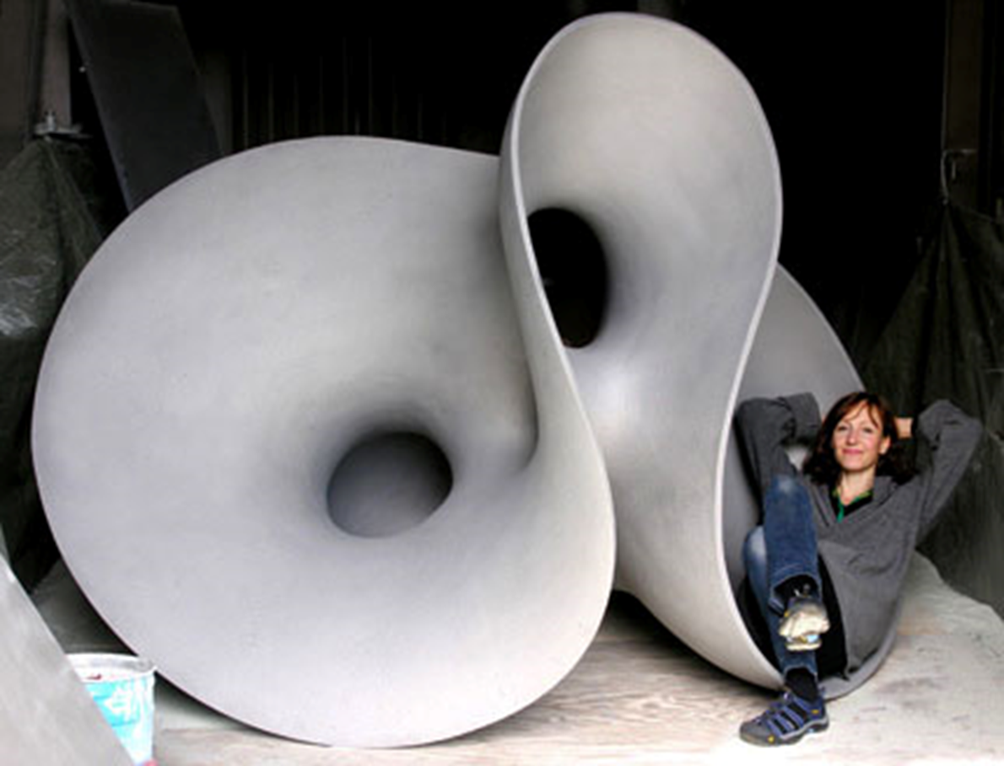
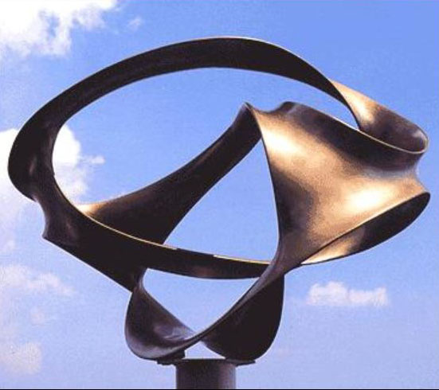
How mathematicians may look at sculptures by Eva Hild and by Charles Perry
2-Manifold Sculptures &
Surface Classification
Notes:
->> “How mathematicians my look at sculptures by Eva Hild and Charles Perry.”
So there is nothing to be afraid of …
-- But why would I take such a mathematical perspective ?? – A little bit about my background …

Slide 3
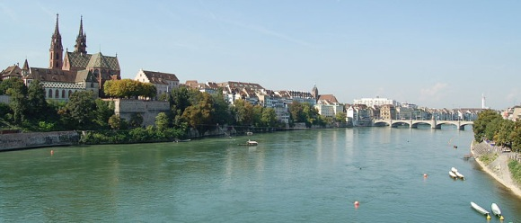
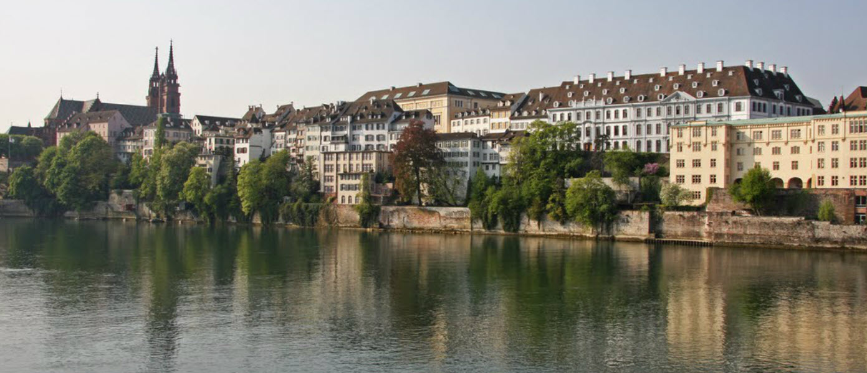
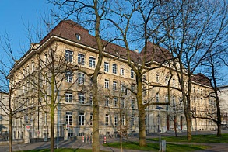
Basel, Switzerland
M N G
Notes:
I grew up in Basel, CH,
>>> where I attended the Mathematisch Naturwissenschaftliche Gymnasium (M N G) (a high school with emphasis in math and science).
>>> During my University years, I heard my math lectures in this 500 year old institute, where many famous mathematicians have lectured: . . .

Slide 4
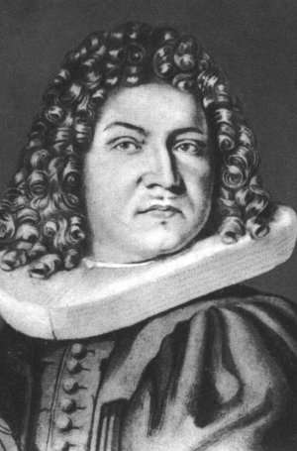
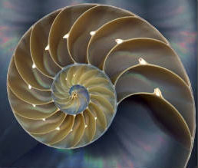
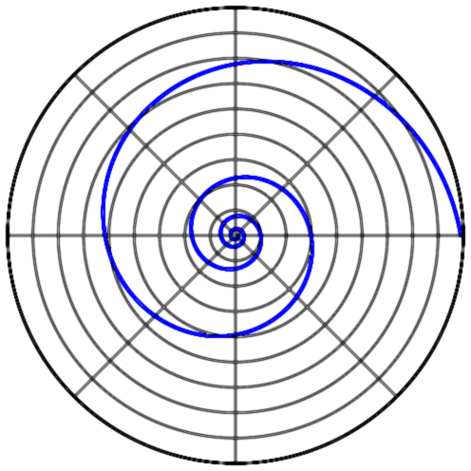
Jakob Bernoulli (1654‒1705)
Logarithmic Spiral
Notes:
such as Jakob Bernoulli, or . . .

Slide 5
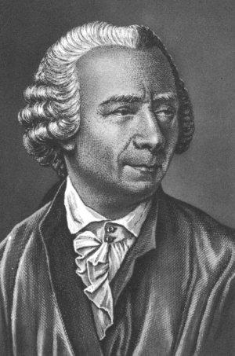
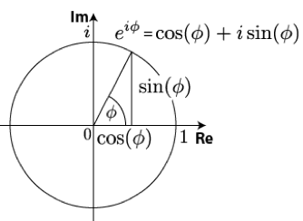
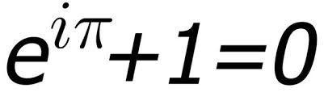
Leonhard Euler (1707‒1783)
Imaginary Numbers
Notes:
… or Leonhard Euler.
From an early age on, I was fascinated with numbers …

Slide 6
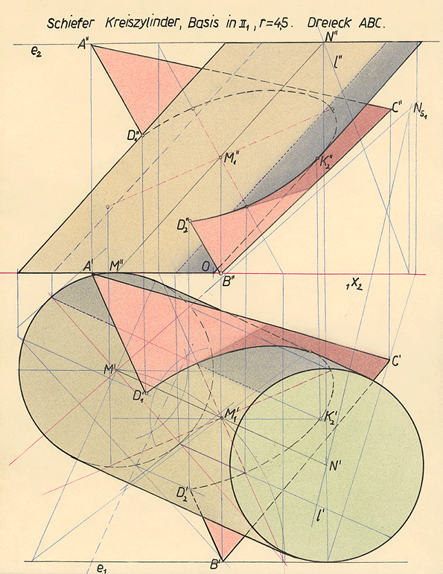
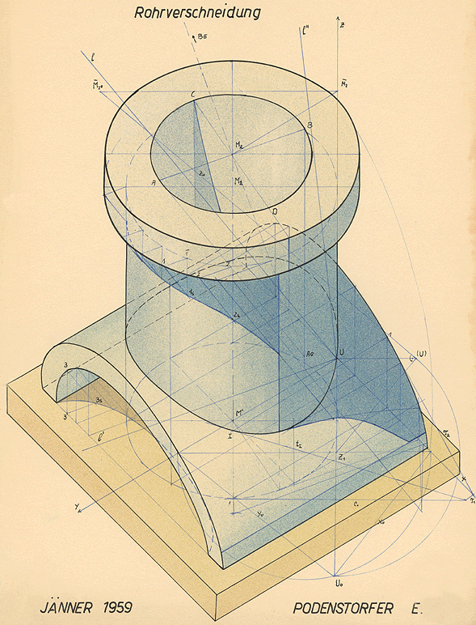
Descriptive Geometry
Notes:
and during high-school I fell in love with geometry.
In 11th grade we had a subject called Descriptive Geometry, where we constructed the intersection lines between two cylinders. -- I thought that this was very cool stuff!
Geometry has been in my blood stream ever since!

Slide 7

“Hollow” by Eva Hild, Varberg, 2006
Notes:
So here again is one of these surface sculptures that I am trying to understand.
Eva lives in Sweden and creates such beautiful, flowing surfaces with intricate connectivity.
I never met her personally; but I became aware of her work on the Internet.

Slide 8
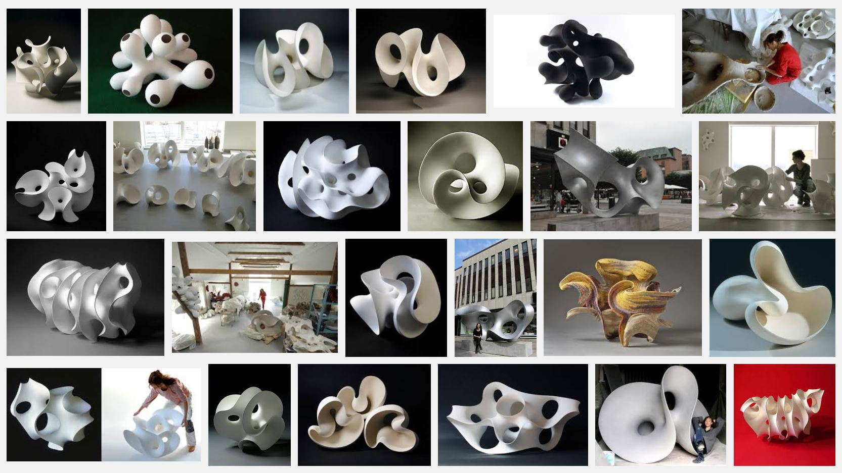
Eva Hild
An large collection of ceramic creations & metal sculptures
Notes:
Her web-site shows a large and highly varied collection of such surface sculptures. Most of them are in ceramic; some of them in metal. Her sculptures are not only a pleasure to look at, but they raise questions such as: How many tunnels are there? How many separate rims are there? Is this a 1-sided or 2-sided surface? A mathematician’s perspective helps to understand what is going on.
Most of these sculptures can be seen as 2-manifolds.

Slide 9
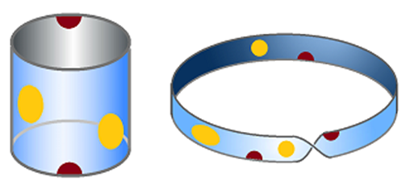
2-Manifolds
Structures made out of thin sheets of material,
e.g., paper, sheet metal, plastic …
Mathematicians abstract this to where we have
an infinitely thin sheet of math substance.
Every interior point has a disk-like neighborhood.
Every rim-point has a half-disk neighborhood.
Notes:
2-Manifolds are . . .
--- << Show a piece of cardboard; some sculpture model {Volution} … >>
Mathematicians abstract this . . .
To make this a true 2-manifold, every point in an interior region must have a disk-like neighborhood and every rim-point must have a half-disk neighborhood. (Structures like a book, where multiple pages hang from a joint spine are NOT 2-manifolds.
->> Now we want to do a topological analysis of such surfaces.

Slide 10
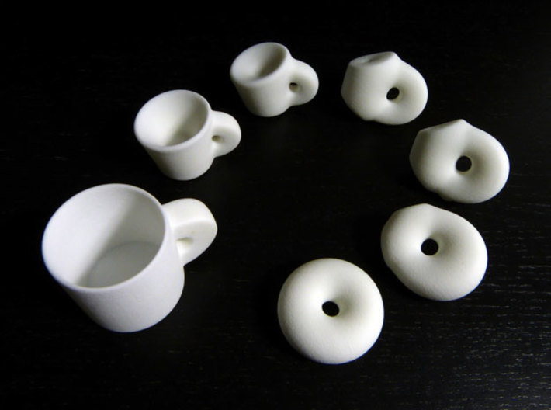
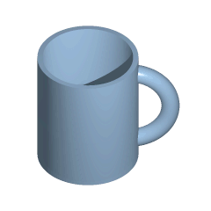
Topological Analysis
What is Topology?
A coffee mug and a donut are both
“handle-bodies of genus 1”
Geometry is NOT important – only connectivity!
Notes:
For that, we need to understand: What is topology ? -- As the joke goes:
For a topologist there is no difference between a coffee mug and a donut: they are both “handle-bodies of genus 1”
Topologists do not look at geometry; they only are concerned with connectivity.
For topologists shapes are infinitely stretchable and pliable.
Another joke is: Topology is the science that proves that you cannot take off your pants over your head.

Slide 11
Topological Analysis of 2-Manifolds
Surface Classification Theorem:
All 2-manifolds can be characterized by 3 parameters:
  Number of borders, B: # of 1D rim-lines;
  Orientability, S: single- / double- sided;
  Genus, G, or: Euler Characteristic, X,
  specifying “connectivity” . . .
Notes:
If we want to analyze surface sculptures, then the most important fact is the “Surface Classification Theorem.” It says: All 2-manifolds can be characterized by just 3 parameters:
The number of its borders, B: -- or 1D rim-lines; its orientability, S: whether the surface is single-sided or double-sided; and its connectivity, specified either by the Genus, G, or by the Euler Characteristic, X, -- Let’s understand these three characteristika . . .

Slide 12
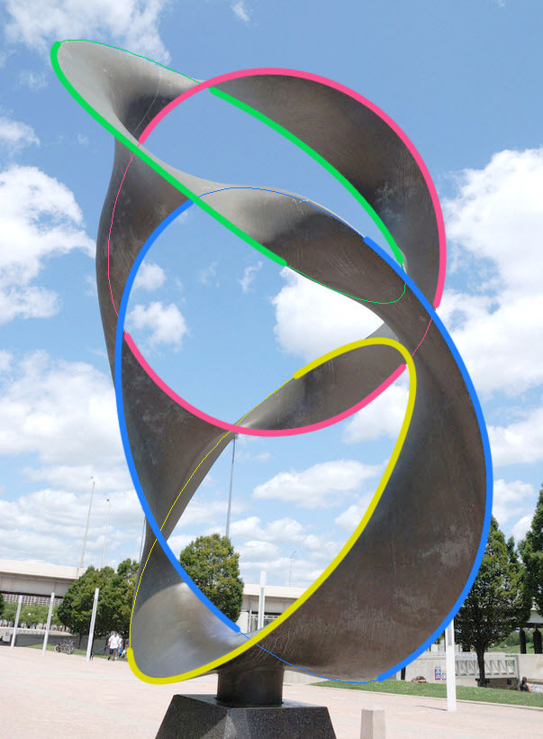
Determining the Number of Borders
Run along a rim-line
until you come back
to the starting point;
count the number of
separate loops.
Here, there are 4 borders:
Notes:
Here is a sculpture by Charles Perry.
Determining the number of borders is the easiest of the 3 tasks:
Run a finger along a rim-line until you come back to the starting point; count this as ONE border. Then count the number of separate loops. In this sculpture, there are 4 borders, marked by 4 different colors; they all happen to be circles.

Slide 13
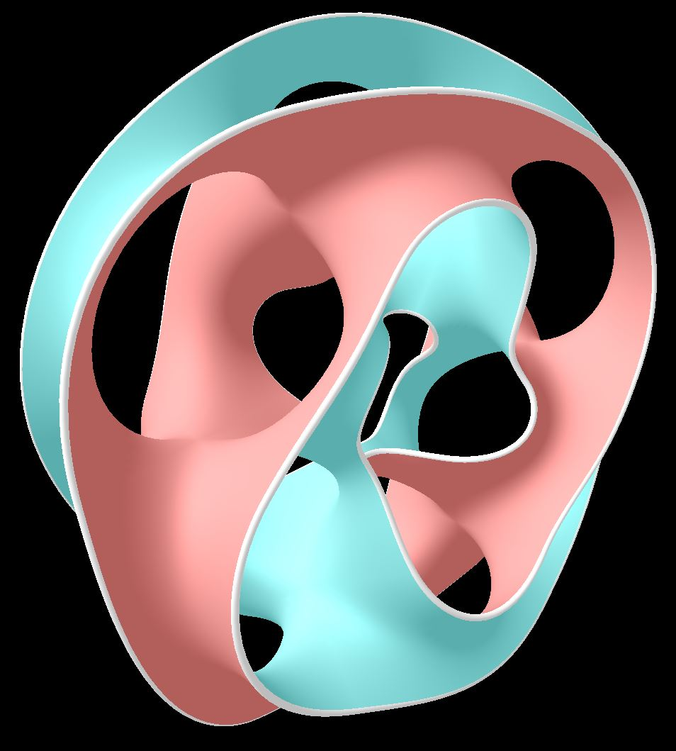
Determining the Surface Orientability
Flood-fill paint the surface
without stepping across rim.
If whole surface is painted,
it is a single-sided surface
(“non-orientable”).
If only half is painted,
it is a two-sided surface
(“orientable”).
The other side can then be painted a different color.
A double-sided surface
Notes:
One can determine the orientability of a surface by starting to flood-fill-paint the surface without ever stepping across the rim. If, in the end, all surface areas have been painted, then the surface is single-sided.
If only half of it got painted, and the rest of the surface can be painted with a different color, then the surface is double sided.
-- If something else happens, then the surface was not a proper 2-manifold in the first place.
A Moebius band is single-sided . . . << show >>

Slide 14
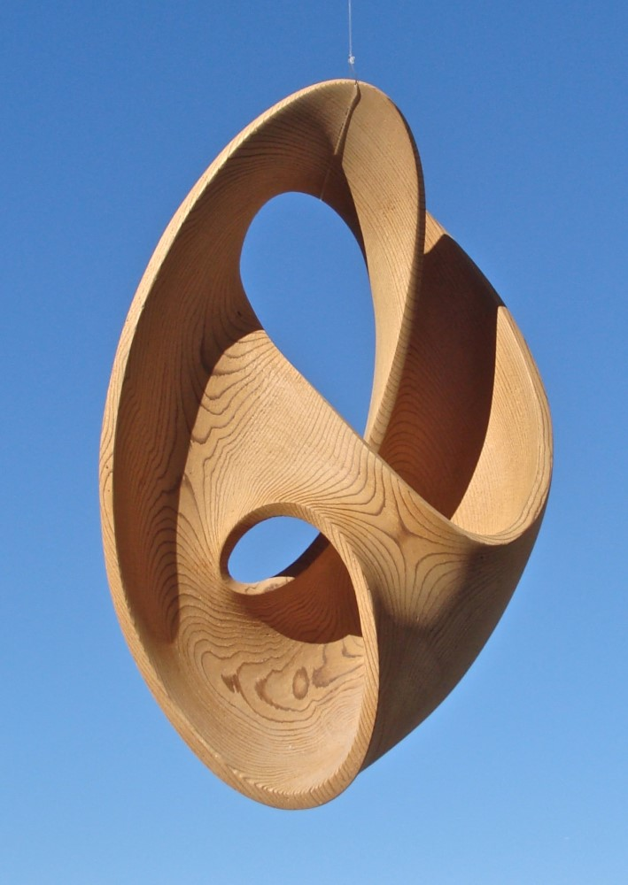
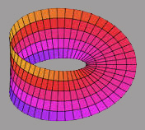
Determining Surface Orientability (2)
A shortcut:
If you can find a path to get
from “one side” to “the other” without stepping across a rim,
it is a single-sided surface.
-- like a
Möbius band:
Notes:
And so is this surface. Often there is a quick way to determine surface orientability:
If you can find a path to get from “one side” to “the same point on other side” without stepping across a rim, it is a single-sided surface. Flood-fill-painting this surface would cover everything with the first color applied.

Slide 15
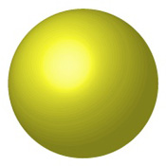
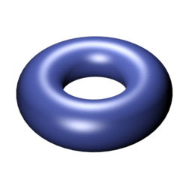
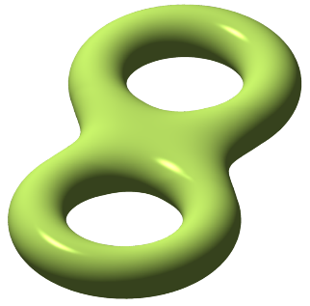
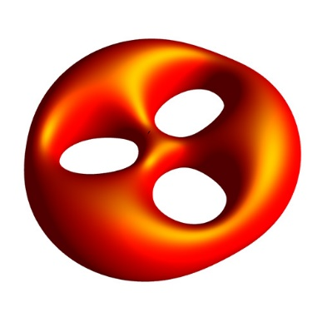
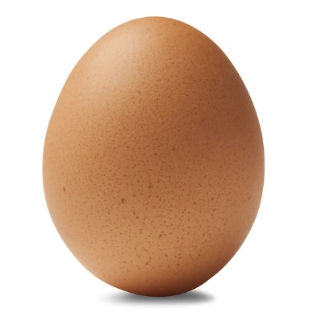
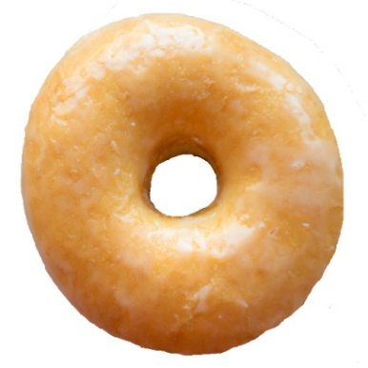
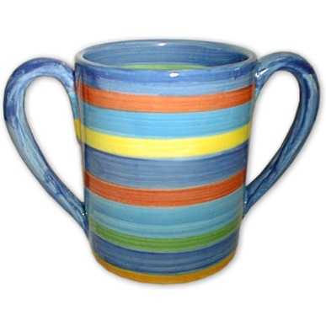
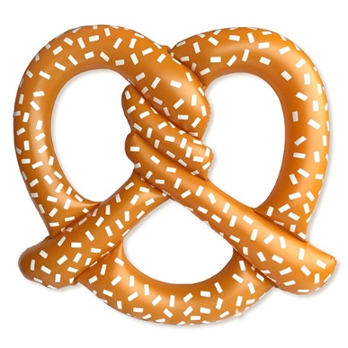
Connectivity of Closed Surfaces
Handle-Bodies: “blobby”, “tubular” shapes
genus 0 genus 1 genus 2 genus 3
genus:
The number of independent closed-loop cuts
that can be made on a surface, while leaving
all its pieces connected to one another.
Notes:
This leaves us with the 3rd characteristic: The connectivity of the surface.
Let’s first deal with some well-behaved surfaces, like the surface of a smooth physical object.
In the top row are some mathematical surfaces, like a sphere, a torus, a 2-hole torus and a 3-hole torus; and in the bottom row are some corresponding physical objects you may find at your breakfast table. The genus is defined as the number of independent, closed-loop cuts . . .
For these simple objects it is simply the number of tunnels going through a solid blob of material – or, alternately, the maximum number of handles or loops you could cut open without this object falling apart.

Slide 16
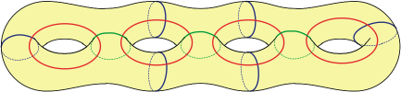
Finding the Genus of a Handle-Body
The number of independent closed-loop cuts
that can be made on a surface, while leaving
all its pieces connected to one another.
genus 4
b
c
c
c
c
a
a
b
b
b
a
a
Subsequent cuts must not intersect !
Some admissible combinations:
a a a a b b b b c c c c
Notes:
Here is a more complicated handle-body of genus 4. It has four tunnels. So you can cut up to four handles and still keep the result in one piece. In blue, green, and red, I show 3 possible combinations of 4 loop cuts that do not interfere with one another. But after any of these sets of four cuts have been made, we are done; any additional closed-loop cut would split the surface apart.

Slide 17
Finding the Genus of Open Surfaces
The number of independent closed-loop cuts
that can be made on a surface, while leaving
all its pieces connected to one another.
Surfaces with borders: E.g., (disks with punctures)
All are genus 0. Punctures do not affect the genus.
No closed-loop cut can be made without dividing the surface.
Punctures are different from tunnels; they have sharp rims.
A disk has genus 0; it is a “sphere” with one puncture.
Notes:
Now we look at the case of open surfaces with borders. I show a few disks with a varying number of punctures or holes. All of them have genus 0: The number of punctures does not change the genus.
Any closed loop would partition the surface – whether there are punctures present or not!
NOTE that: punctures are different from tunnels: they go from one side of the surface to the other and have sharp rims.
Also: REMEMBER: A disk is of genus zero. It can be seen as sphere with one puncture, the rim of which is then stretched out.

Slide 18
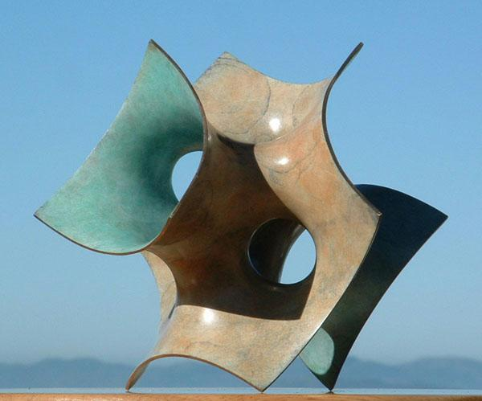
“Costa_in_Cube” Carlo Séquin, 2004, bronze
Number of borders B = 3
Double-sided (orientable)
But what is its genus ??
There is a combination of tunnels and punctures with borders.
Confused? – Use Euler Characteristic …
Notes:
Here is a 2-manifold sculpture … Trying to analyze it, we can easily find the # of borders (3) and see that it is double sided, because it has two different patinas on the two sides of this surface. But what is its genus?? How many tunnels are there? Or is this just a warped disk with some punctures?
Fortunately, there is another tool to analyze connectivity. It is called Euler Characteristic: …

Slide 19
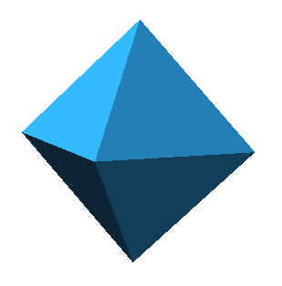
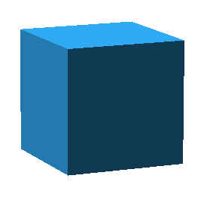
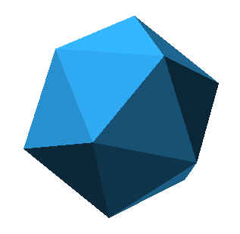
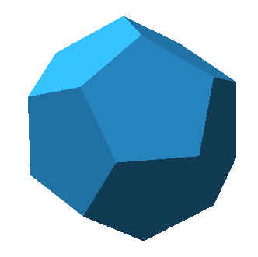

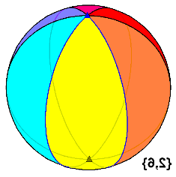
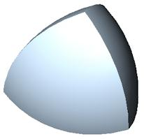
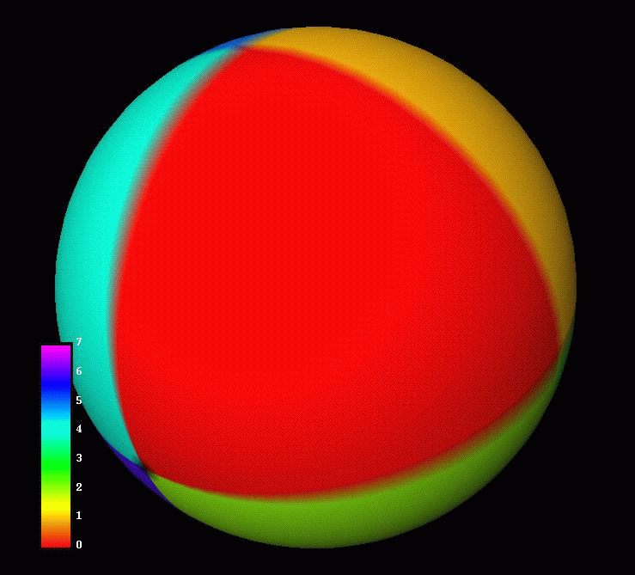
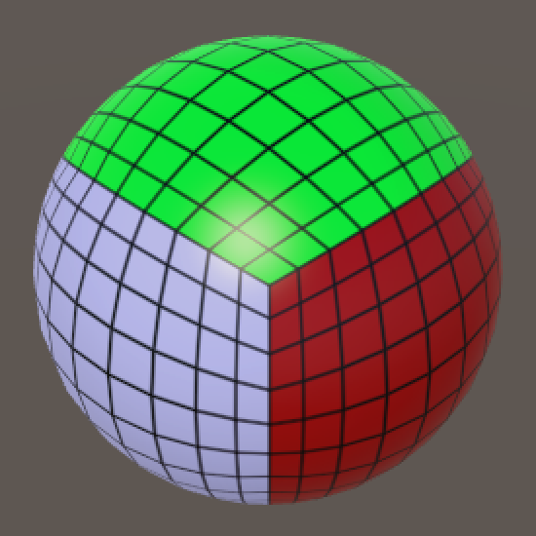
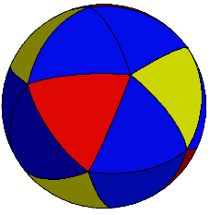
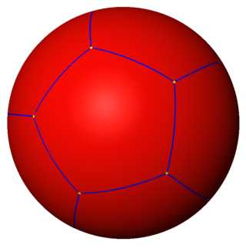
Euler Characteristic of Handle-Bodies
For polyhedral surfaces:
Euler Characteristic = X = V – E + F
Platonic Solids:
V: 4 6 8 12 20
-E: -6 -12 -12 -30 -30
F: 4 8 6 20 12
X: 2 2 2 2 2
➔ Genus = (2 – X – b) / 2 for double-sided surfaces.
Notes:
One way to find the E.C. is to draw a mesh onto the surface, and then apply the formula that E.C. is equal to # of V-E+F.
Here I show the calculations for the regular Platonic Solids. The result is always 2; because all of these are genus-zero surfaces with no borders.
We can also draw corresponding meshes onto a sphere or onto other smooth surfaces.
On the beach ball in the lower left, we have the same number of faces as there are edges. There are two vertices, the N-pole and the S-pole; so the E.C. is again just 2.
Then we apply the simple formula at the bottom to calculate the genus of the surface. For all objects on this slide, the result is genus = zero.

Slide 20
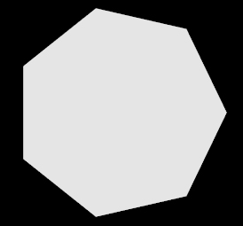
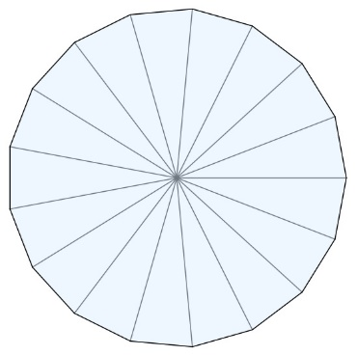
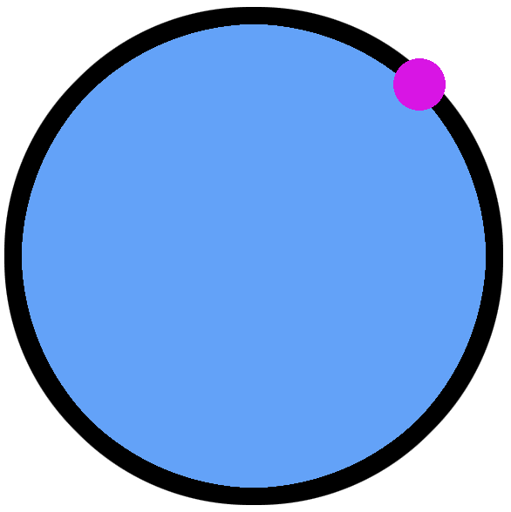
Determining the Euler Characteristic of Disks with Punctures & Borders
E=V; F=1 V+F=E+1 V=E=F=1 → Disk: X = 1
Closing the gap
eliminates 1 edge
and 2 vertices;
EC := EC −1
B := B +1
Genus unchanged
Disk
Genus = (2 – X – B) / 2 for double-sided surfaces.
Notes:
Let’s look at the Euler Characteristic for open surfaces with borders. The EC of a disk-like surface patch is 1. It does not matter how we subdivide this surface into a mesh, a simple n-gon, a set of pizza slices, or a circular rim with one vertex.
The crucial insight is that we can construct the EC incrementally as we deform a disk into a more complex surface with many punctures and borders.

Slide 21

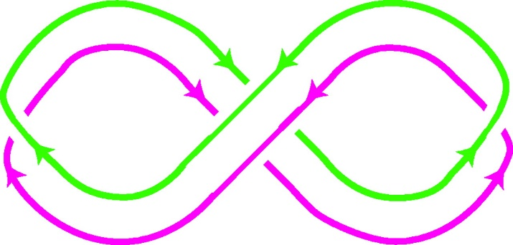
EC-Mathematics (3)
A ribbon is a “disk”; EC =1
Closing the ribbon into a loop yields EC = 1 − 1 = 0
Odd number of half-twists → 1-sided Möbius band
with 1 border;
genus = 1
Even number of half-twists → 2-sided annulus/cylinder
with 2 borders;
genus = 0
Genus = 2 – X – B for non-orientable surfaces;
Genus = (2 – X – B) / 2 for double-sided surfaces.
Notes:
Here is an example: A ribbon is just a disk. When we close it into a loop that EC gets reduced to 0. But depending how we close the ribbon with or without a twist we may get one or two borders. If we get just one border, it is a Moebius band and then the genus calculates to 1. If there is no twist or only full twists, then we get 2 borders and the surface remains 2-sided and the genus is zero.

Slide 22
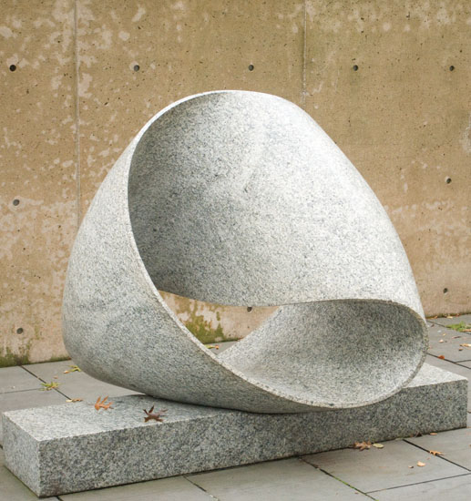
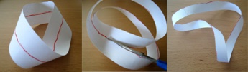
“Endless Ribbon”
Max Bill, 1953, stone
Single-sided (non-orientable)
Number of borders B = 1
E.C. X = 2 – 3 + 1 = 0
Genus G = 2 – X – b = 1
Independent cutting lines: 1
Notes:
Now we do this calculation on real sculpture: “Endless Ribbon” by Max Bill. This is a non-orientable Moebius-band; it has a single border. Its E.C. can be found most easily by laying a simple mesh on this surface, consisting of 2 vertices, 3 edges and a single rectangular, twisted face. It’s E.C. thus is 0, and from this we calculate a genus of 1.
And indeed there is one cut we can make on a Moebius band that keeps the surface still connected. You probably have seen this trick how a Moebius band can be cut down the middle, resulting in a double-sized, 2-sided loop with a full twist in it.

Slide 23
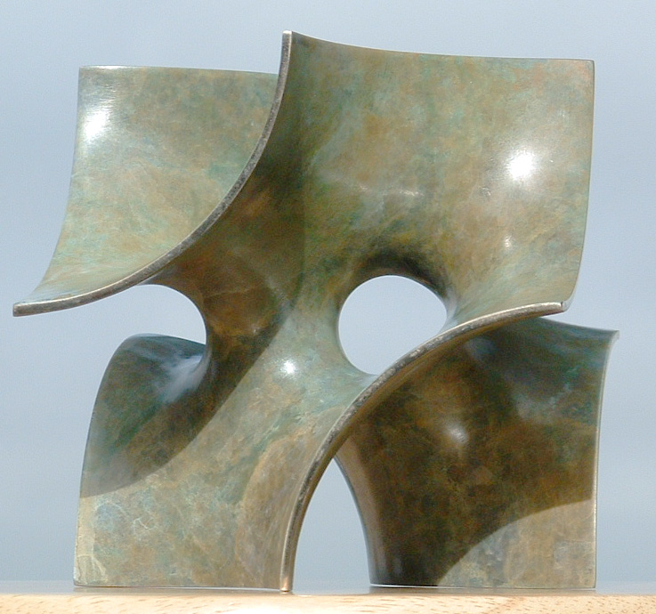
Volution_1
Carlo Séquin, 2003, Bronze
Double-sided (orientable)
Number of borders b = 1
Euler characteristic χ = –1
(2 cuts to produce a disk)
Genus g = (2 – χ – b)/2 = 1
Independent cutting lines: 1
Notes:
Here is one of my own small sculpture.
This surface is 2-sided and has a single border, consisting of 12 quarter-circle segments on a cube surface. It takes two cuts, shown in green to break the two tunnels and open this surface into a disk; so it’s E.C. is -1. From this we calculate its genus to be 1, and indeed we can find a closed cutting loop that still leaves the surface completely connected.

Slide 24
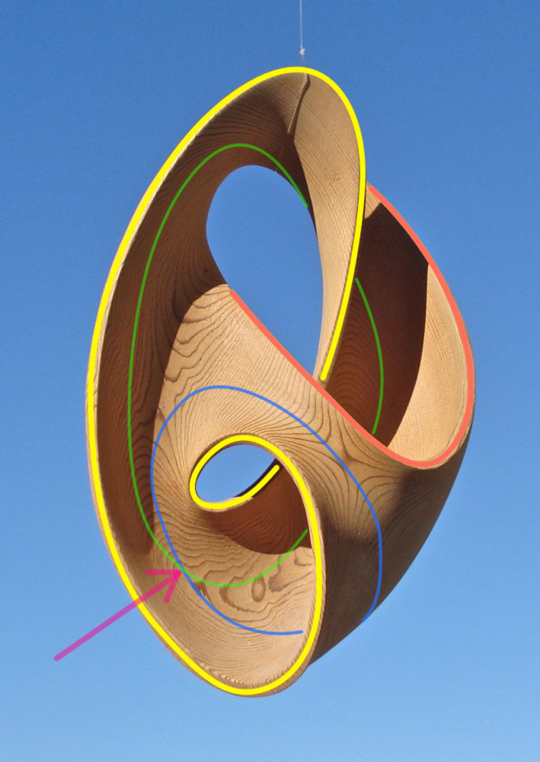
“Möbius Shell”
Brent Collins, 1993, wood
Single-sided (non-orientable)
Number of borders b = 2 (Y,R)
Euler characteristic χ = –1
Genus g = 2 – χ – b = 1
Independent cutting lines: 1
blue or green – but not both,
they would intersect!
Notes:
Brent Collins’ “Moebius Shell” is single-sided, but it has two borders (outlined in yellow and red). Its E.C. is -1, (2 cuts are required to break all the ribbon loops). And from this we calculate again a genus of 1.
>>> On this surface we can make ONE cut – either along the blue OR the green curve and keep the surface still connected – but not both! Since the two curves intersect each other, the second one would no longer be a closed loop.

Slide 25
Workshops on Surface Classification
Topology-Workshops in the Library:
1:30pm – 2:30pm and 3pm – 4pm
I will explain in detail:
Genus and Euler-Characteristics.
There will be plenty of little models
to practice surface classification.
Now just some “eye-candy”:
various sculpture pictures
(with their classifications) . . .
Notes:
You have seen the basic operation of surface classification. But this is not something you learn 20 minutes. If you are interested, I will give two one-hour workshops this afternoon, where we go over these steps again in more detail and with lots of little models to practice on.
Now for the next 5 minutes, I will just give you some eye-candy of several 2-manifold sculptures and show the result of the classification analysis.

Slide 26
“Tetra”, Waterfront Park, Louisville, KY
Charles Perry, 1999, bronze
Double-sided (orientable)
Number of borders B = 4
Euler characteristic X = –2
Genus G = (2 – G – B)/2 = 0
It is a sphere with 4 punctures.
There are no closed-loop cuts
that leave this sculpture connected !
Notes:
Here we come back to Perry’s “Tetra” sculpture. This surface is two-sided; it has 4 borders. It takes 3 cuts to break all the ribbon loops, so its EC is -2 and its genus is zero.
Being double-sided and of genus 0, means it is topologically equivalent to a sphere; and the fact that is has four borders means that the sphere has four punctures. On this surface there are no closed-loop cuts that leave this surface connected!

Slide 27
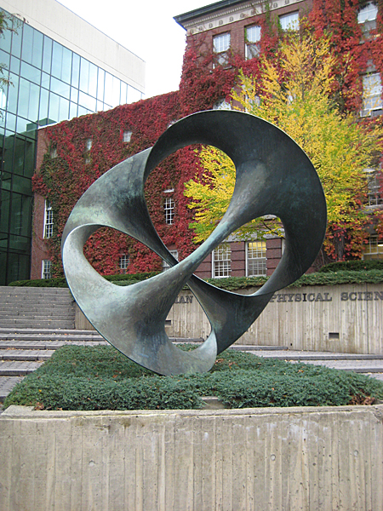
D2d, Dartmouth College, Hanover, NH
Charles Perry, 1975, bronze
Number of borders B = 4
Euler characteristic X = –2
Genus G = (2 – G – B)/2 = 0
It is a sphere with 4 punctures.
Notes:
This sculpture looks somewhat similar, and is topologically exactly the same: “D2d” referring to the overall symmetry of the this shape.
Here it might be easier to see that this is just a sphere with 4 large holes. To visualize this, push the front branch with the positive diagonal slope to the back, and pull the other diagonal branch to the front; and now you can see the 4 large holes, 2 in front and 2 in the back.

Slide 28


“Duality”, Pugh Residence, Greenwich, CT
Charles Perry, 1986, bronze
Double-sided (orientable)
Number of borders B = 2
Euler characteristic X = –2
Genus G = (2 – X – B)/2 = 1
It is a torus with 2 punctures.
There is one closed-loop cut
that leaves this sculpture connected !
Notes:
In this sculpture, the four 3-way junctions of the previous sculptures have been merged into two tightly coupled pairs. This surface is still double-sided; but now it has only 2 borders. So its genus is 1; thus it is a torus with two punctures!
>>> So, there must be one closed-loop cut that leaves this sculpture connected – It is indicated by the magenta line.

Slide 29


“Hyperbolic Hexagon”
Brent Collins, 1996, wood
Double-sided (orientable)
Number of borders B = 4
Euler characteristic X = –6
Genus G = (2 – X – B)/2 = 0
Notes:
Now let’s look at Brent Collins’ work. Here is his pioneering sculpture “Hyperbolic Hexagon” which started our collaboration 20 years ago.
It is clearly double-sided, as the coloring on the right shows.
You can see 3 borders outlined in yellow, and a 4th, triangular one lies in the back.
7 cuts are required to open up this surface into the topology of a simple disk, and this gives an E.C. of -6 and genus of 0.
Once again we have a sphere with 4 punctures.

Slide 30

“Heptoroid”
Collins & Séquin, 1997, wood
Single-sided (non-orientable)
Number of borders B = 1
Euler characteristic X = –21
Genus G = 2 – X – B = 22
Independent cutting lines: 22
Notes:
On the other hand, here is a sculpture of really high genus. Single-sidedness plays an important role, since we need not divide by 2 in the formula for the genus. Higher-order saddles also help, because they provide a lot of branches for added connectivity.
Here we have seven 4th-order saddles connected into a Scherk-Collins ring, and twisted in such a way that there is only a single border curve. And in this way we can indeed make a surface of genus 22 with a single puncture!

Slide 31


“Hollow” by Eva Hild, Varberg, (2006)
Double-sided (orientable)
Number of borders B = 1
Genus G = 2
2-hole torus with 1 puncture
Notes:
Now we come back to Hild’s sculpture: It is a double-sided surface with a single border. When you glue a suitably warped disk to this border, you obtain a simple two-hole torus. You can then see that this sculpture is a 2-hole torus with a single puncture.

Slide 32



“Whole” by Eva Hild
Hild sculpture my CAD model
2-sided, 1 border, genus 2
Notes:
Here is another sculpture by Eva Hild and my CAD model on the right. My model is highly symmetrical and thus looks somewhat rigid. Hild’s sculptures are more “organic” free-form. They are deliberately kept slightly asymmetrical.

Slide 33

“Wolly” by Eva Hild
Notes:
One of Hild’s more complex and more convoluted, free-form sculptures.

Slide 34



Topology of “Wholly”
2-sided, single border, genus 4
Notes:
To figure out the topology and connectivity of the given surface, I have made the simple model at the bottom. This is an orientable surface of genus 4 with a single border.

Slide 35

Eva Hild: Snow Sculpture (2011)
Eva Hild
Notes:
Eva also did a marvelous 12 foot tall snow sculpture at the annual snow-sculpting competition in Breckenridge, CO.

Slide 36


Eva Hild: Snow Sculpture (2011)
2-Sided
1 Border
Genus 3
Eva Hild
Notes:
My analysis of this snow sculpture shows that it is 2-sided; has a single border, and is of genus 3.

Slide 37
Are all Hild Sculptures TWO-sided?
Can we construct single-sided sculptures
that resemble Eva Hild’s creations ?
Notes:
In my analysis of Eva Hild’s sculptures, I found only TWO-sided surfaces!
Is it possible to make a single sided sculpture that looks like it might have come out of Eva Hild’s studio?

Slide 38



Orientability
Cooling tower
Möbius band
Hild: “Interruption”
Klein bottle
2-sided, 1-sided,
orientable non-orientable
Notes:
Here is a quick reminder what orientable and non-orientable surfaces may look like.
Cylinders and “cooling towers” are orientable and have distinct insides and outsides; but the Moebius band on the right is single-sided. Hild’s “Interruption” is clearly 2-sided, as shown by the red and blue paint. A Klein bottle on the other hand is single-sided.

Slide 39




Tunnels and Tongues
A
B
C
D
“Tongues” form paths from inside to outside of a “cooling tower”
Notes:
Hild uses lots of funnel shapes. So, one way of creating a single-sided surface is to take 3 tunnels or cooling towers, and use a tongue to connect the top of one to the bottom of the next one in a cyclical fashion.
The minimal variant of this approach is a single tower with a helical tongue connecting the top rim to the bottom rim. I tried a few different geometries, changing the length, width, and steepness of that ribbon as shown in B, C, and D. The last on is my favorite; I think this one would feel quite at home in Hild’s collection.

Slide 40





Loops “Dyck-Disks” (double funnels)
3, 5, 7 Dyck disks in a cycle
Notes:
Another approach starts with a double funnel, called a “Dyck disk” (top left) and connects the two stubs with a toroidal loop (top right). However, such a toroidal handle is not a typical feature in Hild’s artwork. We can get rid of it by placing 3 or more Dyck disks into a closed loop. Any such loop formed with an odd number of disks will result in a single-sided manifold; the bottom row shows loops with 3, 5, and 7 such disks.
However, Eva Hild would not like such strict regularity!

Slide 41

Final Take: “Pentagonal Dyck Cycle”
Art Gallery, 2017 Bridges Conference in Waterloo
Notes:
So, lets make all Dyck disks of somewhat different sizes and close the loop with an additional blob as found in Eva’s sculpture “Hollow.”
And here you see the result of this “Pentagonal Dyck Cycle”.
It was exhibited in the nominees’ art gallery at the 2017 Bridges conference in Waterloo.

Slide 42
Conclusions
Topology is fun!
It is quite intriguing to find these relationships
between very different-looking sculptures.
Surface classification yields a deeper understanding,
and helps to retain a mental image of a sculpture.
The beauty of a sculpture does not primarily come
from its topology, but from its geometry.
That is why we need artists like Charles Perry
and Eva Hild who can cast a particular topology
into a beautiful geometry.
Notes:
Topology is fun! I find it intriguing to see these relationships between different looking sculptures.
Applying surface classification yields a deeper understanding of a sculpture and helps to retain a mental image of it.
However -- The beauty of a sculpture does not primarily come from its topology, but from its geometry.
That is why we need artists like Charles Perry and Eva Hild who can cast a particular topology into a beautiful geometry.

Slide 43
Workshops on Surface Classification
Topology-Workshops in the Library:
1:30pm – 2:30pm & 3pm – 3:50pm
I will explain in detail:
Genus and Euler-Characteristics.
There will be plenty of little models
to practice surface classification.
http://people.eecs.berkeley.edu/~sequin/TALKS/2017_MSRI_CoM.pptx
Notes:
If you want to hear more about the topology of surfaces, come to the Library.
I hope to see some of you there …
At the bottom you can see, where you can find the slides that I just presented.
Questions??

