Slide 1
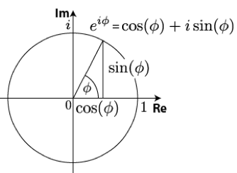
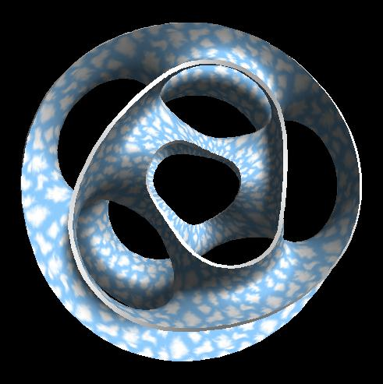
USF, October 2016
Connecting Art and Mathematics
Carlo H. Séquin
University of California, Berkeley
Notes:
title of my presentation today:

Slide 2
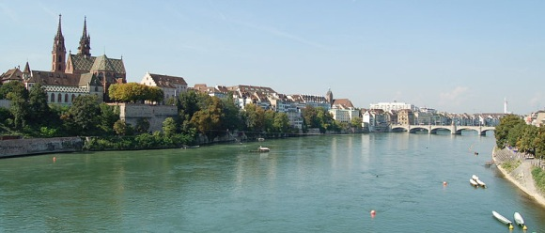
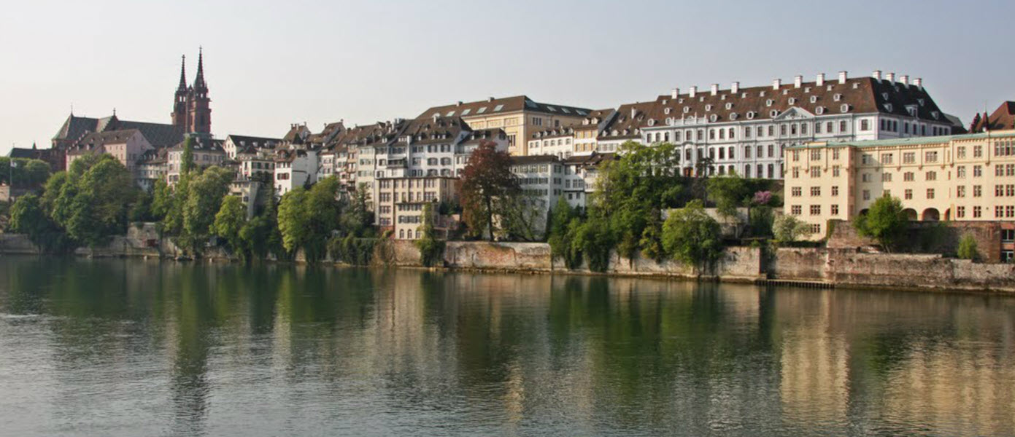
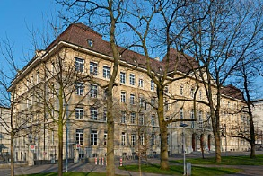
Basel, Switzerland
M N G
Notes:
I grew up in Basel, CH,
>>> where I attended the M N G (a high school with emphasis in math and science).
>>> During my university years I heard my math lectures in this 500 year old institute, where many famous mathematicians have lectured:

Slide 3
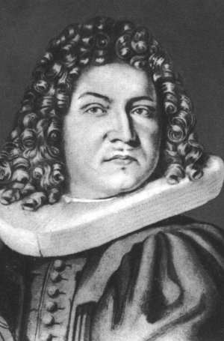
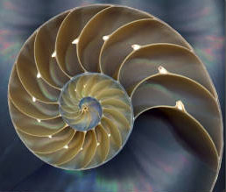
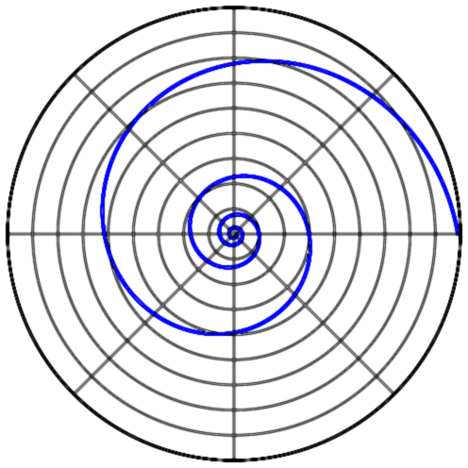
Jakob Bernoulli (1654‒1705)
Logarithmic Spiral
Notes:
such as Jakob Bernoulli, or . . .

Slide 4
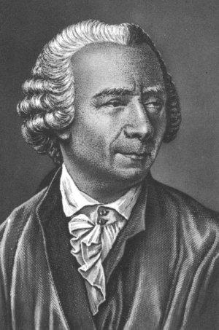
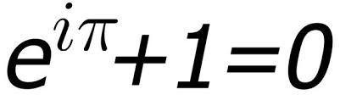
Leonhard Euler (1707‒1783)
Imaginary Numbers
Notes:
… or Leonhard Euler.
From an early age on I was fascinated with numbers …

Slide 5
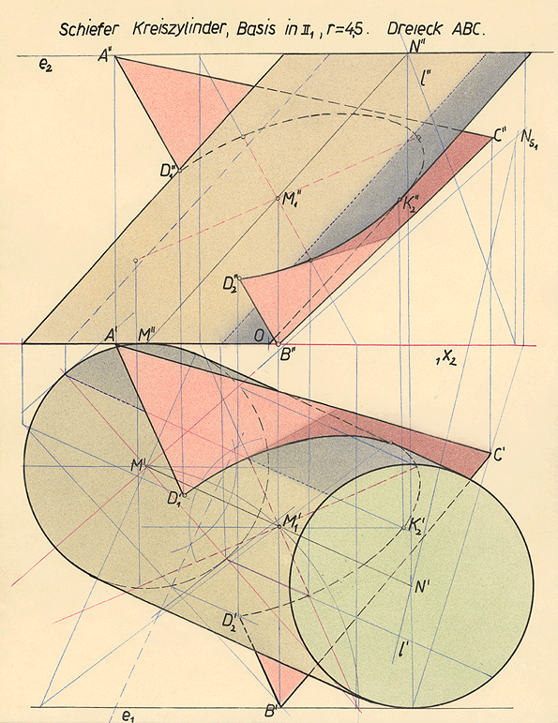
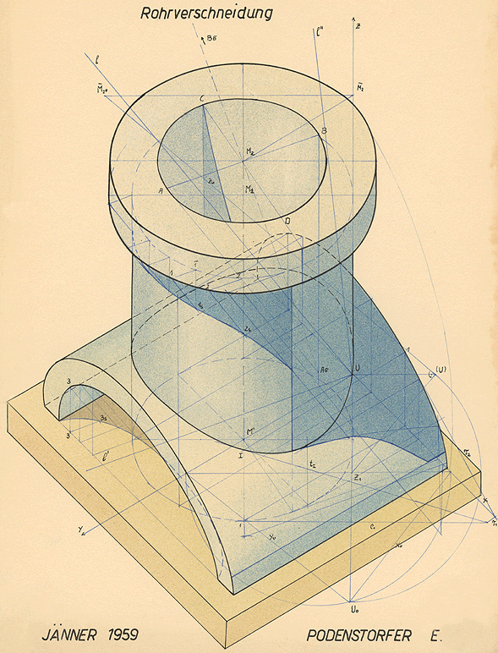
Descriptive Geometry
Notes:
and during high-school I fell in love with geometry.
In 11th grade we had a subject called Descriptive Geometry, where we constructed the intersection lines between two cylinders. -- I thought that this was very cool stuff!
===
By the end of high-school my focus was on Geometry and Physics, in particular Optics, which has a lot to do with geometry! -- So I majored in Experimental Physics.

Slide 6
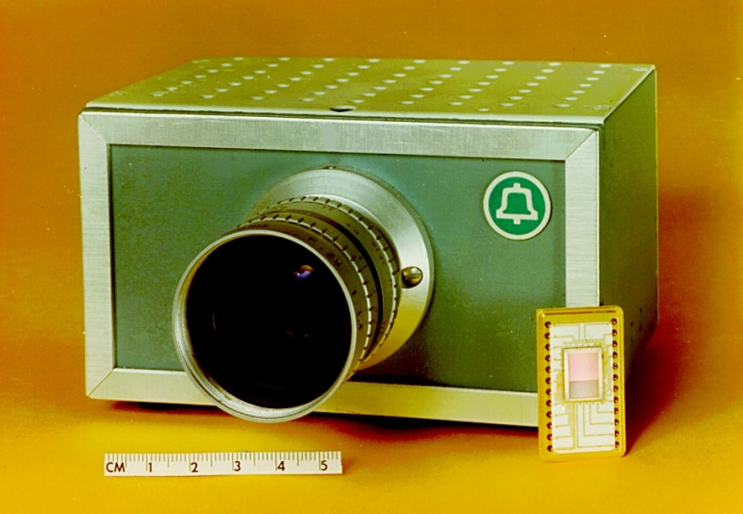
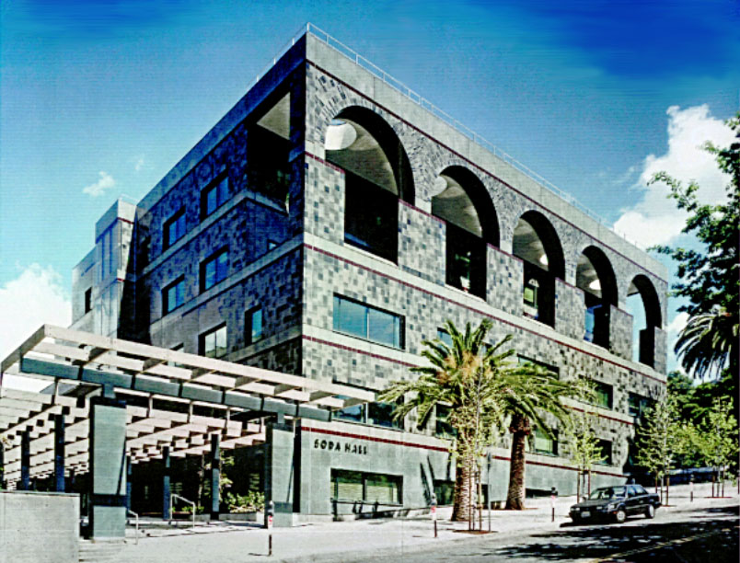
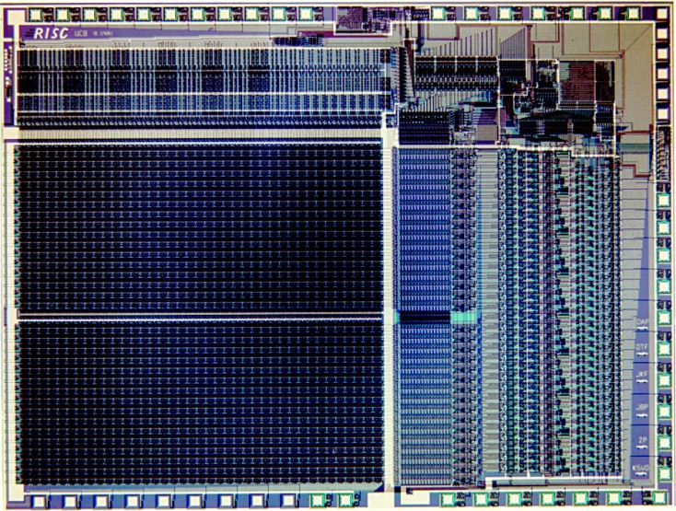
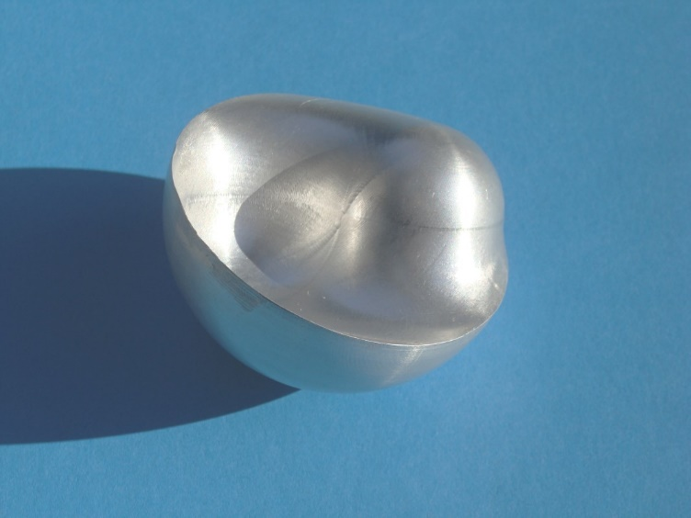
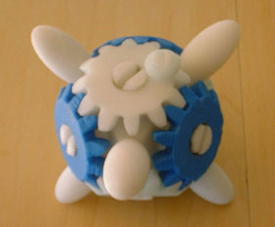
Geometry in every assignment . . .
CCD TV Camera (1973) Soda Hall (1992)
RISC 1 MicroChip (1982) 3D-Yin-Yang (2000)
Notes:
And I love to design and build things!
During the last 40 years, I have been fortunate to be associated with many challenging design projects that involved nifty geometry problems, such as . . .
>>> More recently: I have started to work with artists and with mathematicians.

Slide 7
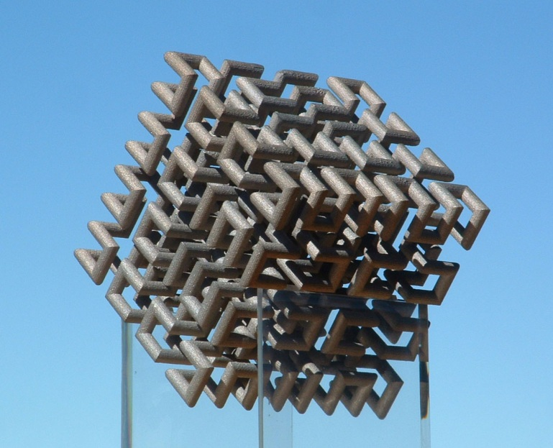
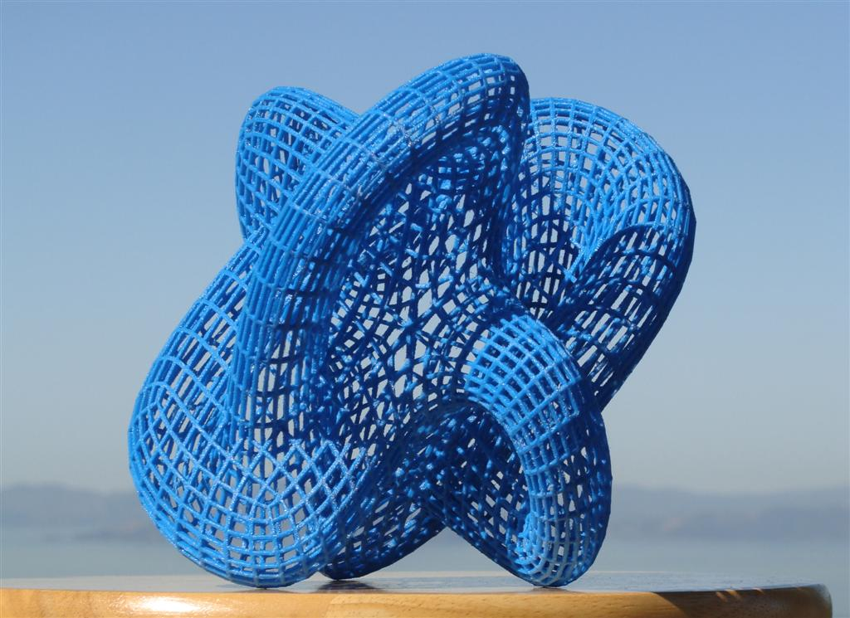
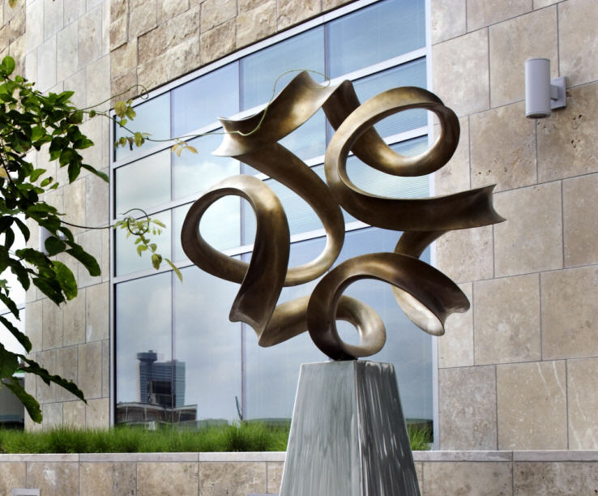
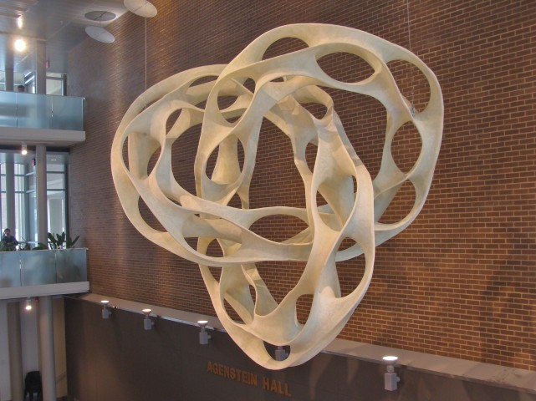
Recent Designs and Models
Notes:
The results are some mathematical visualization models and a few large sculptures which will be the focus of my presentation today.
…
Top-left is a 3D Hilbert cube with 512 “elbows”. Top right is a special Klein bottle which I will explain later. And I could do all these fun things while teaching my regular classes and often integrate some of the necessary design work with some of the classes I taught. I consider this to be a very fortunate situation.
The two sculptures at the bottom came out of my collaboration with Brent Collins…

Slide 8
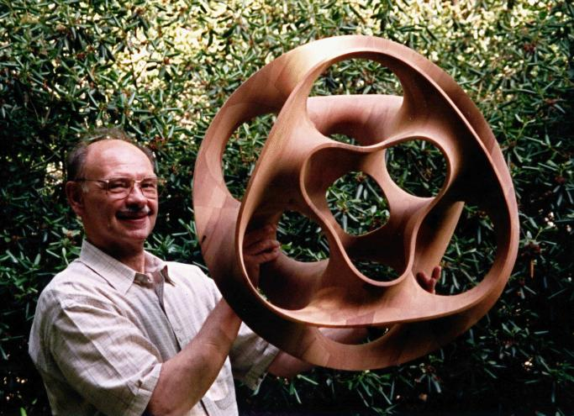
Brent Collins (1997)
“Hyperbolic Hexagon II”
Notes:
Much of this happened after I had started to collaborate with Brent Collins in 1994.
Brent is a wood sculptor, living on Gower MO, out in nowhere, about half an hour north of Kansas City.
Here you can see him holding up Hyperbolic Hexagon II – our very first collaborative piece.

Slide 9
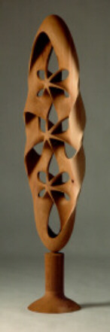
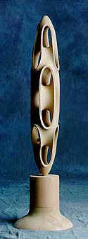
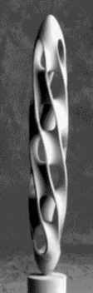
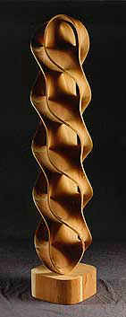
Brent Collins: Stacked Saddles
All photos by Phillip Geller
Notes:
Brent Collins has no mathematical training. He does not use computers; he works with rulers and compasses and with his exceptional sense for beautiful 3D shapes.
These are the kinds of sculptures that he had created a few years before we got in contact.
A characteristic of all of these totem poles is an intricate composition of tunnels and saddles.

Slide 10
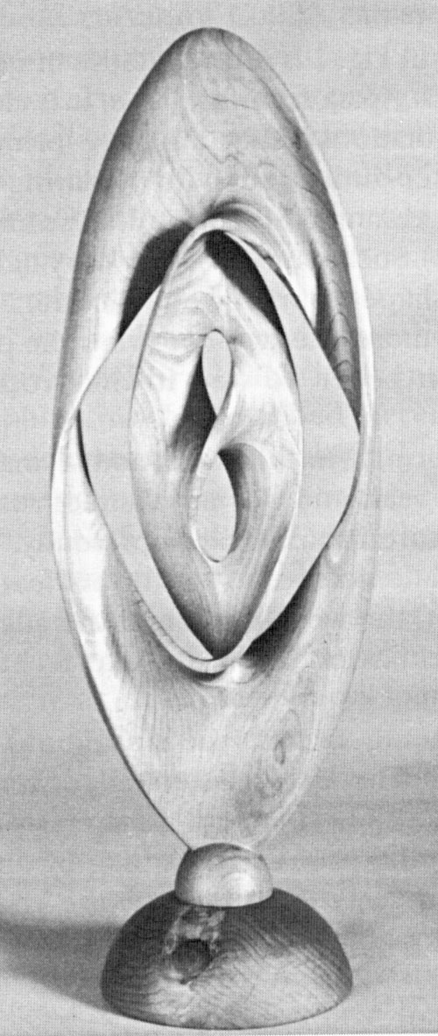
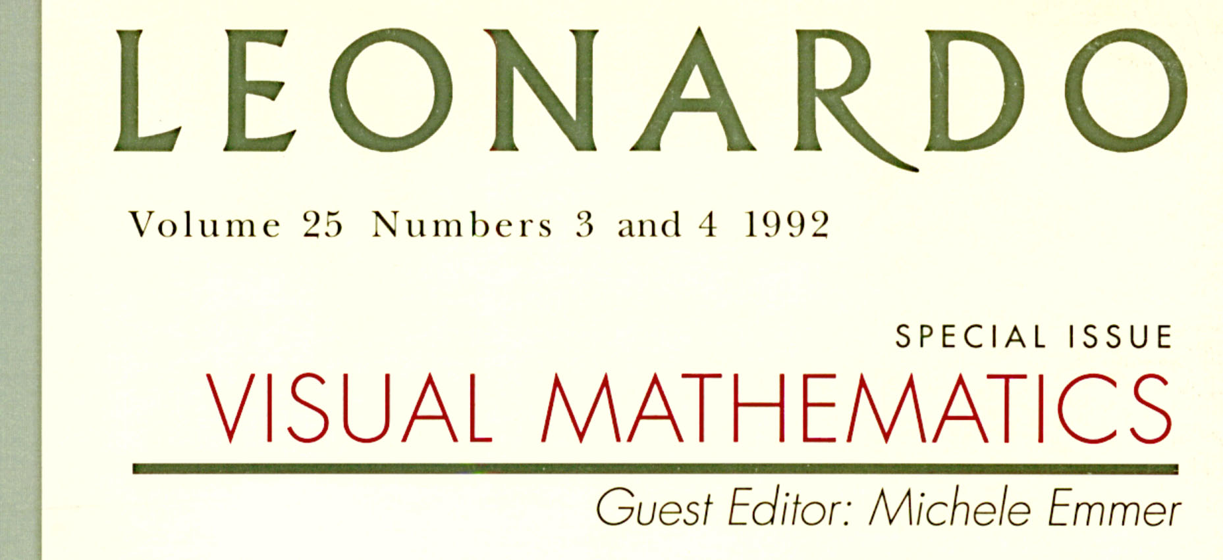
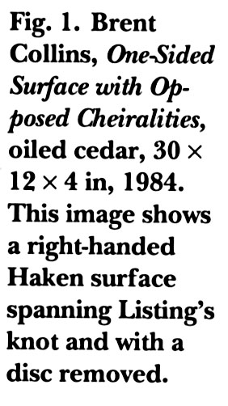
Leonardo -- Special Issue (1992)
On Knot-Spanning Surfaces: An Illustrated Essay on Topological Art
With an Artist’s Statement by Brent Collins
George K. Francis
with Brent Collins
Notes:
This article in a special issue of Leonardo in 1992 made me first aware of the existence of Brent Collins.
George Francis is a mathematics professor at the University of Illinois. In this article he points out that many of the shapes that Brent creates are closely related to minimal surfaces – the shapes that soap films assume when they are suspended in a wire frame.

Slide 11
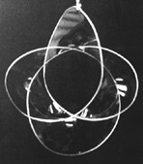
The Math in Collins’ Sculptures
Collins works with rulers and compasses;
any math in his early work is intuitive.
He is inspired by nature,
e.g. soap films
(= minimal area surfaces).
Prof. George Francis:
“Connection to math.
Minimal Surfaces!”
Notes:
Here you can see such a surface suspended in an 8-crossing wire-knot.
Brent is inspired by what he sees in nature and then intuitively integrates such shapes into his work.

Slide 12
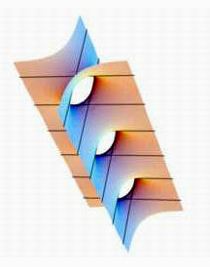
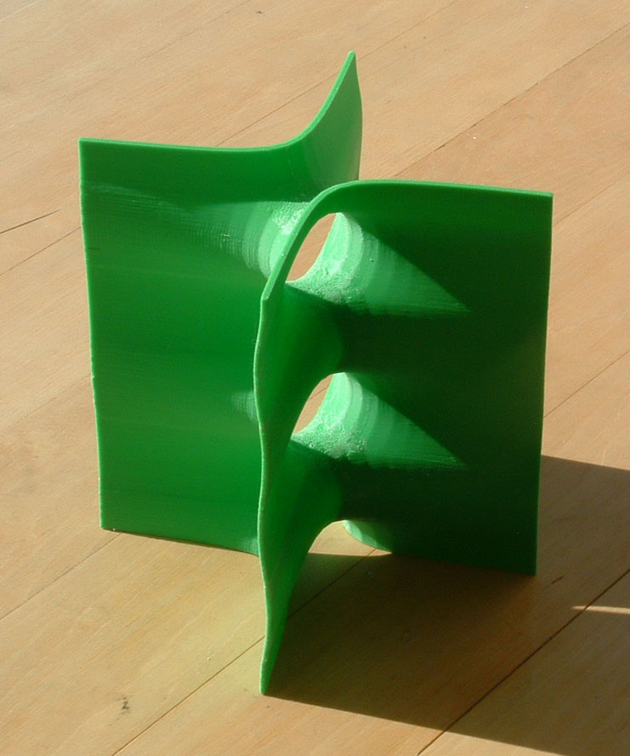
Scherk’s 2nd Minimal Surface (1834)
The central part of this, I call a “Scherk Tower.”
Notes:
Of special significance in this context is the classical minimal surface discovered by Heinrich Scherk in 1834. It is formed by two planes intersecting in the z-axis and being penetrated by an infinite series of criss-crossing tunnels with smooth saddles between them.
Only the central portion is artistically interesting, because the four flanges go off to infinity and become flat and rather boring. This central part I call a “Scherk Tower”.

Slide 13
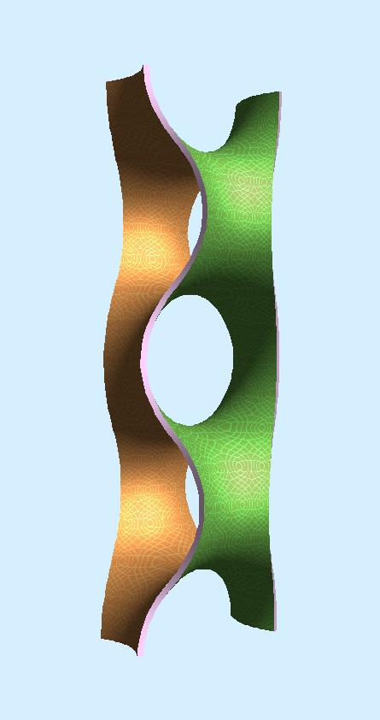
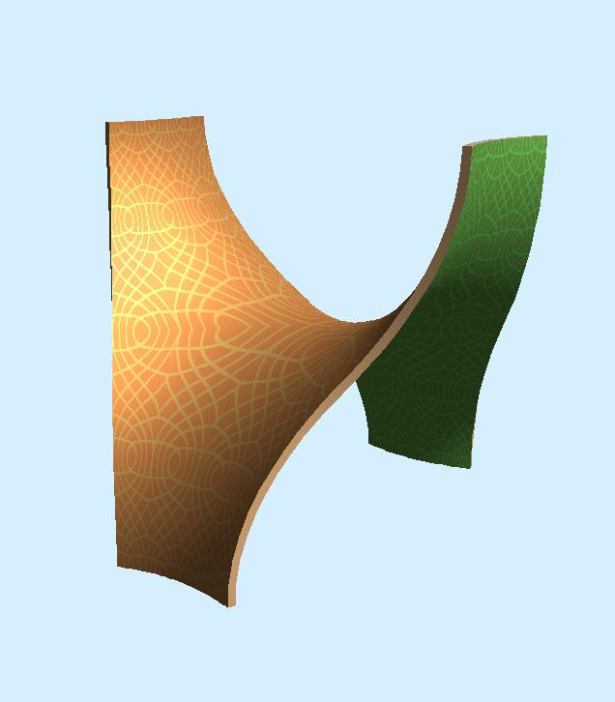
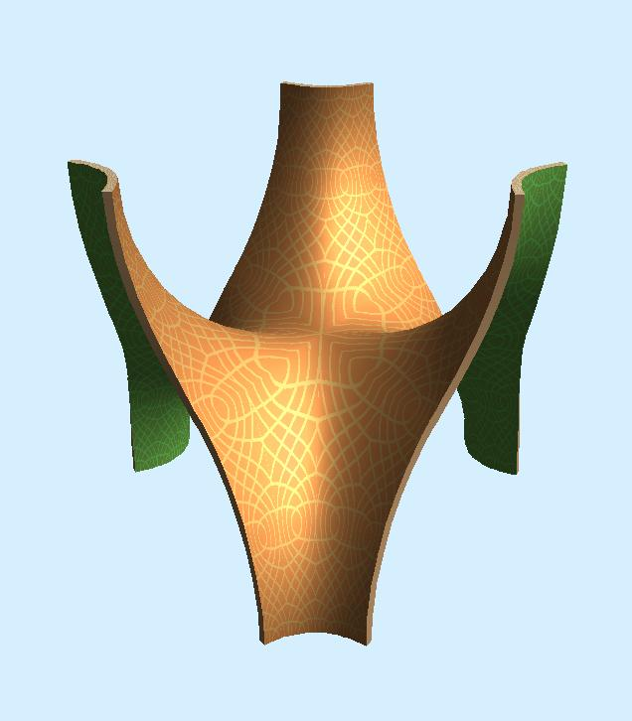
Generalizing the “Scherk Tower”
Normal
“biped”
saddles
Generalization to
higher-order saddles
(“Monkey saddle”)
“Scherk Tower”
Notes:
In the simplest case, it is composed of simple biped saddles as one would find on the back of a horse.
But the Scherk tower can be generalized to saddles of higher order, for instance 3rd-order “monkey saddles” with 3 valleys going down (one for the monkey’s tail) and 3 ridges going up between them

Slide 14
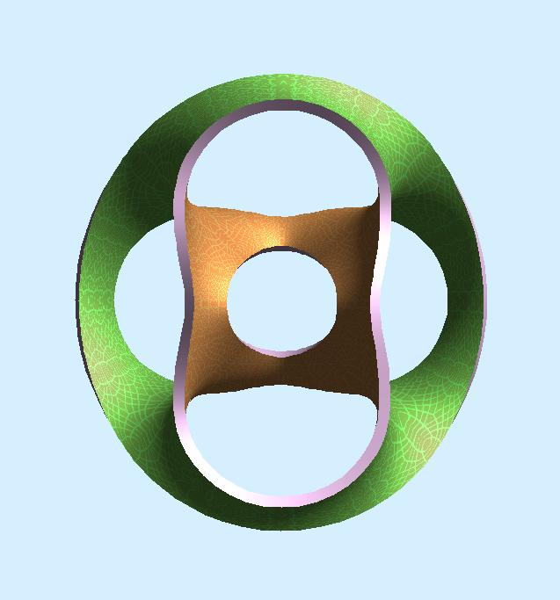
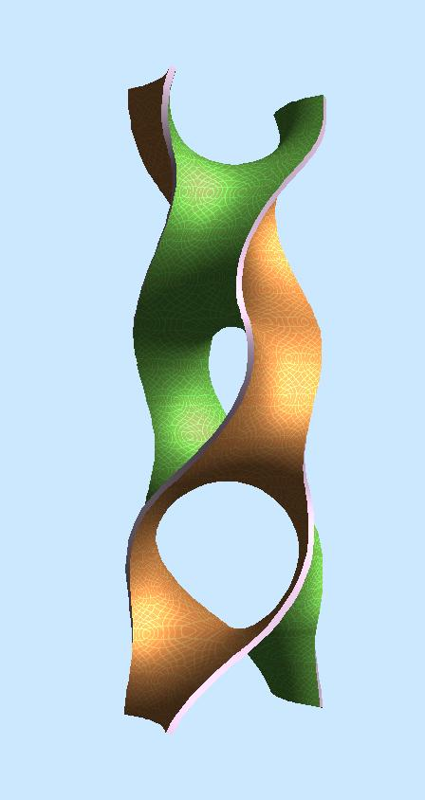
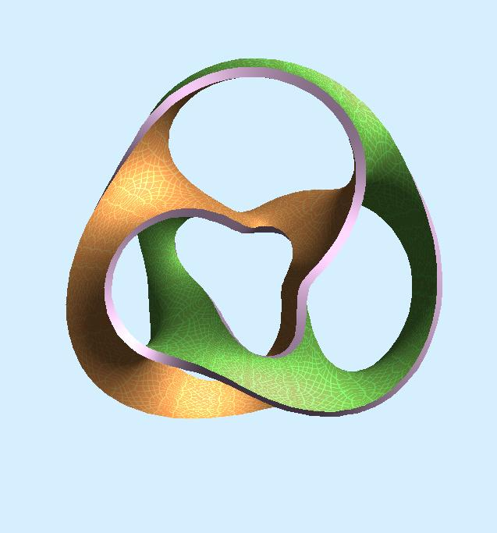
Closing the Loop
straight
or
twisted
“Scherk Tower”
“Scherk-Collins Toroids”
Notes:
And now you can take such a Scherk tower and bend it into a toroidal loop. If you close it into a straight loop without any twisting, you get the result at top right; – it is nice and symmetrical, but somewhat dull.
But if we give the tower a longitudinal twist of 180 degrees, as shown on the left, we obtain a less symmetric – but, I believe, more interesting and more dynamic result, shown at the bottom right.

Slide 15
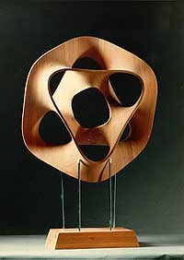
Brent Collins:
Hyperbolic Hexagon
Six balanced saddles
in a circular ring.
Inspired by the shape
of a soap film
suspended in a wire frame.
= Warped “Scherk Tower”
(with 6 stories).
Notes:
And this is the picture that prompted me to pick up the phone and call Brent Collins out of the blue. We had a very good 45-minute conversation, and this started a 20-year collaboration.
Brent called this wood sculpture “Hyperbolic Hexagon.” Because of the article by George Francis, we had a common language to discuss this shape over the phone, where we could not see each other or point to any jointly visible object. We both readily understood this as a 6-story Scherk tower closed into a toroidal loop.
In this first phone conversation, we discussed what might happen if we added a 7th story into this ring, or gave the Scherk tower an initial twist. Under some circumstances that surface then becomes single-sided, like a Moebius band, and the edges of the sculpture would form complicated knots. This was all intellectually challenging, -- but how do we know whether these geometries make beautiful sculptures that are worth 3 months of Collins’ time to carve it?

Slide 16
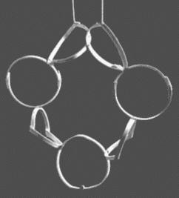
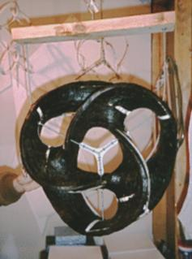
Brent Collins’ Prototyping Process
Armature for the "Hyperbolic Heptagon"
Mockup for the
"Saddle Trefoil"
Time-consuming ! (1-3 weeks)
Notes:
This is the kind of models that Brent normally builds before committing 2-3 months of carving such a shape from solid wood. He makes some kind of skeletal frame – here made from embroidery-hoops. Then he fleshes out the skeleton with wire meshing and beeswax, here shown in black.
But this is time consuming and may take a couple of weeks for such a model. At that time, we had more phone conversations -- about once a week --, and every time we came up with more new and intriguing ideas. So there was no way that Brent could keep up with making models for all these ideas.

Slide 17
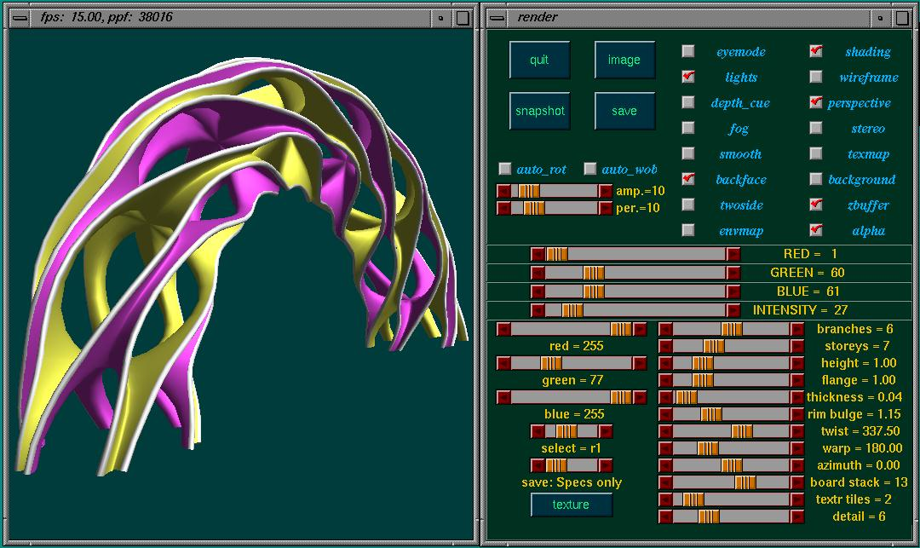
Sculpture Generator 1, GUI
Notes:
Computers to the rescue!! -- To explore all these possibilities, I wrote a very special-purpose computer program. The only thing that it could model was such a chain of saddles and tunnels: I called it somewhat pompously: “Sculpture Generator 1”. Here you see its GUI. About 10 sliders define the geometry of this shape: the order and number of saddles and their height, -- the width and thickness of the flanges, and the treatment of the edges: squarely cut off or rounded; and -- most importantly -- the amount of twisting and bending of the whole structure: For instance you can bend the Scherk tower into a full circle or just into an arch as shown here.

Slide 18
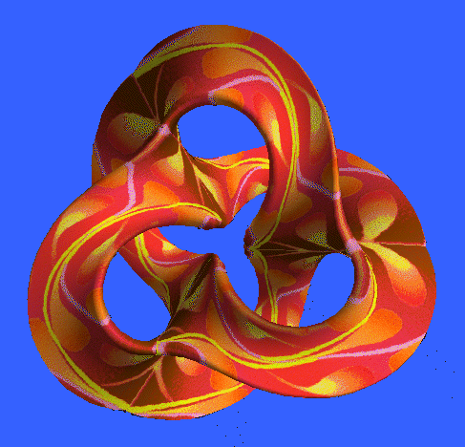
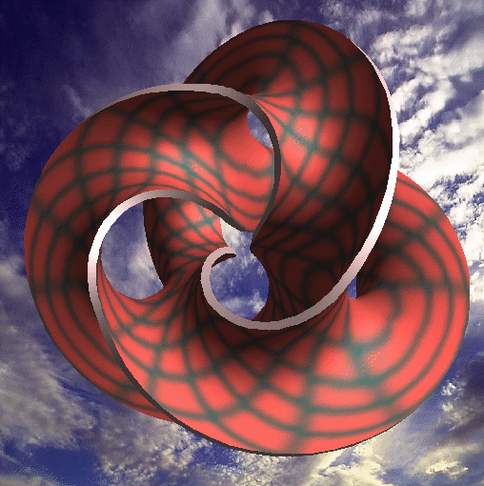
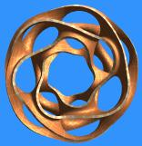
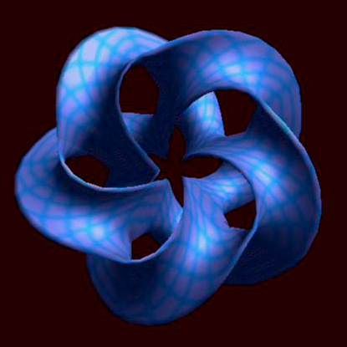
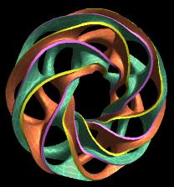
Shapes from Sculpture Generator 1
Notes:
With this generator I could quickly create a whole lot of promising artistic geometries, by moving those sliders and picking some fancy colors and textures.
Some of these images Brent liked enough, so that he was willing to spend 3 months of his life carving them at the 30 inch scale.

Slide 19
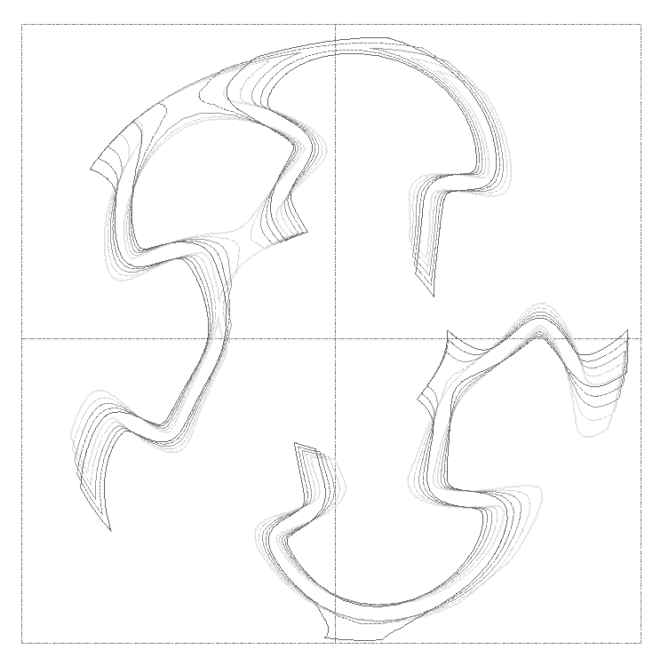
Profiled Slice through “Heptoroid”
One thick slice
thru sculpture,
from which Brent
can cut boards
and assemble a rough shape.
Traces represent:
top and bottom,
as well as cuts
at 1/4, 1/2, 3/4
of one board.
Notes:
From these Collins will precut boards
then assemble the complete shape
and fine tune and polish it.
If Brent decided to build one of these things, this is what I did for him: I let the computer calculate slices through the intended sculpture, one inch apart, and I then sent these 3ft by 3ft blue prints to Brent.
Brent then used a saber saw to cut these shapes out of 1-inch thick Mahagony boards.

Slide 20
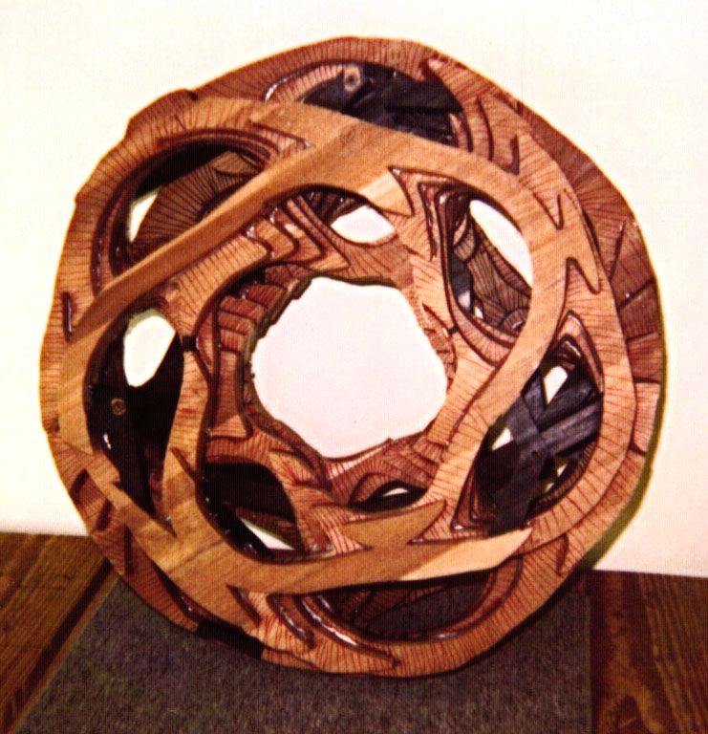
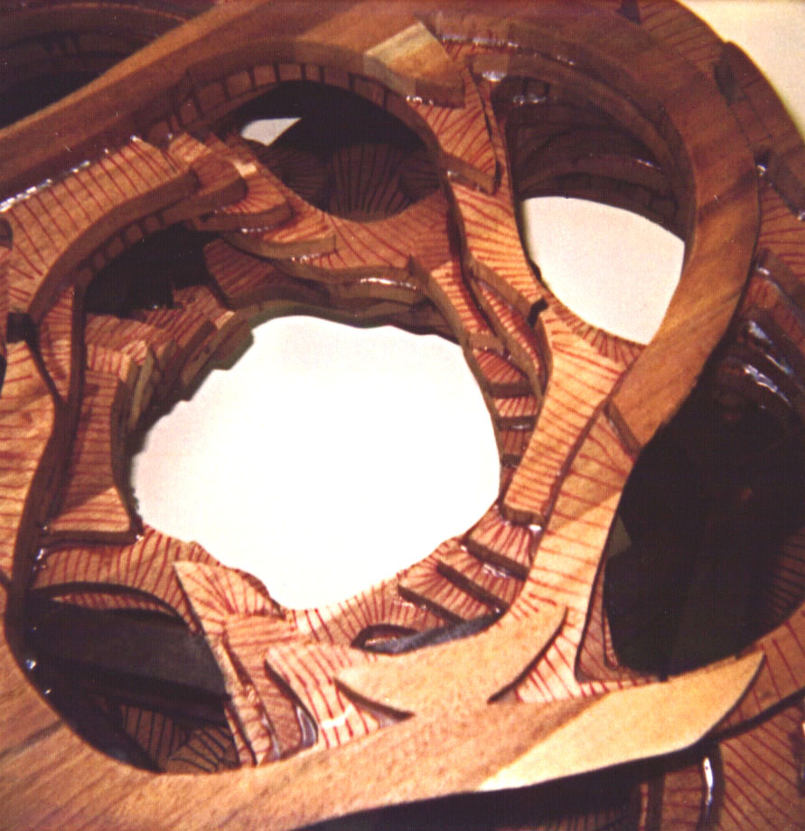
Emergence of the Heptoroid (1)
Assembly of the precut boards
Notes:
Brent then laminates the dozen or so wood boards with industrial-strength glue. In this way he obtains the proper overall shape which maintains all the right symmetries. But initially there is strong stair-casing on its surface.

Slide 21


Emergence of the Heptoroid (2)
Forming a continuous smooth edge
Notes:
Then he grinds down the stair-casing to create a smooth surface. Here you see a continuous broad rim emerge – about an inch wide. It travels around the loop 8 times before it gets back to the starting point.
Because for this sculpture, the Scherk-tower has been given a twist of 135 degrees (3/8 of a full turn) before closing the loop.
Brent then continues to grind down this edge to a smooth, narrow surface.

Slide 22


The Finished
Heptoroid
at Fermi Lab
Art Gallery (1998).
Notes:
And this is what the result looked like: We called it “Heptoroid” because it has seven 4th-order saddles in a toroidal twisted loop.
It was exhibited at the Art Gallery at Fermi Lab near Chicago. The physicists there liked it a lot; everybody saw something different :
>>>
The geometry of a tokamak or stellarator; the head of the tunnel-boring machine used in digging the tunnel for the accelerator; or the inner shape for one of the elementary quark particles.
…
== But every artist dreams of seeing his or her sculpture on a much larger scale. – Well, in 2003 we got an opportunity to build such a sculpture 12 feet tall . . .

Slide 23

12-Story Scherk-Collins Toroid
branches = 4
storeys = 11
height = 1.55
flange = 1.00
thickness = 0.06
rim_bulge = 1.00
warp = 330.00
twist = 247.50
azimuth = 56.25
mesh_tiles = 0
textr_tiles = 1
detail = 8
bounding box:
xmax= 6.01,
ymax= 1.14,
zmax= 5.55,
xmin= -7.93,
ymin= -1.14,
zmin= -8.41
Notes:
A few years later we had a chance of realizing a larger design coming out of my sculpture Generator:
On the right are its design parameters. It has twelve 4-th-order saddles in a circular loop; and the complete ring exhibits ¾ of a full turn of twisting.

Slide 24

David Lynn, Nova Blue Studio Arts
http://sites.google.com/site/novabluestudioarts/
Notes:
With the help of this man -- David Lynn from Nova Blue Studio Arts -- we got a chance of realizing this sculpture on a 10-ft diameter scale.
Our customers wanted a large, light-weight, indoor sculpture, possibly slightly translucent. David cast this sculpture in epoxy and polyester resin.
This is quite an elaborate, multi-phase process. To save cost and labor, the sculpture was designed so that it could be assembled from 6 large, identical modules.
[ 148 Brianna Drive, Seymour, MO 65746 ]

Slide 25

Master Module for “Millennium Arch”
Notes:
Here is the master geometry module – in full size; machined from high-density foam on an numerically controlled milling machine, and coated with clay to make its surface smooth for mold-making.

Slide 26


Fabrication of “Millennium Arch”
The mold for the key module
A polyester segment cast
Notes:
Around this master module, a negative mold is made out of silicone rubber, glass-fiber sheets, and epoxy. The mold was quite complex and was assembled from about 12 different pieces.
In this mold, 6 identical copies were then cast in the yellow polyester material shown on the right.

Slide 27

Two Times Three Modules
Notes:
And then 6 of these elements were assembled into the 10 foot circle. Here is the final assembly step of two semi-circles composed of 3 modules each on the floor of the atrium where the sculpture is to be hung.

Slide 28

Merging the Two Half-Circles
Notes:
And in this location the two halves were epoxied and fused together.

Slide 29

Notes:
The curing of the bond is accelerated with some heat and light, and then the surface is smoothed across these junctions.

Slide 30


Millennium Man
Vitruvian Man by Leonardo
Notes:
It inspired Brent Collins to take this photograph – a take-off on the famous “Vitruvian Man” by Leonardo da Vinci

Slide 31


Notes:
Some snapshots from the installation in Fall 2007 in Overland Park, a suburb of Kansas City.

Slide 32

Brent Collins and David Lynn
Notes:
Here is the final phase of the installation process of this sculpture.
Left: artist Brent Collins – Right: David Lynn, the man who created this object.
This hangs in a community sports center in a suburb of Kansas City.

Slide 33

Notes:
And here it is close-up and personal! -- In the back you can see a guy walking on a rtrack

Slide 34

“Millennium” Arch by Night
Notes:
This is how it looks at night from below, towards the skylight.
Our customers wanted to call it “Millennium Arch”; and this was just fine with us…
The success of this project gave us the courage to choose a similar approach for an even larger and more complicated sculpture.

Slide 35


“Evolving Trefoil”
New: Let a saddle-tunnel chain follow an arbitrary space curve!
Notes:
The idea that came to mind was that we should try to wind up a Scherk-Collins toroid into a simple knot. This led to a piece that is called “Evolving Trefoil”.
On the right is the first quick virtual mock-up with which I proposed the concept to Brent. This is a rough approximation – just sticking 12 circular arc segments together. He liked it and told me to do it for real.

Slide 36




An Evolution of Ideas and Forms
Notes:
The name “Evolving Trefoil” reflects the fact that this concept came out of a lengthy evolution of ideas and forms. – From the basic Scherk surface => Scherk Tower => Hyperbolic Hexagon => Minimal Trefoil => Heptoroid => Millennium Arch or “Solar Circle” => Evolving Trefoil.

Slide 37

Sculpture Generator #2
Notes:
There was only one problem: Sculpture generator I could not handle such complex sweeps through 3D space. – - Kyu Simm, an undergraduate researcher with me in Fall 2010 helped me to enhance the program, and this resulted in this Sculpture Generator #2 that can fit a whole saddle chain along an arbitrary 3D B-spline path. He took my Sculpture Generator I and ported it to a more modern environment. Using the C++ prog lang. , the OpenGL-graphics system, and the AntTweakBar –GUI. Here is a first design shown by this modified Sculpture Generator.

Slide 38


First Maquette
some bad spots!
from FDM machine
Notes:
When I thought we were close to a final design, I made a first maquette on the FDM machine.
This showed that there were some problems that the computer rendering did not reveal: Thin spots at the saddle centers. So we had to do some program fixes.

Slide 39

Refined Maquette
Notes:
Now the flaws have been corrected. Here is a model of the final design -- except that it has a proportionally thicker flange.

Slide 40

Sealed-off Mold (Catalyzed Matrix Inside)
Notes:
Again the sculpture was designed so that it coule be assembled from six identical pieces; -- except this time the pieces were larger and much more complex. The mold now consisted of about 18 pieces
When all the sections have been laid up, and bolted together, the catalyzed matrix is added. This is a mixture of epoxy resins and crushed minerals blended together with a catalyst; it exhibits the viscosity of cool syrup. The assembled mold with the matrix inside will weigh over 300 lbs. It is slowly rolled around its long axis and tilted back and forth during the curing/hardening process to avoid uneven matrix distribution and the formation of undesirable hot spots of higher density. The catalyzed matrix joins the seams and fills all the gaps.

Slide 41
Fabricate 6 Identical Pieces
6 identical pieces had to be fabricated
in this labor-intensive way!
Notes:
6 identical pieces had to be fabricated in this labor-intensive way!

Slide 42

Tentative Assembly of Three Units
Notes:
Three units (12 stories out of 24) = half the sculpture tentatively hooked together at Nova Blue’ Studio Arts.

Slide 43
Evolving Trefoil (polyester resin, 2013)
Notes:
And this is the final sculpture: “Evolving Trefoil”. It hangs in Agenstein Hall in the Science Center of MO Western State University in Saint Joseph.

Slide 44
ART ➔ MATH
Inspiring Sculptures
by Brent Collins
Procedural Capture in
Sculpture Generator
Parameters in the program:
  may be fine tuned to obtain a
  close replica of the original,
  or may be set quite differently
  producing new sculptures in the same family.
Notes:
What I have shown you are examples how art inspires the discovery of underlying regular concepts that lend themselves to be captured in a procedural description.
This description may include some parameters that can be fine tuned to obtain a close replica of the original, -- or they can be set quite differently which then results in many new sculptures that somehow belong into the same family.
All these pieces came out of the original inspiration provided by Brent Collins’ Hyperbolic Hexagon!
This demonstrates how art can lead to mathematics.

Slide 45
MATH ➔ ART
A mathematical concept
that needs to be explained
A visualization model
that is aesthetically pleasing
Notes:
Now let me give you some “reverse” examples where the creative process started from pure math.
A concept that needs to be explained to non-mathematicians leads to some visualization model, that is ideally so pleasing the people would call it art, and even people who do not know the underlying math story may want to place such a model on their mantle piece.
My first example emerges from the Hilbert curve …

Slide 46

The 2D Hilbert Curve (1891)
A plane-filling Peano curve
Do This In 3 D !
Notes:
I encourage creativity in the courses I teach. One approach is to give problems with open-ended solutions.
In one example, I show them the famous space-filling curve named after Hilbert and ask them to “Do This In 3D!”

Slide 47

Construction of 3D Hilbert Curve
Notes:
The students understand quickly that they are supposed to construct a space-filling curve that fills a cube in a recursive manner by breaking the whole cube into 8 smaller cubes that are properly interconnected.

Slide 48


Construction of 3D Hilbert Curve
Use this element with proper orientation, mirroring.
Notes:
So they construct some kind of Hamiltonian path that traces out the 8 corners of a cube, and then they join 8 such elements to form a single trace that fills the larger cube.

Slide 49

Typical Early Student Solution
Design Flaws:
2 collinear segments
less than maximal symmetry
4 coplanar segments
D. Garcia, and T. Eladi (1994)
Notes:
Here is a possible solution. And that is where artistic concerns come into play. I may point out what I see as design flaws …

Slide 50

Jane Yen: “Hilbert Radiator Pipe” (2000)
Flaws
( from a sculptor’s . point of view ):
4 coplanar segments
Not a closed loop
Broken symmetry
Notes:
Some students already bring in extra elements to make their solutions artistically more pleasing, -- but they may still have some of the same design flaws.

Slide 51
Design Choices: 3D Hilbert Curve
What are the things one might optimize ?
Maximal symmetry
Overall closed loop
No consecutive collinear segments
No (3 or 4 ?) coplanar segment sequence
others ... ?
➔ More than one acceptable solution !
Notes:
So then we discuss what might be an extra set of additional constraints.
Is the answer now fully predetermined, or is there some freedom of design ?

Slide 52


Basic Element, Lowest Level
not this – but this !
avoid 4 coplanar segments !
Notes:
This may already affect the basic element at the lowest level.

Slide 53


Plastic Model (from FDM) (1998)
Support removal can be tedious, difficult !
Notes:
Here is a good 2nd generation model made on an FDM machine.

Slide 54

The Next Level of Recursion
Presented a challenge to remove supports.
Resulted in a flimsy, spongy model.
Would like to have a more durable model.
Notes:
This is a model of the next generation with 512 elbow joints.

Slide 55

2006: Metal Sculpture in Exhibit
Notes:
I finally got around to doing a metal sculpture in 2006 using a special layered sintering process using stainless steel powder.
This design meets all the additional constraints. It was shown in the Siggraph Art Exhibit.

Slide 56


The Origins . . .
Klein bottle (1882) Professor Felix Klein
Notes:
Now another example where the math came first – employing single-sided surfaces:
You are probably familiar with the concept of a Klein bottle, which was introduced in 1882 by Prof. Felix Klein.

Slide 57



“klein” = “little” in German
Different and “better”
“Super-Bottle”
Little
Larger
Klein bottles
Notes:
Perhaps you also know that “klein” means “little” in German; -- and here we have clearly a very little bottle.
>>> here is Cliff Stoll with a much larger bottle, -- but its basic structure is the same as before.
>>> But here now is a different bottle. It is better in the sense that it has a higher genus – I call this a Super-Bottle.
To understand this, let’s review two basic concepts from topology.

Slide 58







The Genus of 2-sided Handle-Bodies
genus 1 genus 2 genus 3 genus 7
Punctures in the surface do not alter the genus:
All genus 0,
with: 2 punctures, 3 punctures, zero punctures.
Notes:
Let’s first look at simple, tubular shapes, which are also called “handle bodies”. A sphere has genus zero. The torus on the left has genus 1. If there are two tunnels or two handles, then such a 2-hole torus has genus 2. The next shape has genus 3: You have to make 3 cuts to break enough handles, so that there are no further loops in the structure. Finally the last shape is of genus 7.
>>> We are also allowed to punch holes into these surfaces, -- make so called “punctures” – and this does not change the genus. So all the objects in the bottom row are of genus zero (the same as a sphere) because there are no tubular loops. The first shape is topologically equivalent to a sphere with two punctures in its surface. The next one has three punctures, highlighted by their yellow borders. And the last one is topologically equivalent to a sphere with NO punctures at all, because I have capped off all 4 tube ends.
All these surfaces are TWO-sided, because the sphere as well as the torus have clearly distinct insides and outsides.

Slide 59




Single-Sided Surfaces
Möbius band (1858)
August Ferdinand Möbius
Roelof’s Moebiustorus
Single-sided pipe segments
Notes:
Now let’s look at single-sided surfaces. The one best-known is the Moebius band, which looks like a belt that has been twisted through 180 degrees before closure. If you walk once around the loop, you can get from a particular spot on the surface to the same spot on the opposite side. Below are more sophisticated versions of single sided surfaces, like Rinus Roelof’s Moebiustorus, where a partial torus is completed with 3 half-twisting Moebius bands. Note however, that having some twisting ribbons alone does not guarantee that we have a single-sided surface; If you were to cut apart the tubular bottom half of this torus, you would end up with a 2-sided surface!
The two pipe segments on the right, on the other hand, are already single-sided surfaces, even before you close their open ends into a loop, because they have twisted as well as non-twisted ribbons.
Note also, that all of these surfaces have borders, which are the rims of some rather complicated, drawn-out punctures.

Slide 60



Klein Bottle: σ=1; g=2.
Klein Bottle
right-twist M.B. left-twist M.B
Self-intersection !
Two Möbius bands make a Klein bottle!
Notes:
Now we come back to the Klein bottle. This is a very important case, because it is a single-sided surface with no borders!
However, this is not quite true in 3 dimensional space, because we cannot build a KB without some self-intersection of the surface.
-- right here where the thin arm comes out of the thick body.
>>> Now we can split this Klein bottle along its symmetry plane – and we obtain two Moebius bands!
The lower yellow half is a right-twisted Moebius band. The upper blue half – here shown flipped open to the right -- is a left-twisted Moebius band.

Slide 61


The Genus of Single-Sided Surfaces
genus (g) measures connectivity
Torus
σ=2; g=1
Möbius band
σ=1; g=1
Klein bottle
σ=1; g=2
σ = (1,2) indicates sidedness
Notes:
And now I can give you a more general definition of genus: The genus measures the connectivity of a surface: Torus and Moebius band have a genus of 1: You can make ONE closed-loop cut as indicated by the red curve, and still leave the surface connected in one piece. The Klein bottle has a genus of 2: You can draw two such closed loops that do not cross one another - and leave the surface fully connected. The red loop is entirely in the front half of the bottle; and you can draw a second, mirror-symmetric one on the back half of the bottle – in gthe middle of the other Moebius band.

Slide 62


Towards Higher-Genus Surfaces
Grafting together Klein bottles . . .
does not always yield a higher-genus surface!
Just a Torus: σ=2, g=1
(Cliff Stoll)
Klein “Knottle”: σ=1, g=2
(Carlo Séquin)
Notes:
Now I want to make surfaces of even higher genus. But just stringing together Klein bottles does not always work: -- The two glass Klein bottles fused together by Cliff Stoll actually make a double-sided surface, and the result is just a torus. -- Stringing three Klein bottles together may form an intriguing knotted surface – but topologically it is still just a single Klein bottle of genus 2.
We need to connected the two Klein bottles in a different manner! . . .

Slide 63


Forming a “Connected Sum” of 2 KB
σ=1, g=4: A higher-genus surface (with 2 punctures)
Notes:
. . . We need to make a “connected sum” of two Klein bottles! To do this, we cut a small opening into each one of them,
>>> and then connect these two punctures with an umbilical tube. Now I have successfully doubled the genus of the surface.
This umbilical tube introduced the crucial element needed: Some extra branching capability!

Slide 64

Connected Sum of 2 Klein Bottles
Realization on a 3D printer: b=2, σ=1, g=4
Notes:
Here is a physical realization using layered manufacturing. Each half is just a Klein bottle, which are now fused with the extra arm introduced.

Slide 65

A More Compact Genus-4 Surface
Connected sum of two Klein bottles: b=2, σ=1, g=4
Notes:
Here is another sculpture depicting the connected sum of 2 KB in a more compact form.

Slide 66



Modular Sculptures
Yellow sculpture is made from
two identical 2-sided pieces . . .
Their combination can be:
“KBM”
σ=2; g=2
σ=1; g=4
Expand modularity concept to more complicated models
of higher genus. The key is a branching module with a “KBM.”
“Klein-Bottle Mouth”
Notes:
It is made of two identical pieces. Each piece has the inside-out-everting Klein bottle mouth and three connector arms.
We can put them together in 3 possible ways. In two cases we obtain the connected sum of two Klein bottles.
But in the 3rd case, shown on the left, where we have joined the two thinner arms coming out from the inside of the toroidal body, we obtain a double-sided surface that is just a 2-hole torus.
Now I want to re-design this basic module, so that it becomes a modular component with which I can build more complicated models of even higher genus.
“

Slide 67


“LEGO® Knots” (2014)
A project, a couple of years ago.
Modular components,
based on sweeps of a fixed square cross section, which could be joined together to form models of mathematical knots & of free-form tubular sculptures.
Extend this idea to non-orientable surfaces . . .
Notes:
This goal was inspired by a project that I did 2 years ago, called “LEGO-Knots”. I had created a modular set of components based on sweeps of a fixed square cross section along circular arcs. Some modules were twisted, and some followed helical paths. The parts could then be joined together to form models of mathematical knots and of free-form tubular sculptures.
Now I wanted to extend this approach to non-orientable surfaces such as Moebius bands and Klein bottles.

Slide 68

A Klein Bottle Module
KB module: b=3, σ=2, g=0: Sphere with 3 punctures
Notes:
A key element that I needed to capture: was the “KB mouth”, where the surface turns inside out.
But this building block by itself is still a two-sided surface: The silver and the green surface color never meet. So this is just a sphere with 3 punctures.

Slide 69

KB-Module becomes a Klein-Bottle
b=1, σ=1, g=2: Klein bottle with 1 puncture
Notes:
This only becomes a single-sided Klein bottle, when the green and silver domains are connected through the orange loop.

Slide 70

A Modular KB Component
3 arms at right angles, equal length from center.
Notes:
To make assemblies of higher genus, I also needed to add a third arm, with which we can form proper connected sums.
Here I put the 3 arms at right angles to one another. Two arms come from the outside of the toroidal body, and the 3rd arm comes from the inside through the tunnel of the torus.

Slide 71

Overall Plan: Cube Frame
joint
Module arms are at right angles and of equal length.
Modules occupy the cube corners, join at mid-edge.
Notes:
These components can now readily be placed at the corners of a cube frame. All arms are of the same length and so they can readily join up in the center of the cube frame edges.
The reason I chose this geometry is because id did not just want to make willy-nilly random pipe structures, but well-balanced sculptural models that have some aesthetic appeal – some regularity, and perhaps some symmetry.
But not all modules are the same. To obtain some variety, I experimented with different ways of combining the 3 branching arms with the toroidal Klein-bottle mouth.

Slide 72





Various “KBM” Junction Modules
Many possibilities!
Explored several of them,
fitting a tubular cube-frame.
All have a similar style and
seem to belong into the same family.
4 models: Different ways to introduce branching:
Notes:
To make them look like they all belong to the same family, they all have a toroidal body that accommodates the KB mouth.
Then I looked for different ways of introducing the branching: On the left, the thicker, outer arm does all the branching.
In the other 3 cases, an arm coming from the inside splits into two tubes; this split could happen inside the main body of this module, or on the outside after the inner arm has emerged.

Slide 73




KB-modules of Many Shapes
4 different version of the basic cube-corner module
Notes:
Here are the actual realizations of these four designs.
The were all fabricated on a FDM machine from Stratasys. (It takes about 6-8 hours per pair, and costs about 20$ a piece).

Slide 74


Cube-Frame Assemblies
2 variants of a cube frame:
Double-sided
σ=2, g=5
Single-sided
σ=1, g=10
Notes:
When we finally put these elements together, we have to be careful about what our true goal is. We can either aim for maximal symmetry, or we can aim for obtaining the highest genus. The latter is not too hard:
If we just put 8 of these pieces together randomly, we obtain most likely a single-sided surface of genus 10.
One has to carefully match inside and outside tubes, as in the left example, so that around every loop, there are always an even number of inside/outside switches, to construct a two-sided surface of genus 5.

Slide 75


Two Different Cube Frames
Many possible placements of the KB modules at cube corners
Notes:
Here are two different genus 10 cube frames formed by placing different components at the 8 corners and with different orientations.
I also show examples of two different mounts; – one on the corner of the cube, -- the other supported by one of the cube edges.
---- But just building cube frames gets boring after a while …

Slide 76

Other Cubic Graphs
What else can we build with these 3-arm modules?
These 3-arm (valence-3) branching modules
restrict us to compose only “cubic” graphs
(all nodes are of valence 3).
Done !
Curve these edges through 30°
Curve all edges through 38.96°
Notes:
These 3-arm modules correspond to nodes of valence 3 in a graph; and they should allow me to compose any “cubic” graph – in which all nodes are of valence 3.
Here are a few other regular and semi-regular cubic graphs that I might want to build.
The trouble is, that in all cases the angles between the edges coming together at a corner are different from 90 degrees.
>>> Rather than fabricating new corner modules for each of these graphs, I decided to introduce curved edges that can accommodate the existing right angles of the cube corner pieces.
The easiest case was the 3-sided prism: I just made the top and bottom edges bend through 30 degrees.
The next case I tackled was the tetrahedron; here the edges have to bend through about 39 degrees.

Slide 77


Re-use of KB-modules
3-Sided Prism (g=8)
6 KBM + 6 conn. 30°
Tetrahedron (g=6)
4 KBM + 6 conn. 38.96°
Notes:
And here is the realization of those two graphs
To form a 3-sided prism, I needed 6 curved connectors that bend through 30 degrees.
To form a tetrahedral structure, I needed 6 connectors bending through 39 degrees.

Slide 78


Assemblies with 4-arm Parts
Octahedron: σ=1, g=14
6 KBM + 12 conn. 41.1°
“5-Ring_Loop”: σ=1, g=12
5 KBM + 10 conn. 80.3°
Notes:
Later I also fabricated some KB-modules with 4 arms. This then allowed me to construct an octahedral frame or the nice loop of 5 rings on the right.
The downside is, that every time I also had to fabricate a bunch of new connector tubes, bending through just the right angles.

Slide 79

My “Workshop”
Living room table, July 2016
Notes:
And so, around that time, our Living room table often looked like this . . .

Slide 80

























Super-Bottles
A Selection of Super-Bottles (July 2016)
Notes:
Here is a composite of various pictures of such Super-Bottles – some of them quite irregular!
Since I had all these differently curved connector pieces, I could accommodate many different geometries.

Slide 81

The Quest: April 16, 2015
Walt van Ballegooijen’s e-mail:
Since yesterday I have been wondering about the following question:
In how many different ways can two cube frames be linked together?
My questions to you are:
-- Is my list complete? -- If not, can you complete it?
7 Attachments:
Notes:
To conclude, I would like to present to you another geometrical problem that could lead to some intriguing art-work:
In April 2015, Walt van Ballegooijen sent me this question with the 7 attached images. The issue is to find out, in how many topologically different ways two thin, cubic wire-frames can be interlinked?

Slide 82

An Early Collection
April 19, 2015
Notes:
Well these 7 solutions were not quite the whole set. Within a couple of days, both of us did find an additional configuration. And this was our model collection on April 19.

Slide 83


The Collection Grows . . .
April 27, 2015 The “Evolution Graph”
Notes:
Then we went through a rather “stormy” and confusing period. We often thought we had found some new configurations, but then it turned out, that they were just variations of some that were already comprised in our collection. -- We had to find a clean definition, when two configurations were considered to be same; -- and for that we needed a robust classification scheme:
In the labels on the right, the two numbers indicate how many faces in each of the two cubes were actually linked by some face in the other cube. With this, we tried to figure out what all the possible combinations were, that could be constructed. The “A”s and the “B”s indicate different groupings of the linked faces – whether two of them may be adjacent or opposite of one another.
We thought we might get an understanding of all possibilities by drawing out an “Evolution Graph”, where a link between two nodes means that one state can be converted into the other by one single crossing of two edges. So, for example look at the configuration 2A-2A shown at the bottom: if we start with 2 completely separate cube frames and then just cross ONE edge pair, we get this most simple configuration.

Slide 84



How Do We Find New Configurations?
Manipulate a physical Zometool model:
Opening an edge in one frame and
crossing it over an edge in the other frame …
Then “examine” the result.
This is tedious !!!
Notes:
In the early days we found new configuratiuons by playing with physical Zometool models:
In a given configuration, we would un-hook one of the edges, and let it cross one of the edges in the other cube, and then see whether the result was something that we had not previously seen.
This a very tedious and error prone approach!

Slide 85
Computer Search !
It is impractical to build a physical model
for every conceivable new configuration,
and then manipulate it into various geometries
and comparing it against all previous ones.
➔ Let the computer do the search:
keep one frame fixed and move the other one
through space with 6 DoFs (x, y, z, 3 angles).
How can the computer tell,
if two configurations are the same ???
Notes:
So, Walt decided to let the computer do much of the work. One frame is kept in a fixed symmetrical position around the origin, and the other one is moved through space using all 6 Degrees of Freedom of a rigid body in 3D-space, that is: 3 Euler angles and 3 translations in x, y, and z. But now the question arises: How can the computer tell, whether two configurations are the same?

Slide 86



The Linking Matrix (for 2A-2A)
(Thanks to Matthias Goerner)
Penetrations are not linkings!
front
back
opposite faces
Pairs of opposite faces are linked
(a simple 2−2 configuration)
Notes:
In June, Matthias Goerner, a former math student at UC Berkeley, was also drawn into the discussion, and he encouraged us to write out a matrix showing all the pairwise linkings of all the face-loops in the two wire frames. First we “personify” all individual face-loops by assigning each face in both cubes a different color. We use the following twelve colors: Magenta, Zinnober, Red, Orange, Yellow, and Lime in one cube, and Green, Aqua, Cyan, Uniform(-blue), (midnight-)Blue, and Purple in the other one. Now we write out a 6×6 matrix that explicitly specifies for each “bipartite” loop pair, whether it is linked or not (and the orientation of the linking).
--- Here you see this worked out for the case where two cubes are linked with two pairs of opposite faces: Yellow and Lime in one cube and Blue and Purple in the other. The middle picture is rotated by 180* around the green z-axis, and all faces have been opened up into just thin frames, so that we can also get a glimpse of the back-side. This results in the four entries in the lower right of the matrix. There are no other linkings. Simple corner penetrations, as indicated by the green arrow, do not count.

Slide 87



A More Complicated Case
Chiral Cube Linking
Notes:
Here is a case where all six faces in both cubes are linked; and now we have entries in the matrix in all the rows and all the columns.
Another thing that is new here, is that this configuration is different from its own mirror image; one configuration cannot be manipulated into the other one without crossing and reconnecting some edges.
--- But there is a big problem with those linking matrices: our cube frames have indistinguishable, color-less faces!
Thus, while two link matrices may be different, the linked cube configurations can still be the same!

Slide 88
Symmetry Transformations
By applying all orientation-preserving symmetry transformations, as well as a swap of the two cubes,
we generate 24×24×2 = 1152 link matrices
that all describe the same uncolored physical reality.
If this set of matrices is different from all the matrices
in all the sets of the already known configurations,
then we have found a new one.
Notes:
Thus, for any link configuration to be examined, we need to generate all the link matrices resulting from any symmetry transformations of both cubes – as well as the exchange of the two cubes!
A cube has 24 orientation-preserving symmetry transformations; so we have to generated 24x24x2=1152 link matrices; --all of those matrices describe the same physical linking situation. Only if this set of matrices is different from all the matrices in all the other sets found so far, -- then we have found a new configuration!

Slide 89

Symmetry Transformations
The coloring may change, but the configuration of uncolored wire frames always looks the same!
Notes:
Here is an illustration of this fact: As we rotate a cube 90* around one of its 4-fold symmetry axes, the coloring of the interlinked faces may change, but the configuration of uncolored wire frames always looks the same.
But things get more complicated as we let both cubes perform such rotations. But not all 1152 generated link matrices need to be different!

Slide 90



Counting Link Matrices
Among the generated 1152 transformations,
how many of these matrices are different?
Rotate both cubes 90° around the green z-axis:
➔ None of the face linkings are changed!
The number of matrices tells us something
about the symmetry of the overall configuration…
Notes:
Here is an example, where, going from the left image to the center image, we have rotated the top cube by 90* around the vertical green z-axis. But we have also rotated the bottom cube by 90* around the same axis. So this is like rotating the whole configuration jointly through 90*, -- or like looking at it from a different side. Thus the link matrix does not change at all. The same is true, if we rotate both cubes trough 180* or 270*. Thus all combinations of individual cube rotations will produce fewer than 1152 different link matrices!
Because of this, the number of different link matrices obtained can tell us something about the symmetry of the overall configuration. Here the configuration has a 4-fold rotational symmetry axis! But deriving symmetries from the reduced number of observed linking matrices is a complicated issue that we have not yet completely resolved.

Slide 91

Current Cube Results
Number of Topologically Different Linkings of Two Cube-Frames
We have found 144 different cube-frame linkings,
counting separately the right-handed and left-handed versions of a truly chiral configuration.
Completeness? ➔ The last new configuration
took 700’000 trials to be discovered!
Notes:
Counting separately the right-handed and left-handed versions, we had found so far 144 different cube-frame linkings. If we count chiral pairs only once, then we have 81 different linkings.
But these results are not yet complete, and it takes ever more trials to find a new configuration! The latest discovery took 700’000 trials until something new showed up!
--- So, perhaps the cube-frame problem is just too hard, and we should try to solve a simpler problem first!

Slide 92

Cubes Are Too Hard …
Go to tetrahedra …
Fewer possibilities!
Perhaps we can solve this one completely …
Notes:
Let’s look at tetrahedral frames. There should be fewer possible configurations, and perhaps we have a chance of solving this case completely.

Slide 93


Studying Linked Tetra-Frames
The basic approach remains the same…
The link matrices are only of size 4×4.
There are “only” 12×12×2 = 288 symmetry operations
to be considered for each potentially new linking.
Notes:
The basic approach remains the same, but now the link matrices are only of size 4 by 4, and there are only 288 symmetry operations to be considered for each potentially new linking.
--- On screen is the simplest linked case of two tetrahedra: it is a “2 - 2” configuration: Just 2 faces are involved in each tetrahedron.

Slide 94

The Known Tetra Linkings
We think this is complete . . .
Notes:
Here is a depiction of all the cases we have found so far. There are only 11 of them, not counting mirror images of chiral configurations separately.
In each case, we have inflated the thickness of the wire-frame as far as possible until the configuration just becomes rigid.
This took a bit of tricky optimization of wiggling the frames around and gradually inflating the wire diameter until the local optimum was found.
And, in contrast to our results on the cube frames, we think that this table is complete. -- but we no formal proof yet!

Slide 95


A Link to the World of Art
Some sculptures involving interlinked cube frames:
“Intersecting Crystal Cubes”
by Cross X Collaborate
“Cubes In Each Other”
by Han Lammers
Notes:
Now, what is the link to the world of art for this case?
We are not the first ones to see the artistic potential of some of these interlinked polyhedral frames. Here are a few samples that we found when searching the web:
A virtual image called “Intersecting Crystal Cubes” can be found on the web site Cross X Collaborate. On the right is a physical sculpture that has been made in zinc by the Dutch artist Han Lammers.

Slide 96


More Linked Cube Sculptures
Linking more than just TWO cubes!
“6 Cubes”
by Rinus Roelofs
“Intersecting Cubes”
by Dirk Eisner
Notes:
Multiple interlinked cube-frames have been fabricated on a 3D printer by Rinus Roelofs, and have also been constructed out of origami pieces by Dirk Eisner.

Slide 97


More from the World of Art
Interlinked tetrahedral frames are harder to find:
“Tensegrity Robot”
by J. Friesen, et al.
“Star Tetrahedron”
by Stephen Fitz-Gerald
Notes:
On the other hand, sculptures depicting interlinked tetrahedral frames are harder to find than those depicting linked cubes. One example is Star Tetrahedron by Stephen Fitz-Gerald.
On the right are two interlinked tetra-frames – These are not meant to be art, but they actually form a functional piece of machinery: a tensegrity robot that can crawl through pipes.

Slide 98


Multiple Tetra-Frames Interlinked
Some well-known configurations:
Compound of 5 Tetrahedra
by Carlo Séquin
“15 Isosceles Tetrahedra”
by Daniel Kwan
Notes:
The structure that most frequently shows up in a search for “interlinked tetrahedral frames” is the famous Compound of 5 Tetrahedra. I had modeled and printed this configuration many years ago on a Zcorp 3D printer.
Origami constructions can also be found for this and for many other linkings of tetra-frames. In this model by Daniel Kwan, 15 Isosceles Tetrahedra have been linked with a high degree of symmetry.

Slide 99


Our Own (Virtual) Contributions
Tetra-Link 4-4C1 --- Cube-Link 6-6C4
( Ø = 7.16% ) ( Ø = 6.68% )
Notes:
With the goal of trying to make also a contribution to this domain of the art world, Walt and I selected a tetrahedral as well as a cube-based configuration that both have the promise to make impressive constructivist sculptures when realized at a large enough scale. In both cases, we looked for the geometric realization of a specific configuration that would constitute a local optimum in terms of the maximum thickness that could be used for the tubular edges. These configurations would then be rigid without the need for any additional elements to hold the two frames in their relative positions against one another. We then also chose dramatic, yet balanced angles at which to mount the configurations.

Slide 100




Towards Physical Sculptures
Creating tetra-frames from PVC pipes:
Notes:
But I also wanted to make some actual, physical sculptures – but of a size that allows me to have it in my office.
One approach uses readily available PVC pipes. I just had to make some suitable corner connectors for the tetrahedron and also for the cube frames.
On the left you see an early CAD model, and, next to it, the way that the slicing software sees it --- and some of the first (less than perfect) 3D prints.
On the right is a small assembly of one of the tightest tetra-link configurations.
-- ? -- (And here is a painted version of this model).

Slide 101


Submissions to some Art Exhibits
Bridges 2016, Finland --- JMM, Atlanta, Jan. 2017
Notes:
Here are two larger tetra sculptures representing two different linkings. To make them more attractive, I painted them with silver and bronze colors.

Slide 102
Interlinking Polyhedral Wire-Frames
An intriguing topological puzzle !
It is not finished yet . . .
I welcome mathematical minds
to help me find closure on this problem.
(Perhaps some knot-theoretician ?)
Notes:
Finding the number of topologically different interlinkings has been – and still is – an intriguing puzzle
It is not finished yet! We still have no formal proof that we have found all possible configurations for either the cube frames of the tetrahedra.
I welcome mathematically inclined minds to help me reach closure on this problem. Perhaps somebody versed in knot-theory may see a way to do this.

Slide 103


Torus-Knot_5,3
Inspired by a well defined type of mathematical knot
Torus-Knot_5,3
Notes:
And speaking about knot theory, I want to conclude with two examples of mathematical knots that I have transformed into art-work.
This bronze sculpture is 16” tall. It is an artistic rendering of the torus knot 5,3 shown at right.
…
Torus knots of type (p,q) are simple knots that wind around an invisible donut in a regular manner -- p times around the hole, and q times through the hole. By using a somewhat more angular shape for the donut and a crescent-shaped cross section for the ribbon, this mathematical construct can be turned into a dynamic constructivist sculpture.

Slide 104

Chinese
Button Knot
(Knot 9₄₀)
Bronze, Dec. 2007
Carlo Séquin cast & patina by
Steve Reinmuth
Notes:
A more complicated, 9-crossing knot – known as the Chinese button knot.
This shape was first printed in ABS plastic on a FDM machine and then converted to bronze in a classical investment casting process modified to use a plastic original rather than wax.
Done by Steve Reinmuth in his bronze foundry in Eugene, OR.

Slide 105

Inauguration Sutardja Dai Hall 2/27/09
Notes:
Here once more is “Hyperbolic Hexagon 2”, the first collaborative piece I did with Brent Collins, -- now realized as a bronze cast,
It stands in the entrance lobby to the directors office of Sutardja Dai hall at UC Berkeley.

