Slide 1
Symmetry in Board and Video Games
Tanner Arrizabalaga

Slide 2
Balance
When developing a game, one of the most common, natural thoughts a creator can have is making the game as symmetric as possible
  This symmetry doesn’t only have to do with the board/maps!
      Game developers have slightly twisted the definition of “symmetry” to their own liking (“Similarity between opposing sides”)
      Something developers would consider highly symmetric: All players play by the same rules, and have the same resources at the beginning of the game
  In many instances, this perfect balance is not achievable, but we try to get as close as we can
  Very few games are either fully symmetric or asymmetric

Slide 3
Game with lots of Symmetry

Slide 4
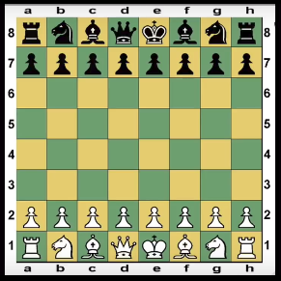
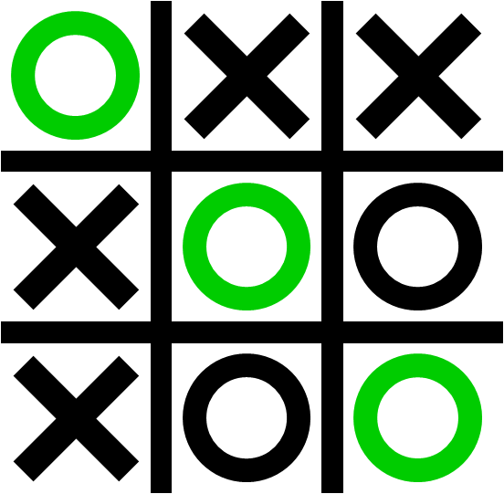
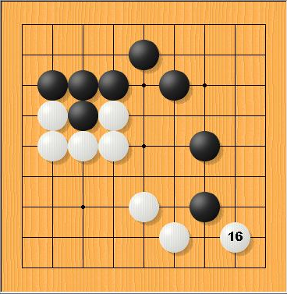
Non-visual Symmetry
Who goes first? (First move advantage)
  In many games, the player who goes first has an advantage over the other player
    Ex: In Tic-tac-toe, the second player typically doesn’t have the same aggression as the first player and plays more defensively
  However, smart game-designers know what to add to eliminate this advantage!
    Ex: In the game Go, the player with the white pieces gets +7.5 points for free

Slide 5
Chess
Pawn or a knight can move on the first turn.
  Two weakest pieces in the game, not counting the king.
    Thus, the first move advantage conferred is not significant.
  The pieces are four rows apart at the beginning, so no single piece can take or even significantly threaten an enemy piece on the first move.
A way to reduce the effect of going first is to make the game a fairly long one, so that going first makes very little difference over the course of the whole game
  And of course, Chess does this well
Symmetry (excluding pieces): D₂
Notes:
They are both symmetry by "center" or "axis". However, one told me that if black's queen faces the white king, then d4 and e5 will be two strong pawn which can beat each other, and after exchange one of the queens will dominate the center with open file against the opponent's king and then castle to the different side and put pawns ahead to enlarge that advantage. The chess will fall into such an easy game like that.

Slide 6
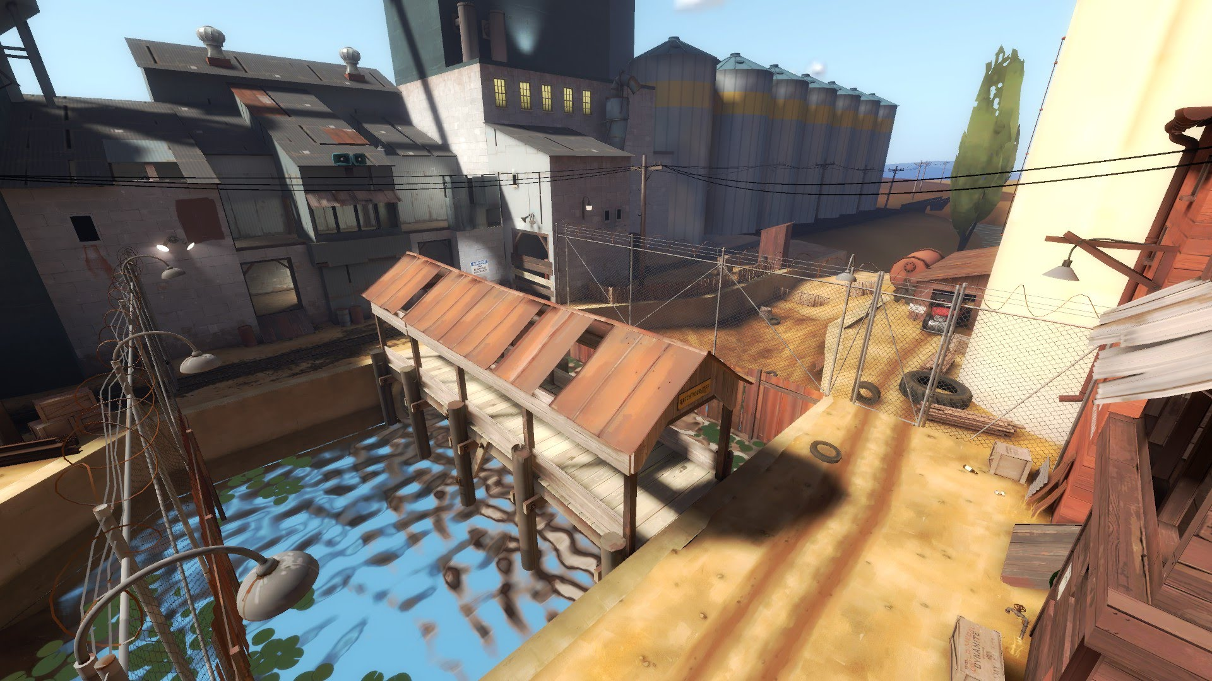
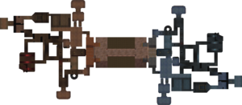
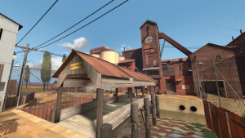
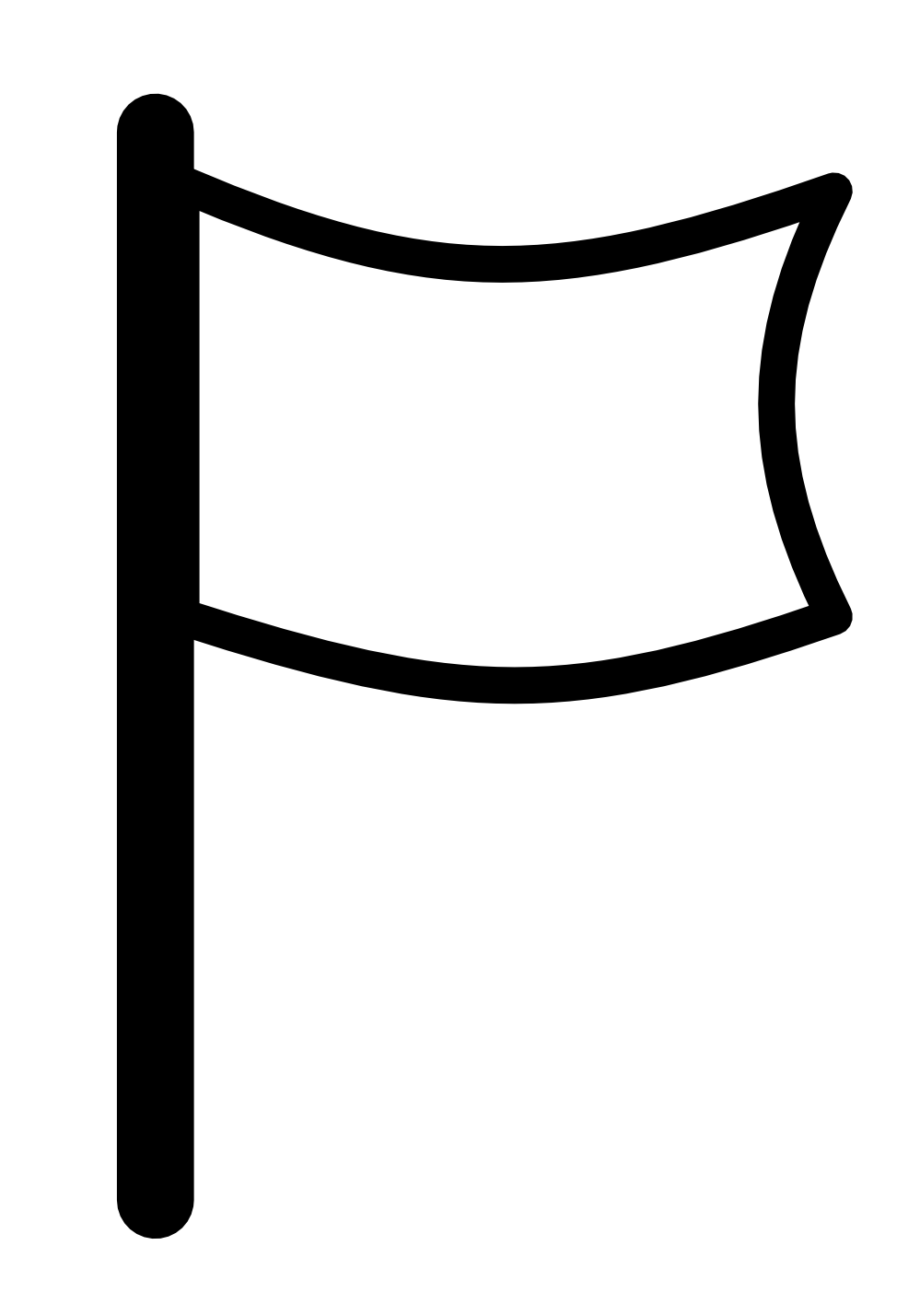
2Fort: Team Fortress 2
Intuitive
Fair
Symmetry of overhead map (Ignoring colors): C₂

Slide 7
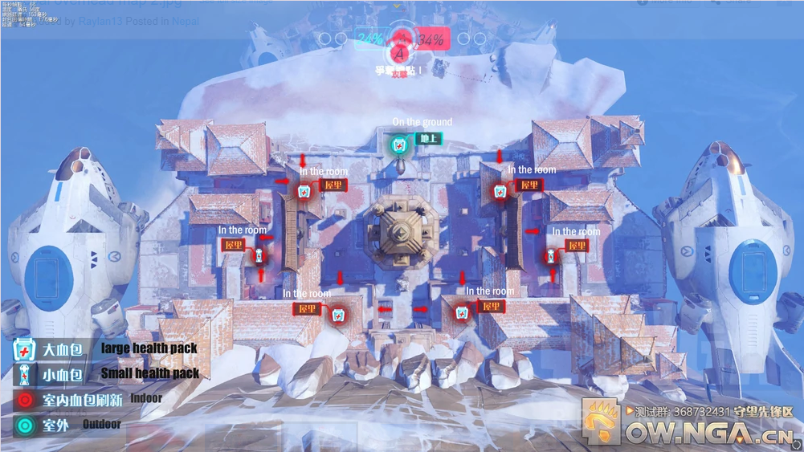
Nepal: Overwatch
Symmetry of overhead map: D₁

Slide 8
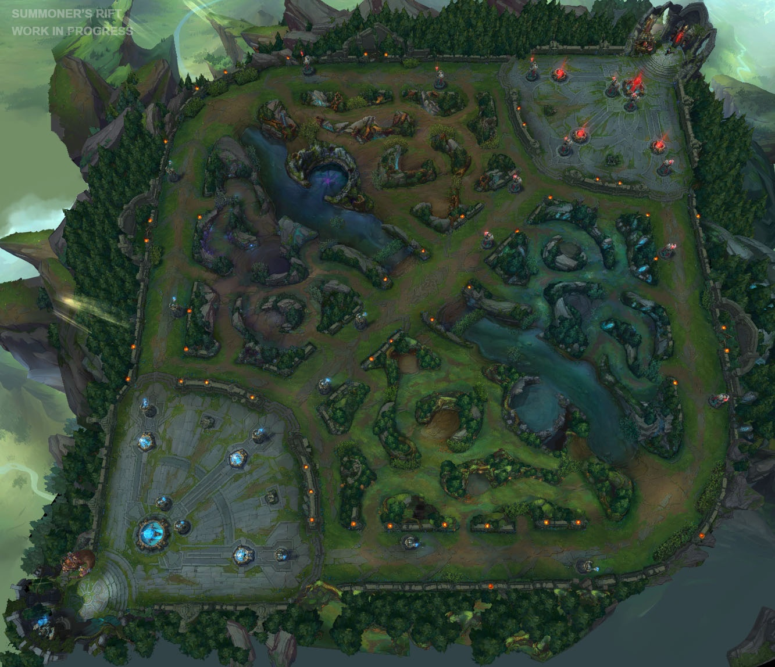
League of Legends
Symmetry for overhead map: D₂

Slide 9
Games with little
Symmetry (Asymmetry)

Slide 10
Keeping the Balance in your Game
“Asymmetric games are games where the opposing sides do not stand on equal ground”
The further you stray away from symmetry, the more you have to think about balance
  A developer will typically make small (or sometimes large if they have really messed up) tweaks to their game if they believe one aspect of gameplay is ruining the user’s experience
  More of a statistical balance
Specialization is introduced
  Each player/piece has their own role
Notes:
Went through a lot of forums where board game creators discussed symmetry, and some thought it wasn’t important

Slide 11
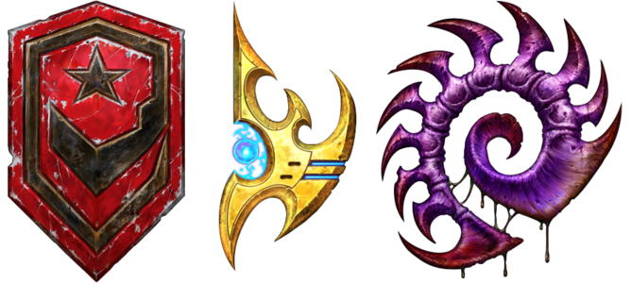
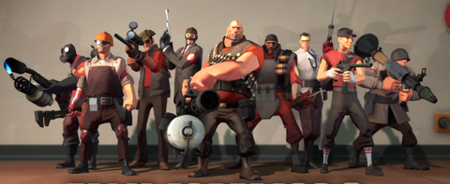
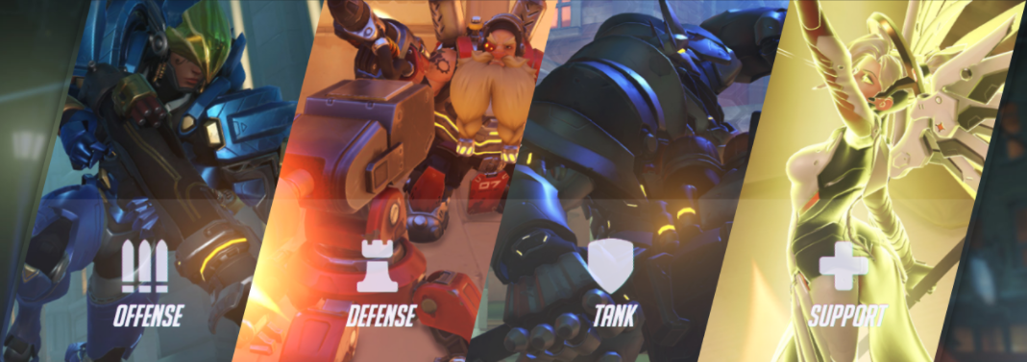
Non-visual Asymmetry
Each player has different attributes, leads to many different strategies
In video games, this introduction of varied characteristics among players leads to high levels of teamwork
  Overwatch, Team Fortress 2, Starcraft 2, etc.
  In games like Call of Duty, there is much less teamwork among players

Slide 12
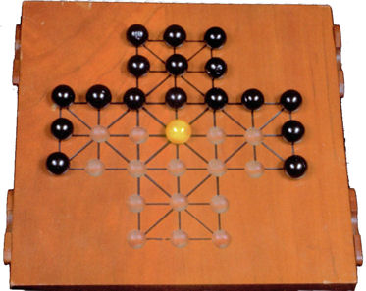
Fox and Geese
Rules
Black pieces = Geese
  Can only move one space forward, diagonal, or sideways, but never backwards (Similar to the Spanish game Alquerque, or for current 61B students: Qirkat)
  Must pin/corner the fox
Yellow piece = Fox
  Can move one space in any direction per turn and jump over geese to capture (get rid of) them
  Must get rid of enough geese to remove the possibility of getting pinned/cornered
Notes:
What if there was only 1 goose? A: Dumb question, game wouldn’t work
What if the fox had the same directional rules as the sheep, but could still capture? Good question to ask
What if the board was a different shape with more or less symmetry?
All of these questions are asked to check if the game is both fair and - very important - fun.

Slide 13
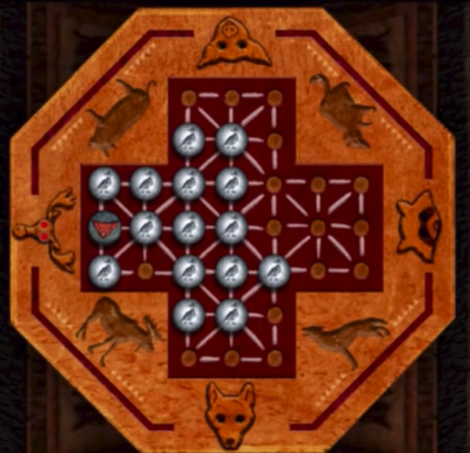

Slide 14
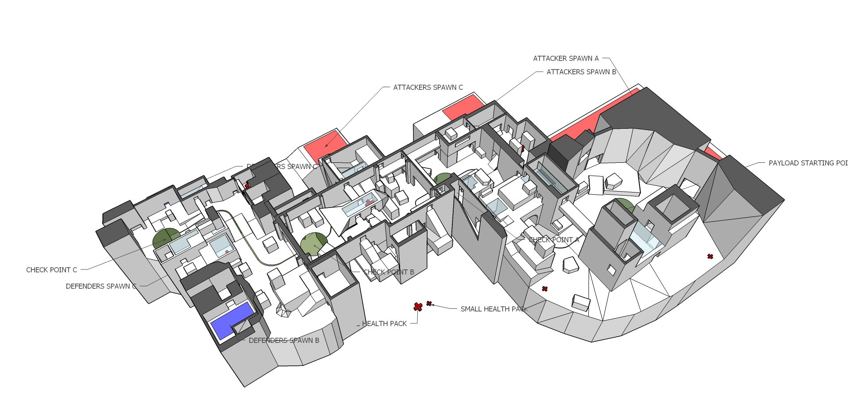
Visual Asymmetry: Overwatch

Slide 15
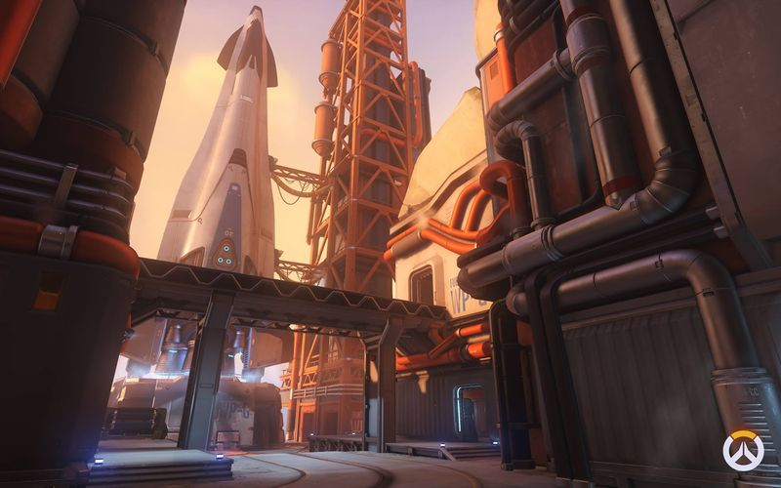
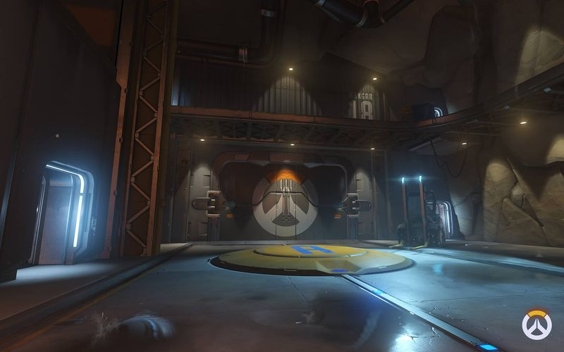
Watchpoint: Gibraltar

Slide 16
Conclusion
Whether or not developers consciously think about the symmetry involved in their games, the majority of a game’s rules will correspond to the nature - in this case, how similar “opposing sides” are - of the game.
Are symmetric/nearly symmetric games always more boring than asymmetric games? Of course not, but for game developers, finding the right balance in their game after analyzing the games symmetrical elements is very important.

Slide 17
Thank you!

