Slide 1
Symmetry in Music and Harmony
Dylan Rowe
CS 39: Symmetry and Topology
Carlo Séquin
11/14/17

Slide 2
Shepard Scales
Sound consisting of a superposition of sine waves separated by octaves, played with the bass pitch of the tone moving upward or downward (Wikipedia)
Similar to a barber pole (notes go upwards and come back from below)
Illusion of constantly ascending/descending pitch
Used often in media: music, video games, movies
Recent example: Dunkirk
Video

Slide 3
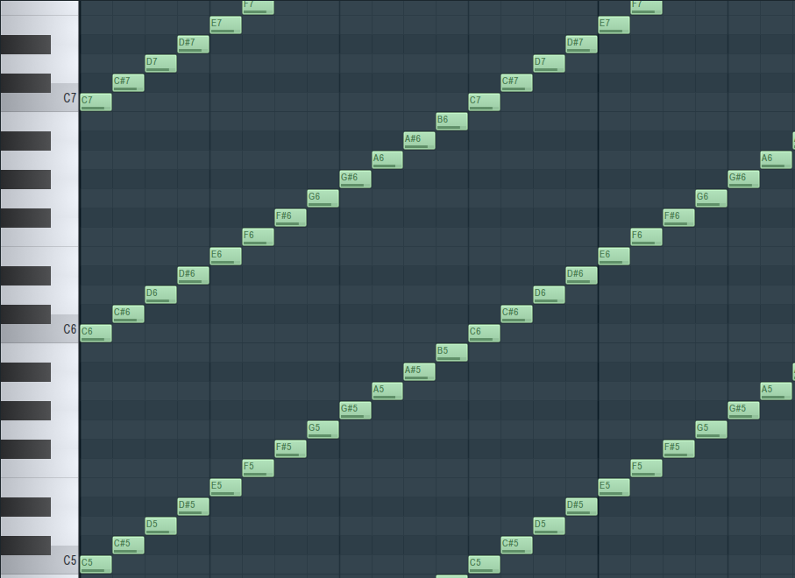
Shepard Scales
Discrete
Logarithmic frequency scale
D_{n}, with n based on the audio play time

Slide 4
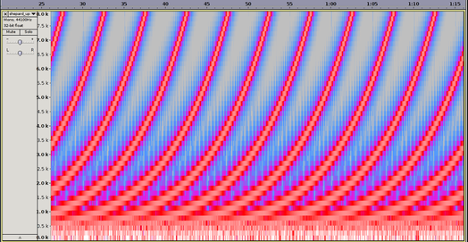
Shepard Scales
Continuous
Linear frequency scale
C_{n}, with n based on the audio play time

Slide 5
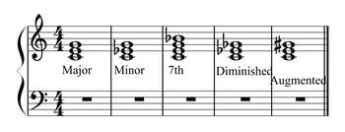
Musical Harmony
Musical chords are collections of music notes
Harmony is the study of how chords connect to each other and are used in music
Common topic: what chords or series of chords “sound good” or “work together”?

Slide 6
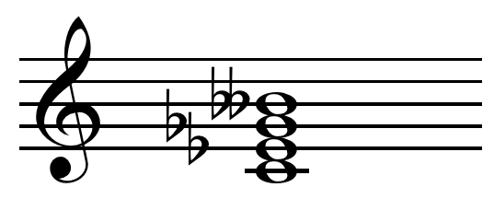
Diminished 7th Chord
Notes stacked on top of each other
  Notes 0, 3, 6, 9 half steps from root
  A root note plus 3 minor thirds stacked on top

Slide 7
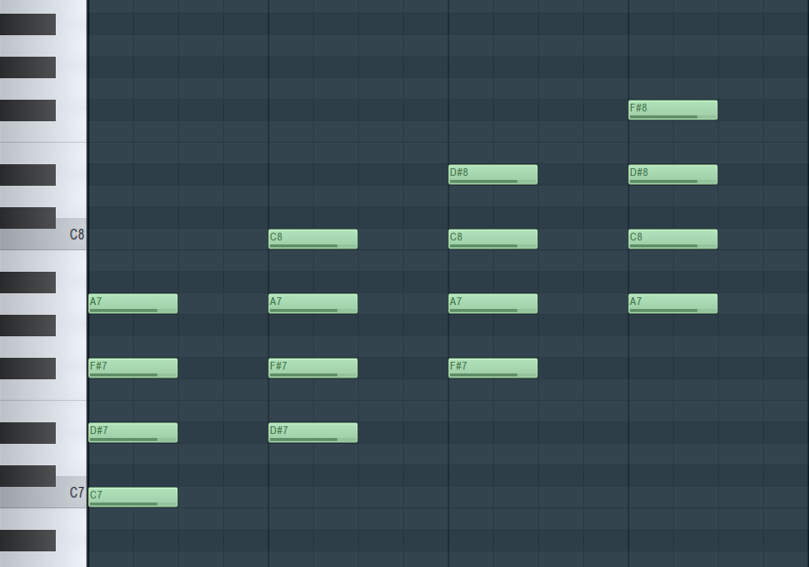
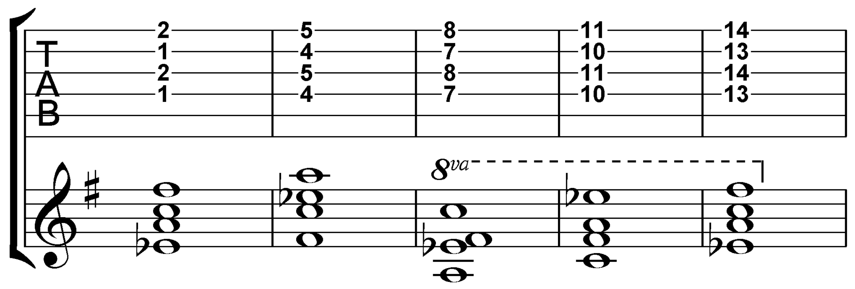
Diminished 7th Chord
Due to symmetry, there are only 3 possible 7th chords
All inversions of the chord sound the same harmonically
Frieze symmetry: D_{n} for below clips

Slide 8
Polar/Negative Harmony
A method for substituting chords for other chords
Involves exploiting the symmetry of the Circle of Fifths and harmony to attain new substitute chords
More specifically: creating a mirror axis between a note and its fifth, and mirroring a chord’s “shape” across the axis
The new chord will “work” in the same place as the old chord

Slide 9
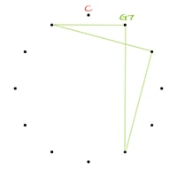
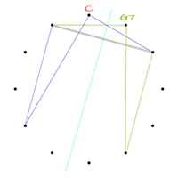
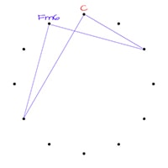
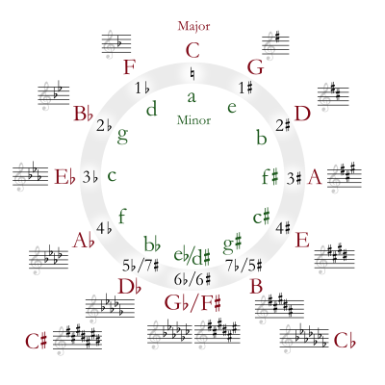
Polar/Negative Harmony

Slide 10
Conclusion
Shepard scales exploit translatory symmetry to create the effect of a constantly rising tone
Diminished 7th chords are inherently symmetric in nature; inversions/adding notes does nothing harmonically
Polar/negative harmony gives us a method for deriving chord substitutions using symmetry

Slide 11
Further Reading/Sources
“Music and Geometry” from Roel Hollander
  https://roelhollander.eu/en/blog-music/music-geometry/
https://en.wikipedia.org/wiki/Shepard_tone
https://en.wikipedia.org/wiki/Diminished_seventh_chord

Slide 12
Thank You!

