Slide 1
Symmetry in Chinese Paper-cutting
Chengcheng Huang
CS 39 Presentation 11/27/2017

Slide 2
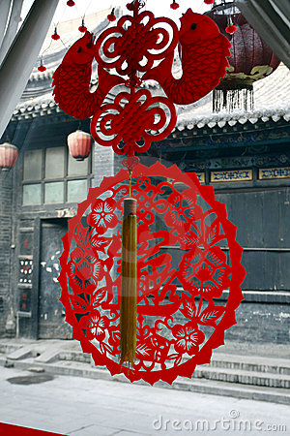
What is Chinese Paper-cutting?
Chinese paper-cutting originated from ancient activities of worshipping ancestors and gods, and is a traditional part of Chinese culture since Cai Lun invented paper in the Eastern Han Dynasty.
Symmetry in Paper-cutting is usually created by some folding over a proportioned crease, and then cutting a shape, so that when unfolded, it forms a symmetrical design. Chinese paper cuttings are usually symmetrical.
Today, paper cuttings are chiefly decorative. They liven up walls, windows, doors.

Slide 3
Different Kinds of Paper-cut

Slide 4
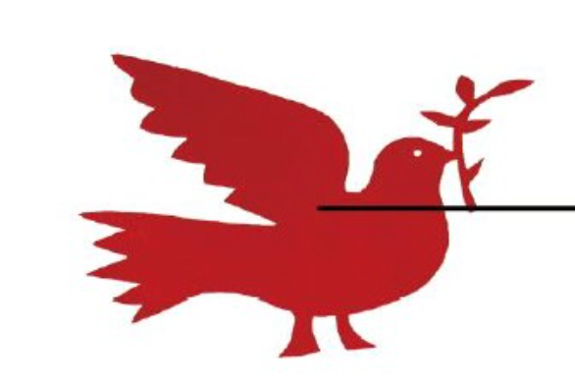
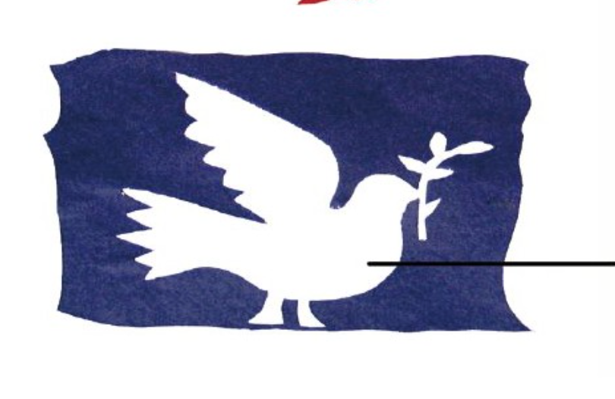
Kinds of scribing
Positive
Negative

Slide 5
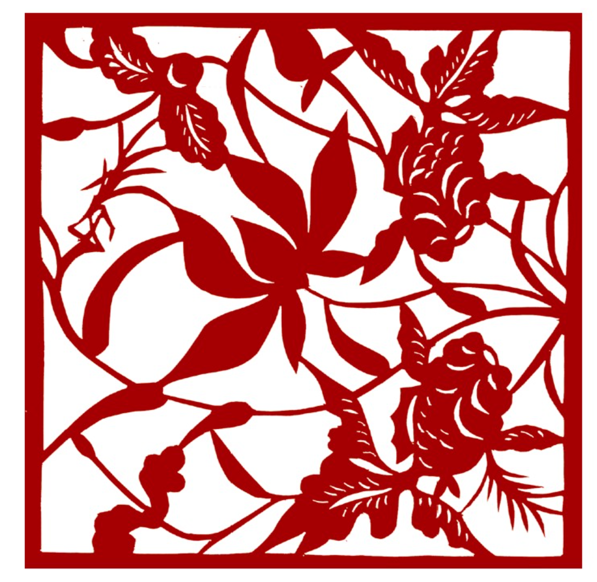
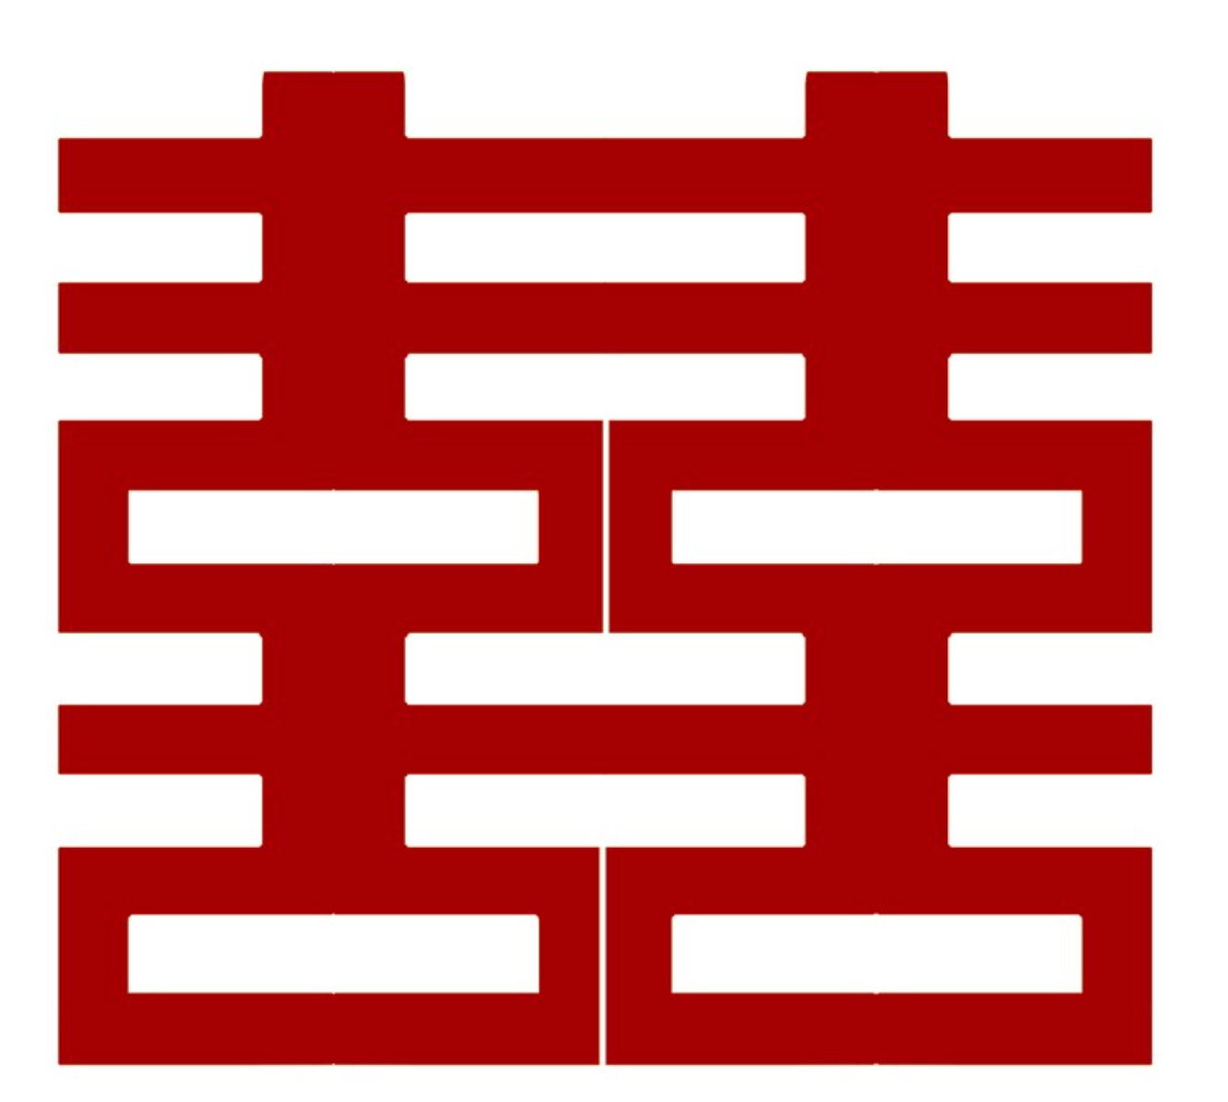
Combined Positive and Negative Scribing

Slide 6
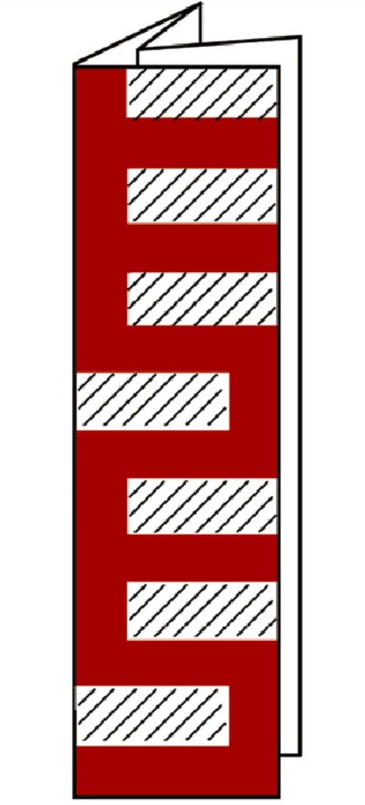
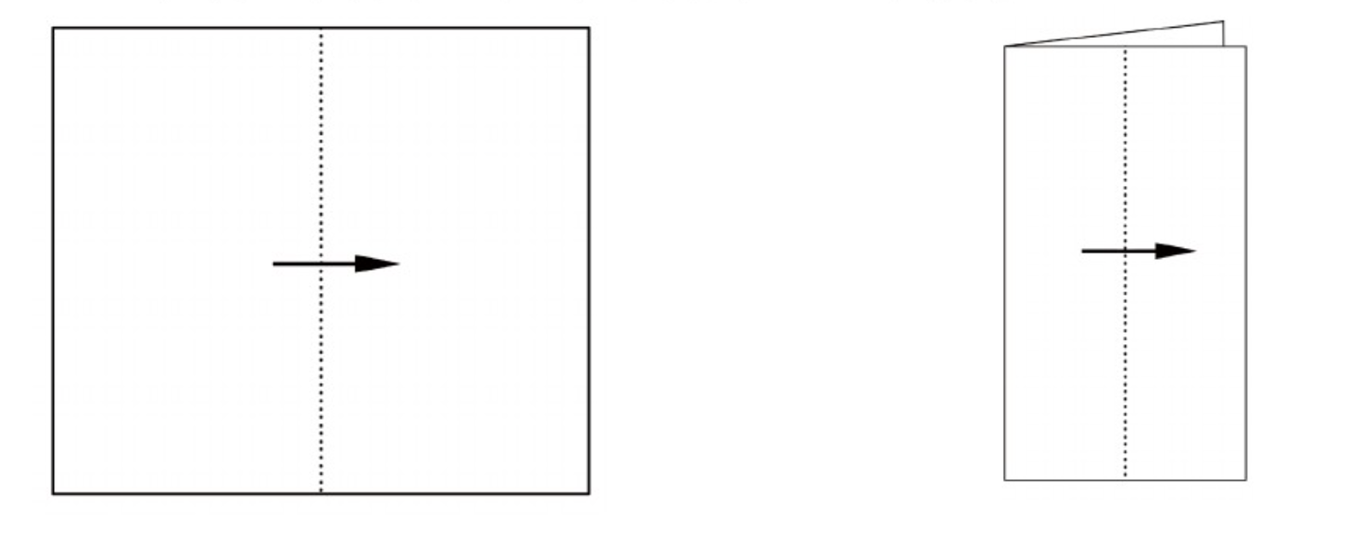
Steps to make a 2-fold paper cut

Slide 7
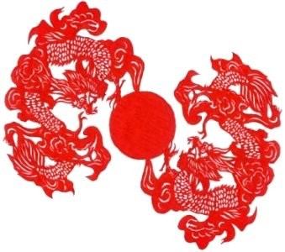
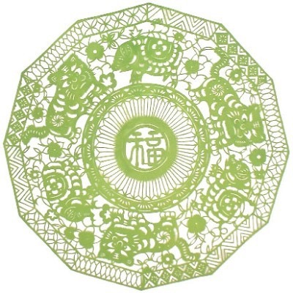
Symmetry in 2-D Paper cutting
C2 Dragons with Sun
C3 Tigers and Pigs

Slide 8
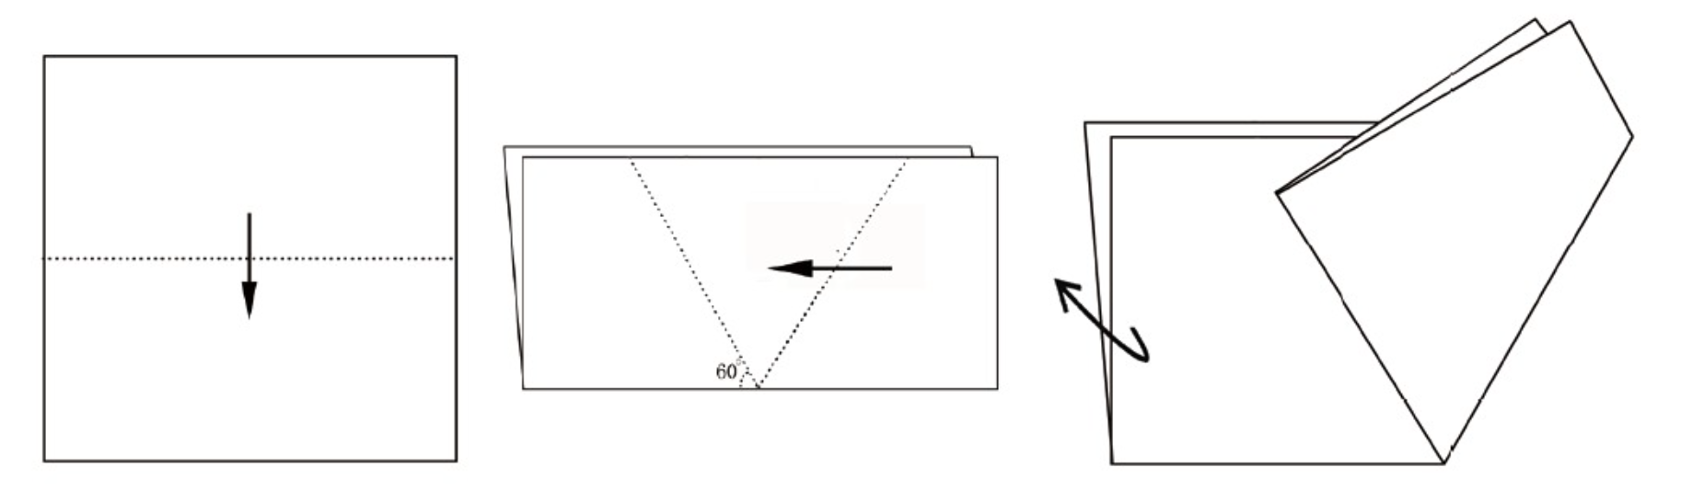
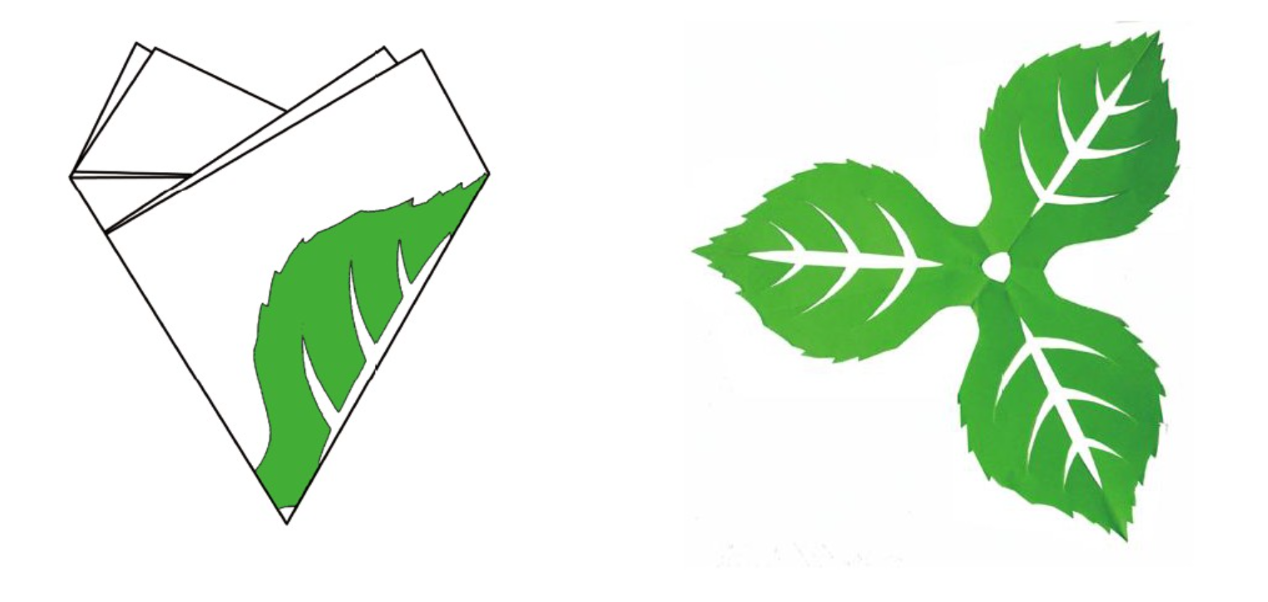
Steps to make a 3-fold paper cut

Slide 9
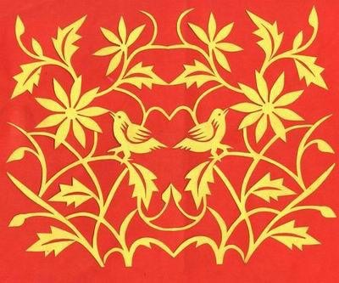
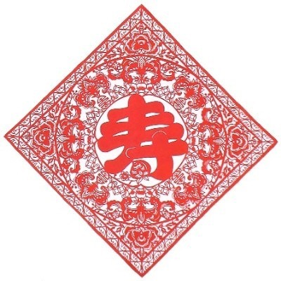
Symmetry in 2-D Paper cutting
D1 Double Birds
D4 Longevity

Slide 10
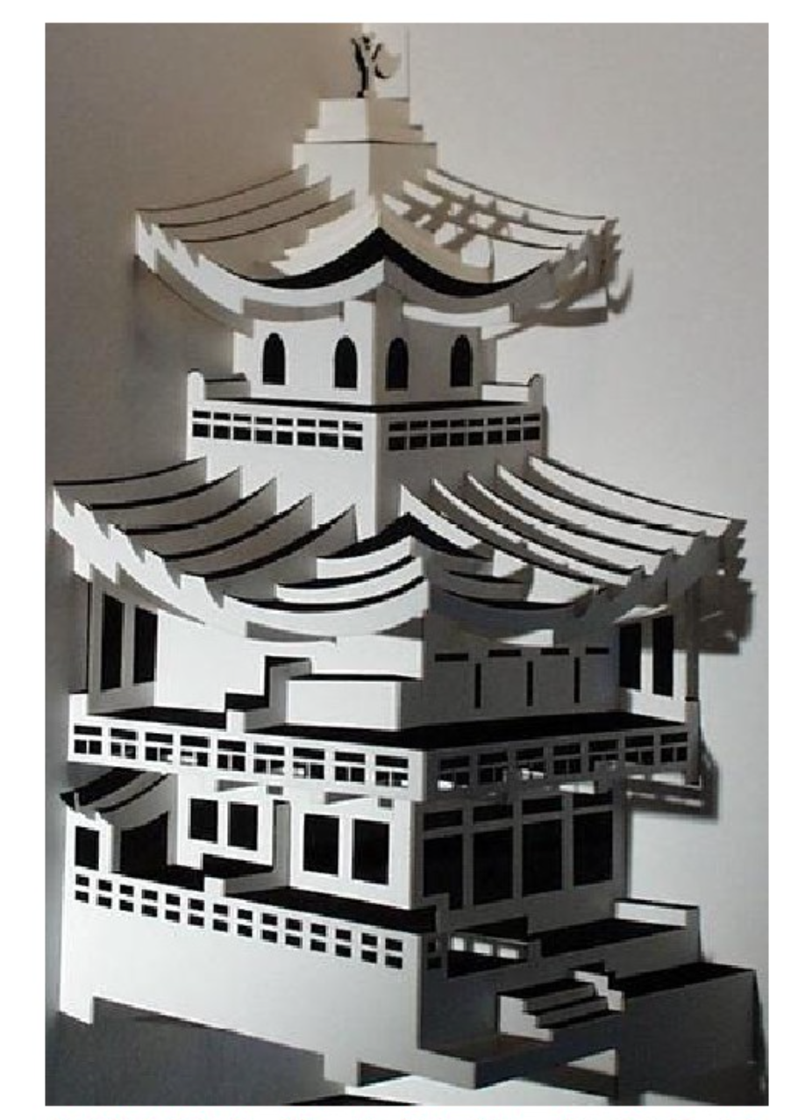
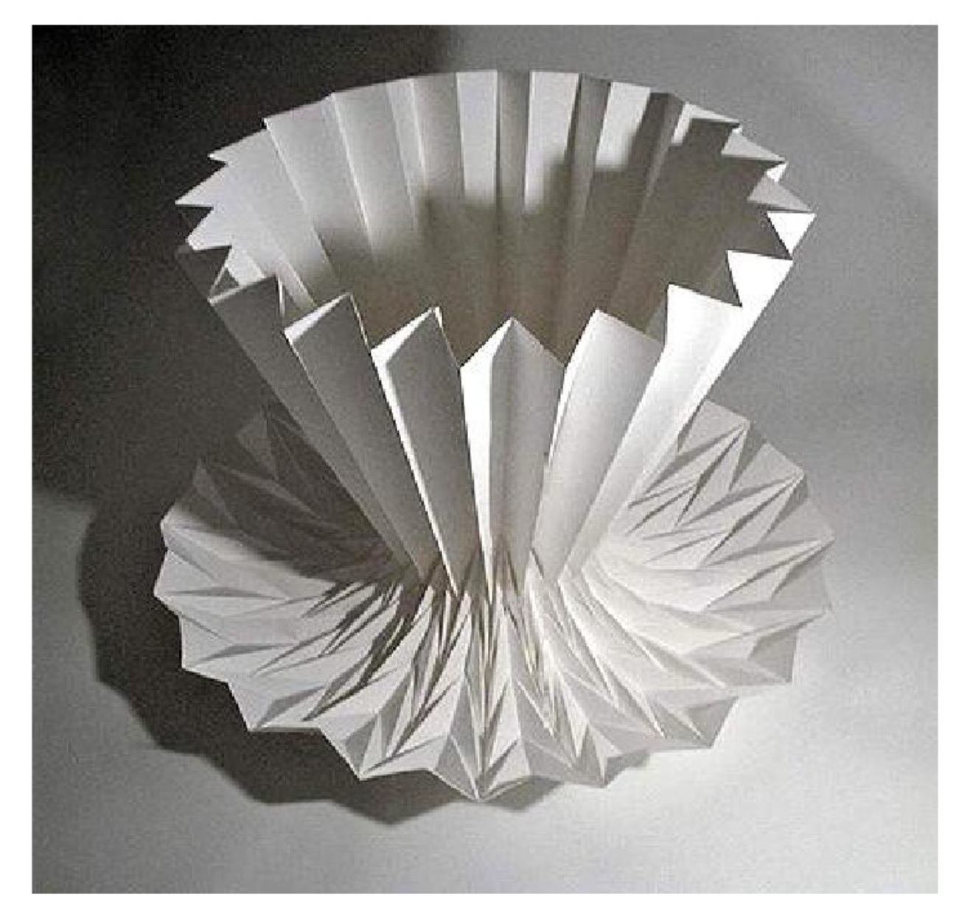
Some example of 3D Paper Cut
C4V
C24V

Slide 11
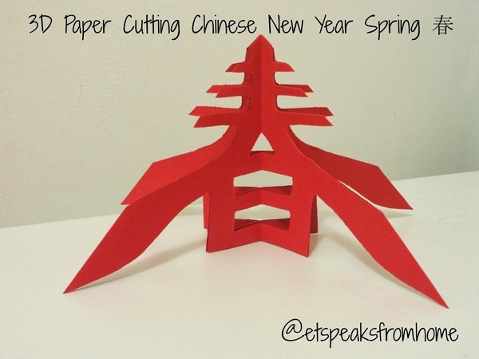
Symmetry in 3D Paper-cutting
C4V Spring

Slide 12
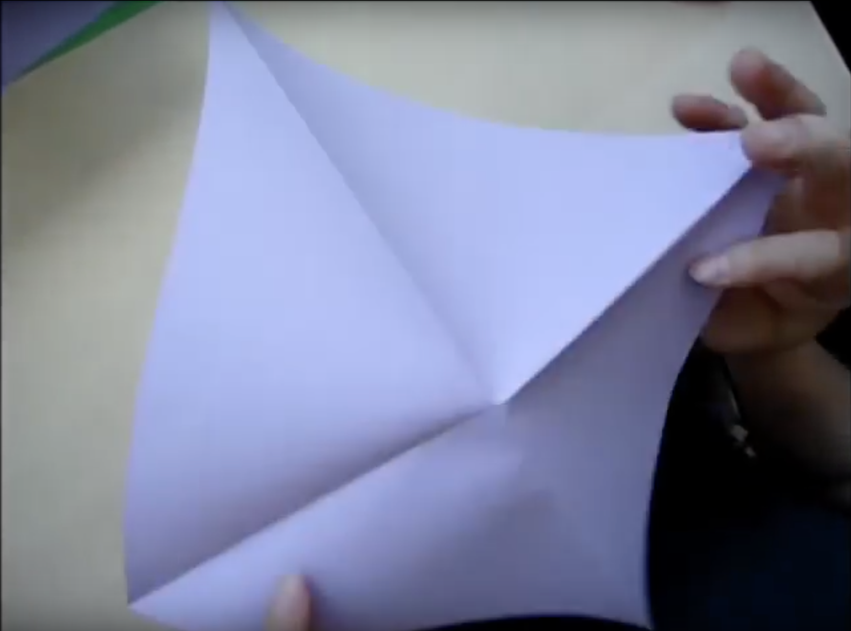
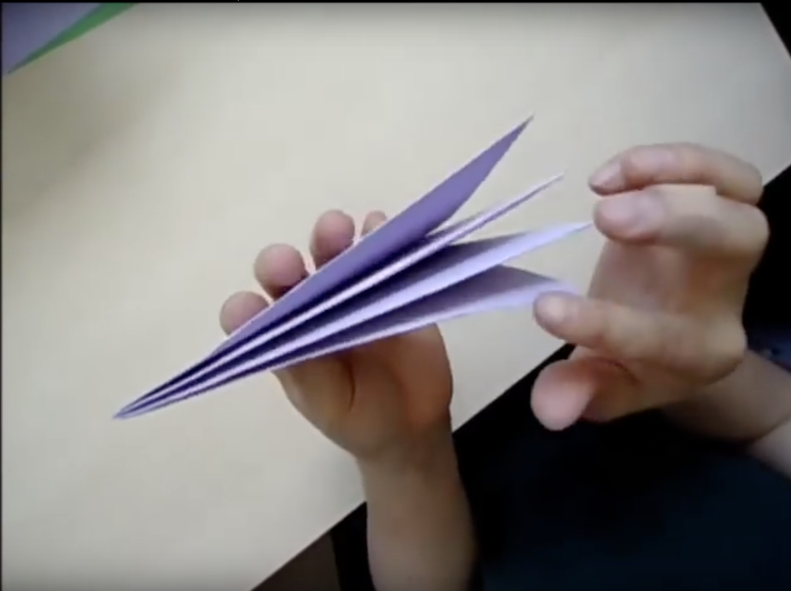
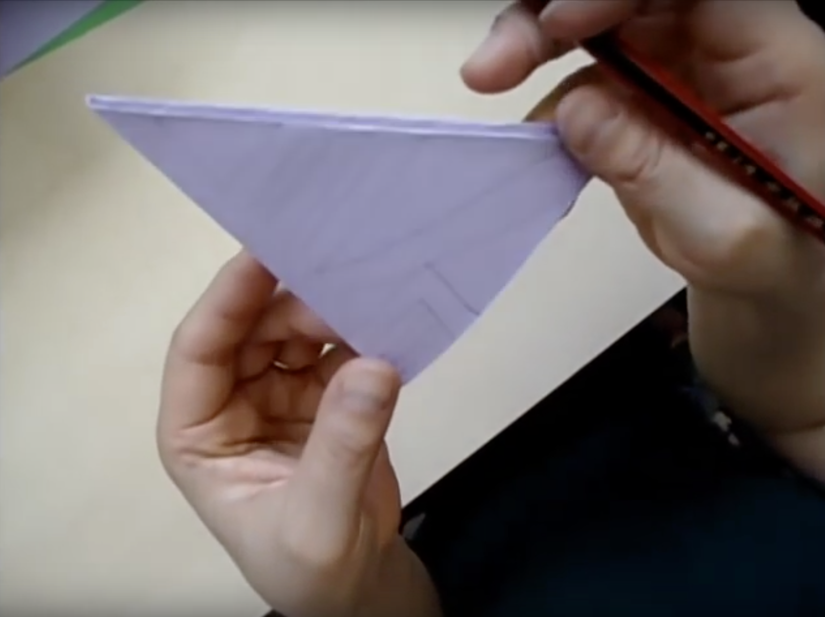
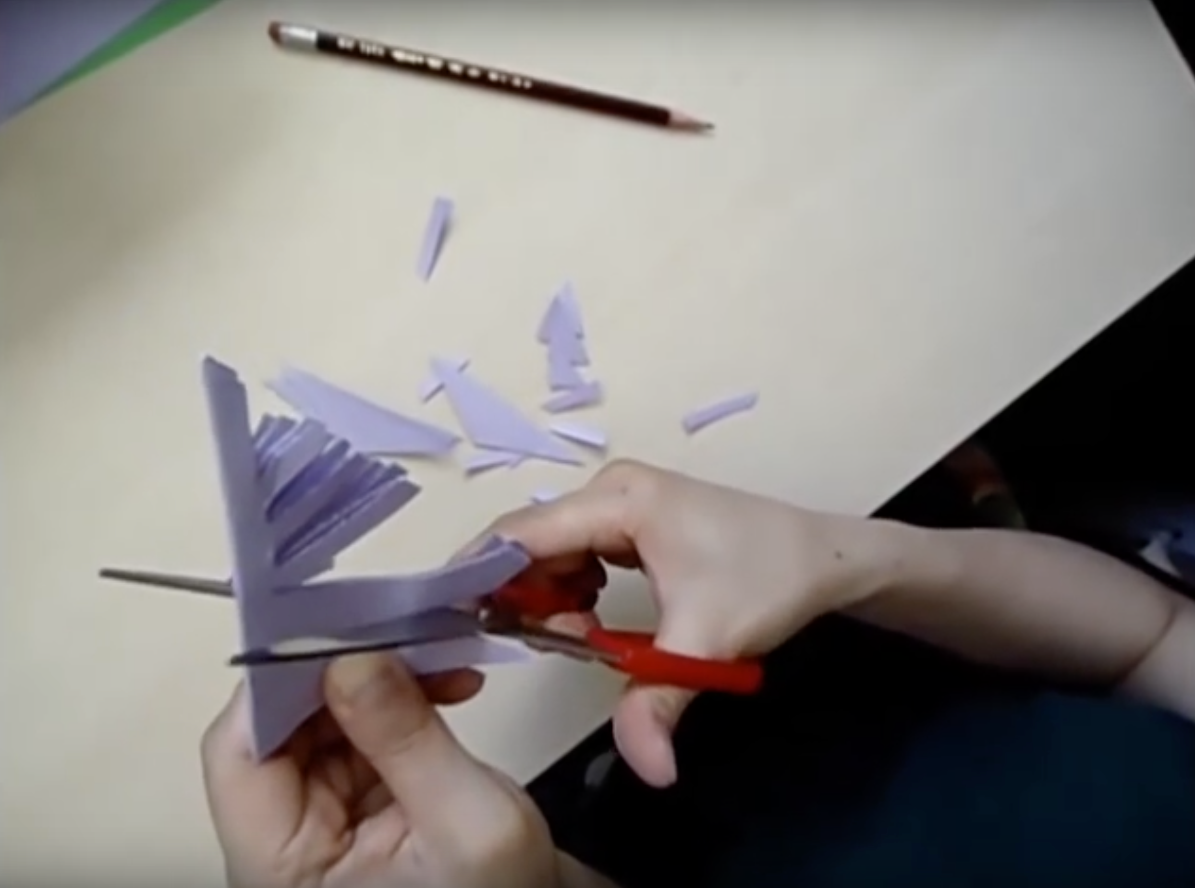
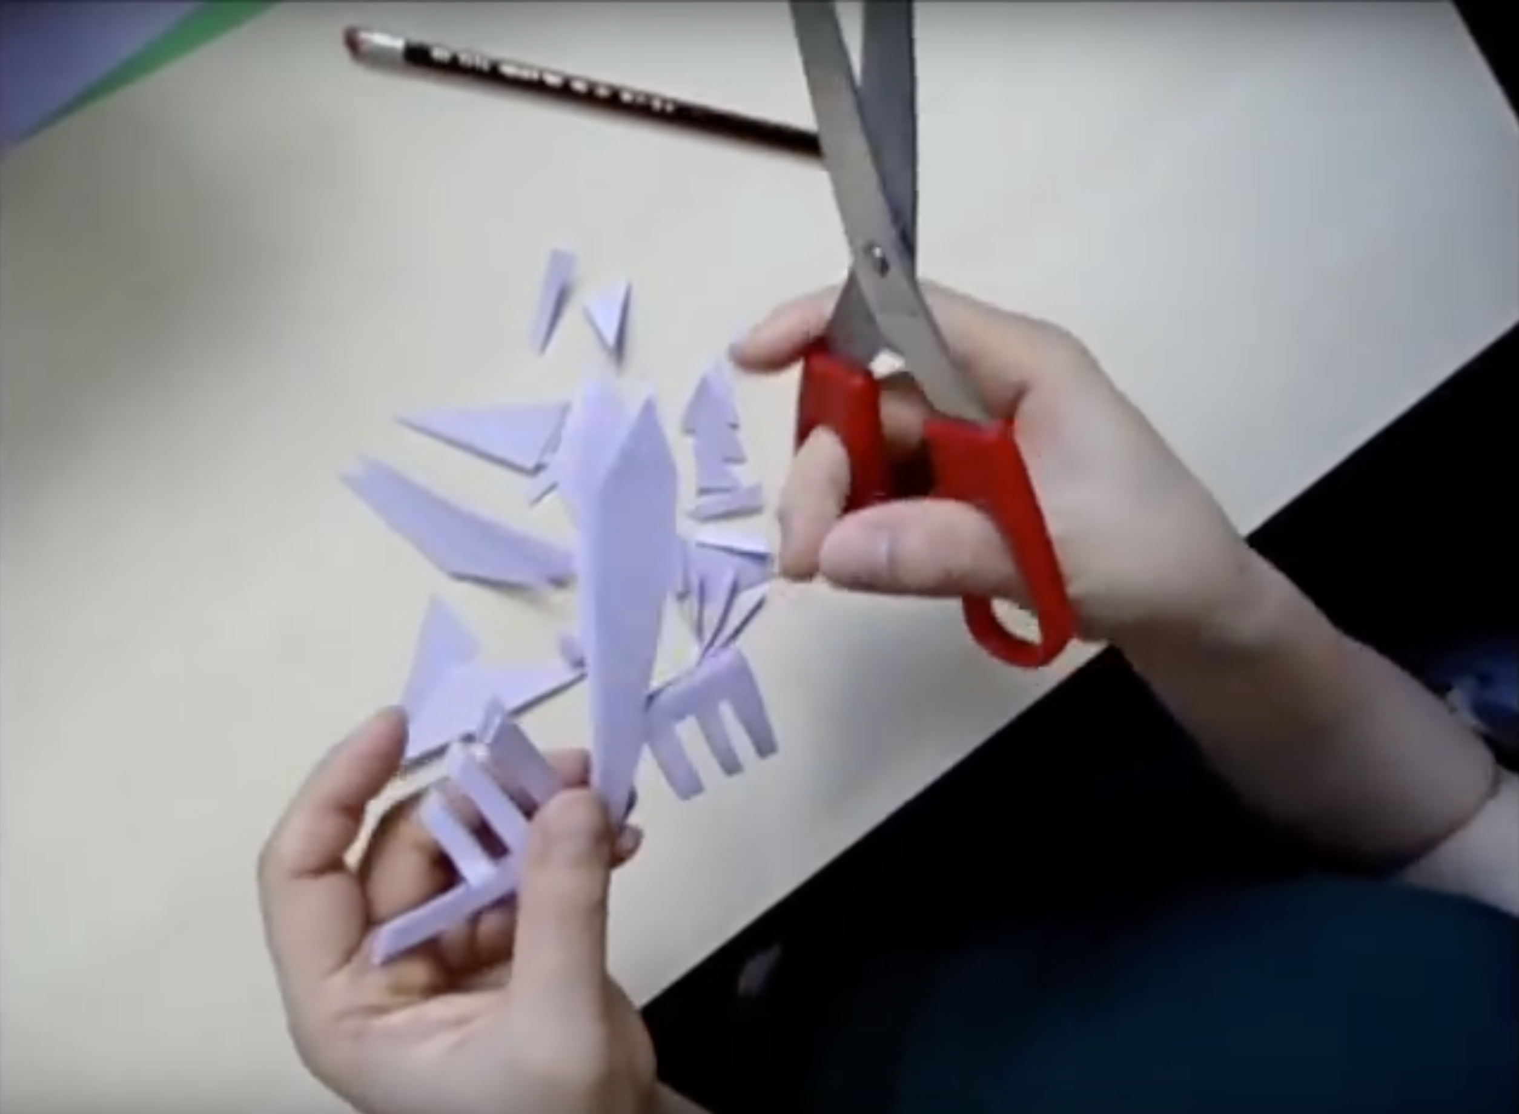
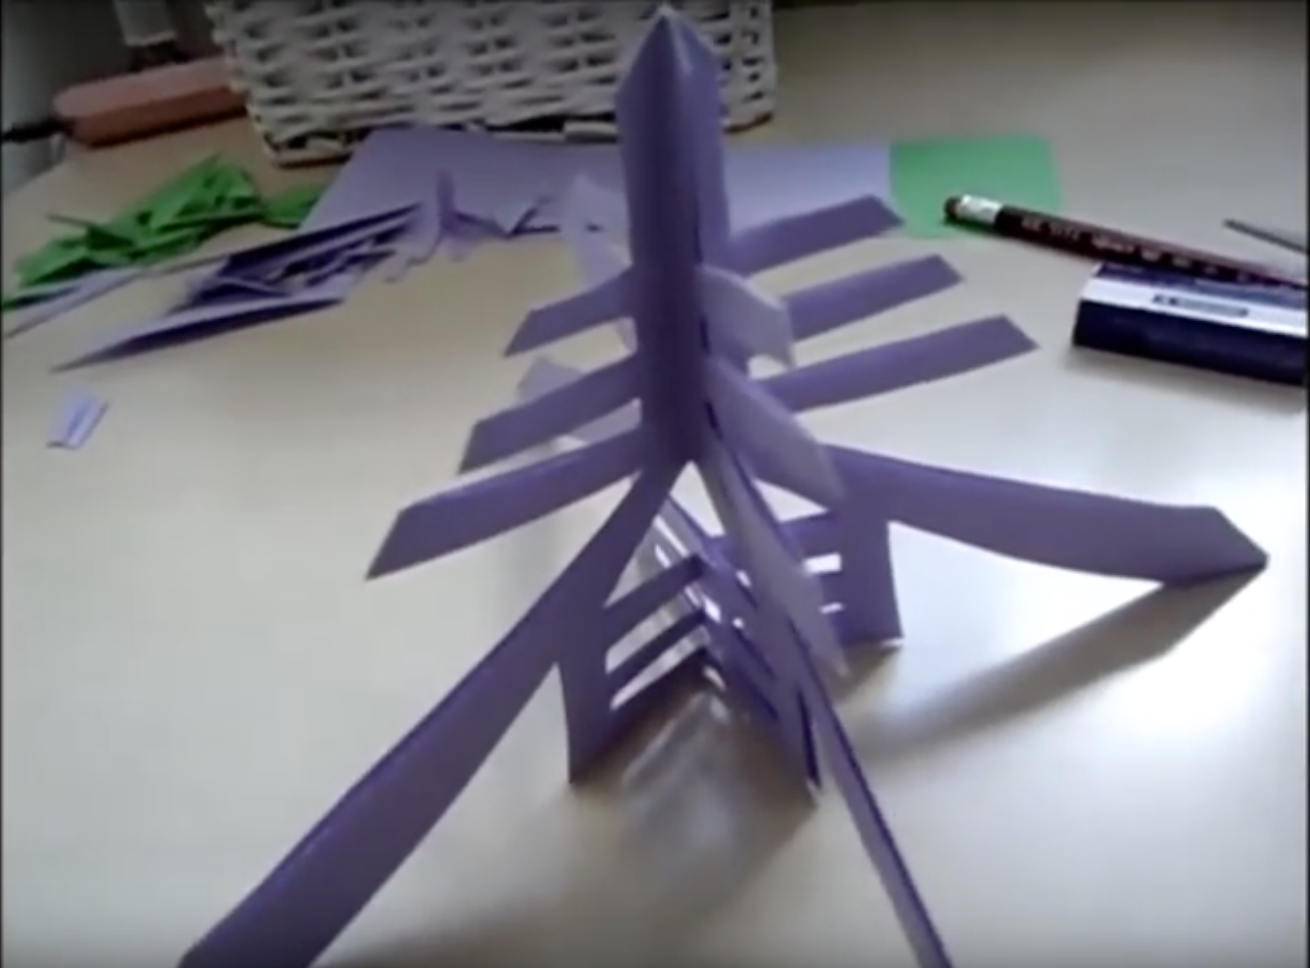
Steps to make it

Slide 13
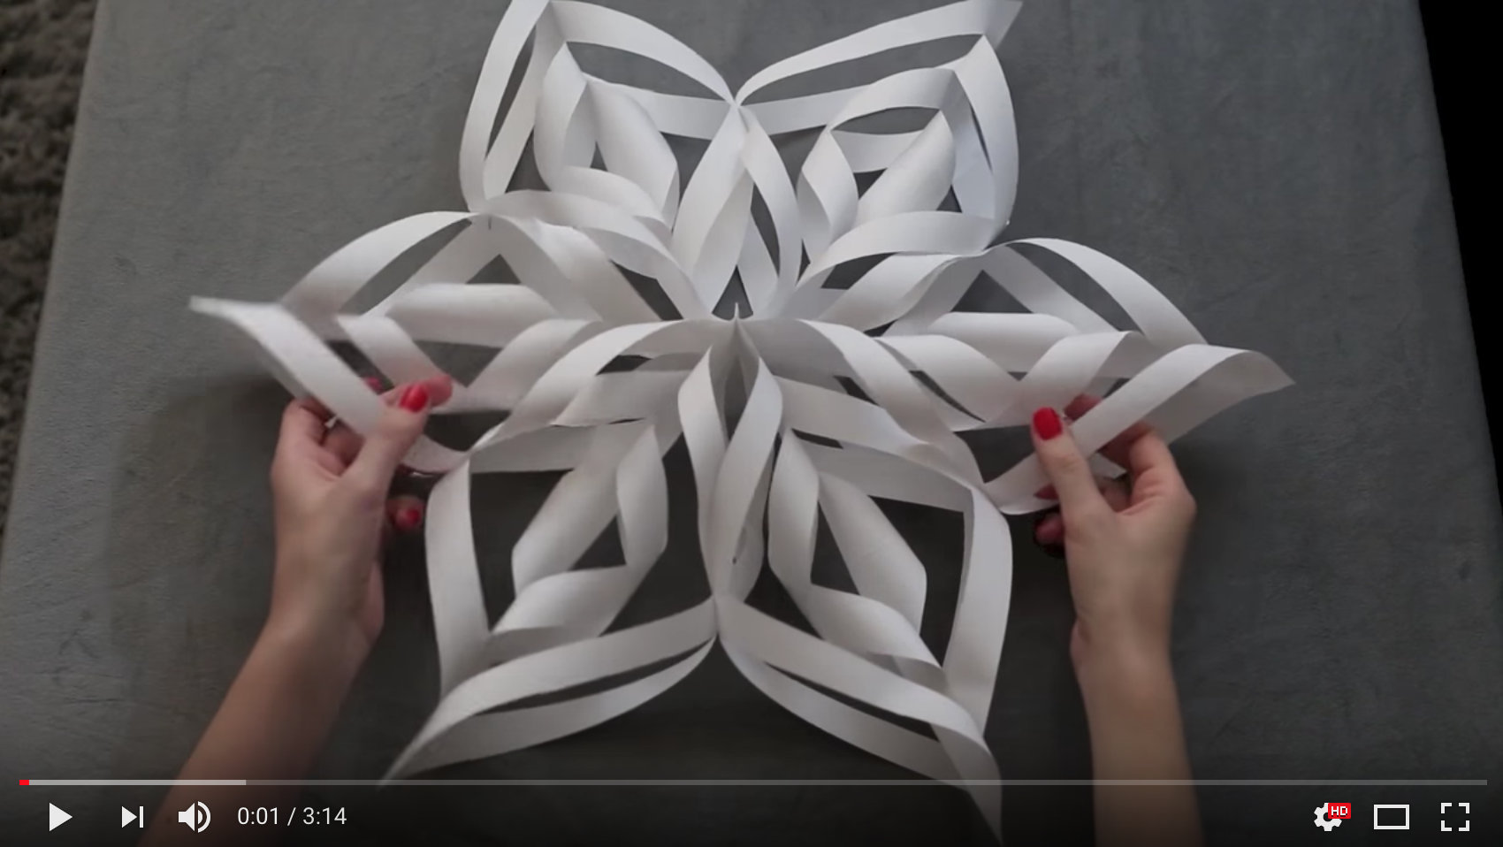
How to make a 3D Paper Snowflake
https://www.youtube.com/watch?v=lT2oeNkTOAk

Slide 14
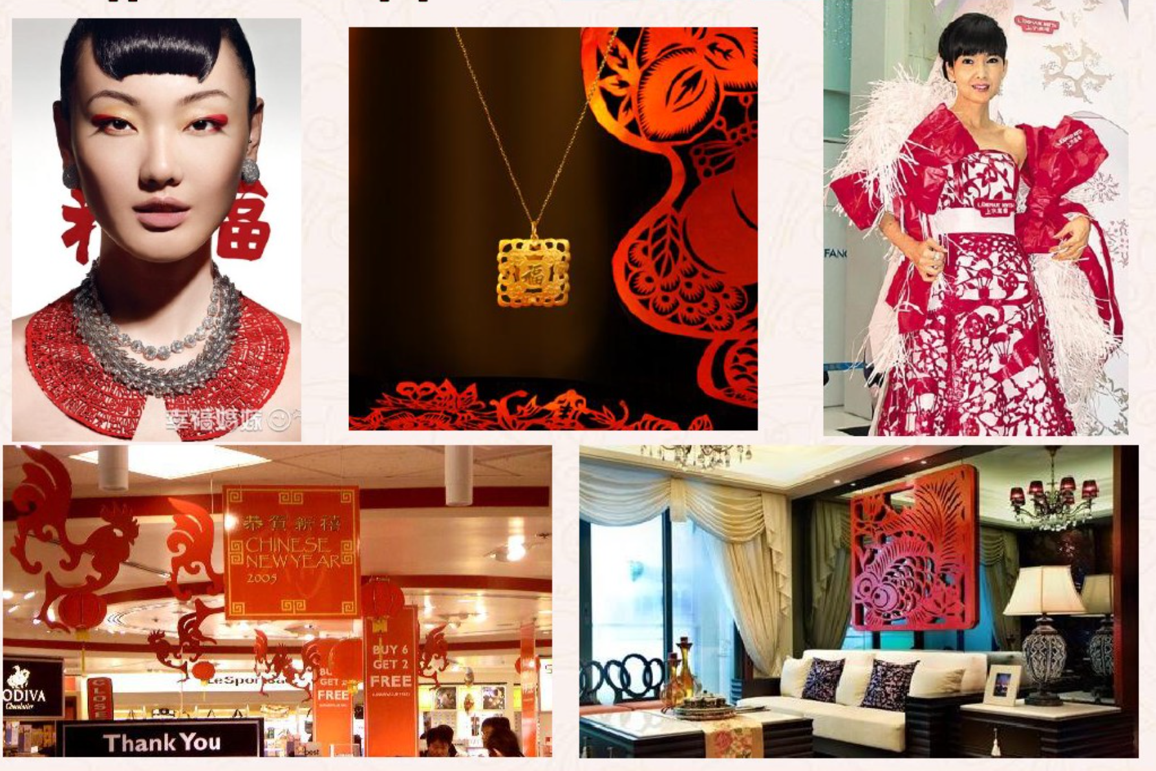
Applications of Papercut

Slide 15
Thank you!

