Slide 1
Symmetry in Jazz
Alex Almond

Slide 2
Presentation Roadmap
Observe how Coltrane incorporates symmetries to create a masterful jazz solo
Difference from symmetry in classical music: completely improvised, and is not refined: ‘on the spot’ symmetry
Key Question:
  Can an entire symmetrical solo be designed over 2 choruses of the chord changes in Coltrane’s Mr. PC utilizing all 7 frieze symmetries?
  What would it sound like to write a premeditated, entirely symmetrical over chord changes solo ?

Slide 3
Jazz Essentials & Applications of Frieze Symmetries
(Loose) Interpretation of symmetry: staff line OR halfway ’line’ between each staff line
Different jazz genres follow different set chord changes: blues changes, rhythm changes, etc.
Key concept: certain notes are ‘right’, others ‘wrong’ over chords

Slide 4
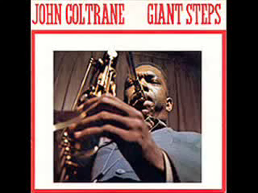

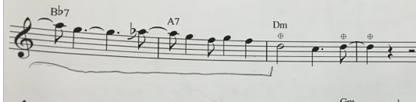
Rotating the “Top” (D_n)
In a typical jazz piece, the intro to the
song is called the ’head’
Observe the rotational symmetry used
Defines the melodic structure
Audio:

Slide 5
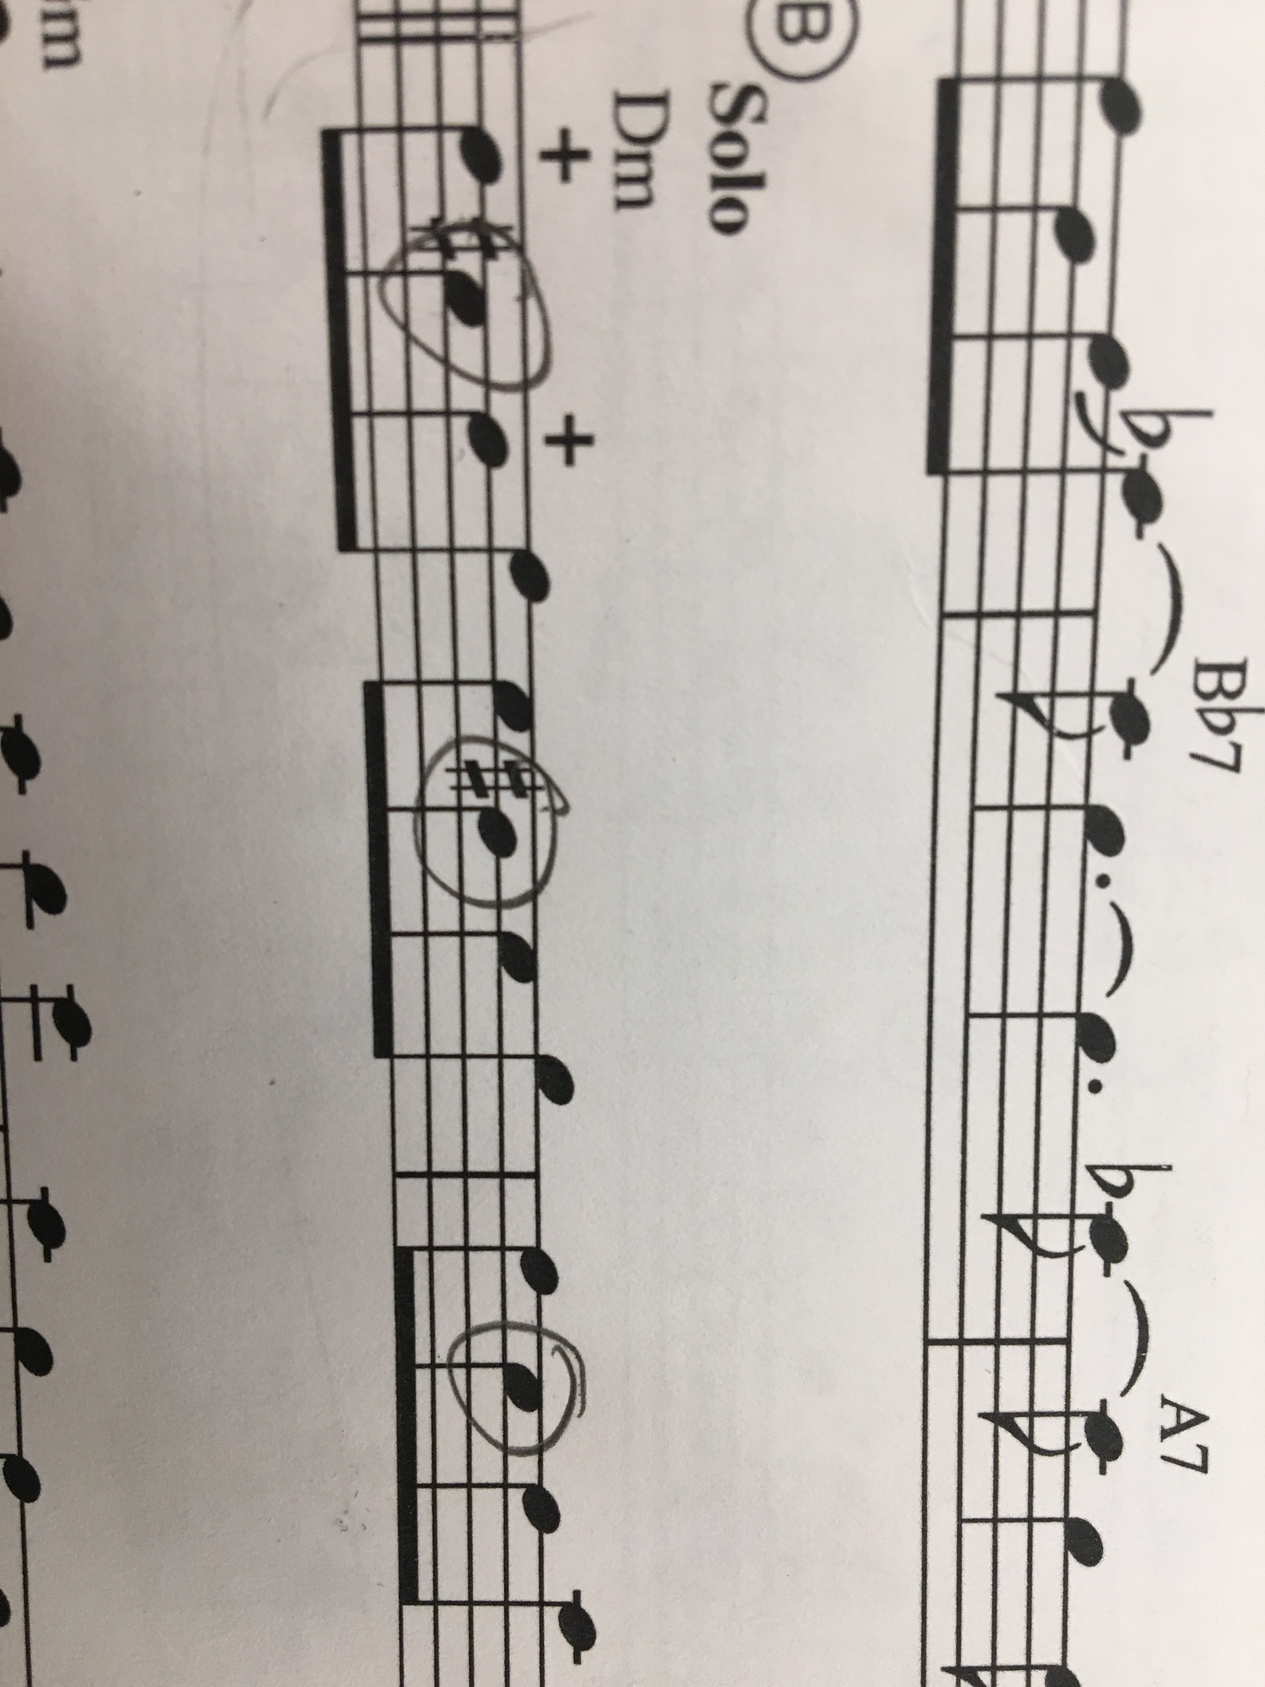
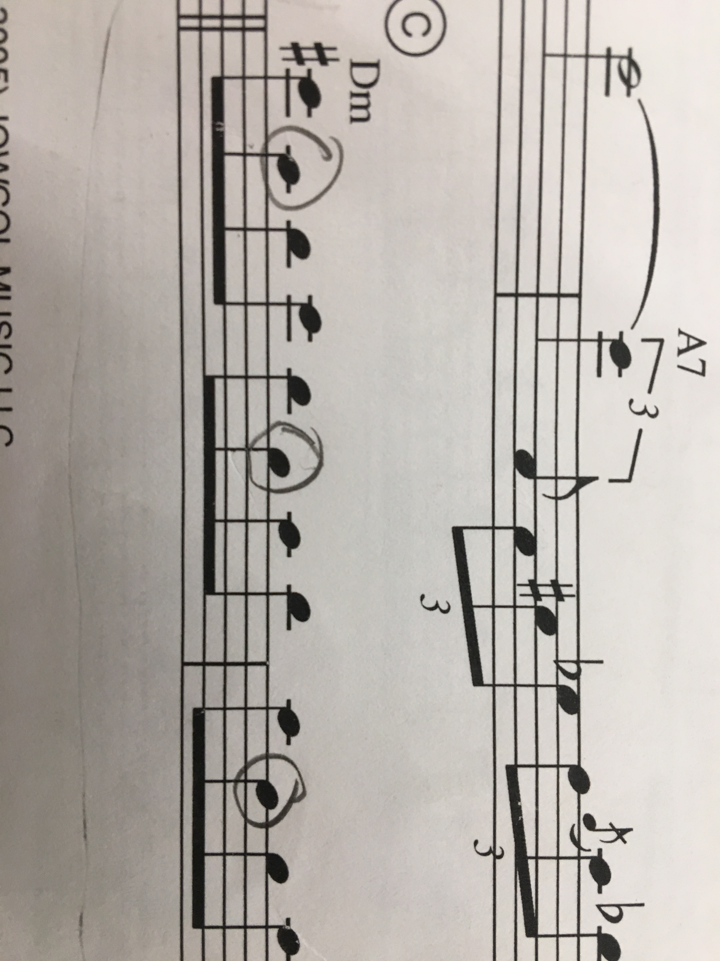
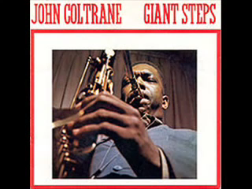
Flip The Script (C_nh) (Imporvised)
Why its important: Taking an idea and making it a motif makes the solo appealing: analogous to sketching before painting
Ascending
Descending
Audio:

Slide 6
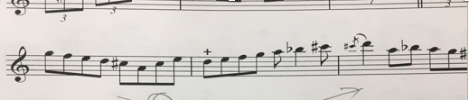
Descend and ascend (C_nv) (Improvised)
Audio:
`
Quick usage of Cnv vertical symmetry to navigate up and down the d minor scale
Why its important: connecting ideas makes the solo feel less disjointed and as if it is building upon itself

Slide 7
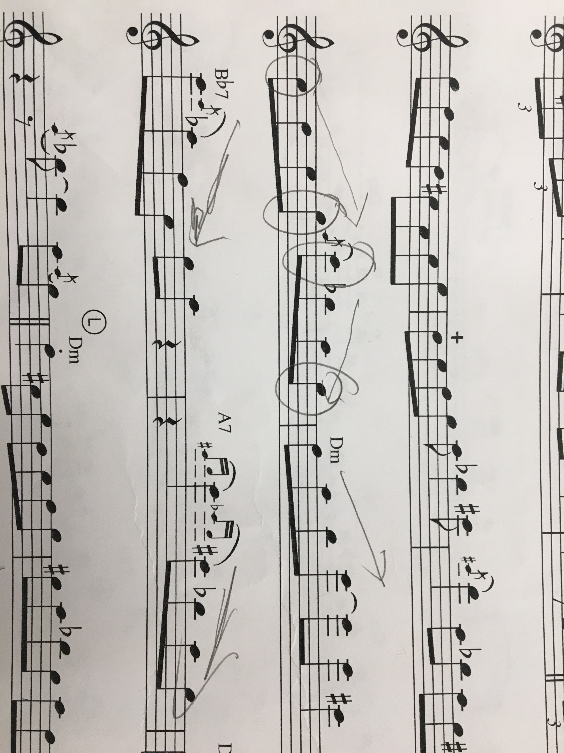

Glidin’ (S_2h) (Improvised)
Audio:
Why its important:
  Here, Coltrane builds
  upon the ascending/
  descending idea
  discussed in the
  previous slide

Slide 8
Making my own Symmetrical Solo
Is it possible, and what would it sound like?
It is possible to write anything symmetrically, but it would not necessarily sound good over the chord changes?
Constraints:
  only chord tones allowed
  Has to be consistently symmetrical over only one line in the staff for the entirety of the solo

Slide 9

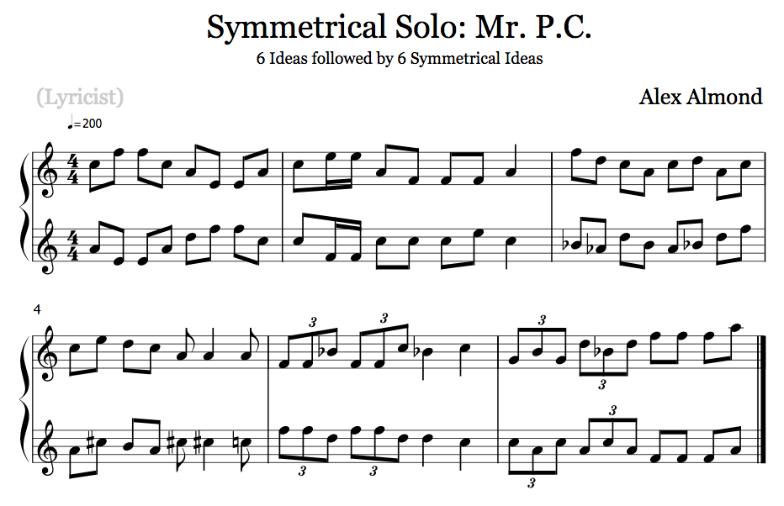
The solo:
Audio:
Bars 1-3
Bars 7-9
Bars 4-6
Bars 10-12

Slide 10
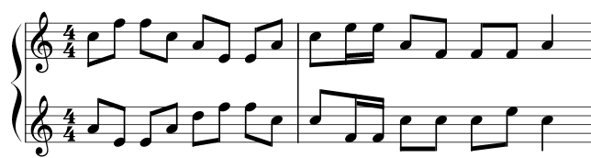


Part 1
For those who read/play music:
Note: I already cheated a bit ! A
Non-Chord Tone was used in the
First bar… which one?
Audio:
Chord: Dminor
Symmetry: Dnh
Chord: Dminor
Symmetry: S2n
S2N when examined side by side

Slide 11
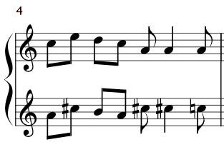
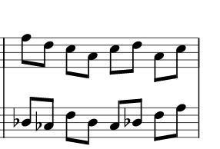




Part 2
Going forward, I decided to allow the second tone of the chord in all instances
Symmetry: Cnv
Symmetry: Cn
Chord: Dm
Chord: Dm
Chord: Bb7
Chord: A7

Slide 12
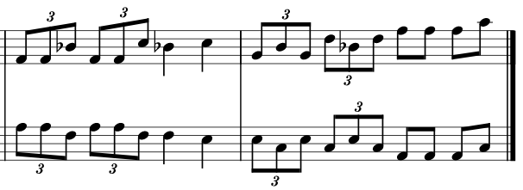


Part 3
Dnd only up to the blue line
Axis of symmetry: middle staff line
Symmetry: Dnd
Symmetry: Cnv
Chord: Gm
Chord: Dm
Overlaid, the axis of symmetry would be between the 3rd and 4th staff lines
Glide:

Slide 13
Difficulties Encountered + Takeaways
It’s possible to write a solo under my conditions, but with little to no variety and with copious exceptions:
  Had to allow 2nd chord tone
  Minimal use of ‘root’ made it sound non-conventional
The solo is rather 1-dimensional
Does not flow very nicely
‘Absolute symmetry’ removes creative possibilities,
  medium of giving solo direction/purpose,
  juxtaposition

