Slide 1
CS162
Operating Systems and
Systems Programming
Lecture 4
Introduction to I/O,
Sockets, Networking
January 31st, 2019
Prof. John Kubiatowicz
http://cs162.eecs.Berkeley.edu

Slide 2
Recall: Fork, Wait, and (optional) Exec
cpid = fork();
if (cpid > 0) { // Parent Process
mypid = getpid();
printf("[%d] parent of [%d]\n", mypid, cpid);
tcpid = wait(&status);
printf("[%d] bye %d\n", mypid, tcpid);
} else if (cpid == 0) { // Child Process
mypid = getpid();
printf("[%d] child\n", mypid);
execl(filename,(char *)0); // Opt: start new program
} else { // Error! }
Return value from Fork: integer
  When > 0: return value is pid of new child (Running in Parent)
  When = 0: Running in new Child process
  When < 0: Error! Must handle somehow
Wait() system call: wait for next child to exit
  Return value is PID of terminating child
  Argument is pointer to integer variable to hold exit status
Exec() family of calls: replace process with new executable

Slide 3
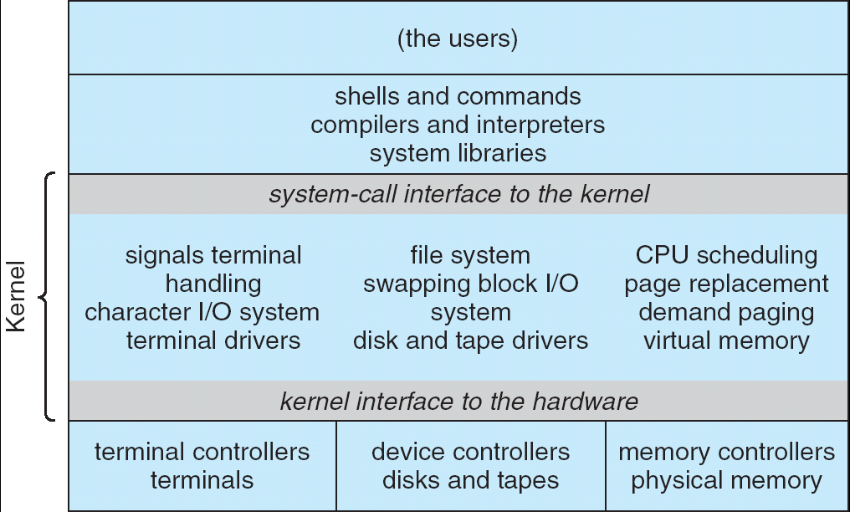
Recall: UNIX System Structure
Applications
User Mode
Standard Libs
Kernel Mode
Hardware

Slide 4
A Kind of Narrow Waist
Word Processing
Compilers
Web Browsers
Email
Databases
Web Servers
Application / Service
Portable OS Library
OS
User
System Call
Interface
System
Portable OS Kernel
Software
Platform support, Device Drivers
Hardware
x86
PowerPC
ARM
PCI
Ethernet (1Gbs/10Gbs)
802.11 a/g/n/ac
SCSI
Graphics
Thunderbolt

Slide 5
Key Unix I/O Design Concepts
Uniformity
  file operations, device I/O, and interprocess communication through open, read/write, close
  Allows simple composition of programs
    find | grep | wc …
Open before use
  Provides opportunity for access control and arbitration
  Sets up the underlying machinery, i.e., data structures
Byte-oriented
  Even if blocks are transferred, addressing is in bytes
Kernel buffered reads
  Streaming and block devices looks the same
  read blocks process, yielding processor to other task

Slide 6
Putting it together: web server
Kernel buffer reads
Server
4. parse request
9. format reply
request
buffer
reply
buffer
network
socket
read
3. kernel
copy
10. network
socket
write
5. file
read
8. kernel
copy
syscall
syscall
Kernel
wait
RTU
11. kernel copy
from user buffer
to network buffer
RTU
interrupt
interrupt
2. copy arriving
packet (DMA)
12. format outgoing
packet and DMA
6. disk
request
7. disk data
(DMA)
Hardware
Network
interface
Disk interface
Request
Reply

Slide 7
Key Unix I/O Design Concepts
Uniformity
  file operations, device I/O, and interprocess communication through open, read/write, close
  Allows simple composition of programs
    find | grep | wc …
Open before use
  Provides opportunity for access control and arbitration
  Sets up the underlying machinery, i.e., data structures
Byte-oriented
  Even if blocks are transferred, addressing is in bytes
Kernel buffered reads
  Streaming and block devices looks the same
  read blocks process, yielding processor to other task
Kernel buffered writes
  Completion of out-going transfer decoupled from the application, allowing it to continue

Slide 8
Putting it together: web server
Kernel buffer write
Server
4. parse request
9. format reply
request
buffer
reply
buffer
network
socket
read
3. kernel
copy
10. network
socket
write
5. file
read
8. kernel
copy
syscall
syscall
Kernel
wait
RTU
11. kernel copy
from user buffer
to network buffer
RTU
interrupt
interrupt
2. copy arriving
packet (DMA)
12. format outgoing
packet and DMA
6. disk
request
7. disk data
(DMA)
Hardware
Network
interface
Disk interface
Request
Reply

Slide 9
Key Unix I/O Design Concepts
Uniformity
  file operations, device I/O, and interprocess communication through open, read/write, close
  Allows simple composition of programs
    find | grep | wc …
Open before use
  Provides opportunity for access control and arbitration
  Sets up the underlying machinery, i.e., data structures
Byte-oriented
  Even if blocks are transferred, addressing is in bytes
Kernel buffered reads
  Streaming and block devices looks the same
  read blocks process, yielding processor to other task
Kernel buffered writes
  Completion of out-going transfer decoupled from the application, allowing it to continue
Explicit close

Slide 10
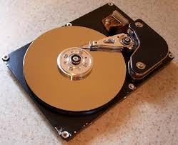
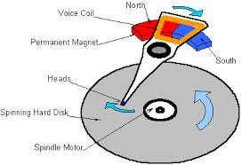
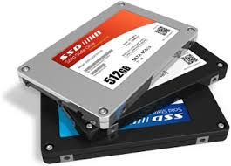

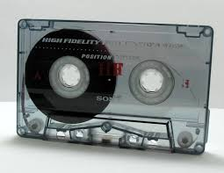
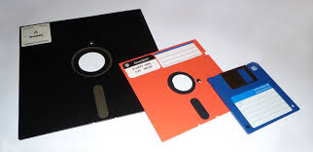
I/O & Storage Layers
Application / Service
High Level I/O
streams
Low Level I/O
handles
Syscall
registers
File System
descriptors
I/O Driver
Commands and Data Transfers
Disks, Flash, Controllers, DMA

Slide 11
The File System Abstraction
High-level idea
  Files live in hierarchical namespace of filenames
File
  Named collection of data in a file system
  File data
    Text, binary, linearized objects
  File Metadata: information about the file
    Size, Modification Time, Owner, Security info
    Basis for access control
Directory
  “Folder” containing files & Directories
  Hierachical (graphical) naming
    Path through the directory graph
    Uniquely identifies a file or directory
      /home/ff/cs162/public_html/fa18/index.html
  Links and Volumes (later)

Slide 12
Recall: C High-Level File API – Streams
Operate on “streams” - sequence of bytes, whether text or data, with a position
#include <stdio.h>
FILE *fopen( const char *filename, const char *mode );
int fclose( FILE *fp );
Mode Text | Binary | Descriptions
r | rb | Open existing file for reading
w | wb | Open for writing; created if does not exist
a | ab | Open for appending; created if does not exist
r+ | rb+ | Open existing file for reading & writing.
w+ | wb+ | Open for reading & writing; truncated to zero if exists, create otherwise
a+ | ab+ | Open for reading & writing. Created if does not exist. Read from beginning, write as append
Don’t forget to flush

Slide 13
Connecting Processes, Filesystem, and Users
Process has a ‘current working directory’
Absolute Paths
  /home/ff/cs162
Relative paths
  index.html, ./index.html - current WD
  ../index.html - parent of current WD
  ~, ~cs162 - home directory

Slide 14
C API Standard Streams
Three predefined streams are opened implicitly when a program is executed
  FILE *stdin – normal source of input, can be redirected
  FILE *stdout – normal source of output, can be redirected
  FILE *stderr – diagnostics and errors, can be redirected
STDIN / STDOUT enable composition in Unix
  Recall: Use of pipe symbols connects STDOUT and STDIN
    find | grep | wc …

Slide 15

C high level File API – Stream Ops
#include <stdio.h>
// character oriented
int fputc( int c, FILE *fp ); // rtn c or EOF on err
int fputs( const char *s, FILE *fp ); // rtn >0 or EOF
int fgetc( FILE * fp );
char *fgets( char *buf, int n, FILE *fp );

Slide 16
C high level File API – Stream Ops
#include <stdio.h>
// character oriented
int fputc( int c, FILE *fp ); // rtn c or EOF on err
int fputs( const char *s, FILE *fp ); // rtn >0 or EOF
int fgetc( FILE * fp );
char *fgets( char *buf, int n, FILE *fp );
// block oriented
size_t fread(void *ptr, size_t size_of_elements,
size_t number_of_elements, FILE *a_file);
size_t fwrite(const void *ptr, size_t size_of_elements,
size_t number_of_elements, FILE *a_file);

Slide 17
C high level File API – Stream Ops
#include <stdio.h>
// character oriented
int fputc( int c, FILE *fp ); // rtn c or EOF on err
int fputs( const char *s, FILE *fp ); // rtn >0 or EOF
int fgetc( FILE * fp );
char *fgets( char *buf, int n, FILE *fp );
// block oriented
size_t fread(void *ptr, size_t size_of_elements,
size_t number_of_elements, FILE *a_file);
size_t fwrite(const void *ptr, size_t size_of_elements,
size_t number_of_elements, FILE *a_file);
// formatted
int fprintf(FILE *restrict stream, const char *restrict format, ...);
int fscanf(FILE *restrict stream, const char *restrict format, ...);

Slide 18
Example Code
#include <stdio.h>
#define BUFLEN 256
FILE *outfile;
char mybuf[BUFLEN];
int storetofile() {
char *instring;
outfile = fopen("/usr/homes/testing/tokens", "w+");
if (!outfile)
return (-1); // Error!
while (1) {
instring = fgets(mybuf, BUFLEN, stdin); // catches overrun!
// Check for error or end of file (^D)
if (!instring || strlen(instring)==0) break;
// Write string to output file, exit on error
if (fputs(instring, outfile)< 0) break;
}
fclose(outfile); // Flushes from userspace
}

Slide 19
C Stream API positioning
int fseek(FILE *stream, long int offset, int whence);
long int ftell (FILE *stream)
void rewind (FILE *stream)
High Level I/O
offset (SEEK_SET)
offset (SEEK_END)
Low Level I/O
whence
Syscall
File System
offset (SEEK_CUR)
I/O Driver
Preserves high level abstraction of uniform stream of objects
Adds buffering for performance

Slide 20
What’s below the surface ??
Application / Service
High Level I/O
streams
Low Level I/O
handles
Syscall
registers
File System
descriptors
I/O Driver
commands and Data Transfers
disks, flash, controllers, DMA

Slide 21
C Low level I/O
Operations on File Descriptors – as OS object representing the state of a file
  User has a “handle” on the descriptor
#include <fcntl.h>
#include <unistd.h>
#include <sys/types.h>
int open (const char *filename, int flags [, mode_t mode])
int creat (const char *filename, mode_t mode)
int close (int filedes)
Bit vector of:
Access modes (Rd, Wr, …)
Open Flags (Create, …)
Operating modes (Appends, …)
Bit vector of Permission Bits:
User|Group|Other X R|W|X
http://www.gnu.org/software/libc/manual/html_node/Opening-and-Closing-Files.html

Slide 22
C Low Level: standard descriptors
#include <unistd.h>
STDIN_FILENO - macro has value 0
STDOUT_FILENO - macro has value 1
STDERR_FILENO - macro has value 2
int fileno (FILE *stream)
FILE * fdopen (int filedes, const char *opentype)
Crossing levels: File descriptors vs. streams
Don’t mix them!

Slide 23
C Low Level Operations
ssize_t read (int filedes, void *buffer, size_t maxsize)
- returns bytes read, 0 => EOF, -1 => error
ssize_t write (int filedes, const void *buffer, size_t size)
- returns bytes written
off_t lseek (int filedes, off_t offset, int whence)
int fsync (int fildes) – wait for i/o to finish
void sync (void) – wait for ALL to finish
When write returns, data is on its way to disk and can be read, but it may not actually be permanent!

Slide 24
And lots more !
TTYs versus files
Memory mapped files
File Locking
Asynchronous I/O
Generic I/O Control Operations
Duplicating descriptors
int dup2 (int old, int new)
int dup (int old)
Notes:
The dup2() system call is similar to dup() but the basic difference between them is that instead of using the lowest-numbered unused file descriptor, it uses the descriptor number specified by the user.

Slide 25
Another example: lowio-std.c
#include <stdlib.h>
#include <stdio.h>
#include <string.h>
#include <unistd.h>
#include <sys/types.h>
#define BUFSIZE 1024
int main(int argc, char *argv[])
{
char buf[BUFSIZE];
ssize_t writelen = write(STDOUT_FILENO, "I am a process.\n", 16);
ssize_t readlen = read(STDIN_FILENO, buf, BUFSIZE);
ssize_t strlen = snprintf(buf, BUFSIZE,"Got %zd chars\n", readlen);
writelen = strlen < BUFSIZE ? strlen : BUFSIZE;
write(STDOUT_FILENO, buf, writelen);
exit(0);
}

Slide 26
Administrivia
Kubiatowicz Office Hours:
  1-2pm, Monday & Thursday
No one left on WaitList! Everyone left is in the class.
  Could take a few concurrent enrollment students: know any?
TOMORROW (Friday) is Drop Deadline!
VERY HARD TO DROP LATER!
Recommendation: Read assigned readings before lecture
You should be going to sections now – Important information covered in section
  Any section will do until groups assigned
Group sign up via autograder form next week
  Get finding groups of 4 people ASAP
  Priority for same section; if cannot make this work, keep same TA
  Remember: Your TA needs to see you in section!
Midterm 1 conflicts
  We will handle these conflicts next week

Slide 27
What’s below the surface ??
Application / Service
High Level I/O
streams
Low Level I/O
handles
Syscall
registers
File System
descriptors
I/O Driver
Commands and Data Transfers
Disks, Flash, Controllers, DMA

Slide 28
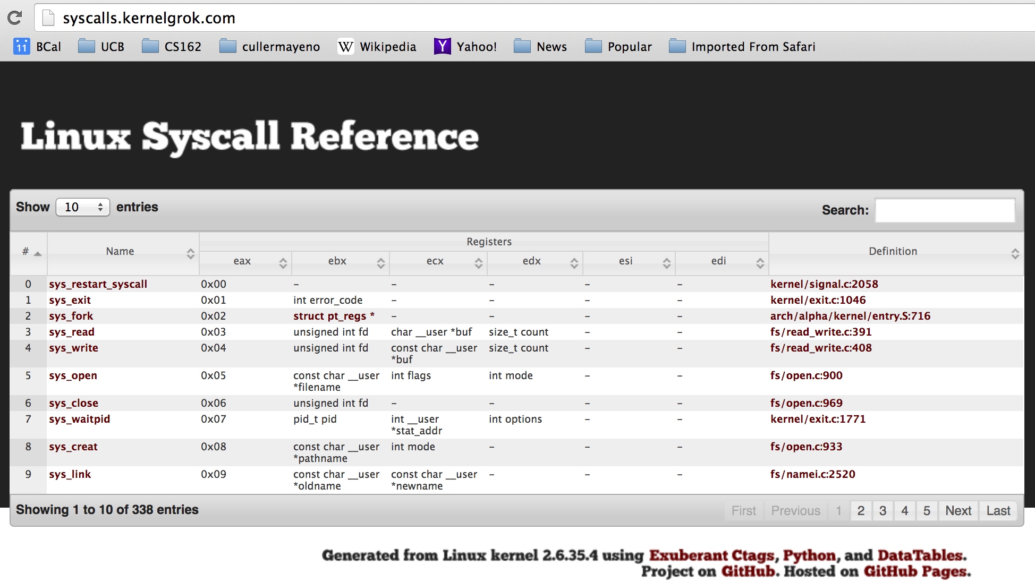
Recall: SYSCALL
Low level lib parameters are set up in registers and syscall instruction is issued
  A type of synchronous exception that enters well-defined entry points into kernel

Slide 29
What’s below the surface ??
File descriptor number
- an int
Application / Service
High Level I/O
streams
Low Level I/O
handles
Syscall
registers
File System
descriptors
File Descriptors
a struct with all the info about the files
I/O Driver
Commands and Data Transfers
Disks, Flash, Controllers, DMA

Slide 30
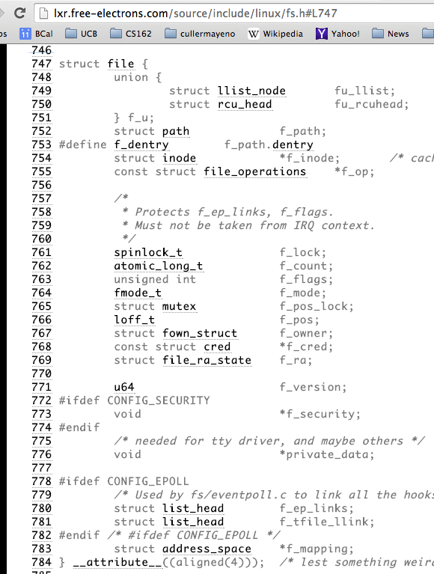
Internal OS File Descriptor
Internal Data Structure describing everything about the file
  Where it resides
  Its status
  How to access it
Pointer:
struct file *file

Slide 31
File System: from syscall to driver
In fs/read_write.c
ssize_t vfs_read(struct file *file, char __user *buf, size_t count, loff_t *pos)
{
ssize_t ret;
if (!(file->f_mode & FMODE_READ)) return -EBADF;
if (!file->f_op || (!file->f_op->read && !file->f_op->aio_read))
return -EINVAL;
if (unlikely(!access_ok(VERIFY_WRITE, buf, count))) return -EFAULT;
ret = rw_verify_area(READ, file, pos, count);
if (ret >= 0) {
count = ret;
if (file->f_op->read)
ret = file->f_op->read(file, buf, count, pos);
else
ret = do_sync_read(file, buf, count, pos);
if (ret > 0) {
fsnotify_access(file->f_path.dentry);
add_rchar(current, ret);
}
inc_syscr(current);
}
return ret;
}
Read up to “count” bytes from “file” starting from “pos” into “buf”.
Return error or number of bytes read.

Slide 32
File System: from syscall to driver
In fs/read_write.c
ssize_t vfs_read(struct file *file, char __user *buf, size_t count, loff_t *pos)
{
ssize_t ret;
if (!(file->f_mode & FMODE_READ)) return -EBADF;
if (!file->f_op || (!file->f_op->read && !file->f_op->aio_read))
return -EINVAL;
if (unlikely(!access_ok(VERIFY_WRITE, buf, count))) return -EFAULT;
ret = rw_verify_area(READ, file, pos, count);
if (ret >= 0) {
count = ret;
if (file->f_op->read)
ret = file->f_op->read(file, buf, count, pos);
else
ret = do_sync_read(file, buf, count, pos);
if (ret > 0) {
fsnotify_access(file->f_path.dentry);
add_rchar(current, ret);
}
inc_syscr(current);
}
return ret;
}
Make sure we are allowed to read this file

Slide 33
File System: from syscall to driver
In fs/read_write.c
ssize_t vfs_read(struct file *file, char __user *buf, size_t count, loff_t *pos)
{
ssize_t ret;
if (!(file->f_mode & FMODE_READ)) return -EBADF;
if (!file->f_op || (!file->f_op->read && !file->f_op->aio_read))
return -EINVAL;
if (unlikely(!access_ok(VERIFY_WRITE, buf, count))) return -EFAULT;
ret = rw_verify_area(READ, file, pos, count);
if (ret >= 0) {
count = ret;
if (file->f_op->read)
ret = file->f_op->read(file, buf, count, pos);
else
ret = do_sync_read(file, buf, count, pos);
if (ret > 0) {
fsnotify_access(file->f_path.dentry);
add_rchar(current, ret);
}
inc_syscr(current);
}
return ret;
}
Check if file has read methods

Slide 34
File System: from syscall to driver
In fs/read_write.c
ssize_t vfs_read(struct file *file, char __user *buf, size_t count, loff_t *pos)
{
ssize_t ret;
if (!(file->f_mode & FMODE_READ)) return -EBADF;
if (!file->f_op || (!file->f_op->read && !file->f_op->aio_read))
return -EINVAL;
if (unlikely(!access_ok(VERIFY_WRITE, buf, count))) return -EFAULT;
ret = rw_verify_area(READ, file, pos, count);
if (ret >= 0) {
count = ret;
if (file->f_op->read)
ret = file->f_op->read(file, buf, count, pos);
else
ret = do_sync_read(file, buf, count, pos);
if (ret > 0) {
fsnotify_access(file->f_path.dentry);
add_rchar(current, ret);
}
inc_syscr(current);
}
return ret;
}
Check whether we can write to buf (e.g., buf is in the user space range)
unlikely(): hint to branch prediction this condition is unlikely

Slide 35
File System: from syscall to driver
In fs/read_write.c
ssize_t vfs_read(struct file *file, char __user *buf, size_t count, loff_t *pos)
{
ssize_t ret;
if (!(file->f_mode & FMODE_READ)) return -EBADF;
if (!file->f_op || (!file->f_op->read && !file->f_op->aio_read))
return -EINVAL;
if (unlikely(!access_ok(VERIFY_WRITE, buf, count))) return -EFAULT;
ret = rw_verify_area(READ, file, pos, count);
if (ret >= 0) {
count = ret;
if (file->f_op->read)
ret = file->f_op->read(file, buf, count, pos);
else
ret = do_sync_read(file, buf, count, pos);
if (ret > 0) {
fsnotify_access(file->f_path.dentry);
add_rchar(current, ret);
}
inc_syscr(current);
}
return ret;
}
Check whether we read from a valid range in the file.

Slide 36
File System: from syscall to driver
In fs/read_write.c
ssize_t vfs_read(struct file *file, char __user *buf, size_t count, loff_t *pos)
{
ssize_t ret;
if (!(file->f_mode & FMODE_READ)) return -EBADF;
if (!file->f_op || (!file->f_op->read && !file->f_op->aio_read))
return -EINVAL;
if (unlikely(!access_ok(VERIFY_WRITE, buf, count))) return -EFAULT;
ret = rw_verify_area(READ, file, pos, count);
if (ret >= 0) {
count = ret;
if (file->f_op->read)
ret = file->f_op->read(file, buf, count, pos);
else
ret = do_sync_read(file, buf, count, pos);
if (ret > 0) {
fsnotify_access(file->f_path.dentry);
add_rchar(current, ret);
}
inc_syscr(current);
}
return ret;
}
If driver provide a read function (f_op->read) use it; otherwise use do_sync_read()

Slide 37
File System: from syscall to driver
In fs/read_write.c
ssize_t vfs_read(struct file *file, char __user *buf, size_t count, loff_t *pos)
{
ssize_t ret;
if (!(file->f_mode & FMODE_READ)) return -EBADF;
if (!file->f_op || (!file->f_op->read && !file->f_op->aio_read))
return -EINVAL;
if (unlikely(!access_ok(VERIFY_WRITE, buf, count))) return -EFAULT;
ret = rw_verify_area(READ, file, pos, count);
if (ret >= 0) {
count = ret;
if (file->f_op->read)
ret = file->f_op->read(file, buf, count, pos);
else
ret = do_sync_read(file, buf, count, pos);
if (ret > 0) {
fsnotify_access(file->f_path.dentry);
add_rchar(current, ret);
}
inc_syscr(current);
}
return ret;
}
Notify the parent of this file that the file was read (see http://www.fieldses.org/~bfields/kernel/vfs.txt)

Slide 38
File System: from syscall to driver
In fs/read_write.c
ssize_t vfs_read(struct file *file, char __user *buf, size_t count, loff_t *pos)
{
ssize_t ret;
if (!(file->f_mode & FMODE_READ)) return -EBADF;
if (!file->f_op || (!file->f_op->read && !file->f_op->aio_read))
return -EINVAL;
if (unlikely(!access_ok(VERIFY_WRITE, buf, count))) return -EFAULT;
ret = rw_verify_area(READ, file, pos, count);
if (ret >= 0) {
count = ret;
if (file->f_op->read)
ret = file->f_op->read(file, buf, count, pos);
else
ret = do_sync_read(file, buf, count, pos);
if (ret > 0) {
fsnotify_access(file->f_path.dentry);
add_rchar(current, ret);
}
inc_syscr(current);
}
return ret;
}
Update the number of bytes read by “current” task (for scheduling purposes)

Slide 39
File System: from syscall to driver
In fs/read_write.c
ssize_t vfs_read(struct file *file, char __user *buf, size_t count, loff_t *pos)
{
ssize_t ret;
if (!(file->f_mode & FMODE_READ)) return -EBADF;
if (!file->f_op || (!file->f_op->read && !file->f_op->aio_read))
return -EINVAL;
if (unlikely(!access_ok(VERIFY_WRITE, buf, count))) return -EFAULT;
ret = rw_verify_area(READ, file, pos, count);
if (ret >= 0) {
count = ret;
if (file->f_op->read)
ret = file->f_op->read(file, buf, count, pos);
else
ret = do_sync_read(file, buf, count, pos);
if (ret > 0) {
fsnotify_access(file->f_path.dentry);
add_rchar(current, ret);
}
inc_syscr(current);
}
return ret;
}
Update the number of read syscalls by “current” task (for scheduling purposes)

Slide 40
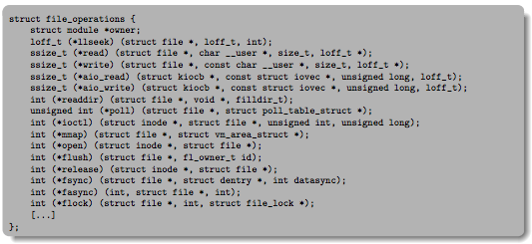
Lower Level Driver
Associated with particular hardware device
Registers / Unregisters itself with the kernel
Handler functions for each of the file operations

Slide 41
Device Drivers
Device Driver: Device-specific code in the kernel that interacts directly with the device hardware
  Supports a standard, internal interface
  Same kernel I/O system can interact easily with different device drivers
  Special device-specific configuration supported with the ioctl() system call
Device Drivers typically divided into two pieces:
  Top half: accessed in call path from system calls
    implements a set of standard, cross-device calls like open(), close(), read(), write(), ioctl(), strategy()
    This is the kernel’s interface to the device driver
    Top half will start I/O to device, may put thread to sleep until finished
  Bottom half: run as interrupt routine
    Gets input or transfers next block of output
    May wake sleeping threads if I/O now complete

Slide 42
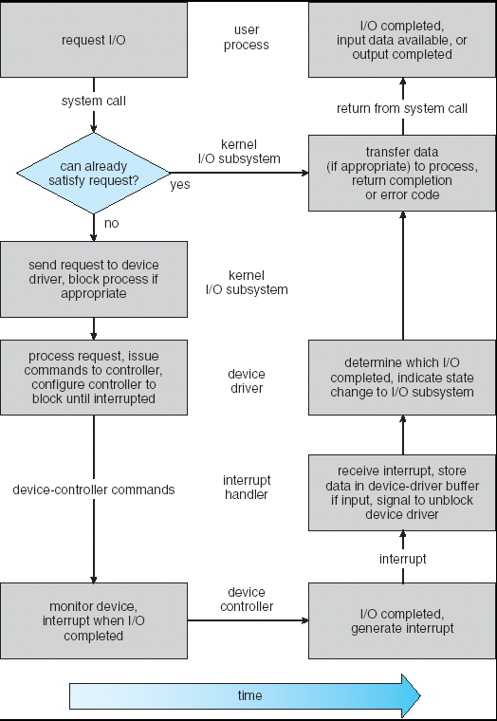
Life Cycle of An I/O Request
User
Program
Kernel I/O
Subsystem
Device Driver
Top Half
Device Driver
Bottom Half
Device
Hardware

Slide 43
Communication between processes
Can we view files as communication channels?
Producer and Consumer of a file may be distinct processes
  May be separated in time (or not)
However, what if data written once and consumed once?
  Don’t we want something more like a queue?
  Can still look like File I/O!
write(wfd, wbuf, wlen);
n = read(rfd,rbuf,rmax);

Slide 44
Communication Across the world looks like file IO
write(wfd, wbuf, wlen);
n = read(rfd,rbuf,rmax);
Connected queues over the Internet
  But what’s the analog of open?
  What is the namespace?
  How are they connected in time?

Slide 45
Request Response Protocol
Client (issues requests)
Server (performs operations)
write(rqfd, rqbuf, buflen);
requests
n = read(rfd,rbuf,rmax);
wait
service request
write(wfd, respbuf, len);
responses
n = read(resfd,resbuf,resmax);

Slide 46
Request Response Protocol
Client (issues requests)
Server (performs operations)
write(rqfd, rqbuf, buflen);
requests
n = read(rfd,rbuf,rmax);
wait
service request
write(wfd, respbuf, len);
responses
n = read(resfd,resbuf,resmax);

Slide 47
Client-Server Models
Client 1
Client 2
Server
***
Client n
File servers, web, FTP, Databases, …
Many clients accessing a common server

Slide 48
Sockets
Socket: an abstraction of a network I/O queue
  Mechanism for inter-process communication
  Embodies one side of a communication channel
    Same interface regardless of location of other end
    Could be local machine (called “UNIX socket”) or remote machine (called “network socket”)
  First introduced in 4.2 BSD UNIX: big innovation at time
    Now most operating systems provide some notion of socket
Data transfer like files
  Read / Write against a descriptor
Over ANY kind of network
  Local to a machine
  Over the internet (TCP/IP, UDP/IP)
  OSI, Appletalk, SNA, IPX, SIP, NS, …

Slide 49


Silly Echo Server – running example
Client (issues requests)
Server (performs operations)
gets(fd,sndbuf, …);
requests
write(fd, buf,len);
n = read(fd,buf,);
wait
print
write(fd, buf,);
responses
n = read(fd,rcvbuf, );
print

Slide 50
Echo client-server example
void client(int sockfd) {
int n;
char sndbuf[MAXIN]; char rcvbuf[MAXOUT];
getreq(sndbuf, MAXIN); /* prompt */
while (strlen(sndbuf) > 0) {
write(sockfd, sndbuf, strlen(sndbuf)); /* send */
memset(rcvbuf,0,MAXOUT); /* clear */
n=read(sockfd, rcvbuf, MAXOUT-1); /* receive */
write(STDOUT_FILENO, rcvbuf, n); /* echo */
getreq(sndbuf, MAXIN); /* prompt */
}
}
void server(int consockfd) {
char reqbuf[MAXREQ];
int n;
while (1) {
memset(reqbuf,0, MAXREQ);
n = read(consockfd,reqbuf,MAXREQ-1); /* Recv */
if (n <= 0) return;
n = write(STDOUT_FILENO, reqbuf, strlen(reqbuf));
n = write(consockfd, reqbuf, strlen(reqbuf)); /* echo*/
}
}

Slide 51
Prompt for input
char *getreq(char *inbuf, int len) {
/* Get request char stream */
printf("REQ: "); /* prompt */
memset(inbuf,0,len); /* clear for good measure */
return fgets(inbuf,len,stdin); /* read up to a EOL */
}

Slide 52
Socket creation and connection
File systems provide a collection of permanent objects in structured name space
  Processes open, read/write/close them
  Files exist independent of the processes
Sockets provide a means for processes to communicate (transfer data) to other processes.
Creation and connection is more complex
Form 2-way pipes between processes
  Possibly worlds away

Slide 53
Namespaces for communication over IP
Hostname
  www.eecs.berkeley.edu
IP address
  128.32.244.172 (ipv6?)
Port Number
  0-1023 are “well known” or “system” ports
    Superuser privileges to bind to one
  1024 – 49151 are “registered” ports (registry)
    Assigned by IANA for specific services
  49152–65535 (2¹⁵+2¹⁴ to 2¹⁶−1) are “dynamic” or “private”
    Automatically allocated as “ephemeral Ports”

Slide 54
Socket Setup over TCP/IP
Server
Socket
Request Connection
new
socket
socket
socket
connection
Client
Server
Server Socket: Listens for new connections
  Produces new sockets for each unique connection
Things to remember:
  Connection involves 5 values:
  [ Client Addr, Client Port, Server Addr, Server Port, Protocol ]
  Often, Client Port “randomly” assigned
    Done by OS during client socket setup
  Server Port often “well known”
    80 (web), 443 (secure web), 25 (sendmail), etc
    Well-known ports from 0—1023

Slide 55
Sockets in concept
Client
Server
Create Server Socket
Create Client Socket
Bind it to an Address
(host:port)
Connect it to server (host:port)
Listen for Connection
Accept syscall()
Connection Socket
Connection Socket
write request
read request
read response
write response
Close Client Socket
Close Connection Socket
Close Server Socket

Slide 56
Client Protocol
char *hostname;
int sockfd, portno;
struct sockaddr_in serv_addr;
struct hostent *server;
server = buildServerAddr(&serv_addr, hostname, portno);
/* Create a TCP socket */
sockfd = socket(AF_INET, SOCK_STREAM, 0)
/* Connect to server on port */
connect(sockfd, (struct sockaddr *) &serv_addr, sizeof(serv_addr)
printf("Connected to %s:%d\n",server->h_name, portno);
/* Carry out Client-Server protocol */
client(sockfd);
/* Clean up on termination */
close(sockfd);

Slide 57
Server Protocol (v1)
/* Create Socket to receive requests*/
lstnsockfd = socket(AF_INET, SOCK_STREAM, 0);
/* Bind socket to port */
bind(lstnsockfd, (struct sockaddr *)&serv_addr,sizeof(serv_addr));
while (1) {
/* Listen for incoming connections */
listen(lstnsockfd, MAXQUEUE);
/* Accept incoming connection, obtaining a new socket for it */
consockfd = accept(lstnsockfd, (struct sockaddr *) &cli_addr,
&clilen);
server(consockfd);
close(consockfd);
}
close(lstnsockfd);

Slide 58
How does the server protect itself?
Isolate the handling of each connection
By forking it off as another process

Slide 59
Sockets With Protection
Client
Server
Create Server Socket
Create Client Socket
Bind it to an Address
(host:port)
Connect it to server (host:port)
Listen for Connection
Accept syscall()
Connection Socket
Connection Socket
Child
Parent
Close Listen Socket
Close Connection Socket
write request
read request
read response
write response
Wait for child
Close Client Socket
Close Connection Socket
Close Server Socket

Slide 60
Server Protocol (v2)
while (1) {
listen(lstnsockfd, MAXQUEUE);
consockfd = accept(lstnsockfd, (struct sockaddr *) &cli_addr,
&clilen);
cpid = fork(); /* new process for connection */
if (cpid > 0) { /* parent process */
close(consockfd);
tcpid = wait(&cstatus);
} else if (cpid == 0) { /* child process */
close(lstnsockfd); /* let go of listen socket */
server(consockfd);
close(consockfd);
exit(EXIT_SUCCESS); /* exit child normally */
}
}
close(lstnsockfd);

Slide 61
Concurrent Server
Listen will queue requests
Buffering present elsewhere
But server waits for each connection to terminate before initiating the next

Slide 62
Sockets With Protection and Parallelism
Client
Server
Create Server Socket
Create Client Socket
Bind it to an Address
(host:port)
Connect it to server (host:port)
Listen for Connection
Accept syscall()
Connection Socket
Connection Socket
Child
Parent
Close Listen Socket
Close Connection Socket
write request
read request
read response
write response
Close Client Socket
Close Connection Socket
Close Server Socket

Slide 63
Server Protocol (v3)
while (1) {
listen(lstnsockfd, MAXQUEUE);
consockfd = accept(lstnsockfd, (struct sockaddr *) &cli_addr,
&clilen);
cpid = fork(); /* new process for connection */
if (cpid > 0) { /* parent process */
close(consockfd);
//tcpid = wait(&cstatus);
} else if (cpid == 0) { /* child process */
close(lstnsockfd); /* let go of listen socket */
server(consockfd);
close(consockfd);
exit(EXIT_SUCCESS); /* exit child normally */
}
}
close(lstnsockfd);

Slide 64
Server Address - itself
memset((char *) &serv_addr,0, sizeof(serv_addr));
serv_addr.sin_family = AF_INET;
serv_addr.sin_addr.s_addr = INADDR_ANY;
serv_addr.sin_port = htons(portno);
Simple form
Internet Protocol
accepting any connections on the specified port
In “network byte ordering”

Slide 65
Client: getting the server address
struct hostent *buildServerAddr(struct sockaddr_in *serv_addr,
char *hostname, int portno) {
struct hostent *server;
/* Get host entry associated with a hostname or IP address */
server = gethostbyname(hostname);
if (server == NULL) {
fprintf(stderr,"ERROR, no such host\n");
exit(1);
}
/* Construct an address for remote server */
memset((char *) serv_addr, 0, sizeof(struct sockaddr_in));
serv_addr->sin_family = AF_INET;
bcopy((char *)server->h_addr,
(char *)&(serv_addr->sin_addr.s_addr), server->h_length);
serv_addr->sin_port = htons(portno);
return server;
}

Slide 66
Conclusion (I)
System Call Interface is “narrow waist” between user programs and kernel
Streaming IO: modeled as a stream of bytes
  Most streaming I/O functions start with “f” (like “fread”)
  Data buffered automatically by C-library functions
Low-level I/O:
  File descriptors are integers
  Low-level I/O supported directly at system call level
STDIN / STDOUT enable composition in Unix
  Use of pipe symbols connects STDOUT and STDIN
    find | grep | wc …

Slide 67
Conclusion (II)
Device Driver: Device-specific code in the kernel that interacts directly with the device hardware
  Supports a standard, internal interface
  Same kernel I/O system can interact easily with different device drivers
File abstraction works for inter-processes communication (local or Internet)
Socket: an abstraction of a network I/O queue
  Mechanism for inter-process communication

