Slide 1
CS162
Operating Systems and
Systems Programming
Lecture 15
Demand Paging (Finished)
October 21st, 2015
Prof. John Kubiatowicz
http://cs162.eecs.Berkeley.edu

Slide 2
Recall: Precise Exceptions
Precise ⇒ state of the machine is preserved as if program executed up to the offending instruction
  All previous instructions completed
  Offending instruction and all following instructions act as if they have not even started
  Same system code will work on different implementations
  Difficult in the presence of pipelining, out-of-order execution, ...
  MIPS takes this position
Imprecise ⇒ system software has to figure out what is where and put it all back together
Performance goals often lead designers to forsake precise interrupts
  system software developers, user, markets etc. usually wish they had not done this
Modern techniques for out-of-order execution and branch prediction help implement precise interrupts

Slide 3
Working Set Model
As a program executes it transitions through a sequence of “working sets” consisting of varying sized subsets of the address space
Address
Time

Slide 4
Cache Behavior under WS model
1
new working set fits
Hit Rate
0
Cache Size
Amortized by fraction of time the WS is active
Transitions from one WS to the next
Capacity, Conflict, Compulsory misses
Applicable to memory caches and pages. Others ?

Slide 5
Another model of Locality: Zipf
Likelihood of accessing item of rank r is α1/rª
Although rare to access items below the top few, there are so many that it yields a “heavy tailed” distribution.
Substantial value from even a tiny cache
Substantial misses from even a very large one

Slide 6
Demand Paging
Modern programs require a lot of physical memory
  Memory per system growing faster than 25%-30%/year
But they don’t use all their memory all of the time
  90-10 rule: programs spend 90% of their time in 10% of their code
  Wasteful to require all of user’s code to be in memory
Solution: use main memory as cache for disk
Processor
Control
Caching
Tertiary
Storage
(Tape)
Second
Level
Cache
(SRAM)
Main
Memory
(DRAM)
Secondary
Storage
(Disk)
Datapath
On-Chip
Cache

Slide 7
Illusion of Infinite Memory
∞
TLB
Page
Table
Physical
Memory
512 MB
Disk
500GB
Virtual
Memory
4 GB
Disk is larger than physical memory ⇒
  In-use virtual memory can be bigger than physical memory
  Combined memory of running processes much larger than physical memory
    More programs fit into memory, allowing more concurrency
Principle: Transparent Level of Indirection (page table)
  Supports flexible placement of physical data
    Data could be on disk or somewhere across network
  Variable location of data transparent to user program
    Performance issue, not correctness issue

Slide 8
Demand Paging is Caching
Since Demand Paging is Caching, must ask:
  What is block size?
    1 page
  What is organization of this cache (i.e. direct-mapped, set-associative, fully-associative)?
    Fully associative: arbitrary virtual→physical mapping
  How do we find a page in the cache when look for it?
    First check TLB, then page-table traversal
  What is page replacement policy? (i.e. LRU, Random…)
    This requires more explanation… (kinda LRU)
  What happens on a miss?
    Go to lower level to fill miss (i.e. disk)
  What happens on a write? (write-through, write back)
    Definitely write-back. Need dirty bit!

Slide 9
Review: What is in a PTE?
What is in a Page Table Entry (or PTE)?
  Pointer to next-level page table or to actual page
  Permission bits: valid, read-only, read-write, write-only
Example: Intel x86 architecture PTE:
  Address same format previous slide (10, 10, 12-bit offset)
  Intermediate page tables called “Directories”
  P: Present (same as “valid” bit in other architectures)
  W: Writeable
  U: User accessible
  PWT: Page write transparent: external cache write-through
  PCD: Page cache disabled (page cannot be cached)
  A: Accessed: page has been accessed recently
  D: Dirty (PTE only): page has been modified recently
  L: L=1⇒4MB page (directory only).
  Bottom 22 bits of virtual address serve as offset
Page Frame Number
(Physical Page Number)
Free
(OS)
0
L
D
A
PCD
PWT
U
W
P
31-12
11-9
8
7
6
5
4
3
2
1
0

Slide 10
Demand Paging Mechanisms
PTE helps us implement demand paging
  Valid ⇒ Page in memory, PTE points at physical page
  Not Valid ⇒ Page not in memory; use info in PTE to find it on disk when necessary
Suppose user references page with invalid PTE?
  Memory Management Unit (MMU) traps to OS
    Resulting trap is a “Page Fault”
  What does OS do on a Page Fault?:
    Choose an old page to replace
    If old page modified (“D=1”), write contents back to disk
    Change its PTE and any cached TLB to be invalid
    Load new page into memory from disk
    Update page table entry, invalidate TLB for new entry
    Continue thread from original faulting location
  TLB for new page will be loaded when thread continued!
  While pulling pages off disk for one process, OS runs another process from ready queue
    Suspended process sits on wait queue
Cache

Slide 11
Loading an executable into memory
disk (huge)
memory
info
data
code
exe
.exe
  lives on disk in the file system
  contains contents of code & data segments, relocation entries and symbols
  OS loads it into memory, initializes registers (and initial stack pointer)
  program sets up stack and heap upon initialization: CRT0

Slide 12
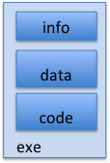
Create Virtual Address Space of the Process
disk (huge)
process VAS
memory
kernel
user page
frames
stack
sbrk
user pagetable
heap
data
kernel code & data
code
Utilized pages in the VAS are backed by a page block on disk
  called the backing store
  typically in an optimized block store, but can think of it like a file

Slide 13
Create Virtual Address Space of the Process
disk (huge, TB)
process VAS (GBs)
memory
kernel
stack
user page
frames
stack
heap
heap
user pagetable
data
data
code
kernel code & data
code
User Page table maps entire VAS
All the utilized regions are backed on disk
  swapped into and out of memory as needed
For every process

Slide 14
Create Virtual Address Space of the Process
disk (huge, TB)
VAS – per process
PT
memory
kernel
stack
user page
frames
stack
heap
heap
user pagetable
data
data
code
kernel code & data
code
User Page table maps entire VAS
  resident pages to the frame in memory they occupy
  the portion of it that the HW needs to access must be resident in memory

Slide 15
Provide Backing Store for VAS
disk (huge, TB)
VAS – per process
memory
kernel
stack
user page
frames
stack
heap
heap
user pagetable
data
data
code
kernel code & data
code
User Page table maps entire VAS
Resident pages mapped to memory frames
For all other pages, OS must record where to find them on disk

Slide 16
What data structure is required to map non-resident pages to disk?
FindBlock(PID, page#) => disk_block
  Some OSs utilize spare space in PTE for paged blocks
  Like the PT, but purely software
Where to store it?
  In memory – can be compact representation if swap storage is contiguous on disk
  Could use hash table (like Inverted PT)
Usually want backing store for resident pages too.
May map code segment directly to on-disk image
  Saves a copy of code to swap file
May share code segment with multiple instances of the program

Slide 17
Administrivia
Still working on the grading of exams
  Hope to be done by this weekend!
  Solutions should be posted
Peer review is *NOT* optional
  Every person must fill out the project 1 peer review
  Due this Sunday
    We will consider taking off points for missing reviews
  The peer review is an important part of our evaluation of partner dynamics. Please take is very seriously.
Homework 3 deadline pushed out 1 week

Slide 18
Administrivia (con’t)
Please use git branches on Project 2
  Merge to the master branch occasionally to invoke the autograder (but only occasionally)
  Each team member should be committing code regularly (and pushing to github)
    We should see commits from everyone as code is evolving
    We should not see just a single commit from one person
Survey on Piazza: Please tell us how the course is going!
  What is going well, what is not going well
  What could we change?

Slide 19
Provide Backing Store for VAS
disk (huge, TB)
VAS 1
PT 1
memory
kernel
stack
stack
stack
heap
user page
frames
heap
heap
data
VAS 2
PT 2
data
code
user pagetable
data
kernel
code
stack
kernel code & data
heap
data
code

Slide 20
On page Fault …
disk (huge, TB)
VAS 1
PT 1
memory
kernel
stack
stack
stack
heap
user page
frames
heap
heap
data
VAS 2
PT 2
data
code
user pagetable
data
kernel
code
stack
kernel code & data
heap
active process & PT
data
code

Slide 21
On page Fault … find & start load
disk (huge, TB)
VAS 1
PT 1
memory
kernel
stack
stack
stack
heap
user page
frames
heap
heap
data
VAS 2
PT 2
data
code
user pagetable
data
kernel
code
stack
kernel code & data
heap
active process & PT
data
code

Slide 22
On page Fault … schedule other P or T
disk (huge, TB)
VAS 1
PT 1
memory
kernel
stack
stack
stack
heap
user page
frames
heap
heap
data
VAS 2
PT 2
data
code
user pagetable
data
kernel
code
stack
kernel code & data
heap
active process & PT
data
code

Slide 23
On page Fault … update PTE
disk (huge, TB)
VAS 1
PT 1
memory
kernel
stack
stack
stack
heap
user page
frames
heap
heap
data
VAS 2
PT 2
data
code
user pagetable
data
kernel
code
stack
kernel code & data
heap
active process & PT
data
code

Slide 24
Eventually reschedule faulting thread
disk (huge, TB)
VAS 1
PT 1
memory
kernel
stack
stack
stack
heap
user page
frames
heap
heap
data
VAS 2
PT 2
data
code
user pagetable
data
kernel
code
stack
kernel code & data
heap
active process & PT
data
code

Slide 25
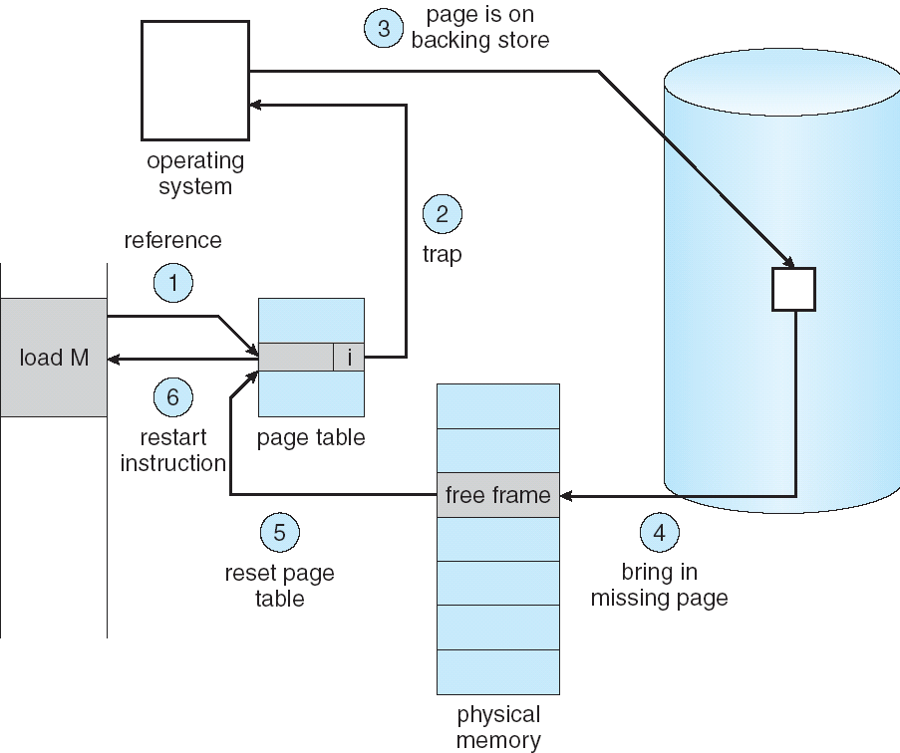
Summary: Steps in Handling a Page Fault

Slide 26
Management & Access to the Memory Hierarchy
Managed in
Hardware
Managed in Software - OS
?
Processor
Secondary
Storage
(Disk)
TLB
PT
L2 Cache
Registers
L1 Cache
Secondary
Storage
(SSD)
PT
PT
Main
Memory
(DRAM)
PT
TLB
L3 Cache
(shared)
L2 Cache
Registers
L1 Cache
Accessed in Hardware
Speed (ns):
0.3
1
3
10-30
100
100,000
(0.1 ms)
10,000,000
(10 ms)
Size (bytes):
100Bs
10kBs
100kBs
MBs
GBs
100GBs
TBs
Notes:
The design goal is to present the user with as much memory as is available in the cheapest technology (points to the disk).
While by taking advantage of the principle of locality, we like to provide the user an average access speed that is very close to the speed that is offered by the fastest technology.
(We will go over this slide in details in the next lecture on caches).
+1 = 16 min. (X:56)

Slide 27
Some following questions
During a page fault, where does the OS get a free frame?
  Keeps a free list
  Unix runs a “reaper” if memory gets too full
  As a last resort, evict a dirty page first
How can we organize these mechanisms?
  Work on the replacement policy
How many page frames/process?
  Like thread scheduling, need to “schedule” memory resources:
    utilization? fairness? priority?
  allocation of disk paging bandwidth

Slide 28
Demand Paging Cost Model
Since Demand Paging like caching, can compute average access time! (“Effective Access Time”)
  EAT = Hit Rate x Hit Time + Miss Rate x Miss Time
  EAT = Hit Time + Miss Rate x Miss Penalty
Example:
  Memory access time = 200 nanoseconds
  Average page-fault service time = 8 milliseconds
  Suppose p = Probability of miss, 1-p = Probably of hit
  Then, we can compute EAT as follows:
EAT = 200ns + p x 8 ms
= 200ns + p x 8,000,000ns
If one access out of 1,000 causes a page fault, then EAT = 8.2 μs:
  This is a slowdown by a factor of 40!
What if want slowdown by less than 10%?
  200ns x 1.1 < EAT ⇒ p < 2.5 x 10⁻⁶
  This is about 1 page fault in 400000!

Slide 29
What Factors Lead to Misses?
Compulsory Misses:
  Pages that have never been paged into memory before
  How might we remove these misses?
    Prefetching: loading them into memory before needed
    Need to predict future somehow! More later.
Capacity Misses:
  Not enough memory. Must somehow increase size.
  Can we do this?
    One option: Increase amount of DRAM (not quick fix!)
    Another option: If multiple processes in memory: adjust percentage of memory allocated to each one!
Conflict Misses:
  Technically, conflict misses don’t exist in virtual memory, since it is a “fully-associative” cache
Policy Misses:
  Caused when pages were in memory, but kicked out prematurely because of the replacement policy
  How to fix? Better replacement policy

Slide 30
Page Replacement Policies
Why do we care about Replacement Policy?
  Replacement is an issue with any cache
  Particularly important with pages
    The cost of being wrong is high: must go to disk
    Must keep important pages in memory, not toss them out
FIFO (First In, First Out)
  Throw out oldest page. Be fair – let every page live in memory for same amount of time.
  Bad, because throws out heavily used pages instead of infrequently used pages
MIN (Minimum):
  Replace page that won’t be used for the longest time
  Great, but can’t really know future…
  Makes good comparison case, however
RANDOM:
  Pick random page for every replacement
  Typical solution for TLB’s. Simple hardware
  Pretty unpredictable – makes it hard to make real-time guarantees

Slide 31
Replacement Policies (Con’t)
LRU (Least Recently Used):
  Replace page that hasn’t been used for the longest time
  Programs have locality, so if something not used for a while, unlikely to be used in the near future.
  Seems like LRU should be a good approximation to MIN.
How to implement LRU? Use a list!
  On each use, remove page from list and place at head
  LRU page is at tail
Problems with this scheme for paging?
  Need to know immediately when each page used so that can change position in list…
  Many instructions for each hardware access
In practice, people approximate LRU (more later)
Page 6
Page 7
Page 1
Page 2
Head
Tail (LRU)

Slide 32
Example: FIFO
Suppose we have 3 page frames, 4 virtual pages, and following reference stream:
  A B C A B D A D B C B
Consider FIFO Page replacement:
  FIFO: 7 faults.
  When referencing D, replacing A is bad choice, since need A again right away
Ref:
Page:
A
B
C
A
B
D
A
D
B
C
B
1
A
D
C
2
B
A
3
C
B

Slide 33
Example: MIN
Suppose we have the same reference stream:
  A B C A B D A D B C B
Consider MIN Page replacement:
  MIN: 5 faults
  Where will D be brought in? Look for page not referenced farthest in future.
What will LRU do?
  Same decisions as MIN here, but won’t always be true!
Ref:
Page:
A
B
C
A
B
D
A
D
B
C
B
1
A
C
2
B
3
C
D

Slide 34
When will LRU perform badly?
Consider the following: A B C D A B C D A B C D
LRU Performs as follows (same as FIFO here):
  Every reference is a page fault!
MIN Does much better:
Ref:
Page:
A
B
C
D
A
B
C
D
A
B
C
D
1
A
D
C
B
2
B
A
D
C
3
C
B
A
D
Ref:
Page:
A
B
C
D
A
B
C
D
A
B
C
D
1
A
B
2
B
C
3
C
D

Slide 35
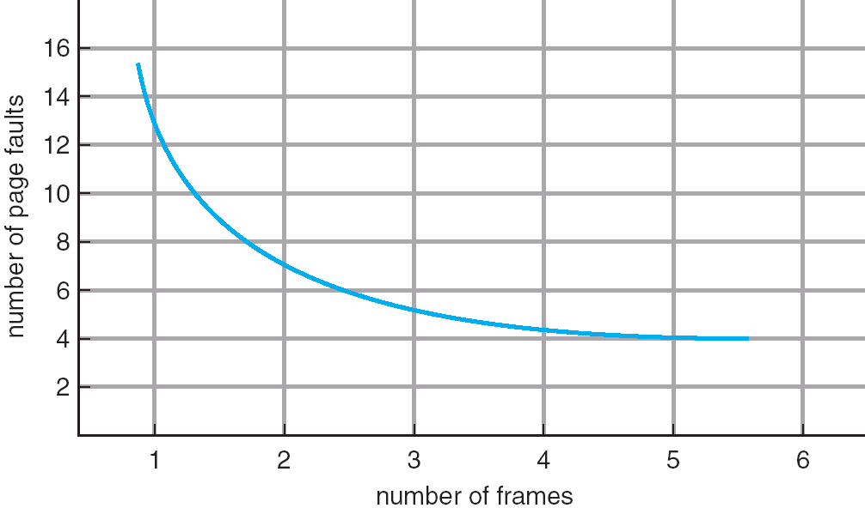
Graph of Page Faults Versus The Number of Frames
One desirable property: When you add memory the miss rate goes down
  Does this always happen?
  Seems like it should, right?
No: BeLady’s anomaly
  Certain replacement algorithms (FIFO) don’t have this obvious property!

Slide 36
Adding Memory Doesn’t Always Help Fault Rate
Does adding memory reduce number of page faults?
  Yes for LRU and MIN
  Not necessarily for FIFO! (Called Belady’s anomaly)
After adding memory:
  With FIFO, contents can be completely different
  In contrast, with LRU or MIN, contents of memory with X pages are a subset of contents with X+1 Page
Ref:
Page:
A
B
C
D
A
B
E
A
B
C
D
E
1
A
D
E
2
B
A
C
3
C
B
D
Ref:
Page:
A
B
C
D
A
B
E
A
B
C
D
E
1
A
E
D
2
B
A
E
3
C
B
4
D
C

Slide 37
Implementing LRU
Perfect:
  Timestamp page on each reference
  Keep list of pages ordered by time of reference
  Too expensive to implement in reality for many reasons
Clock Algorithm: Arrange physical pages in circle with single clock hand
  Approximate LRU (approx to approx to MIN)
  Replace an old page, not the oldest page
Details:
  Hardware “use” bit per physical page:
    Hardware sets use bit on each reference
    If use bit isn’t set, means not referenced in a long time
    Nachos hardware sets use bit in the TLB; you have to copy this back to page table when TLB entry gets replaced
  On page fault:
    Advance clock hand (not real time)
    Check use bit: 1→used recently; clear and leave alone
    0→selected candidate for replacement
  Will always find a page or loop forever?
    Even if all use bits set, will eventually loop around⇒FIFO

Slide 38

Clock Algorithm: Not Recently Used
Set of all pages
in Memory
Single Clock Hand:
  Advances only on page fault!
  Check for pages not used recently
  Mark pages as not used recently
What if hand moving slowly?
  Good sign or bad sign?
    Not many page faults and/or find page quickly
What if hand is moving quickly?
  Lots of page faults and/or lots of reference bits set
One way to view clock algorithm:
  Crude partitioning of pages into two groups: young and old
  Why not partition into more than 2 groups?

Slide 39
N^{th} Chance version of Clock Algorithm
N^{th} chance algorithm: Give page N chances
  OS keeps counter per page: # sweeps
  On page fault, OS checks use bit:
    1⇒clear use and also clear counter (used in last sweep)
    0⇒increment counter; if count=N, replace page
  Means that clock hand has to sweep by N times without page being used before page is replaced
How do we pick N?
  Why pick large N? Better approx to LRU
    If N ~ 1K, really good approximation
  Why pick small N? More efficient
    Otherwise might have to look a long way to find free page
What about dirty pages?
  Takes extra overhead to replace a dirty page, so give dirty pages an extra chance before replacing?
  Common approach:
    Clean pages, use N=1
    Dirty pages, use N=2 (and write back to disk when N=1)

Slide 40
Clock Algorithms: Details
Which bits of a PTE entry are useful to us?
  Use: Set when page is referenced; cleared by clock algorithm
  Modified: set when page is modified, cleared when page written to disk
  Valid: ok for program to reference this page
  Read-only: ok for program to read page, but not modify
    For example for catching modifications to code pages!
Do we really need hardware-supported “modified” bit?
  No. Can emulate it (BSD Unix) using read-only bit
    Initially, mark all pages as read-only, even data pages
    On write, trap to OS. OS sets software “modified” bit, and marks page as read-write.
    Whenever page comes back in from disk, mark read-only

Slide 41
Clock Algorithms Details (continued)
Do we really need a hardware-supported “use” bit?
  No. Can emulate it similar to above:
    Mark all pages as invalid, even if in memory
    On read to invalid page, trap to OS
    OS sets use bit, and marks page read-only
  Get modified bit in same way as previous:
    On write, trap to OS (either invalid or read-only)
    Set use and modified bits, mark page read-write
  When clock hand passes by, reset use and modified bits and mark page as invalid again
Remember, however, that clock is just an approximation of LRU
  Can we do a better approximation, given that we have to take page faults on some reads and writes to collect use information?
  Need to identify an old page, not oldest page!
  Answer: second chance list

Slide 42
Second-Chance List Algorithm (VAX/VMS)
LRU victim
Directly
Mapped Pages
Marked: RW
List: FIFO
Overflow
Second
Chance List
Marked: Invalid
List: LRU
Access
New
Active
Pages
New
SC
Victims
Page-in
From disk
Split memory in two: Active list (RW), SC list (Invalid)
Access pages in Active list at full speed
Otherwise, Page Fault
  Always move overflow page from end of Active list to front of Second-chance list (SC) and mark invalid
  Desired Page On SC List: move to front of Active list, mark RW
  Not on SC list: page in to front of Active list, mark RW; page out LRU victim at end of SC list

Slide 43
Second-Chance List Algorithm (con’t)
How many pages for second chance list?
  If 0 ⇒ FIFO
  If all ⇒ LRU, but page fault on every page reference
Pick intermediate value. Result is:
  Pro: Few disk accesses (page only goes to disk if unused for a long time)
  Con: Increased overhead trapping to OS (software / hardware tradeoff)
With page translation, we can adapt to any kind of access the program makes
  Later, we will show how to use page translation / protection to share memory between threads on widely separated machines
Question: why didn’t VAX include “use” bit?
  Strecker (architect) asked OS people, they said they didn’t need it, so didn’t implement it
  He later got blamed, but VAX did OK anyway

Slide 44
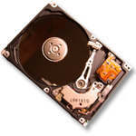
Free List
Set of all pages
in Memory
Single Clock Hand:
  Advances as needed to keep freelist full (“background”)
D
D
Free Pages
For Processes
Keep set of free pages ready for use in demand paging
  Freelist filled in background by Clock algorithm or other technique (“Pageout demon”)
  Dirty pages start copying back to disk when enter list
Like VAX second-chance list
  If page needed before reused, just return to active set
Advantage: Faster for page fault
  Can always use page (or pages) immediately on fault

Slide 45
Demand Paging (more details)
Does software-loaded TLB need use bit?
Two Options:
  Hardware sets use bit in TLB; when TLB entry is replaced, software copies use bit back to page table
  Software manages TLB entries as FIFO list; everything not in TLB is Second-Chance list, managed as strict LRU
Core Map
  Page tables map virtual page → physical page
  Do we need a reverse mapping (i.e. physical page → virtual page)?
    Yes. Clock algorithm runs through page frames. If sharing, then multiple virtual-pages per physical page
    Can’t push page out to disk without invalidating all PTEs

Slide 46
Allocation of Page Frames (Memory Pages)
How do we allocate memory among different processes?
  Does every process get the same fraction of memory? Different fractions?
  Should we completely swap some processes out of memory?
Each process needs minimum number of pages
  Want to make sure that all processes that are loaded into memory can make forward progress
  Example: IBM 370 – 6 pages to handle SS MOVE instruction:
    instruction is 6 bytes, might span 2 pages
    2 pages to handle from
    2 pages to handle to
Possible Replacement Scopes:
  Global replacement – process selects replacement frame from set of all frames; one process can take a frame from another
  Local replacement – each process selects from only its own set of allocated frames

Slide 47
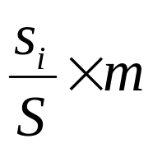
Fixed/Priority Allocation
Equal allocation (Fixed Scheme):
  Every process gets same amount of memory
  Example: 100 frames, 5 processes⇒process gets 20 frames
Proportional allocation (Fixed Scheme)
  Allocate according to the size of process
  Computation proceeds as follows:
  s_{i} = size of process p_{i} and S = Σs_{i}
  m = total number of frames
  a_{i} = allocation for p_{i} =
Priority Allocation:
  Proportional scheme using priorities rather than size
    Same type of computation as previous scheme
  Possible behavior: If process p_{i} generates a page fault, select for replacement a frame from a process with lower priority number
Perhaps we should use an adaptive scheme instead???
  What if some application just needs more memory?

Slide 48
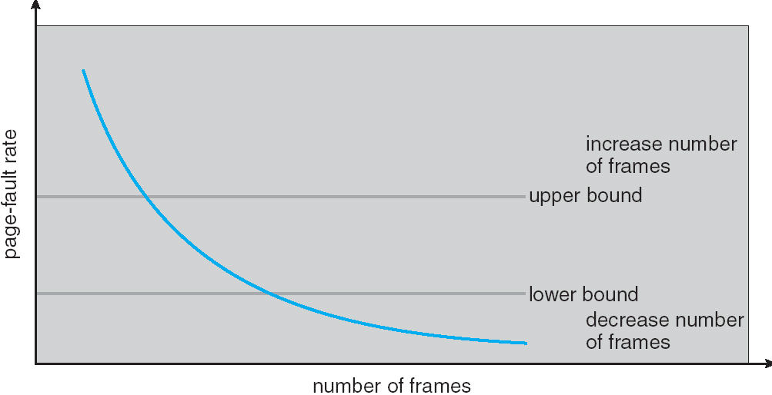
Page-Fault Frequency Allocation
Can we reduce Capacity misses by dynamically changing the number of pages/application?
Establish “acceptable” page-fault rate
  If actual rate too low, process loses frame
  If actual rate too high, process gains frame
Question: What if we just don’t have enough memory?

Slide 49
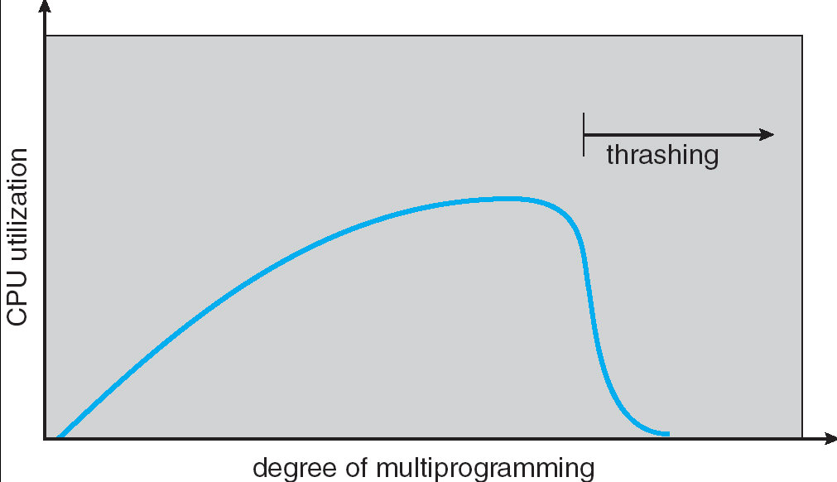
Thrashing
If a process does not have “enough” pages, the page-fault rate is very high. This leads to:
  low CPU utilization
  operating system spends most of its time swapping to disk
Thrashing ≡ a process is busy swapping pages in and out
Questions:
  How do we detect Thrashing?
  What is best response to Thrashing?
Notes:
Example: one program, touches 50 pages (each equally likely). Have only 40 physical page frames.
How bad is this?
- Does your program run at 80% speed?
- Does your program run at 20% speed?
Performance is really bad
If we have enough pages, 200 ns/ref, but if too few pages, assume every 5th page reference causes a page fault
= 4 refs x 200 ns
1 page fault x 10 ms for disk I/O
= 5 refs, 10 ms + 800 ns => 2 ms/ref (not 100 MIPS, but 500 IPS! Factor of 10,000)
Machine appears to have stopped!

Slide 50
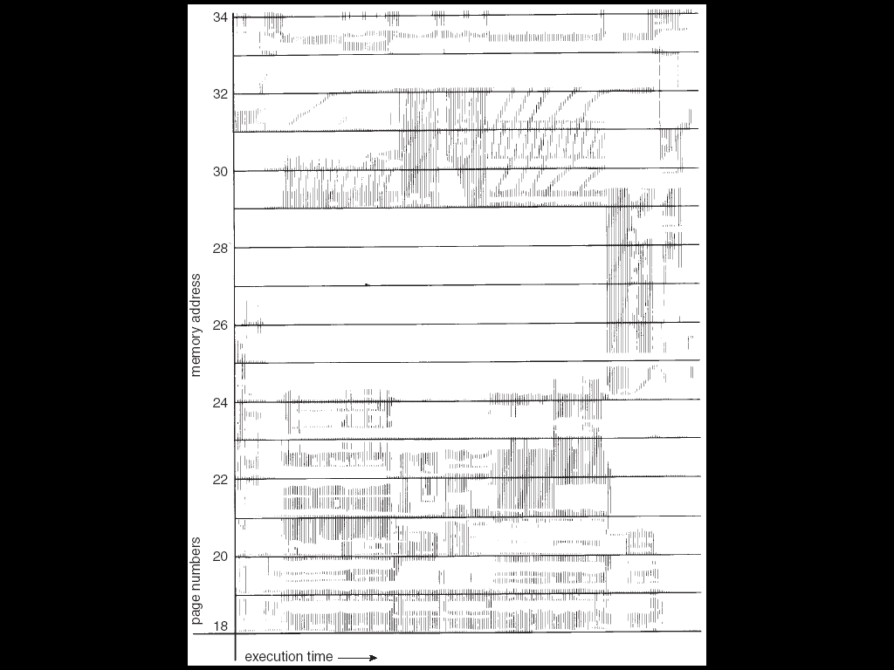
Locality In A Memory-Reference Pattern
Program Memory Access Patterns have temporal and spatial locality
  Group of Pages accessed along a given time slice called the “Working Set”
  Working Set defines minimum number of pages needed for process to behave well
Not enough memory for Working Set⇒Thrashing
  Better to swap out process?

Slide 51
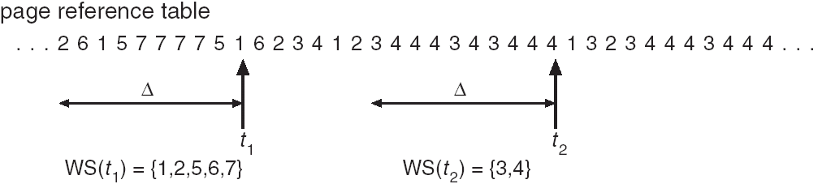
Working-Set Model
Δ ≡ working-set window ≡ fixed number of page references
  Example: 10,000 instructions
WS_{i} (working set of Process P_{i}) = total set of pages referenced in the most recent Δ (varies in time)
  if Δ too small will not encompass entire locality
  if Δ too large will encompass several localities
  if Δ = ∞ ⇒ will encompass entire program
D = Σ|WS_{i}| ≡ total demand frames
if D > m ⇒ Thrashing
  Policy: if D > m, then suspend/swap out processes
  This can improve overall system behavior by a lot!

Slide 52
What about Compulsory Misses?
Recall that compulsory misses are misses that occur the first time that a page is seen
  Pages that are touched for the first time
  Pages that are touched after process is swapped out/swapped back in
Clustering:
  On a page-fault, bring in multiple pages “around” the faulting page
  Since efficiency of disk reads increases with sequential reads, makes sense to read several sequential pages
Working Set Tracking:
  Use algorithm to try to track working set of application
  When swapping process back in, swap in working set

Slide 53
Reverse Page Mapping (Sometimes called “Coremap”)
Physical page frames often shared by many different address spaces/page tables
  All children forked from given process
  Shared memory pages between processes
Whatever reverse mapping mechanism that is in place must be very fast
  Must hunt down all page tables pointing at given page frame when freeing a page
  Must hunt down all PTEs when seeing if pages “active”
Implementation options:
  For every page descriptor, keep linked list of page table entries that point to it
    Management nightmare – expensive
  Linux 2.6: Object-based reverse mapping
    Link together memory region descriptors instead (much coarser granularity)

Slide 54
Linux Memory Details?
Memory management in Linux considerably more complex that the previous indications
Memory Zones: physical memory categories
  ZONE_DMA: < 16MB memory, DMAable on ISA bus
  ZONE_NORMAL: 16MB ⇒ 896MB (mapped at 0xC0000000)
  ZONE_HIGHMEM: Everything else (> 896MB)
Each zone has 1 freelist, 2 LRU lists (Active/Inactive)
Many different types of allocation
  SLAB allocators, per-page allocators, mapped/unmapped
Many different types of allocated memory:
  Anonymous memory (not backed by a file, heap/stack)
  Mapped memory (backed by a file)
Allocation priorities
  Is blocking allowed/etc

Slide 55
Recall: Linux Virtual memory map
0xFFFFFFFF
0xFFFFFFFFFFFFFFFF
Kernel
Addresses
1GB
Kernel
Addresses
128TiB
896MB
Physical
64 TiB
Physical
0xC0000000
User
Addresses
0xFFFF800000000000
3GB Total
Empty
Space
“Canonical Hole”
0x00007FFFFFFFFFFF
128TiB
User
Addresses
0x00000000
0x0000000000000000
32-Bit Virtual Address Space
64-Bit Virtual Address Space

Slide 56
Virtual Map (Details)
Kernel memory not generally visible to user
  Exception: special VDSO facility that maps kernel code into user space to aid in system calls (and to provide certain actual system calls such as gettimeofday().
Every physical page described by a “page” structure
  Collected together in lower physical memory
  Can be accessed in kernel virtual space
  Linked together in various “LRU” lists
For 32-bit virtual memory architectures:
  When physical memory < 896MB
    All physical memory mapped at 0xC0000000
  When physical memory >= 896MB
    Not all physical memory mapped in kernel space all the time
    Can be temporarily mapped with addresses > 0xCC000000
For 64-bit virtual memory architectures:
  All physical memory mapped above 0xFFFF800000000000

Slide 57
Internal Interfaces: Allocating Memory
One mechanism for requesting pages: everything else on top of this mechanism:
  Allocate contiguous group of pages of size 2^{order} bytes given the specified mask:
  struct page * alloc_pages(gfp_t gfp_mask,
  unsigned int order)
  Allocate one page:
  struct page * alloc_page(gfp_t gfp_mask)
  Convert page to logical address (assuming mapped):
  void * page_address(struct page *page)
Also routines for freeing pages
Zone allocator uses “buddy” allocator that tries to keep memory unfragmented
Allocation routines pick from proper zone, given flags

Slide 58
Page Frame Reclaiming Algorithm (PFRA)
Several entrypoints:
  Low on Memory Reclaiming: The kernel detects a “low on memory” condition
  Hibernation reclaiming: The kernel must free memory because it is entering in the suspend-to-disk state
  Periodic reclaiming: A kernel thread is activated periodically to perform memory reclaiming, if necessary
Low on Memory reclaiming:
  Start flushing out dirty pages to disk
  Start looping over all memory nodes in the system
    try_to_free_pages()
    shrink_slab()
    pdflush kernel thread writing out dirty pages
Periodic reclaiming:
  Kswapd kernel threads: checks if number of free page frames in some zone has fallen below pages_high watermark
  Each zone keeps two LRU lists: Active and Inactive
    Each page has a last-chance algorithm with 2 count
    Active page lists moved to inactive list when they have been idle for two cycles through the list
    Pages reclaimed from Inactive list

Slide 59
SLAB Allocator
Replacement for free-lists that are hand-coded by users
  Consolidation of all of this code under kernel control
  Efficient when objects allocated and freed frequently
Objects segregated into “caches”
  Each cache stores different type of object
  Data inside cache divided into “slabs”, which are continuous groups of pages (often only 1 page)
  Key idea: avoid memory fragmentation
Obj 1
SLAB
Obj 2
Obj 3
Cache
Obj 4
SLAB
Obj 5

Slide 60
SLAB Allocator Details
Based on algorithm first introduced for SunOS
  Observation: amount of time required to initialize a regular object in the kernel exceeds the amount of time required to allocate and deallocate it
  Resolves around object caching
    Allocate once, keep reusing objects
Avoids memory fragmentation:
  Caching of similarly sized objects, avoid fragmentation
  Similar to custom freelist per object
Reuse of allocation
  When new object first allocated, constructor runs
  On subsequent free/reallocation, constructor does not need to be reexecuted

Slide 61
SLAB Allocator: Cache Use
Example:
task_struct_cachep =
kmem_cache_create(“task_struct”,
sizeof(struct task_struct),
ARCH_MIN_TASKALIGN,
SLAB_PANIC | SLAB_NOTRACK,
NULL);
Use of example:
struct task_struct *tsk;
tsk = kmem_cache_alloc(task_struct_cachep, GFP_KERNEL);
if (!tsk)
return NULL;
kmem_free(task_struct_cachep,tsk);

Slide 62
SLAB Allocator Details (Con’t)
Caches can be later destroyed with:
int kmem_cache_destroy(struct kmem_cache *cachep);
  Assuming that all objects freed
  No one ever tries to use cache again
All caches kept in global list
  Including global caches set up with objects of powers of 2 from 2⁵ to 2¹⁷
  General kernel allocation (kmalloc/kfree) uses least-fit for requested cache size
Reclamation of memory
  Caches keep sorted list of empty, partial, and full slabs
    Easy to manage – slab metadata contains reference count
    Objects within slabs linked together
  Ask individual caches for full slabs for reclamation

Slide 63
Summary
Replacement policies
  FIFO: Place pages on queue, replace page at end
  MIN: Replace page that will be used farthest in future
  LRU: Replace page used farthest in past
Clock Algorithm: Approximation to LRU
  Arrange all pages in circular list
  Sweep through them, marking as not “in use”
  If page not “in use” for one pass, than can replace
N^{th}-chance clock algorithm: Another approx LRU
  Give pages multiple passes of clock hand before replacing
Second-Chance List algorithm: Yet another approx LRU
  Divide pages into two groups, one of which is truly LRU and managed on page faults.
Working Set:
  Set of pages touched by a process recently
Thrashing: a process is busy swapping pages in and out
  Process will thrash if working set doesn’t fit in memory
  Need to swap out a process

