Slide 1
Unified Pragmatic Models for
Generating and Following Instructions
Daniel Fried, Jacob Andreas, and Dan Klein
UC Berkeley
Notes:
Pragmatic models that generate instructions by reasoning about they’ll be interpreted, and interpreting instructions by reasoning about why they were generated the way they were.

Slide 2




Interpreting instructions
walk along the blue carpet and you pass
two objects
Instruction
Notes:
But let’s set aside pragmatics for a minute and just talk about instruction following. As a running example, magine that you’re a robot placed in this house, with hallways and furniture, and someone gives you this instruction to carry out: “walk along the blue carpet and you pass two objects”. What should you do?

Slide 3
Interpreting instructions
walk along the blue carpet and you pass
two objects
Instruction
✔
Notes:
Walking forward along the blue carpet, we pass the chair and the stool, and choose to stop right afterward. And this is the correct end location that the person giving the direction had in mind. But there’s a lot of ways we could get this wrong.

Slide 4
Interpreting instructions
walk along the blue carpet and you pass
two objects
Instruction
✗
Notes:
One way is to do something inconsistent, for example here stopping before we’ve passed any objects.

Slide 5
Interpreting instructions
walk along the blue carpet and you pass
two objects
Instruction
✗
Notes:
There’s a more subtle kind of mistake too, that pragmatic reasoning might help us fix. Here, we walk along the carpet and pass two objects, and then stop at the bench. This is technically a valid interpretation of the given direction. And we’ll find that, in practice, standard sequence-to-sequence models that have become common for this interpretation task are happy to make predictions like this one. So how do we know that it’s not the best interpretation of the direction the person gave?

Slide 6
Interpreting instructions
walk along the blue carpet and you pass
two objects
Instruction
✔
Notes:
And that we should have instead stopped immediately after passing these two objects?

Slide 7

Listener: reasoning about routes
?
walk along the blue carpet and you pass two objects
walk along the blue carpet and you pass two objects
Notes:
How should the agent, which we’ll call the listener and show in green, carry out this instruction? One way is to reason counterfactually about the speaker, in orange, who produced the directions, considering what routes might have made the speaker say what they did.

Slide 8
Listener: reasoning about routes
walk along the blue carpet and you pass two objects
walk along the blue carpet and you pass two objects
Notes:
Is this route, that stops after taking one step, a good explanation of “walk along the blue carpet and you pass two objects? No, since we don’t pass two objects.

Slide 9
Listener: reasoning about routes
walk along the blue carpet and you pass two objects
walk along the blue carpet and you pass two objects
Notes:
Or maybe this route? It’s a better explanation – more likely to have made the speaker say what they did -- but still not the best – since this route continues on and stops later, it would be better described as something like walk along the blue carpet and stop at the bench.

Slide 10
Listener: reasoning about routes
walk along the blue carpet and you pass two objects
walk along the blue carpet and you pass two objects
Notes:
Finally, let’s consider this route: out of all the ones we’ve consider so far, it’s the best explanation of the instruction we observed, since other routes would probably have been described differently. So this is the path that the listener should choose.
So reasoning counterfactually about the person we’re interacting with might help us resolve ambiguity when we’re following instructions. Could reasoning also help for the inverse task, of generating instructions?

Slide 11
Generating instructions
✔
Generated
Instruction:
go forward four segments to the intersection with the bare concrete hall
Notes:
Suppose we’re shown this route as input, and need to generate an instruction that someone else could carry out to produce the route. For example, a descriptive instruction might be …

Slide 12
Speaker: reasoning about interpretation
?
Notes:
A speaker, shown in orange here, might reason about how a listener, in green, would carry out the instruction we give to them, and choose to say something that has a high chance of getting the listener to the correct destination.

Slide 13
Speaker: reasoning about interpretation
go forward four segments to the intersection with the bare concrete hall
Notes:
Specifying how far to travel, and where to stop.

Slide 14
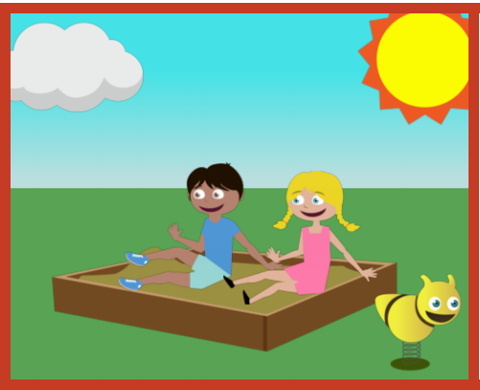
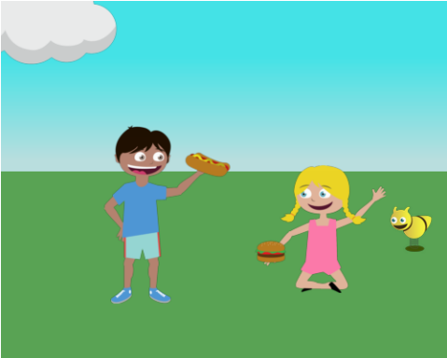


Explicit pragmatic reasoning
Interpretation
Generation
“blue”
“The sun is in the sky”
Golland et al., 2010; Monroe and Potts, 2015; Andreas and Klein, 2016; Mao et al., 2016; …
Frank and Goodman, 2012; Goodman and Stühlmuller, 2013; Wang et al., 2016
Both
Monroe et al. 2017
Large, structured
domains
Our work
Notes:
This sort of explicit reasoning between speakers and listeners has been explored in a long line of work on pragmatics, particularly in the rational speech acts framework. However, most work has focused on small domains, such as interpreting expressions to choose between several objects. Explicit reasoning has also been applied to generation tasks, for example generating discriminative captions for image pairs. Recent work by Monroe et al., shows that a unified reasoning procedure between speaker and listener helps for both generation and interpretation tasks, distinguishing between a set of colors. What makes our work different is that we apply pragmatic reasoning to a variety of large, structured domains (similar to ones Wang et al applied a listener model to): carrying out sequential actions in a complex environment.
# maybe connect the last
# fix the background
# Emphasize difference btwn ours and Monroe (figure?)

Slide 15
Learned models of listeners and speakers
walk along the blue carpet and you pass two objects
Base Listener
walk along the blue carpet and you pass two objects
Base Speaker
Both models trained independently on action
sequences annotated with human instructions
Notes:
To deal with these domains of sequential actions, we use *base* listener and speaker models. The listener model performs the interpretation task, taking an instruction and carrying it out in a world context by producing a sequence of actions. The speaker model performs the inverse, generation task: produce an instruction that describes a sequence of actions in context. We’ll treat these listener and speaker models as black boxes for the next part of the talk, and then come back to implementation details later. They just need to produce a probabilistic mapping from instructions to actions, for the listener; and from actions to instructions, for the speaker, and be able to generate a set of candidate outputs for a given input. They’ll be trained separately, using sequences of actions in context, annotated with human-produced instructions.
# could do the base listener and speaker after this slides

Slide 16
Building a pragmatic listener
0.1
?
Base Speaker
0.1
walk along the blue carpet and you pass two objects
Base Listener
rescores
proposes
walk along the blue carpet and you pass two objects
Pragmatic Listener
Notes:
Given these base models, we can implement the counterfactual pragmatic reasoning procedure we used earlier to interpret directions. We’ll build a pragmatic listener by using the base speaker model to select a route that provides a good explanation of the observed instructions. To get a set of possible routes to feed into the base speaker and choose between, we’ll use the base listener to propose routes. Concretely, the base listener is shown a direction, and from an initial starting location in the environment produces a set of candidate routes. We show two here, but in practice we use 10 to 40.

Slide 17
Building a pragmatic listener
0.1
Base Speaker
0.2
walk along the blue carpet and you pass two objects
Base Listener
rescores
proposes
0.2
walk along the blue carpet and you pass two objects

Slide 18
Building a pragmatic listener
0.1
Base Listener
Base Speaker
walk along the blue carpet and you pass two objects
rescores
proposes
0.2
walk along the blue carpet and you pass two objects

Slide 19
Unified pragmatic inference
Pragmatic Listener
walk along the blue carpet …
?
walk along the blue carpet …
Base Listener
Base Speaker
actions
Pragmatic Speaker
?
Base Speaker
Base Listener
instructions
Notes:
So we built a pragmatic listener that interprets an instruction by reasoning about a base speaker, choosing actions that explain the speaker’s instruction. To do this, we relied on a base listener to propose some candidate action sequences. To build a pragmatic speaker, we can apply the same inference procedure with the roles of speaker and listener swapped -- choose an instruction that should cause the base listener to produce the intended route, using candidate instructions from the base speaker. What’s unified about this is that one model proposes candidates, and then the other chooses between them.

Slide 20
Building a pragmatic speaker
0.4
walk forward past the stool
Base Speaker
Base Listener
0.4
go forward four segments to the intersection with the bare concrete hall
proposes
rescores
Notes:
As before, we have the base model, this time the speaker, propose a set of candidate instructions to describe a route. Here, a more ambiguous (but still valid) description: walk forward past the stool, and one that’s more specific, but might have lower probability under the base speaker model: “go forward four segments to the intersection with the bare concrete hall”. We then choose the path that’s highest scoring under the base listener model.

Slide 21
Building a pragmatic speaker
0.4
walk forward past the stool
Base Speaker
Base Listener
0.8
go forward four segments to the intersection with the bare concrete hall
proposes
rescores
0.8

Slide 22
Building a pragmatic speaker
0.4
walk forward past the stool
Base Speaker
Base Listener
go forward four segments to the intersection with the bare concrete hall
proposes
rescores
0.8

Slide 23
Base model implementations
Base Listener
LSTM Encoder
LSTM Decoder with Attention
+
…
…
…
…
walk along the blue carpet …
  [Mei et al., 2016]
Notes:
To implement these base listener and speaker models, we use standard sequence-to-sequence models with attention. Our listener model follows Mei et al. 2016. We use a bidirectional LSTM encoder to encode the input instruction, then output actions one-at-a-time sequentially using an LSTM decoder. The LSTM decoder conditions on the environment state and a representation of the input instruction, produced using an attention mechanism.

Slide 24
Base model implementations
Base Speaker
LSTM Encoder
LSTM Decoder with Attention
+
walk
along the blue
…
…
…
…
…
<S>
walk along the blue
…
Notes:
Our base speaker model is symmetric: it takes as input a sequence of actions, along with the world context at the point at which each action is taken, and then encodes this sequence using a bidirectional LSTM encoder. The instruction is then output one word at a time using an LSTM decoder, with an attention mechanism over the route. Each of these models, the base speaker and listener, can be used to score output sequences using the probability of each incremental production, and can be used to produce candidates by performing beam search.

Slide 25



Listener tasks
SAIL navigation [MacMahon et al., 2006; Chen and Mooney, 2011]
walk along the blue carpet and you pass two objects
Listener
✔
Sequential Context-dependent Execution (SCONE) [Long et al. 2016]
1. a red guy appears on the far left
2. then to orange’s other side
Listener
✔
Notes:
We compare our pragmatic listener model to the base listener model on two different datasets. The SAIL navigation dataset contains the examples we’ve seen so far, navigating in a grid-world of hallways with furniture and different color floors and walls. We evaluate our listener models by their average accuracy at reaching the correct final position in the world that the human direction was intended to describe. We also look at the SCONE datasets, which contain instruction following examples for manipulating discrete objects. Here’s an example from a SCONE domain called Scene, there are two other domains as well. The evaluation is the same.

Slide 26
Listener results, SAIL
Base
listener
Pragmatic
listener
Artzi &
Zettlemoyer
Notes:
We find that adding pragmatic inference to our base model helps substantially in accuracy at following human instructions, and approaches the state-of-the-art performance of A&Z, which use some extra supervision and extra structure in their semantic parsing-based model.

Slide 27
Listener example, SAIL
walk along the blue carpet and you pass
two objects
Instruction
Base Listener
✗
Pragmatic Listener
✔
Notes:
To see how the explicit reasoning procedure improves, we’ll come back to our running example. Interpreting “walk along the blue carpet and you pass two objects”, we see that the base listener does go too far, stopping at the bench, while the pragmatic listener chooses to stop immediately after passing two objects.

Slide 28
Listener results, SCONE
Notes:
We repeat the same evaluation in the SCONE domains. We find that the base listener models obtain fairly strong performance already. But we still see some improvement from the pragmatic listener in two out of three domains.

Slide 29

Listener example, SCONE
a red guy appears on the far left
then to orange’s other side
Instruction
✗
✔
Base Listener
Pragmatic Listener
Notes:
Similar effect here: the base listener chooses an interpretation that’s valid, but marginal, for the given instruction, choosing to move the red figure next to the blue. The pragmatic listener corrects for this. Signpost here.

Slide 30
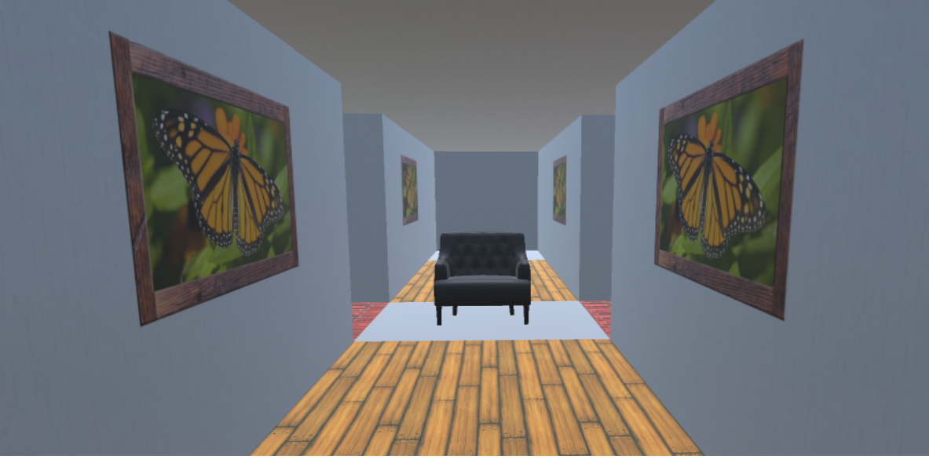

Speaker task and evaluation
Speaker produces an instruction
walk along the wood path to the chair
Speaker
Humans try to interpret it
walk along the wood path to the chair
Human direction
followers (MTurk)
Notes:
To evaluate the speaker model, we use human subject experiments on mechanical turk.

Slide 31
Speaker results
Other humans
Base speaker
Pragmatic speaker
83.3
78.0
73.2
66.0
Notes:
First, for sake of comparison, let’s look at the accuracies of humans at following instructions written by other humans, these dotted lines – so this can be a difficult task even for people. And our base sequence-to-sequence speaker models are substantially worse. But we see large improvements from the pragmatic reasoning procedure, and instructions produced by these systems are comparable to those by humans, and even substantially better in the Tangrams domain.

Slide 32



Speaker example, SCONE
remove the last figure
add it back
Base Speaker
✗
remove the last figure
add it back in the 3rd position
✔
Pragmatic Speaker
Human
take away the last item
undo the last step
✗

Slide 33

Real-world navigation
  Matterport3D vision-and-language navigation dataset [Anderson et al., 2018]
human description:
walk through the kitchen. go right into the living room and stop by the rug.
base speaker:
walk past the dining room table and chairs and wait there .
pragmatic speaker:
walk past the dining room table and chairs and take a right into the living room . stop once you are on the rug .

Slide 34
Conclusions
Unified inference for sequential interpretation and generation
Reasoning counterfactually, and about likely interpretations
Pragmatics helps for complex tasks in structured domains
Listener
Speaker

Slide 35
Thanks!
http://github.com/dpfried/pragmatic-instructions

