Slide 1
Improving Exception Handling in the BLAS and LAPACK
Jim Demmel, Jack Dongarra, Mark Gates, Greg Henry, Xiaoye Li, Jason Riedy, Weslley Pereira, Julien Langou, Piotr Luszczek

Slide 2
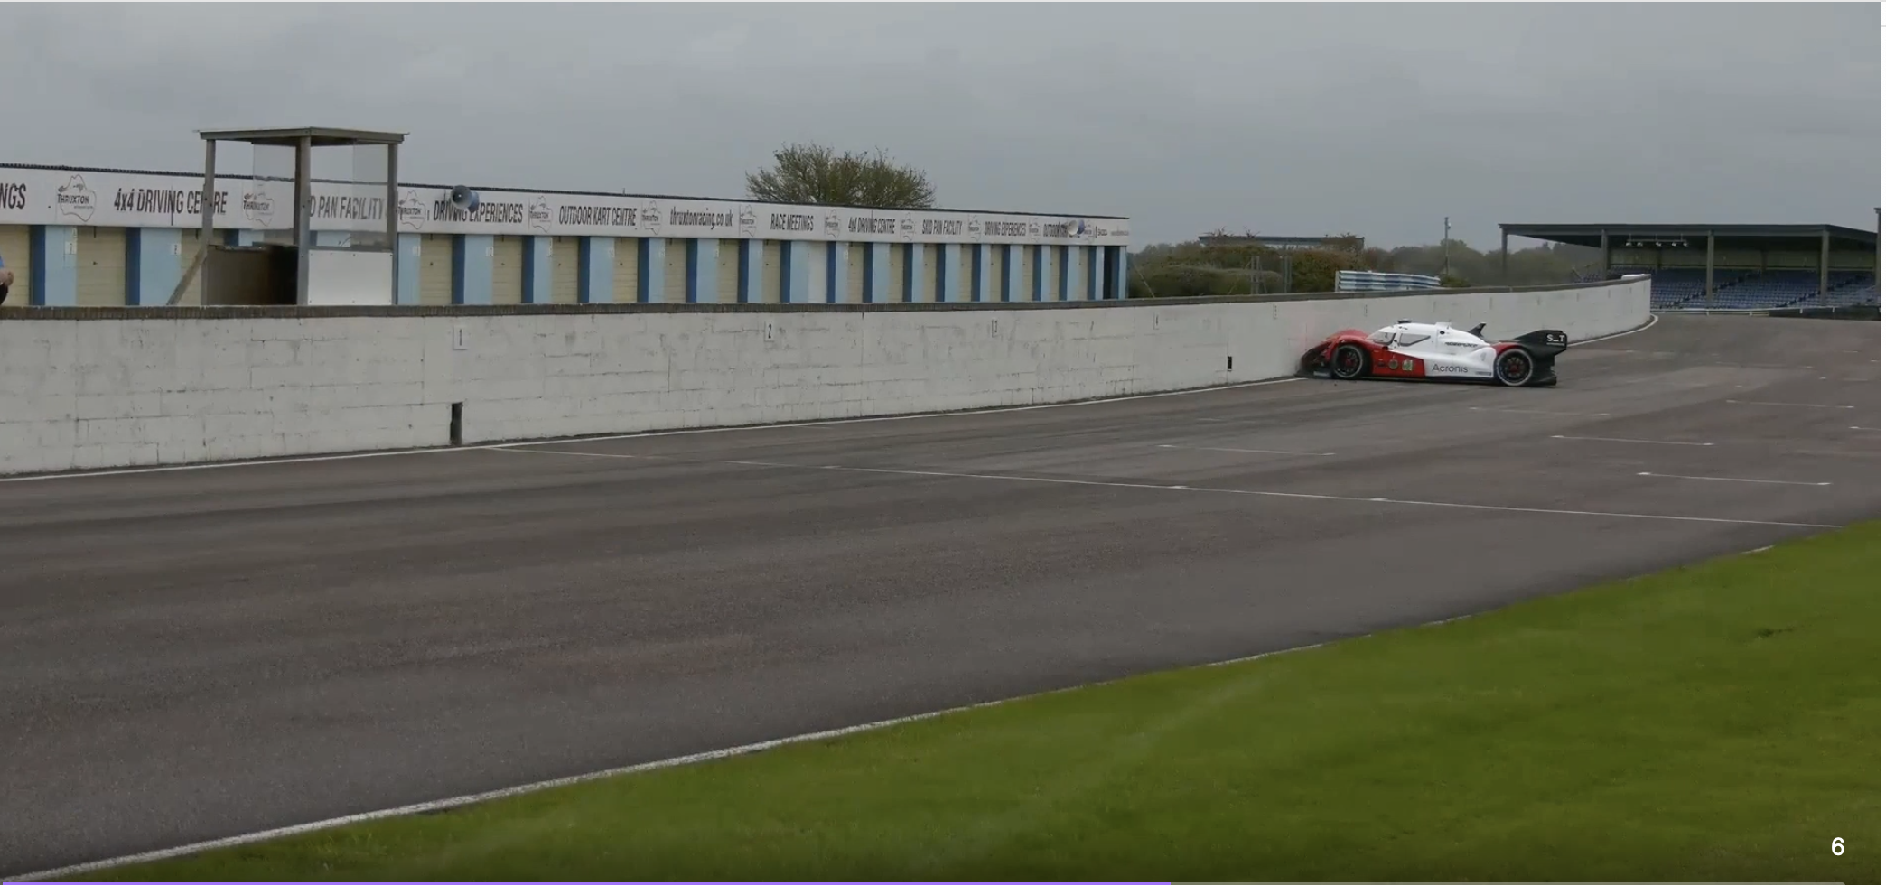
Examples of handling exceptions badly
USS Yorktown out-of-service
Ariane 5 Rocket crash
Air France Flight crash
“During this initialization lap
something happened which
apparently cause the steering
control signal to go to NaN”
https://www.reddit.com/r/formula1/comments/jk9jrg/
ot_roborace_driverless_racecar_drives_straight/gai295l/
Notes:
USS Yorktown, 21 Sept 1997, 0 field in data base => divide-by-zero => crashed DB, then OS, then whole
ship’s control system (for ~3 hours, fortunately no damage)
Ariane 5: 4 June 1996, overflow in Ada led to failure of flight control, cost = $500M
Air France #447, Airbus 330, 1 June 2009, failure of flight sensors led to failure of flight control, 228 lives lost
(thanks to Velvel for examples)

Slide 3
Outline
Basic high level goals: handle exceptions “consistently”
Goals for BLAS
Goals for LAPACK
Comments welcome!

Slide 4
High level goals
Handle exceptions “consistently”
  Always terminate, despite exceptions
  Report exceptions for which problem “ill-posed”
    Ex: eig(NaN), not inv(Inf)
  Propagate exceptions “consistently” (see later examples)
Do not change default interface semantics
  Allow options for more detailed reporting
    NaN and/or Inf appear in inputs, outputs, or internally
Do not slow down (much)
Accommodate inconsistent building blocks
  Eg: How compilers implement max or complex/complex, how vendors optimize BLAS, summation order, …

Slide 5
“Bug” 1/3 in BLAS: IxAMAX
IxAMAX returns index of first entry of largest “absolute value”
ISAMAX:
  ISAMAX([0,NaN,2]) = 3 and ISAMAX([NaN,0,2]) = 1
  NaNs do not propagate consistently
ICAMAX
  OV = overflow threshold
  ICAMAX([OV + i*OV, Inf + i*0]) = 1
  ICAMAX points to finite entry instead of Inf

Slide 6
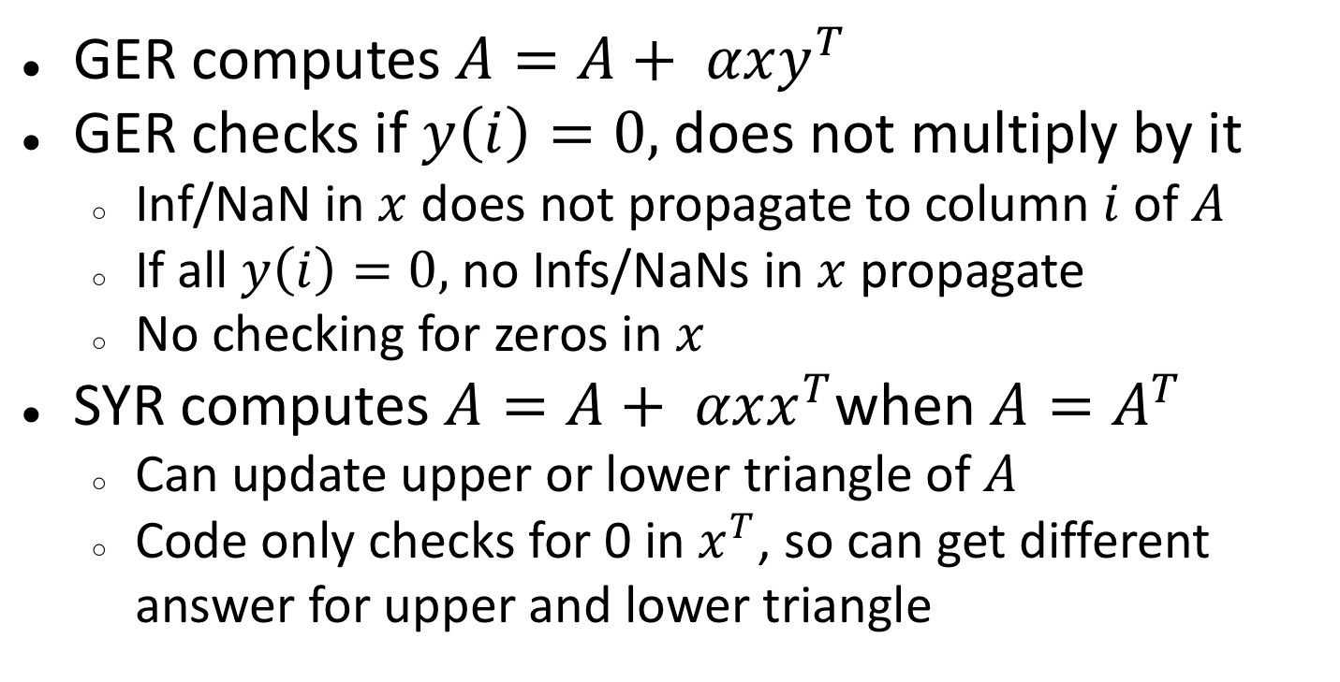
“Bug” 2/3 in BLAS: GER and SYR
GER computes $A=A+ αxy^{T}$
GER checks if $y\left(i\right)=0,$ does not multiply by it
  Inf/NaN in $x$ does not propagate to column $i$ of $A$
  If all $y\left(i\right)=0,$ no Infs/NaNs in $x$ propagate
  No checking for zeros in $x$
SYR computes $A=A+ αxx^{T}$when $A=A^{T}$
  Can update upper or lower triangle of $A$
  Code only checks for 0 in $x^{T}$, so can get different answer for upper and lower triangle

Slide 7
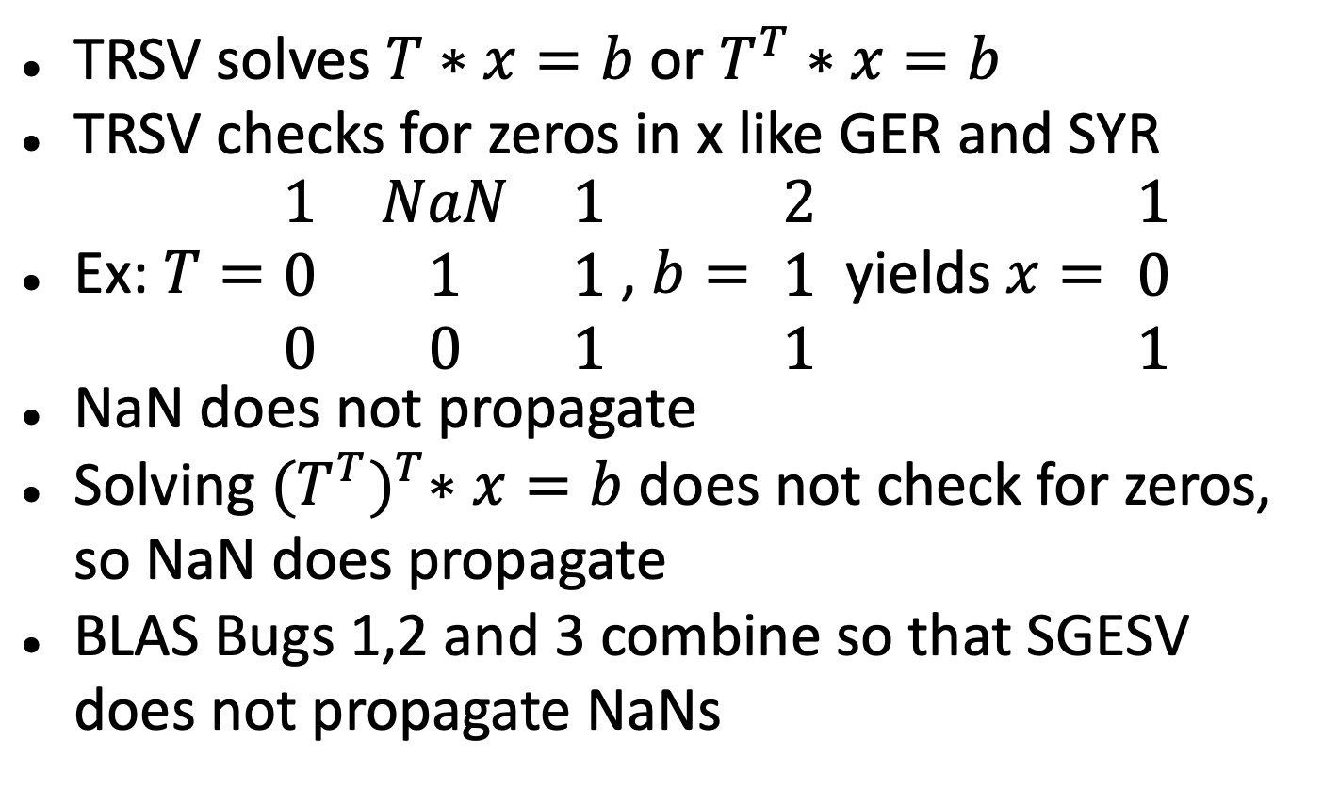
“Bug” 3/3 in BLAS: TRSV
TRSV solves $T∗x=b$ or $T^{T}∗x=b$
TRSV checks for zeros in x like GER and SYR
Ex: $T=\begin{matrix}1 & NaN & 1 \\ 0 & 1 & 1 \\ 0 & 0 & 1\end{matrix}$ , $b= \begin{matrix}2 \\ 1 \\ 1\end{matrix}$ yields $x= \begin{matrix}1 \\ 0 \\ 1\end{matrix}$
NaN does not propagate
Solving ${(T^{T})}^{T}∗x=b$ does not check for zeros, so NaN does propagate
BLAS Bugs 1,2 and 3 combine so that SGESV does not propagate NaNs

Slide 8
Not Bugs in BLAS
C = 0*A*B + beta*C = beta*C: expected semantics
Different rules for complex*complex in C vs Fortran: live with it
Different orders of summation, algorithms (Strassen, Gauss’s complex*complex) may cause different exceptions: live with it
Goals:
  Provide new reference BLAS that propagates NaN and Inf “consistently”,
  Provide test code for exception handling
  Encourage vendor adoption

Slide 9

”Bug” in SGESV
Assume version that calls GER to update Schur complement, not newer recursive version that uses GEMM
Solve
ISAMAX chooses 1 as pivot, not NaN
GER updates 2 – NaN*0 = 2, NaN does not propagate
TRSV does not multiply by 0 in x, NaN does not propagate, get x = [0; .5]
$\left[\begin{matrix}1 & 0 \\ NaN & 2\end{matrix}\right]$ * x = $\begin{matrix}0 \\ 1\end{matrix}$

Slide 10
Goals for LAPACK (1/2)
Use INFO for all exception reporting
Modify LAPACK drivers that already compute norm(A) to report Inf and/or NaN in inputs, possibly return immediately if ill-posed (eg eig)
  Add option to CLANGE
  Consistency with LAPACKE

Slide 11
Goals for LAPACK (2/2)
Some users want more reporting and control over exception handling, some want no changes
Provide wrappers that allow more detailed reporting options using INFO:
  INFO behaves as usual (except for last slide)
  Check inputs and outputs for NaNs/Infs, report first one found
  Also report if any internal subroutine reported NaNs/Infs (and no input/output NaN/Inf to report)
Provide test code for exception handling

Slide 12
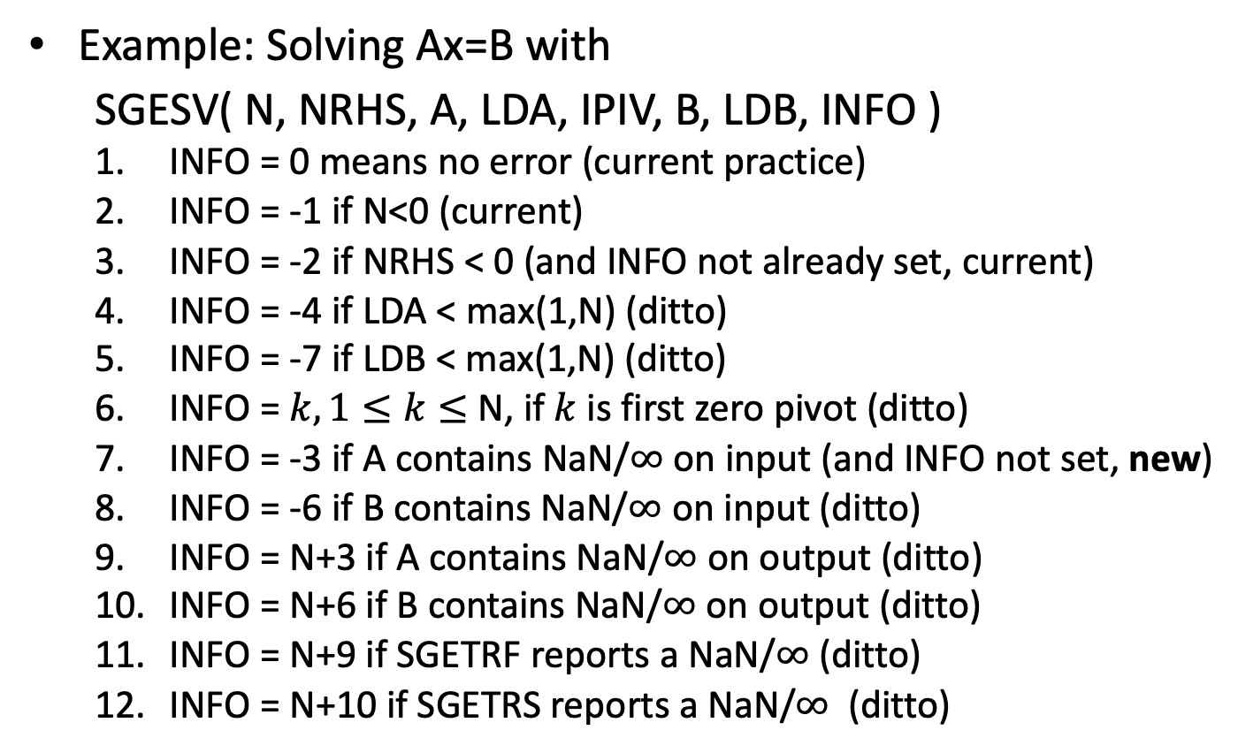
Example of LAPACK Exception Handling
Example: Solving Ax=B with
  SGESV( N, NRHS, A, LDA, IPIV, B, LDB, INFO )
  INFO = 0 means no error (current practice)
  INFO = -1 if N<0 (current)
  INFO = -2 if NRHS < 0 (and INFO not already set, current)
  INFO = -4 if LDA < max(1,N) (ditto)
  INFO = -7 if LDB < max(1,N) (ditto)
  INFO = $k, 1≤k≤$ N, if $k$ is first zero pivot (ditto)
  INFO = -3 if A contains NaN/$∞$ on input (and INFO not set, new)
  INFO = -6 if B contains NaN/$∞$ on input (ditto)
  INFO = N+3 if A contains NaN/$∞$ on output (ditto)
  INFO = N+6 if B contains NaN/$∞$ on output (ditto)
  INFO = N+9 if SGETRF reports a NaN/$∞$ (ditto)
  INFO = N+10 if SGETRS reports a NaN/$∞$ (ditto)
Notes:
Repeat slide 9?
Choose example (from old draft proposal) , next slide

Slide 13
How to build test code
BLAS
  Test both examples with NaN/Inf inputs, and unexceptional inputs that generate Infs (at least) internally
LAPACK
  Harder to generate unexceptional inputs that lead to Infs or NaNs at selected locations internally
  Possible solution: “Fuzzing”, artificially insert Infs or NaNs at selected locations during execution
    “Fluzzing”?

Slide 14
More details available at:
https://people.eecs.berkeley.edu/~demmel/Exception_Handling_for_the_BLAS_and_LAPACK_130721.pdf
Comments welcome!

