Slide 1



Golden Gate
Bridging The Resource-Efficiency Gap Between ASICs and FPGA Prototypes
Albert Magyar, David Biancolin, Jack Koenig, Sanjit Seshia, Jonathan Bachrach, Krste Asanović

Slide 2
Two major challenges of FPGA simulation
FireSim
Labor-intensive
Chip might not fit
Karandikar et al., “FireSim: FPGA-Accelerated Cycle-Exact Scale-Out System Simulation in the Public Cloud,” ISCA ‘18.

Slide 3
FireSim: The easy button for FPGA simulation
Target Workloads
Target Architecture
Target Microarchitecture
Golden Gate Compiler
Flexible SoC generators
User accelerator designs
Architectural experiments
Simulator Microarchitecture
FPGA Implementation
Host FPGA Platform
“Batteries included” for the full stack!

Slide 4
Two major challenges of FPGA simulation
Labor-intensive
Chip might not fit

Slide 5
Why the chip won’t fit
Common ASIC structures map poorly
  Highly-ported RAMs
  Content-addressable memories
  Multiplexers
Abundant memory resources are underutilized
  Logic is relatively more expensive
Making the chip fit often means buying bigger FPGA!

Slide 6
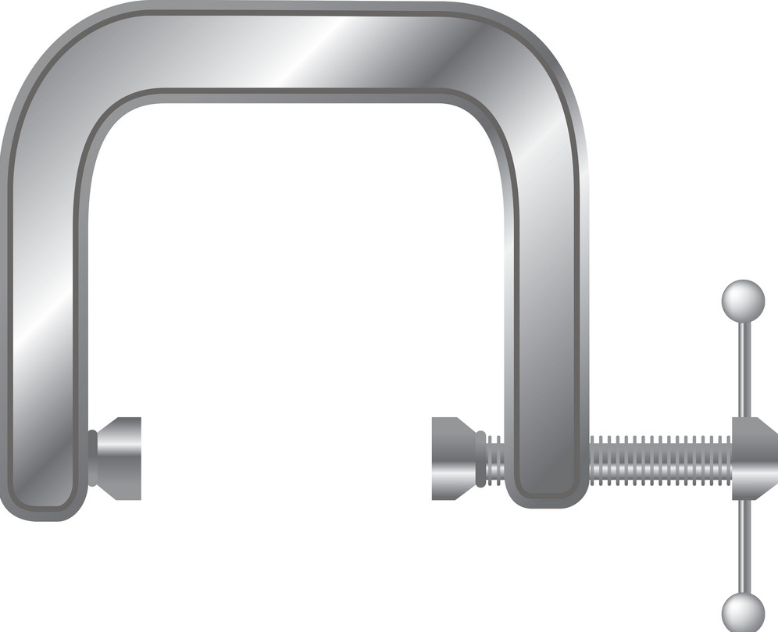


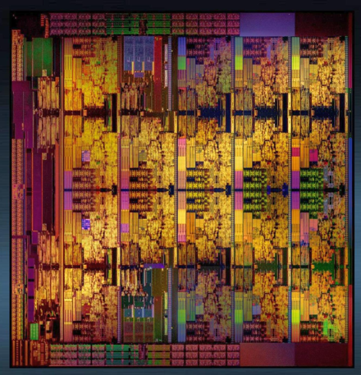
How do we make the chip fit?
Golden Gate: an optimizing compiler for simulators

Slide 7
Golden Gate: a hardware compiler framework
Operating on concrete RTL target designs
Producing cycle- and bit-exact FPGA simulators
…structured as a network of communicating actors
…relying on decoupling to ease per-cycle synchronization
With a reusable API for FPGA-centric resource optimizations
With a basic optimization, we fit 50% more out-of-order cores per FPGA!

Slide 8
Introduction
Prior work in increasing FPGA capacity
Golden Gate: an optimizing compiler for FPGA simulators
Case study: adding an optimization to Golden Gate
Verification of complex simulation models
Conclusion

Slide 9
Introduction
Prior work in increasing FPGA capacity
Golden Gate: an optimizing compiler for FPGA simulators
Case study: adding an optimization to Golden Gate
Verification of complex simulation models
Conclusion

Slide 10
Partitioning to solve capacity “cliffs”
Split design across multiple FPGAs
Each FPGA is still under-utilized!
Well put in HAsim†: “in order to maximize capacity of the multi-FPGA scenario we must first maximize utilization of an individual FPGA.”
† Pellauer et al., “HAsim: FPGA-Based High-Detail Multicore Simulation Using Time-Division Multiplexing” in HPCA 2011.

Slide 11
Decoupling
FPGA prototype: one host FPGA clock = one simulated cycle
Decoupled simulator: target and host time advance independently
  Each target cycle may take multiple FPGA host cycles to simulate
Software RTL simulators take this idea to the extreme

Slide 12
Clock gating: the simplest form of decoupling
output
input
clk
valid

Slide 13
You can save resources with decoupling
Efficient
1-Read, 1-Write RAM
Resource-hogging
4-Read, 4-Write RAM
With 4 host cycles to simulate 1 target cycle ➨ trade space for time!

Slide 14
Tradeoff: it now takes 4 host cycles to simulate one target cycle, but we save FPGA resources

Slide 15
Decoupling enables optimizations that can significantly reduce utilization
No tools to apply them automatically

Slide 16
Where prior work falls short
Target Workloads
Paper idea: conceptual improvement in simulator architecture and/or microarchitecture arch
Paper artifact: “artisanal” simulator based on idea
Different goals: why write a compiler for RTL if most users don’t have working RTL to start with?
Target Architecture
Target Microarchitecture
PhD student cleverness
Simulator Microarchitecture
FPGA Implementation
Host FPGA Platform
Conceptual simulation stack

Slide 17
Introduction
Prior work in increasing FPGA capacity
Golden Gate: an optimizing compiler for FPGA simulators
Case study: adding an optimization to Golden Gate
Verification of complex simulation models
Conclusion

Slide 18
A compiler framework for FPGA simulators
Target RTL
Guarding state updates
Transforming costly RAMs
Multi-threading host logic
Optimized, decoupled simulator
Golden Gate Compiler
These compiler passes are not RTL-preserving
The generated simulator no longer implements the target’s RTL semantics
But it must simulate them in a cycle-exact manner!

Slide 19
Building blocks for Golden Gate
Strong model of simulator behavior
Interface
Latency-Insensitive Bounded Dataflow Networks [1]
Infrastructure for hardware compiler development
Implementation
FIRRTL: Flexible Intermediate Representation for RTL [2]
[1] Vijayaraghavan et al., “Bounded Dataflow Networks and Latency-Insensitive Circuits,” MEMOCODE ‘09.
[2] Izraelevitz et al., “Reusability is FIRRTL Ground: Hardware Construction Languages, Compiler Frameworks, and Transformations,” ICCAD ’17.

Slide 20
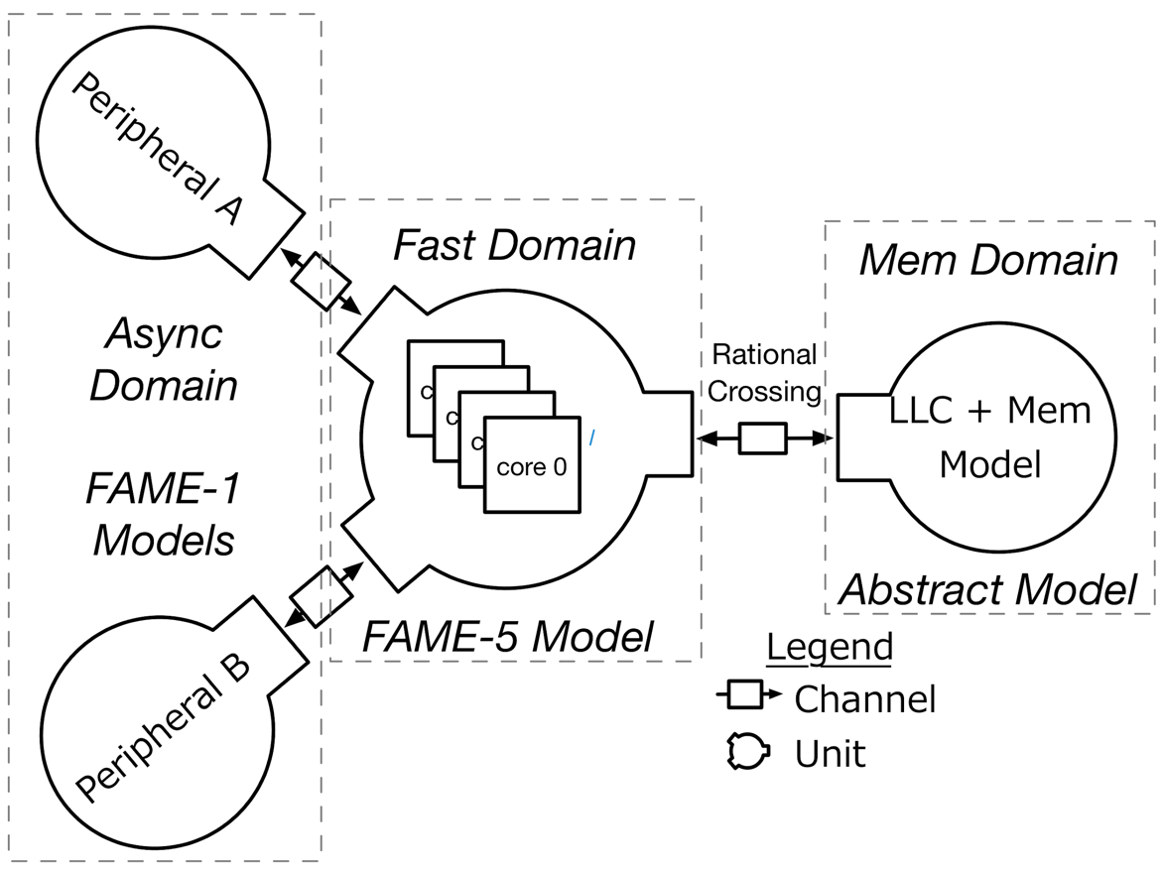
Golden Gate models simulator as a dataflow network
Simulation Collateral
Un-optimized Mapping
Optimized Mapping
Dividing target into multiple models enables composable optimizations!

Slide 21
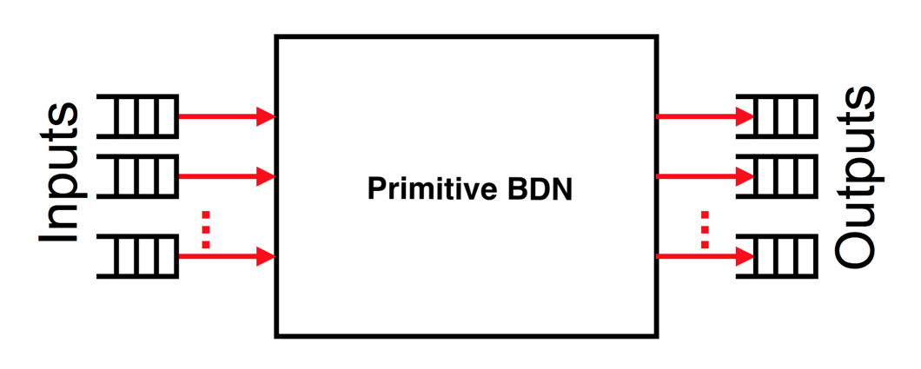
Latency-Insensitive Bounded Dataflow Networks*
BDNs: Bounded Dataflow Networks
General design technique to avoid synchronous design constraints
Replace synchronously timed signals with decoupled channels
Latency-Insensitive BDNs (LI-BDNs)
Conform to a set of properties on both token values and the conditions under which tokens must be produced/accepted
As a simulator: properties prescribe the behavior of tokens modeling inputs and outputs of components that are simulated.
* Vijayaraghavan et al., “Bounded Dataflow Networks and Latency-Insensitive Circuits,” MEMOCODE ‘09.

Slide 22
Compiler pass: RTL block to unoptimized LI-BDN
Model the value of a given I/O on a particular cycle with a token
Replace I/O with token queues
Analyze netlist to find combinational I/O dependencies
Transform RTL to a set of guarded atomic actions
  Update target state when per-cycle synchronization is complete
  I/O tokens are processed according to LI-BDN properties

Slide 23
LI-BDN structure guarantees freedom from deadlock and defines equivalence of two simulator components!
Helpful framework for inserting resource-optimized simulator components!

Slide 24
Building blocks for Golden Gate
Interface
Latency-Insensitive Bounded Dataflow Networks [1]
Implementation
FIRRTL: Flexible Intermediate Representation for RTL [2]
[1] Vijayaraghavan et al., “Bounded Dataflow Networks and Latency-Insensitive Circuits,” MEMOCODE ‘09.
[2] Izraelevitz et al., “Reusability is FIRRTL Ground: Hardware Construction Languages, Compiler Frameworks, and Transformations,” ICCAD ’17.

Slide 25
FIRRTL hardware compiler framework (ICCAD ‘17)
Extensive suite of tools for writing hardware compiler passes
Aimed at helping separate RTL from low-level implementation details
Makes writing CAD tools for chip design accessible to a wide audience!

Slide 26
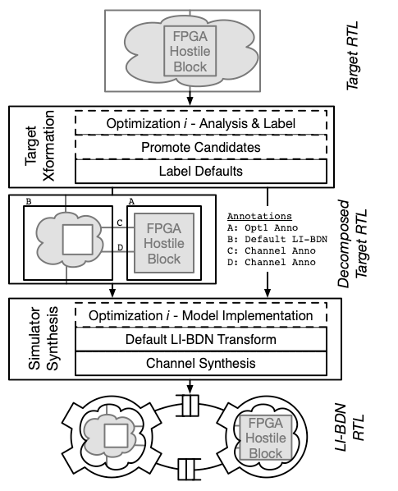
Golden Gate is structured as an extensible compiler
Sequence of FIRRTL passes
Optimizations fit in reusable framework

Slide 27
Introduction
Prior work in increasing FPGA capacity
Golden Gate: an optimizing compiler for FPGA simulators
Case study: adding an optimization to Golden Gate
Verification of complex simulation models
Conclusion

Slide 28
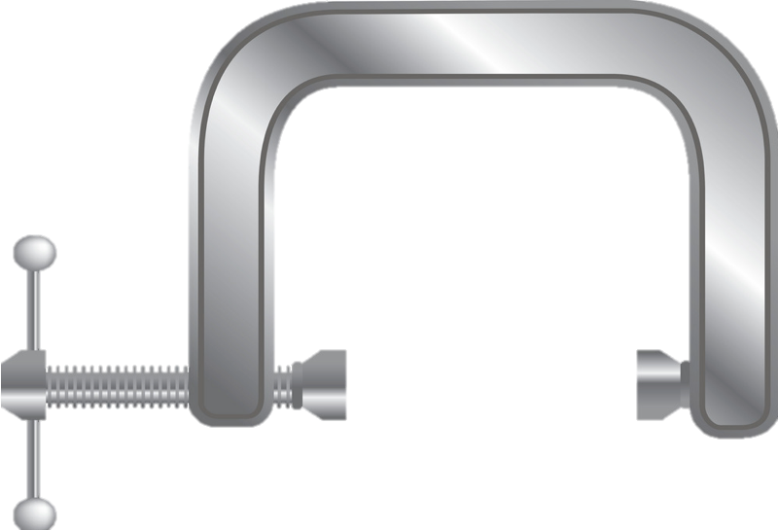
Case study: implementing an optimizing transform
Application: optimizing highly-ported register files in BOOM, an open-source RISC-V out-of-order core for the Rocket Chip Generator

Slide 29
The Rocket Chip Generator
Parameterizable SoC Generator [1]
Cache-coherent TileLink network
Variable number of cores
                Rocket: 5-stage in-order
BOOM: parameterized out-of-order [2]
[1] Asanović et al., “The Rocket Chip Generator,” Berkeley Tech Report, 2016.
                [2] Celio et al. “The Berkeley Out-of-Order Machine (BOOM): An Industry-Competitive, Synthesizable, Parameterized RISC-V Processor,” Berkeley Tech Report, 2015.

Slide 30
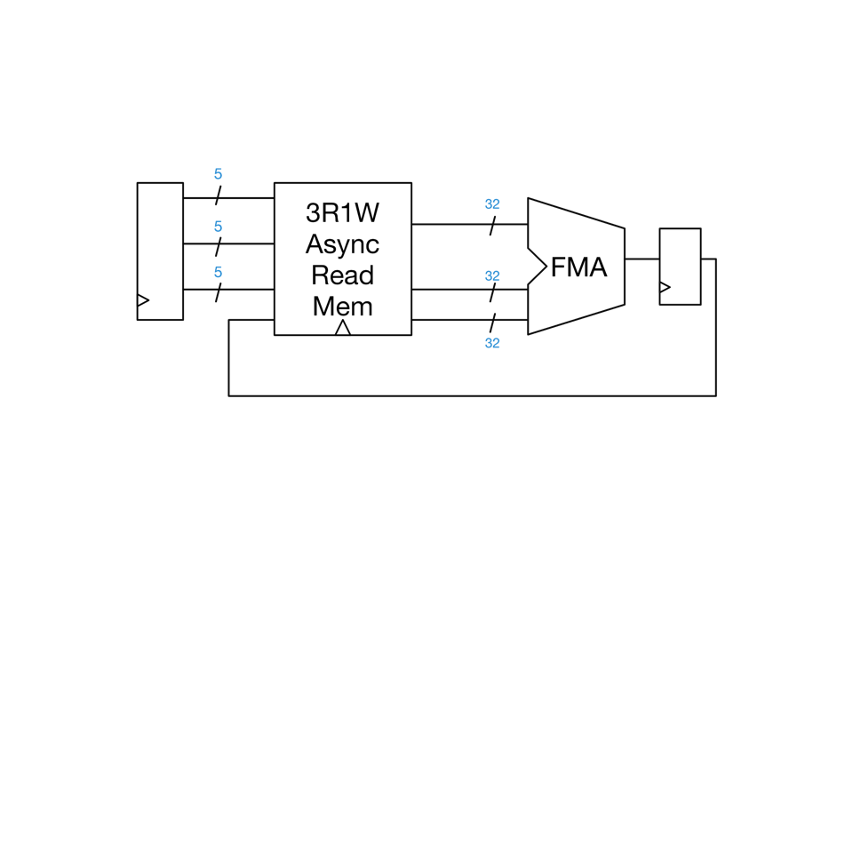

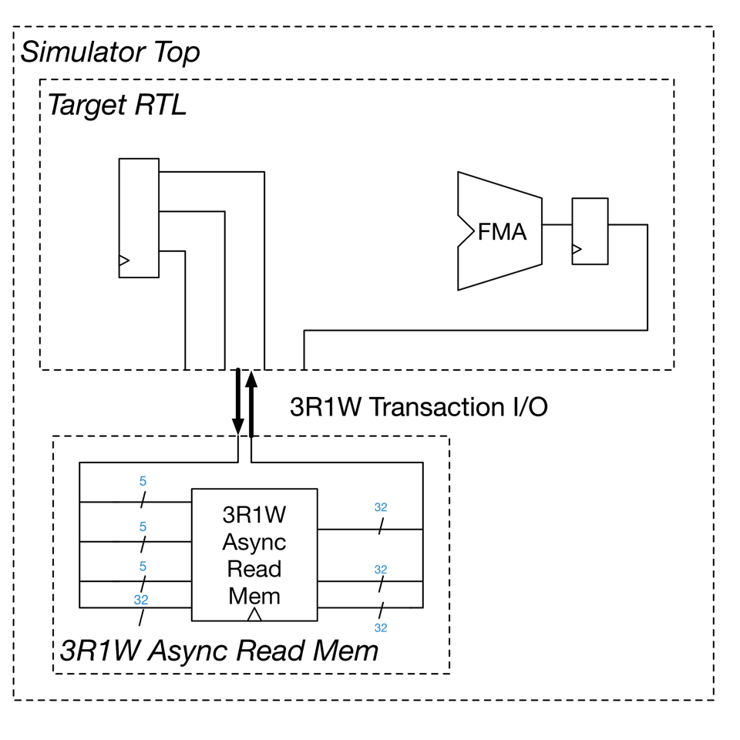
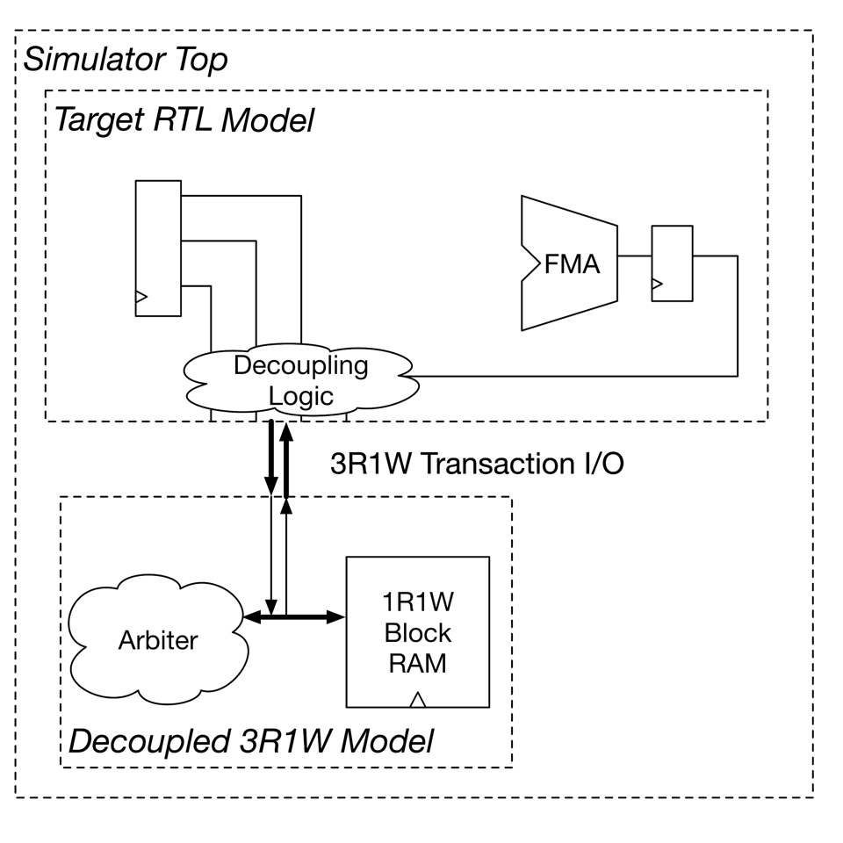
How the multi-ported memory optimization works
Create multi-model simulator hierarchy
Extract memory that is problematic for QoR
Generate an FPGA-optimized memory model
  Models exact target memory
  Resource-efficient underlying BRAM
Mapped independently from rest of circuit

Slide 31
How do we know this optimization works?
While FPGA simulation helps with pre-silicon verification, it brings new challenges.
A functional bug in the simulator can manifest as:
An apparent functional bug in the target
A timing irregularity in the target
Nondeterminism of execution or host deadlock
LIME: Automatic checking of decoupled models

Slide 32
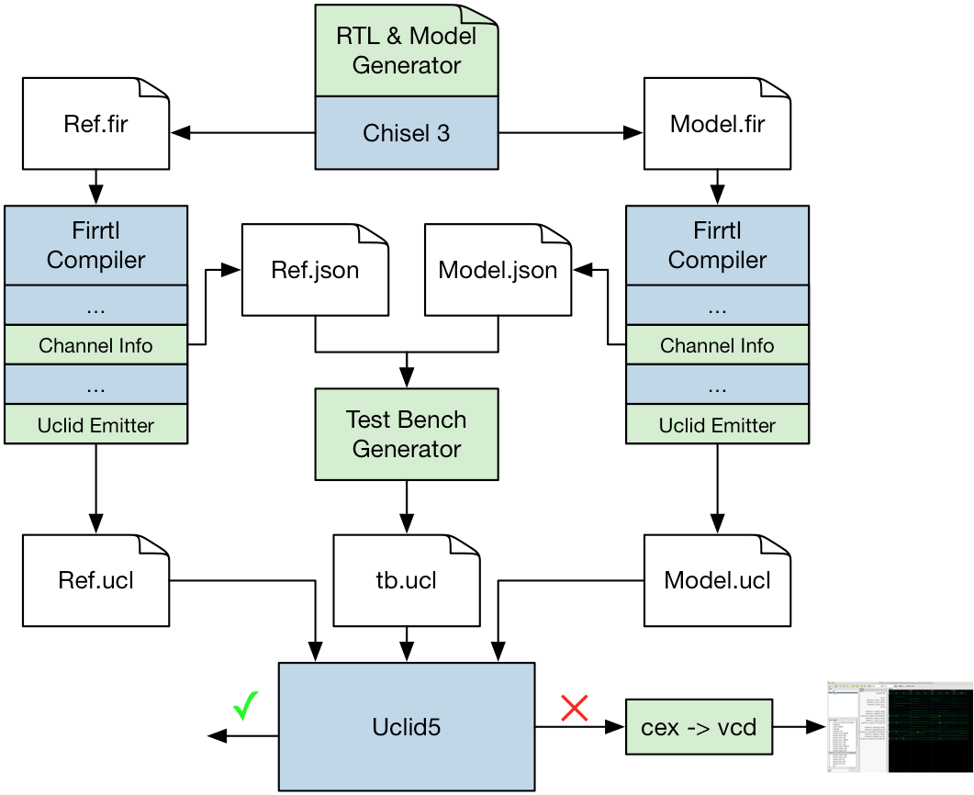
LIME: Automatic checking of decoupled models
Checks LI-BDN properties with BMC
Ensures model is cycle-accurate
Targets UCLID5 modeling system
Used to verify multi-port RAM model
Inputs: reference RTL & model RTL
Output: counterexample waveforms (if any)

Slide 33
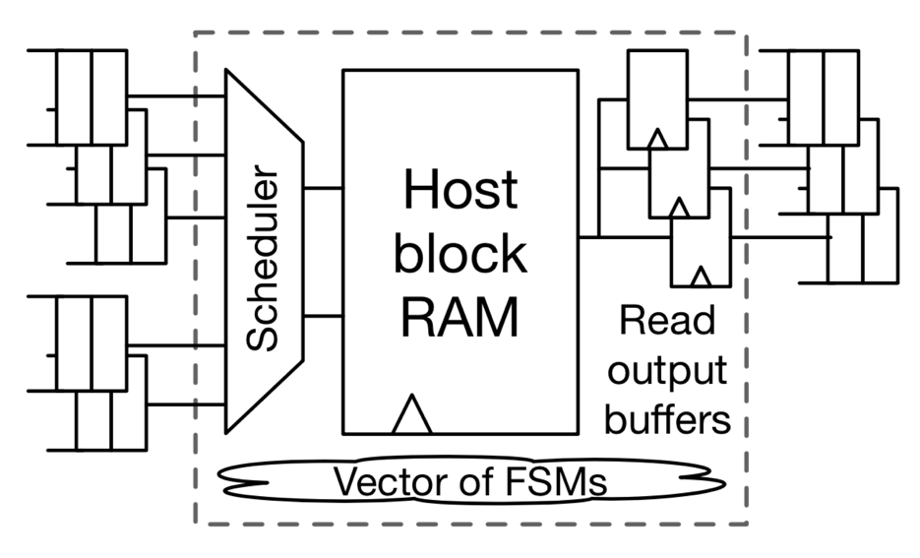
Results of optimizing register files
VU9P FPGA
Same VU9P FPGA
BOOM
BOOM
BOOM
BOOM
BOOM
BOOM
Underlying 1R1W implementation maps efficiently to FPGA block RAMS (BRAMs)
4 cores ➨6 cores

Slide 34
Results of optimizing register files
FPGA resource utilization on Xilinx VU9P FPGAs (AWS F1 devices)
Rx = x Rocket cores, By = y BOOM cores
33% less LUT utilization per core
Ample slack in BRAM count

Slide 35
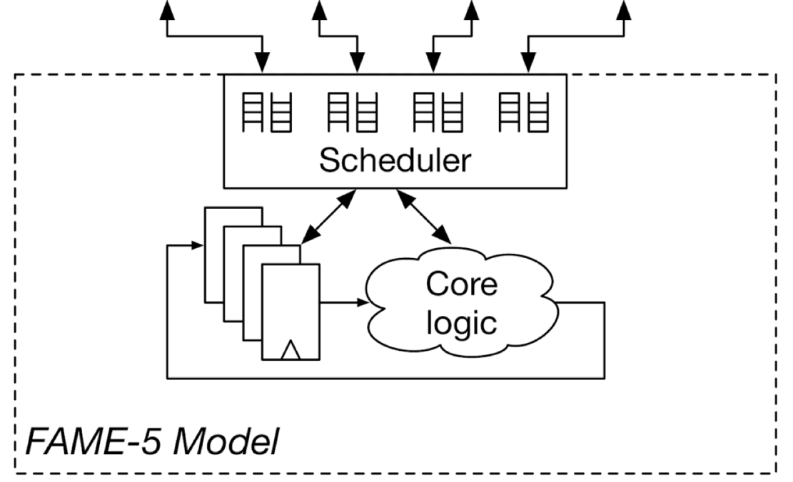
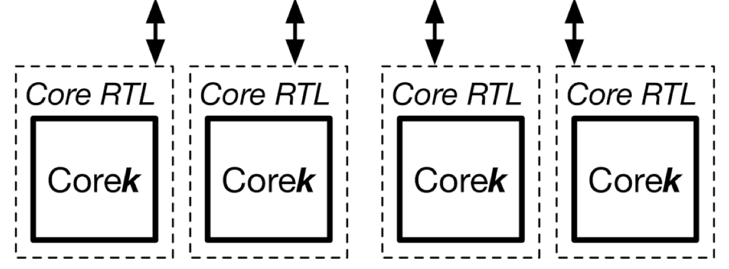
Future work: multi-threading to save resources
Why not borrow from software simulators and time-multiplex one copy of host logic to simulate N copies of a target block?
[1] Z. Tan et al, “RAMP Gold : A High-Throughput FPGA-Based Manycore Simulator,” DAC ‘10.
[2] M. Pellauer et al., “HAsim: FPGA-Based High-Detail Multicore Simulation Using Time-Division Multiplexing,” HPCA ‘12.
[3] Z. Tan et al., “A Case for FAME: FPGA Architecture Model Execution,” ISCA ‘10.

Slide 36
Introduction
Prior work in increasing FPGA capacity
Golden Gate: an optimizing compiler for FPGA simulators
Case study: adding an optimization to Golden Gate
Verification of complex simulation models
Conclusion

Slide 37
Conclusion
We present Golden Gate, a compiler framework for FPGA simulators
It includes a spec for simulators structured as dataflow networks
We provide an API for heterogenous compiler passes
Golden Gate open-sourced as part of FireSim @ https://fires.im
As a case study, we present a multi-cycle RAM optimization that significantly increases simulation capacity of a large Xilinx FPGA!

