Slide 1

Delay-Oriented
Logic Synthesis
Luca Amarù
Alan Mishchenko, Mathias Soeken, Robert K. Brayton
Design Group, Synopsys Inc., Sunnyvale, California, USA

Slide 2
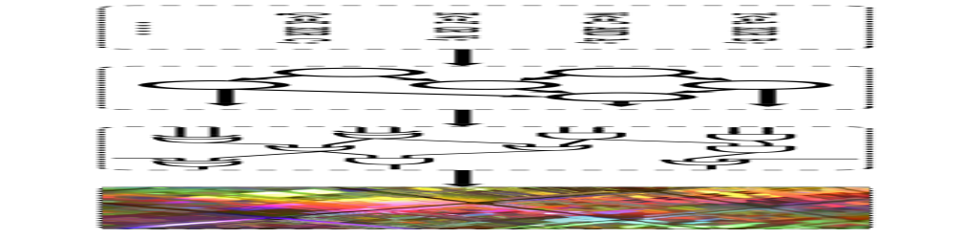
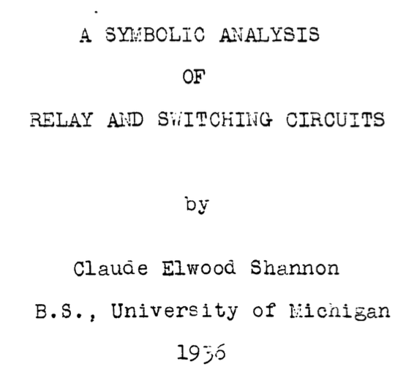

Logic Synthesis
Different definitions…
Logic synthesis is a process by which an abstract form of desired circuit behavior is turned into a design implementation in terms of logic gates. (standard definition)
“Given certain characteristics, it is required to find a circuit incorporating these characteristics… …the solution is not unique…”

Slide 3
Logic Synthesis
Primary goals of logic synthesis:
Reduce delay
Reduce area
Reduce power
With small runtime budget!
What is currently a “good deal” for the EDA industry?
Compare to a complete design flow
1% runtime overhead for 10% total negative slack reduction (at negligible area cost)
1% runtime overhead for 1% area reduction (at no timing cost)
How to obtain these challenging goals?

Slide 4
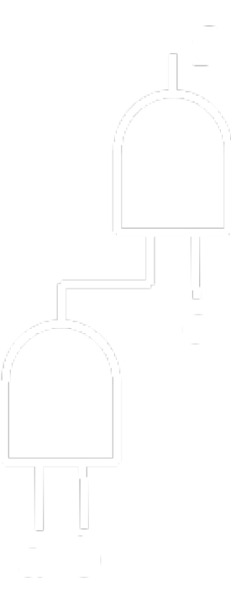
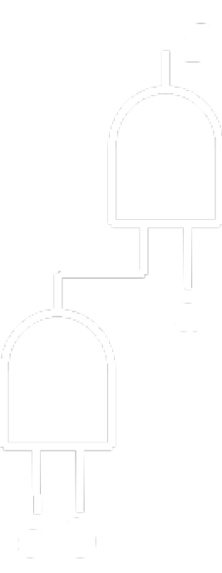
Delay Synthesis: The Problem
Given:
  a Boolean function
  a set of arrival times at the inputs
  a gate library with associated delay values
The delay synthesis problem asks for a circuit implementation which minimizes the arrival time at the output(s).
f = a * b * c
t_{a}=4
d_{and}=2
t_{b}=1
d_{inv}=1
t_{c}=0

Slide 5
Outline
Heuristic Delay Synthesis
  Algebraic Techniques
  Boolean Techniques
Exact Delay Synthesis
  Solving online with SAT
  Creation of exact delay databases
Next Challenges
Conclusions

Slide 6
Outline
Heuristic Delay Synthesis
  Algebraic Techniques
  Boolean Techniques
Exact Delay Synthesis
  Solving online with SAT
  Creation of exact delay databases
Next Challenges
Conclusions

Slide 7
Outline
Heuristic Delay Synthesis
  Algebraic Techniques
  Boolean Techniques
Exact Delay Synthesis
  Solving online with SAT
  Creation of exact delay databases
Next Challenges
Conclusions

Slide 8
Delay Synthesis: Algebraic Approach
Set of techniques operating on a local logic abstraction of nodes/gates
Pros:
  Fast
  Acceptable results on average
  Good starting point for stronger techniques
Cons:
  Suboptimal
  Operate on logic assumptions – not aware of the technology
How are they used?
  Iterated many times, until a delay improvement is seen
  Use more aggressive techniques to escape local minima

Slide 9
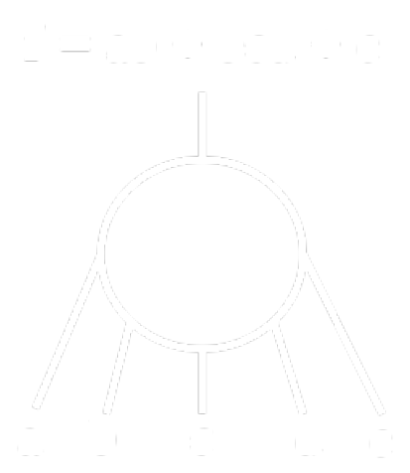
Delay Synthesis: Algebraic Approach
Huffman decomposition:
  One of the most popular delay-oriented decomposition techniques
Input: SOP representation of a logic function, input arrival times
Output: Multi-level circuit made of simple gates, optimized for delay
t_{n2} = 4
Apply Huffman
decomposition
on the terms
t_{n1} = 2
t_{n3} = 1
d
e
a
b
c
b
t_{a} = 0
t_{b} = 1
t_{c} = 1
t_{d} = 3
t_{e} = 1

Slide 10
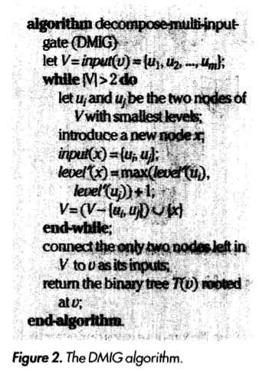
Delay Synthesis: Algebraic Approach
f = ab + bcd + e
t_{a} = 0
t_{b} = 1
t_{c} = 1
t_{d} = 3
t_{e} = 1
f
t_{n2} = 4
Apply Huffman
decomposition
on the sum
t_{f} = 5
t_{n1} = 2
t_{i} = 3
t_{n3} = 1
d
e
e
d
a
b
c
b
Can be applied to any symmetric Boolean operator/representation
c
b
a
b
DAG MAP, Cong et al., IEEE Design & Test of Comp., 1992

Slide 11
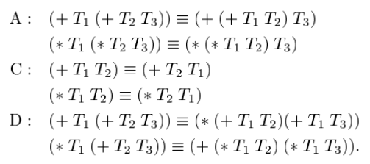
Delay Synthesis: Algebraic Approach
ACD Rewriting Rules:
  Efficient way to speedup AND/OR/INV circuits without collapsing
Input: AOIG, input arrival times
Output: AOIG optimized for delay
AND/OR Boolean algebra Rules
Timing-Driven Logic Bi-Decomposition, Cortadella, IEEE TCAD, 2003

Slide 12
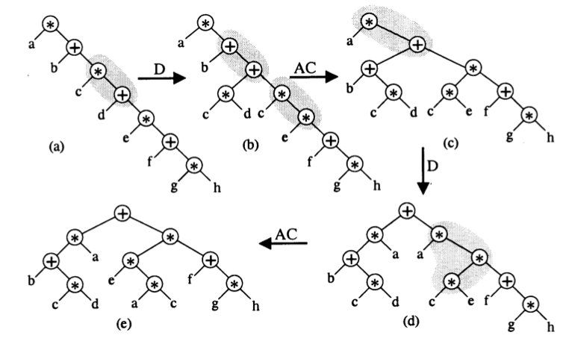
Delay Synthesis: Algebraic Approach
ACD Rewriting Rules Example:

Slide 13
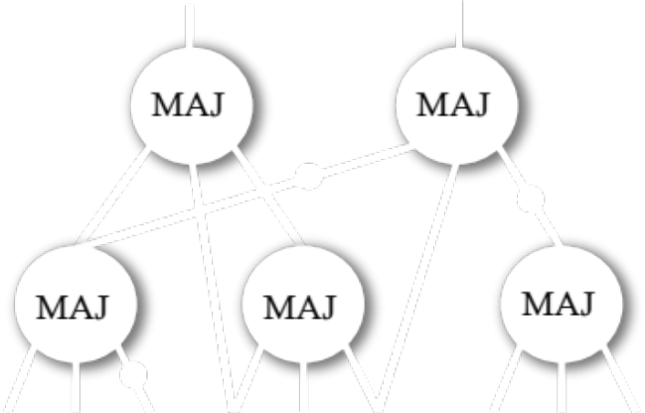
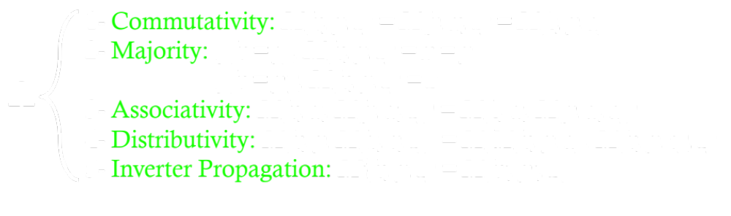
Delay Synthesis: Algebraic Approach
Majority-Inverter Graphs (MIGs) Algebra:
  Simple yet effective transformations for delay
Input: MIG, input arrival times
Output: MIG optimized for delay
Majority-Inverter Graph: A New Paradigm for Logic Optimization, Amaru et al, IEEE TCAD, 2016

Slide 14
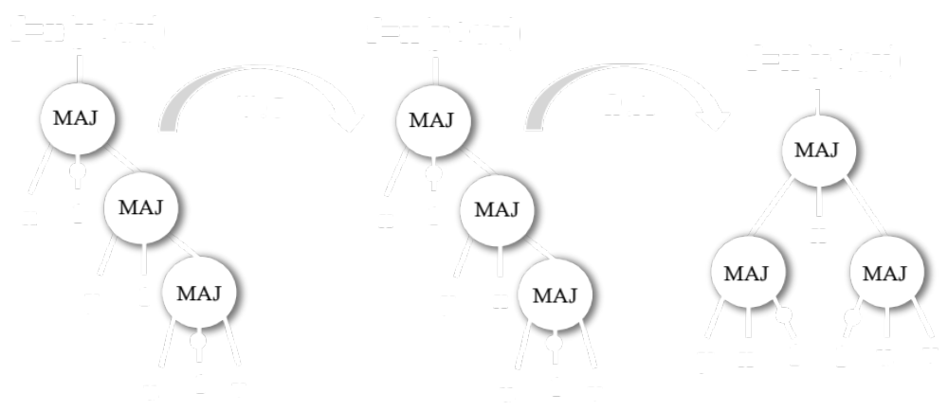
Delay Synthesis: Algebraic Approach
-1 level
1- Commutativity: M(x, y, z) = M(y, x, z) = M(z, y, x)
2- Majority: if(x = y), M(x, y, z) = x = y
if(x = yʹ), M(x, y, z) = z
3- Associativity: M(x, u, M(y, u, z)) = M(z, u, M(y, u, x))
4- Distributivity: M(x, y, M(u, v, z)) = M(M(x, y, u), M(x, y, v), z)
5- Inverter Propagation: Mʹ(x, y, z) = M(xʹ, yʹ, zʹ)
-1 level
Ω
-1 level

Slide 15
Outline
Heuristic Delay Synthesis
  Algebraic Techniques
  Boolean Techniques
Exact Delay Synthesis
  Solving online with SAT
  Creation of exact delay databases
Next Challenges
Conclusions

Slide 16
Delay Synthesis: Boolean Approach
Set of techniques operating on a global logic abstraction of nodes/gates
Pros:
  High quality results
  Exploit the Boolean nature of logic
  Global sight on optimization opportunities
Cons:
  Runtime expensive
    But with today’s computational power they are quite affordable
  Operate on logic assumptions – not aware of the technology
How are they used?
  Helpful to escape local minima found by algebraic techniques
  Provide a deeper logic restructuring – less structural bias

Slide 17
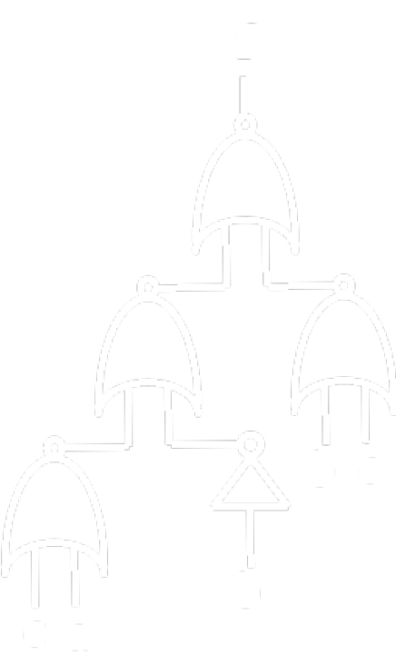
Delay Synthesis: Boolean Approach
Logic collapsing + decomposition:
  One effective way to get rid of structural bias
Input: Single output logic cone/circuit, input arrival times
Output: Delay-optimized circuit
Collapsing
Simplifying
f
SOP -> Espresso!
BDD -> Sifting!
ESOP -> Exorcism!
a
b
c

Slide 18
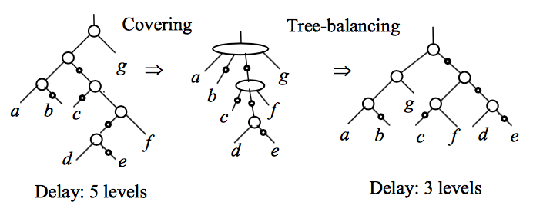
Delay Synthesis: Boolean Approach
Decomposition
Gate sharing + speedup
f
SOP -> Huffman!
Accept if new implementation is faster (and smaller)
BDD -> BDS!
ESOP -> Huffman!
a
b
c
Delay Optimization Using SOP Balancing, Mishchenko et al, ICCAD, 2011

Slide 19

Delay Synthesis: Boolean Approach
Shannon’s decomposition:
  The golden approach to push up critical variables
Input: Single output logic cone/circuit, input arrival times
Output: Delay-optimized circuit, with critical var. close to the output
Shannon’s decomposition (cofactoring)
f = (a XOR b) + c
t_{a} = 12
t_{b} = 0
t_{c} = 1
Algebraic techniques fail!
t_{nor} = 1
Collapsing is not effective
t_{xor} = 2

Slide 20
Delay Synthesis: Boolean Approach
Shannon’s decomposition
Sharing & simplification
f
f
t_{f} = 14
f
t_{f} = 15
s₀
s₁
a
s₀
s₁
a
c
c
b
c
c
c
b
a
b
t_{nand-i} = 1.5
0
b
1
b
t_{nor} = 1
t_{a} = 12
t_{b} = 0
t_{c} = 1
Very effective delay reduction
t_{xor} = 2
f = (a XOR b) + c
Area overhead 2X in the worst case
t_{mux} = 2

Slide 21
Delay Synthesis: Boolean Approach
Transformations & Reductions, Reductions & Expansion:
  Exploit Don’t Care (DC) information to simplify the circuit
Input: Multiple output logic circuit, input arrival times
Output: Delay-optimized circuit
Transformations & Reductions
Reductions & Expansion
connection addition and deletion
connection substitution
3) gate substitution
4) gate merging
5) redundancy removal
focus on a signal x
modify the fanout to reduce timing:
  alter logic to include x (reduction)
  substitute gates in cutset (expansion)

Slide 22

Delay Synthesis: Boolean Approach
Gate substitution/merging
Redundancy removal/addition
Reduce/Expand (Global flow)
L. Trevillyan,W. Joyner L. Berman, “Global flow analysis in automated logic design,” IEEE TC, 1986.
Select one literal and expand or reduce many cubes in the Boolean network associated with that literal

Slide 23
Outline
Heuristic Delay Synthesis
  Algebraic Techniques
  Boolean Techniques
Exact Delay Synthesis
  Solving online with SAT
  Creation of exact delay databases
Next Challenges
Conclusions

Slide 24
Delay Synthesis: Exact Approach
Set of techniques achieving provably optimal results
Pros:
  Best results possible
  Can be made technology dependent
  If stored in a database, replacing exact results is runtime friendly
Cons:
  Runtime “prohibitive”
    Exact synthesis is an intractable problem in computer science
  Search space potentially infinite
    Arrival times are unbounded in principle
How are they used?
  Online computation with SAT: only where runtime is not critical
  Creation of an exact delay circuit database for logic rewriting
    Address the infinite search space challenge

Slide 25
Outline
Heuristic Delay Synthesis
  Algebraic Techniques
  Boolean Techniques
Exact Delay Synthesis
  Solving online with SAT
  Creation of exact delay databases
Next Challenges
Conclusions

Slide 26

Delay Synthesis: Exact Approach
SAT-based approach:
  Find an exact circuit for a specific Boolean function, exploring the search space with SAT
Input: Multiple output logic circuit, input arrival times
Output: Exact-delay circuit
Compute
Exact Delay Solution
Collapsing
f
SAT Solver
a
b
c

Slide 27
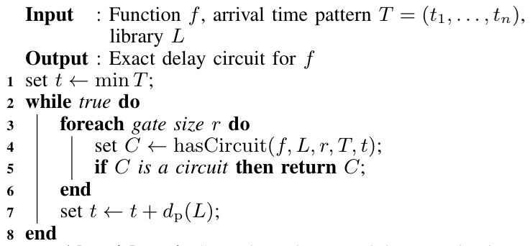
Delay Synthesis: Exact Approach
“Does there exists a circuit with r gates from library L that implements function f with input arrival times T respecting an output delay of t?”
First solution found is the delay-exact by construction
Z3 SMT Solver
L. M. de Moura and N. Bjørner, “Z3: an efficient SMT solver,” in Tools and Algorithms for the Construction and Analysis of Systems, 2008, pp. 337–340.
Delay-size optimal (can be skipped for exact delay only)

Slide 28
Outline
Heuristic Delay Synthesis
  Algebraic Techniques
  Boolean Techniques
Exact Delay Synthesis
  Solving online with SAT
  Creation of exact delay databases
Next Challenges
Conclusions

Slide 29
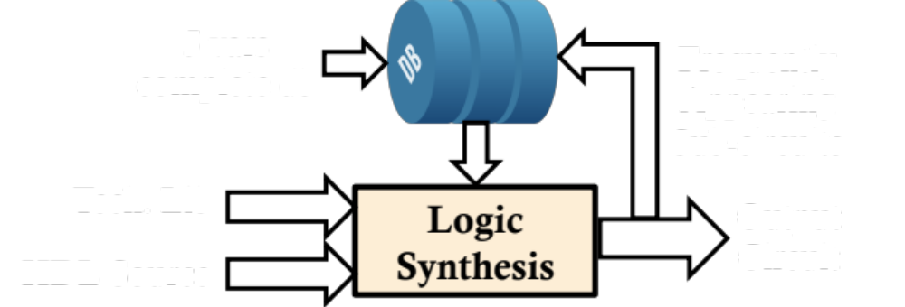
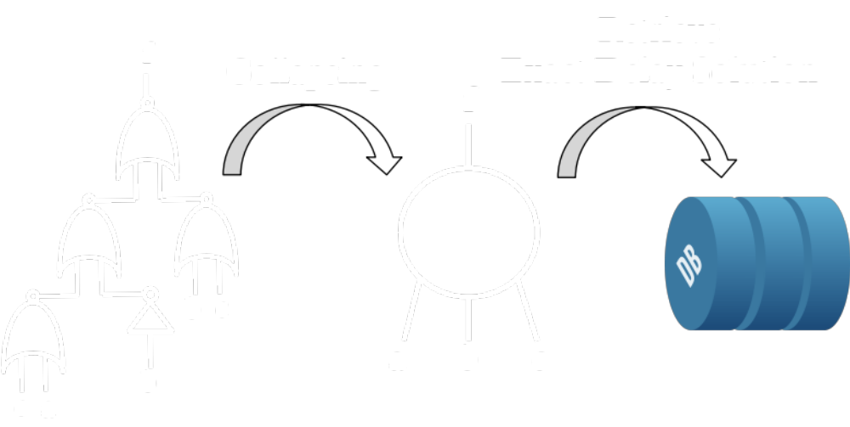
Delay Synthesis: Exact Approach
Exact-delay databases and delay-oriented logic rewriting:
  Pre-compute exact solutions offline, and substitute them online
Input: Multiple output logic circuit, input arrival times
Output: Exact-delay circuit
Build db offline (runtime expensive)
Circuit retrieval from db needs to be efficient

Slide 30
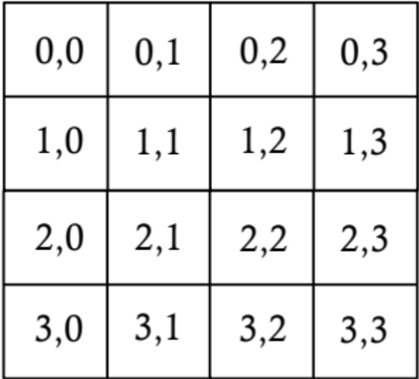
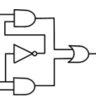

Exact Delay Databases
Delay Databases
2D Matrix of constant circuits made of library gates
  1D: function ID
  2D: input arrival times
Number of possible function ID is finite
  2^{(2^n)}
  Using permutation classes much less
Number of possible arrival time patterns is infinite
  An input pin can take any positive rational value (or integer if normalized w.r.t. library precision)
Function ID
Arrival time pattern
∞

Slide 31
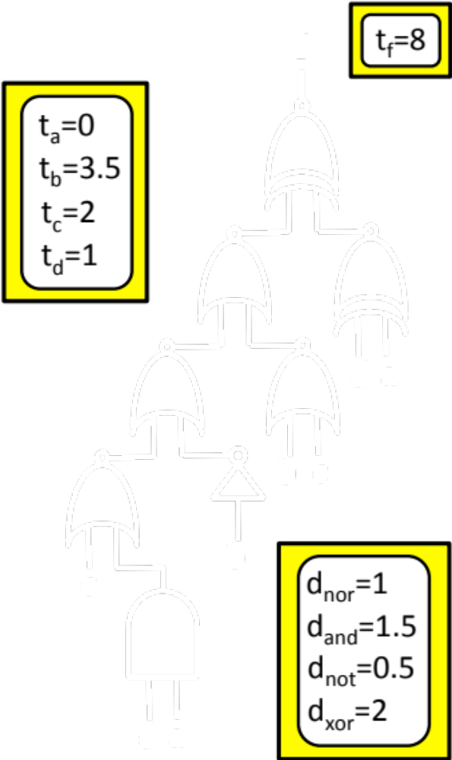
Exact Delay Databases
We have developed a theory of equioptimizable arrival times
  Encoding of arrival time pattern into equioptimizable pattern is efficient
  Number of equioptimizable patterns is finite
    The actual number if technology dependent
Building exact delay databases is now possible
  Complete for n=4, 5 variables
  For n = 4, we have 280 distinct equioptimizable patterns for a simple INV/NAND/NOR/XNOR/MUX technology
Sample entry of the exact delay database

Slide 32
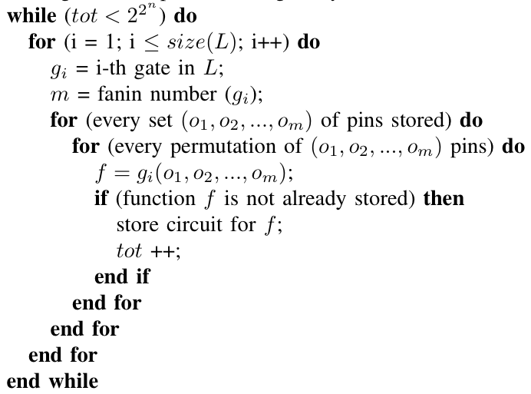
Technology Dependent Databases
How to populate the circuit database?
We can store exact results via explicit enumeration with n = 4, 5
  We can generate db with n = 4, with practical libraries, in few mins!
  We need SMT methods for n > 5
  Exact synthesis is not necessarily hopeless for n > 5: some large instances can be solved fast:
    AND-n, OR-n, full-DSD functions, etc.
4 variable db is < 8MB
A LOT of filtering can be applied to speed up execution!

Slide 33
Exact Delay Rewriting
How to use the exact delay database of size n?
For each node of the network, compute all n-cuts:
For each cut:
  Constant time lookup of the exact circuit realization from the database
  Evaluate the delay gain (eventually attenuated by the area cost) for the replacement move
Evaluate best delay gain:
  If best delay gain > threshold: commit the best replacement
Iterate 1 as long as there is timing gain or maximum # passes is reached

Slide 34
Outline
Heuristic Delay Synthesis
  Algebraic Techniques
  Boolean Techniques
Exact Delay Synthesis
  Solving online with SAT
  Creation of exact delay databases
Next Challenges
Conclusions

Slide 35
Next Challenges
Stronger cut computation for rewriting
  Lookahead for re-convergence
  New techniques to make Cartesian product of cuts scale further
  Treat cuts as logic functions?
Stronger collapsing to eliminate structural bias
  Symmetric normal forms
  BDD/SOP hybrid forms
  HW Accelerators?
Pushing further exact delay synthesis
  Special function classes
  Runtime-expensive engines for offline computation
Technology-dependent technology-independent synthesis
  Revisit both algebraic and Boolean techniques to operate directly on library gates

Slide 36
Outline
Heuristic Delay Synthesis
  Algebraic Techniques
  Boolean Techniques
Exact Delay Synthesis
  Solving online with SAT
  Creation of exact delay databases
Next Challenges
Conclusions

Slide 37
Conclusions (Take-home Messages)
Exact solutions become more and more available
  We are at a point in technology where suboptimal design has a tremendous cost
  Computing capabilities increased a lot since heuristic techniques have been developed
  For small/medium instances of the problem, obtaining exact solutions is today runtime affordable
Time to revisit Boolean techniques!
  We have new theoretical developments making Boolean techniques runtime affordable w.r.t. algebraic counterparts
  QoR is much better
Technology-dependent technology-independent synthesis
  Traditional assumptions on level to delay may lose validity
    Advanced technology nodes
    Emerging nanotechnologies
  Core logic engine must be running on accurate technology assumptions – otherwise optimization may be ineffective

Slide 38
Questions?
Thank you for your attention!

